Slide 1
Lua Game-Development Workshop
Presented by:
Gamedev Utopia

Slide 2
“Introduction”
Welcome to the World of Game Development with Lua!
In this captivating journey, we invite you to explore the dynamic realm of game development powered by Lua scripting.
Lua, renowned for its simplicity and efficiency, serves as a key tool for crafting immersive and engaging gaming experiences.
Throughout this presentation, we'll delve into the myriad ways Lua can be harnessed to create games that captivate players and push the boundaries of interactive entertainment.

Slide 3
Why LUA?
Lua's Role in Game Dev: Lua's scripting prowess empowers game developers to breathe life into their creations through real-time interaction, AI behavior, and dynamic storytelling.
Efficiency and Performance: Lua's lightweight design ensures optimal performance, enabling games to run seamlessly on a variety of platforms without sacrificing quality.
Accessible for All: Whether you're a seasoned developer or new to coding, Lua's user-friendly syntax makes it an ideal choice for beginners and experts alike.
Libraries: Lua boasts a range of libraries and frameworks that are widely used in game development to expedite development and enhance various aspects of game creation.

Slide 4
Python VS Lua

Slide 5

“INTRODUCING LÖVE2D”
LÖVE, often referred to as Love2D, is a popular open-source framework that empowers developers to create 2D games, interactive applications, and multimedia experiences. Designed for simplicity and accessibility, Love2D is built using the Lua scripting language and provides a wide range of features for game development.

Slide 6
Advantages of using LÖVE2D
Ease of Use: Love2D's simple and intuitive API allows developers to focus on creativity rather than complex technicalities.
Rapid Prototyping: Love2D's fast iteration cycle makes it ideal for quickly prototyping game ideas and experimenting with different concepts.
Learning Curve: Lua's relatively straightforward syntax and Love2D's minimalistic design make it an excellent choice for beginners who want to enter the world of game development.
Open Source: Love2D is open-source, meaning its source code is available for exploration and modification. This encourages community contributions and customization.
Customizability: While Love2D provides a strong foundation, its extensible nature allows developers to tailor their game development experience by incorporating third-party libraries and tools

Slide 7
Framework VS Engine

Slide 8
Pygame VS Love2D

Slide 9
Some Game-Specific Concepts

Slide 10
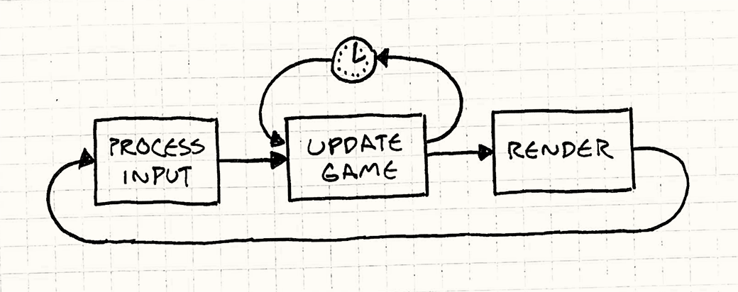
Game Loops
Decouple the progression of game time from user input and processor speed.
Credits: Robert Nystrom
http://gameprogrammingpatterns.com/game-loop.html

Slide 11
What a game loop looks like:
Implementing an efficient and well-structured game loop is crucial for achieving smooth gameplay and maintaining a consistent user experience. The loop needs to strike a balance between updating the game state frequently enough to ensure responsiveness and rendering frames at a suitable frame rate to prevent issues like screen tearing or stuttering.

Slide 12
2D Coordinate System

Slide 13
Drawing Basic Shapes

Slide 14
Delta Time

Slide 15
AABB Collision

Slide 16
Sprites

Slide 17
Instantiation (Spawning)

