Slide 1
Introduction To Data Analytics Final Project – Group 02
FALL 2021 – SECTION 004

Slide 2


Program
Data Analytics for Business
Course Title
Introduction to Data Analytics
Course Code
DAB100
Professor
Dr. Sabbir Ahmed
Semester
Fall 2021
Section
004

Slide 3






Group 02 - Team Members
0792620
0787447
0780765
0791620
0796641
0789558
Apruv Hiteshkumar Sathwara
Dhurvin Ketankumar Raval
Farzin Valiloo
Manikandan Selva Subramanian
Navjot Kaur
Shraddha Rajaram Kolte

Slide 4
Project Developing Approach
All members were involved in all tasks of the project.
Including: Data cleaning and transformation, Creating dashboard, and Modeling

Slide 5
Cleaning & Transforming Data

Slide 6
Cleaning & Transformation
Detected Missing Data in "TotalCharges" Column
Created "Seniority" Column
Created "PhoneServices" Column
Filled the missing data in "TotalCharges" with 0 based on the 0 value of "Tenure" of the respective clients
Filled "Seniority" with corresponding text values to 0 and 1 (NotSenior and Senior)
Grouped "PhoneService" and "MultipleLines" services column and filled it with "MultipleLines", "SingleLine" and "No" values
-Created "Churned" column
Filled "Churned" Column
Created "NumberofInternetServices" Column
Delete Columns
These columns have been deleted based on new created columns:
"customerID", "SeniorCitizen", "PhoneService", "MultipleLines", "InternetService", "OnlineSecurity", "OnlineBackup", "DeviceProtection", "TechSupport", "StreamingTV", "StreamingMovies", "Churn"
Filled "Churned" column with corresponding text values to 0 and 1 (Churned and NotChurned)
Filled "NumberofInternetServices" based on the customer's number of active services that are related to internet services.

Slide 7
Dashboard & Models

Slide 8
Dashboard Description & Results
This dashboard utilizes a slicer (top right corner) in order to help the marketing manager to identify the difference between demographic and behavioral characteristics of the churned and retained clients of the company.
RESULTS
RECOMMENDATIONS
‌Based on these charts:
Churned clients are more likely to have partners, have dependents, be seniors, be females, be new clients, have more monthly charges, have less total charges, use fewer internet services and use more multiple lines phone services. They also have used more paperless billing and used electronic checks as their payment method and tend to have more longer-term contracts
‌Based on these charts it is recommended that the company:
Promote bundle service subscriptions
Promote referral subscriptions
Design loyalty programs

Slide 9
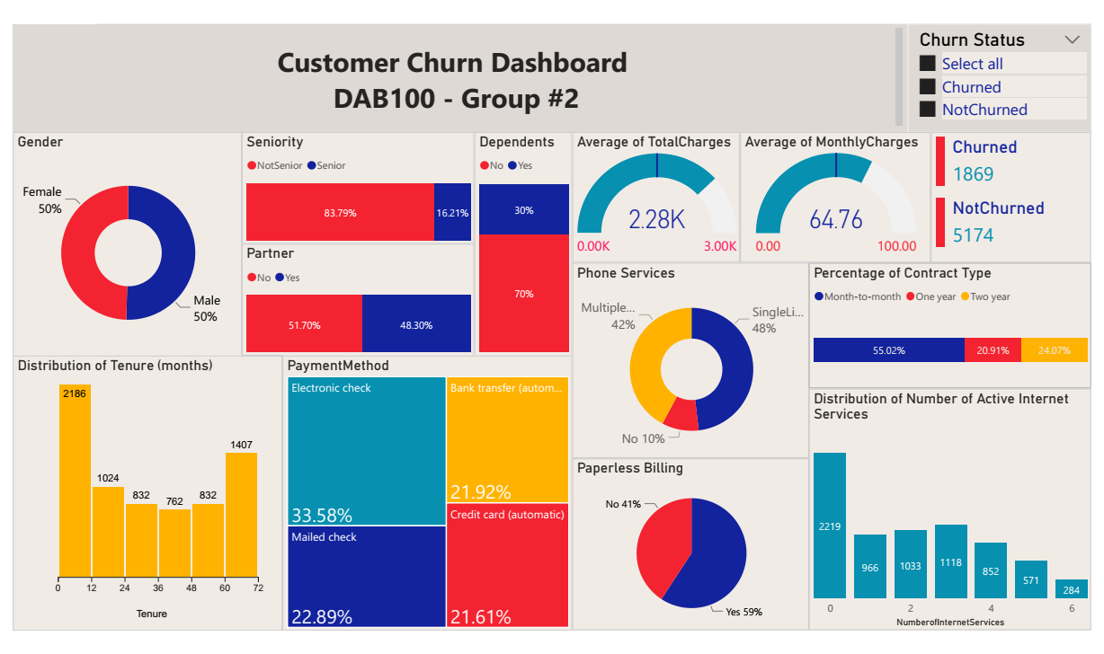
All Customers

Slide 10
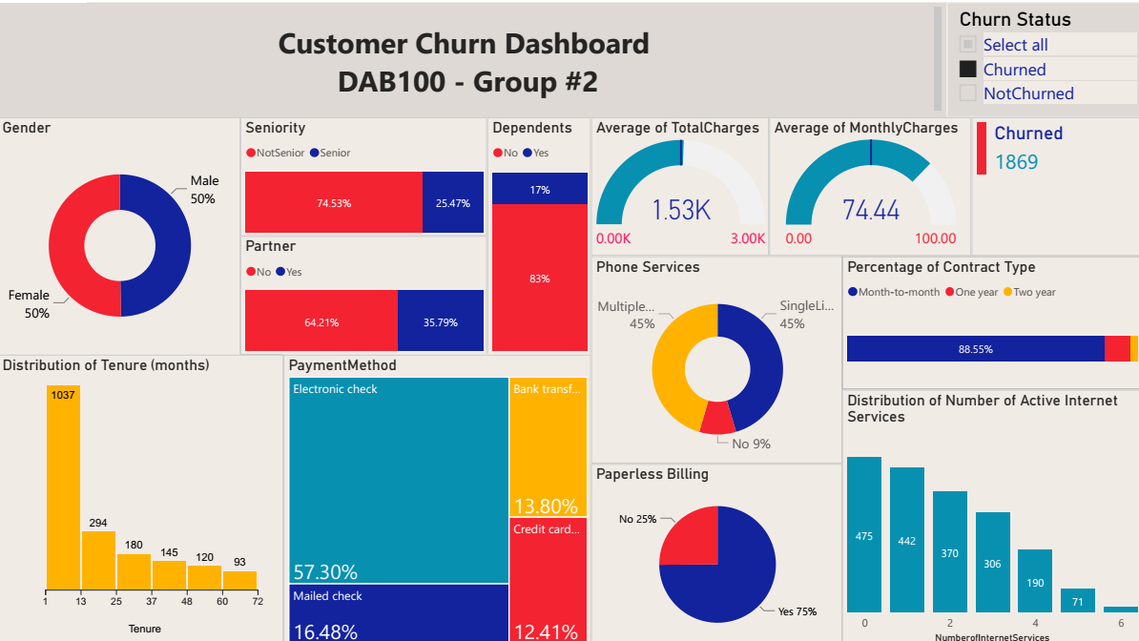
Churned Customers

Slide 11
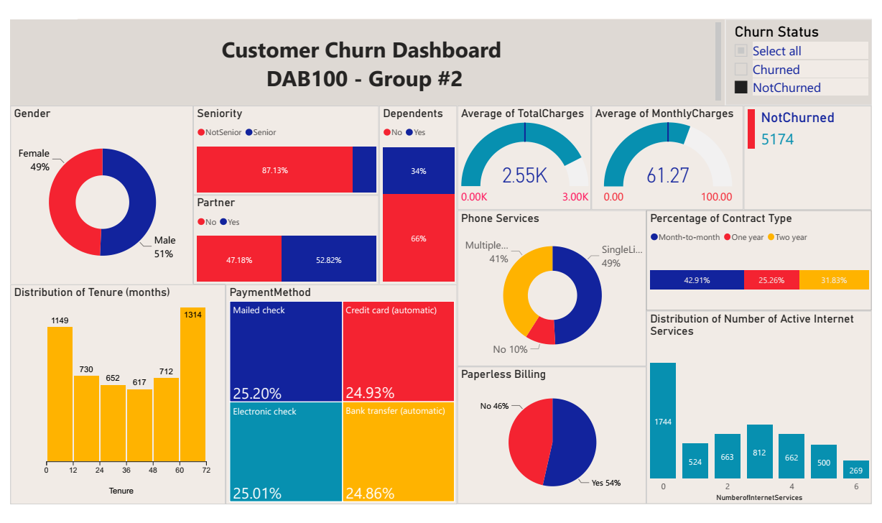
Not Churned Customers

Slide 12
Modeling With Azure Machine Learning Tool
The objective of this model is to predict RETAINED clients (NotChurned).
In this model we utilized all the remaining columns
Two-Class Boosted Decision Tree & Logistics Regression classification models are utilized
The fraction of rows in the first output dataset is set to 0.7
The selected column in Train section is set to “Churned” column

Slide 13
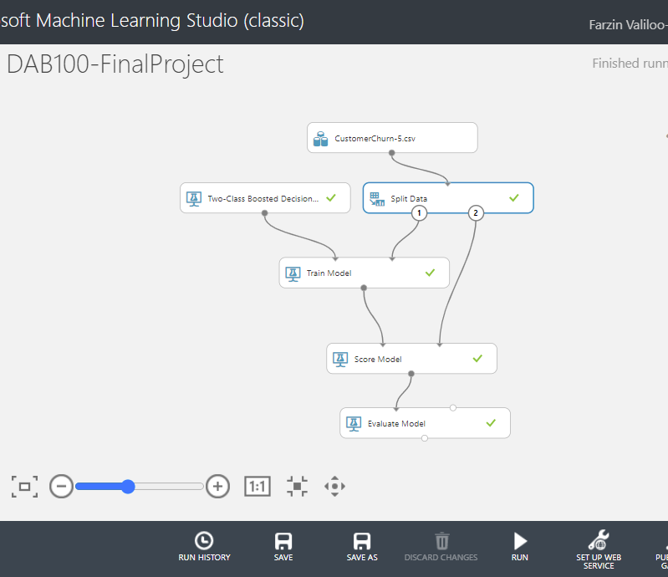
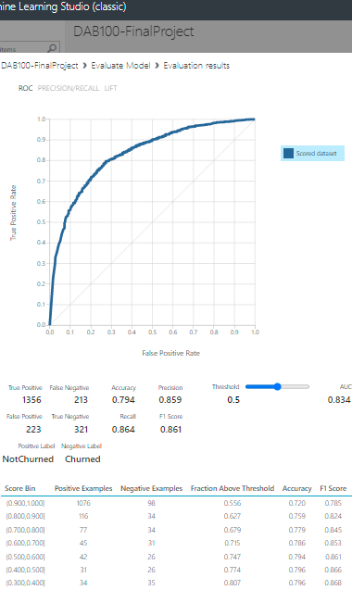
Decision Tree Model

Slide 14
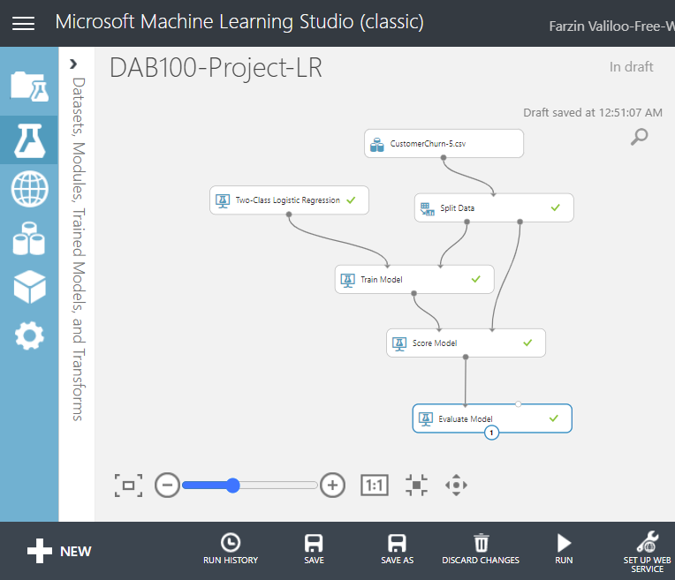
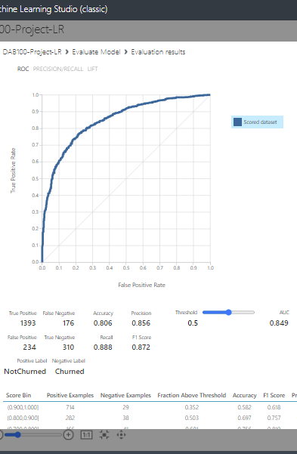
Logistic Regression Model

Slide 15
Logistic Regression
Results Comparison
Decision Tree
Confusion Matrix
True Positive
1356
1393
Negative Label
Positive Label
False Positive
223
234
Churned
NotChurned
True Negative
321
310
As the tables depicts
LR have predicted better TP and FN
DT have predicted better FP and TN
LR model has higher metrics except for precision
False Negative
213
176
Metrics
Accuracy
0.794
0.806
Precision
0.859
0.856
Recall
0.864
0.888
F1 Score
0.861
0.872
AUC
0.834
0.849

