Slide 1
PLATES OF FLAVOURS
SUBJECT: UML DIAGRAMS AND SCREEN DESIGNING
PROJECT MEMBERS:
ALEX D’SOUZA – 24
APURVA JAMBHALE – 42
POOJA KULKARNI - 55

Slide 2
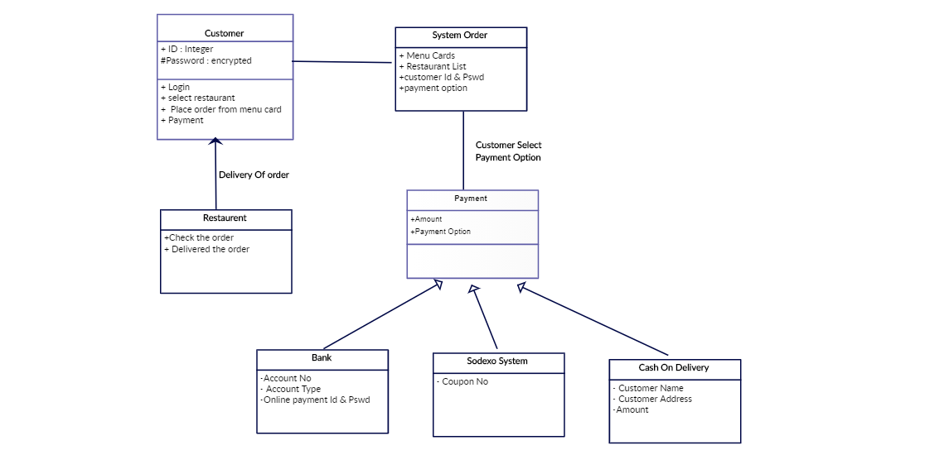
CLASS DIAGRAM

Slide 3

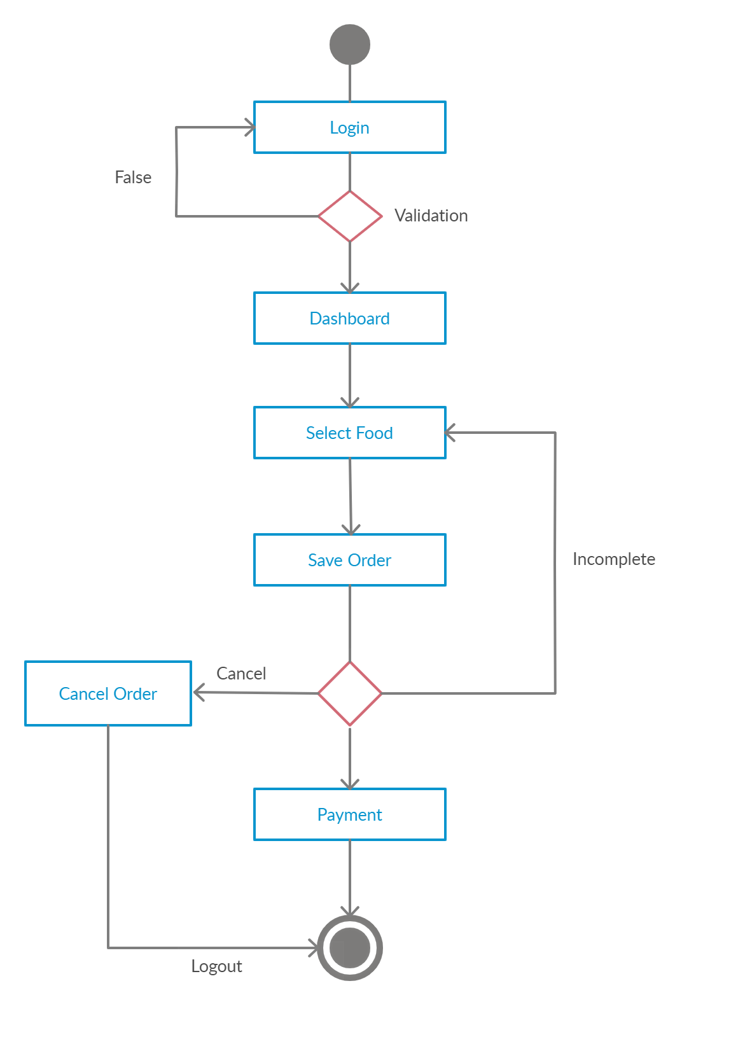
ACTIVITY DIAGRAM

Slide 4
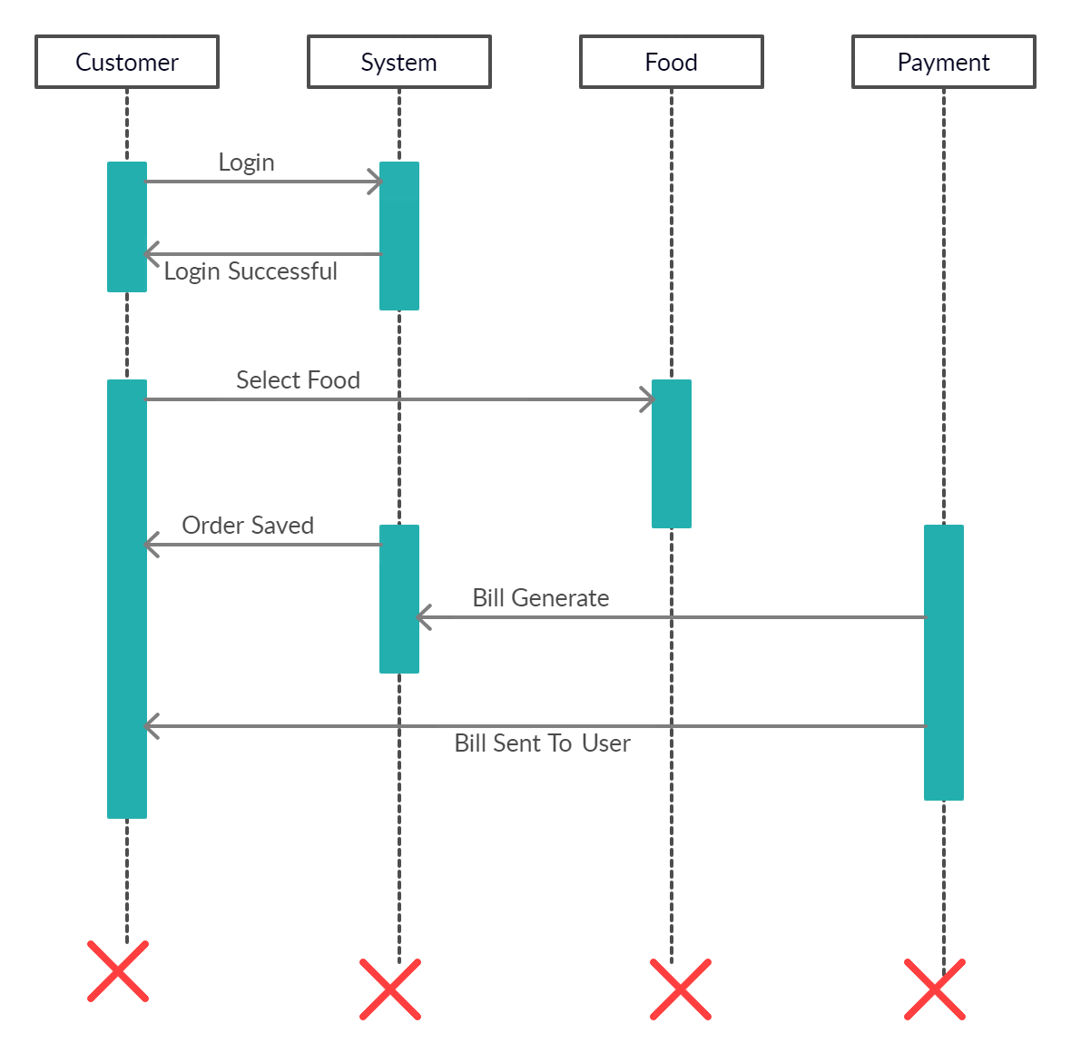
SEQUENCE DIAGRAM

Slide 5
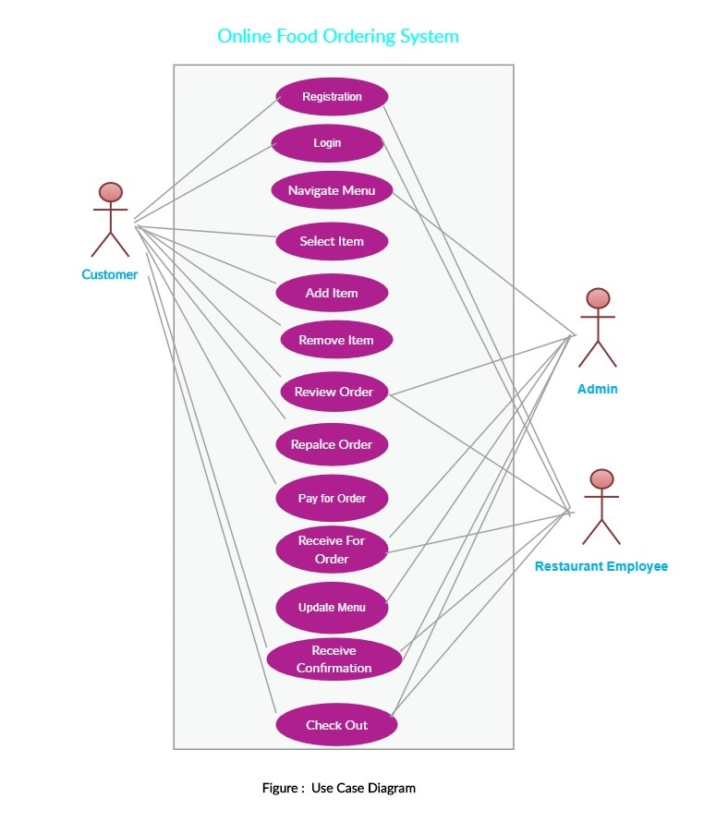
USECASE DIAGRAM

Slide 6
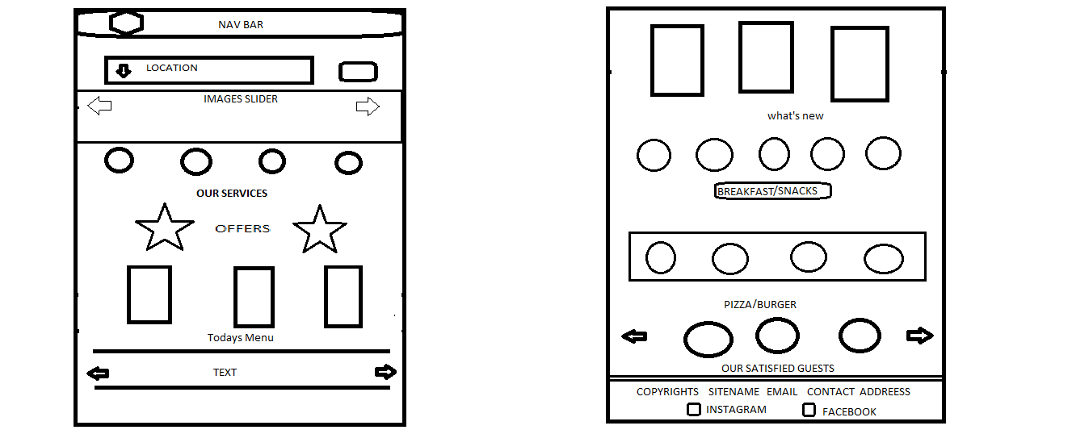
SCREEN DESIGNS

Slide 7
