Slide 1
SmartDrive – Serverless File Management System
A Serverless Architecture Using AWS Lambda, S3 & DynamoDB
Presented By: Apurva Kadam
Internship Project by Elevate Labs
Date: November 2025

Slide 2
Project Goal
Enable fast and secure access with optional CloudFront CDN and HTTPS.
To design and deploy a secure, scalable, and efficient cloud-based file storage system where users can upload, access, and share files through a web interface using cloud services.
Allow file upload/download using AWS S3
Provide a simple UI for users
Use serverless architecture for scalability and low maintenance.

Slide 3
Tools & Technologies
Frontend: HTML, CSS, JavaScript
Backend: AWS Lambda, API Gateway
Storage: AWS S3
Database: DynamoDB (SmartDriveFiles table)
Security: JWT Authentication, SSL/HTTPS
Optional: CloudFront CDN
Other: Base64 encoding for file transfer, CORS configured

Slide 4
System Features
JWT-secured login
Upload files via frontend → Lambda → S3
Store metadata: file_id, filename, owner_email, upload_date in DynamoDB
File operations: List, Download, Delete, Share (pre-signed URLs)
Serverless, scalable, and secure

Slide 5
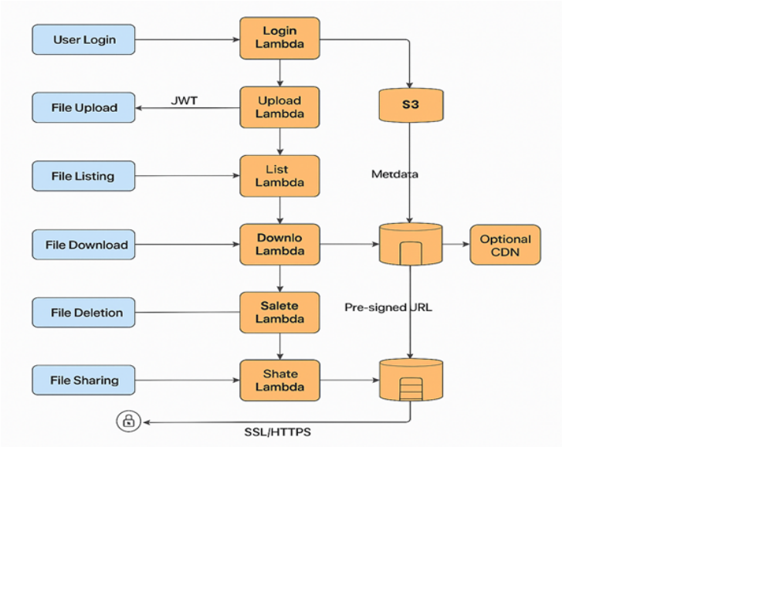
Workflow Overview
SmartDrive – End-to-end file management workflow

Slide 6
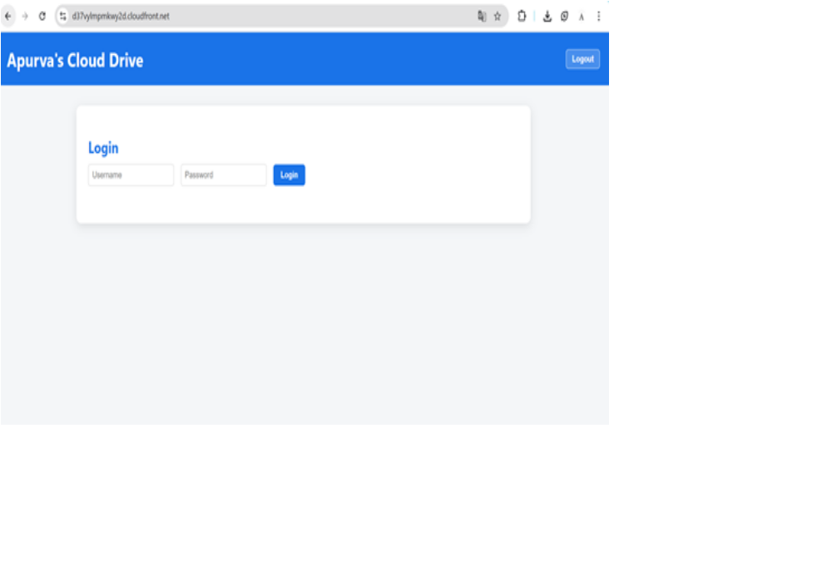
Demo Screenshots
Login screen

Slide 7
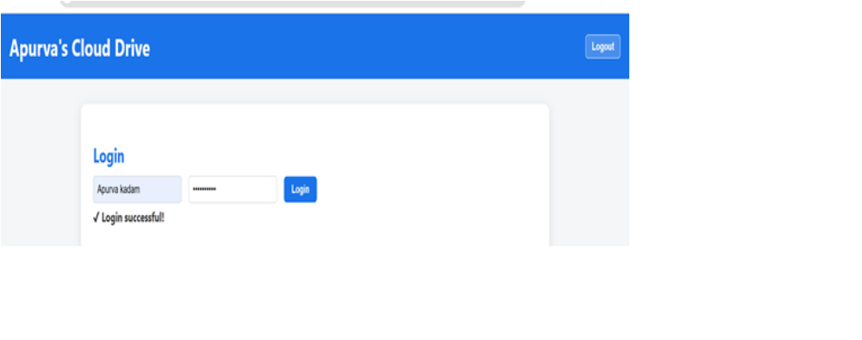
Login successful

Slide 8
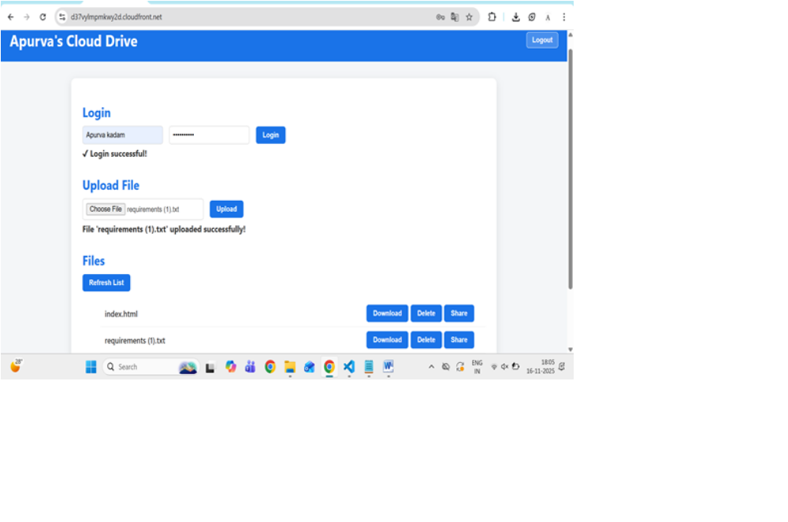

Slide 9

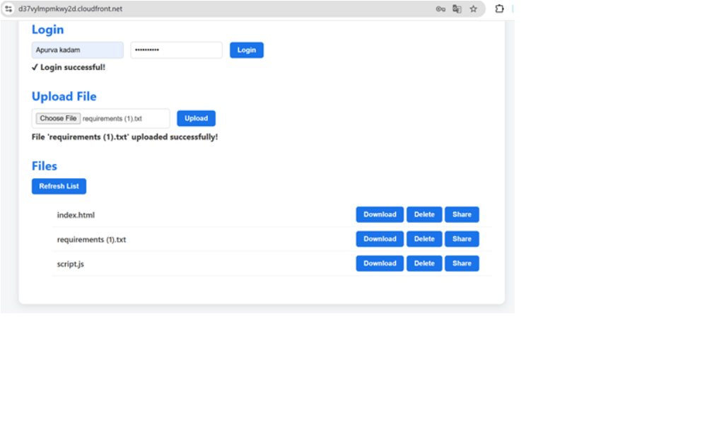

Slide 10

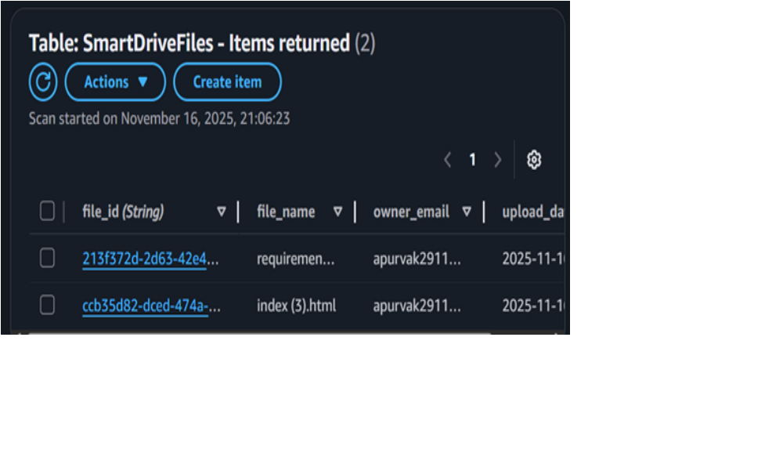

Slide 11

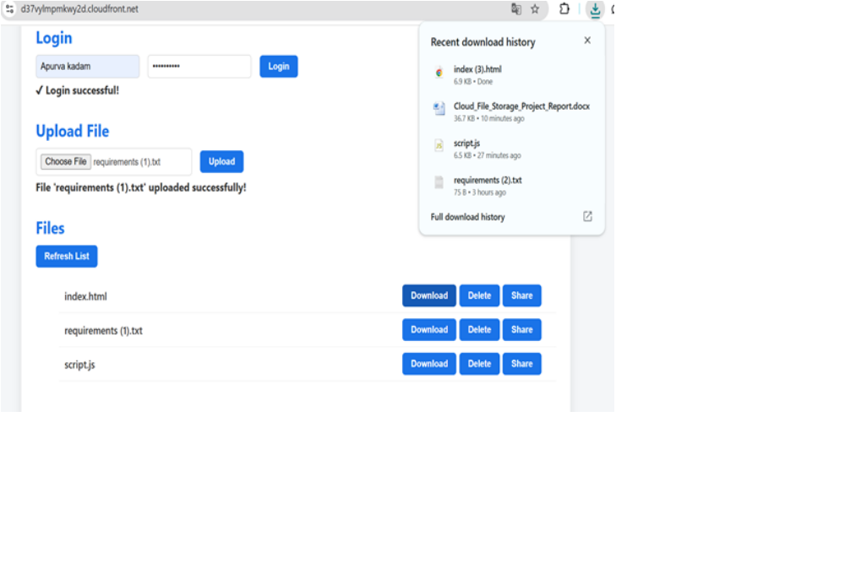

Slide 12

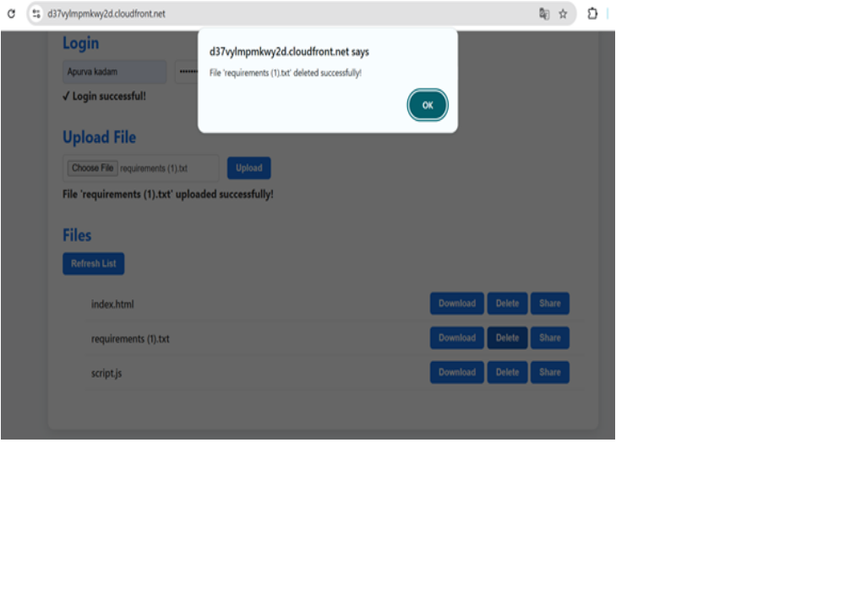

Slide 13
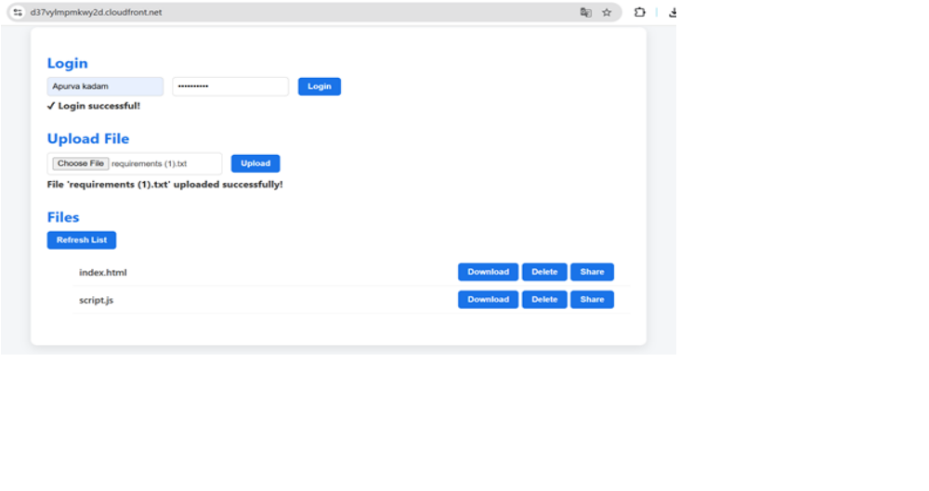

Slide 14

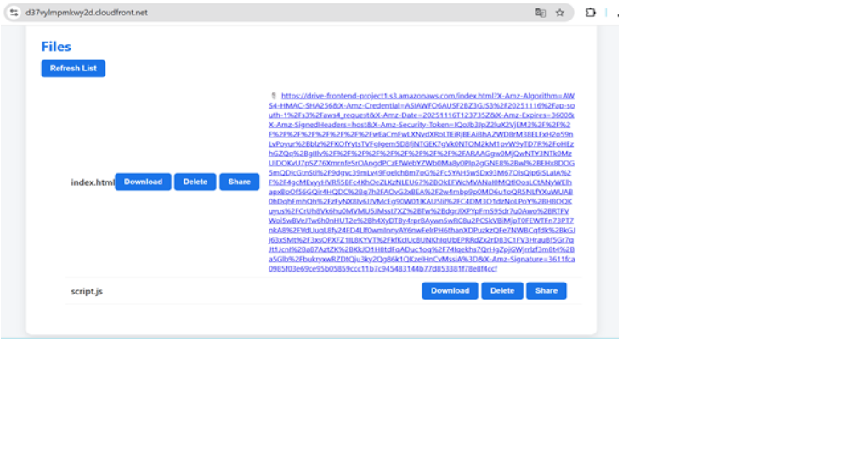

Slide 15



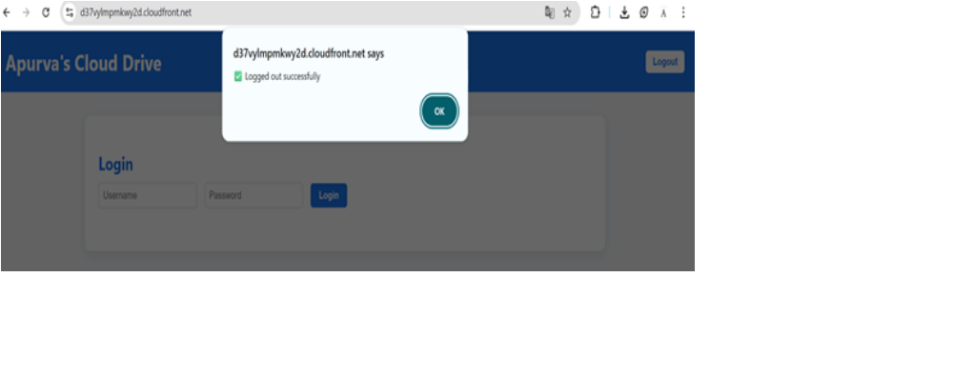

Slide 16
Security & Performance Highlights
JWT Authentication – Ensures secure access
HTTPS / SSL – Encrypted data transfer
CORS – Frontend-backend communication
CloudFront (optional) – Faster file access globally

Slide 17
Advantages
Fully serverless → no server maintenance
Scalable → handle multiple users and files seamlessly
Secure → JWT, HTTPS, controlled file sharing
User-friendly interface

Slide 18
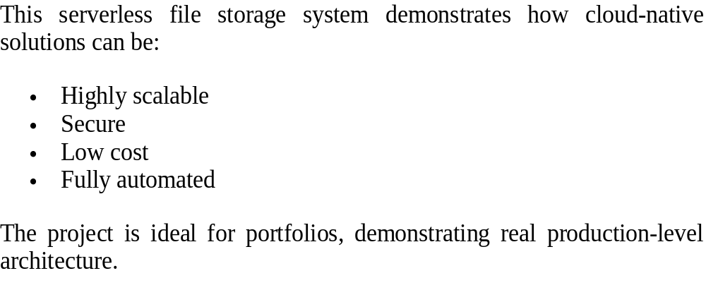
Conclusion

Slide 19
Questions / Thank You
Thank You!
Contact: Apurva Kadam

