Slide 1

DDoS Attack Classification
Dune Security
AI Engineer - Take home assessment
- Apurva Patel

Slide 2
Introduction
Increasing prevalence of cyber threats makes network security a crucial concern.
Distributed Denial-of-Service (DDoS) attacks can severely disrupt services
This work aims to develop an AI-powered DDoS detection system that classifies network traffic in near real-time
- Goal: Classify traffic as either 'Benign' or 'DDoS' attack with high accuracy

Slide 3
Problem Statement
Conventional detection methods struggle with scalability and real-time response.
Key Challenges:
Differentiating between benign and DDoS traffic.
Handling large-scale, high-velocity network data(if deployed).
Reducing false positives to prevent unnecessary service disruptions.

Slide 4
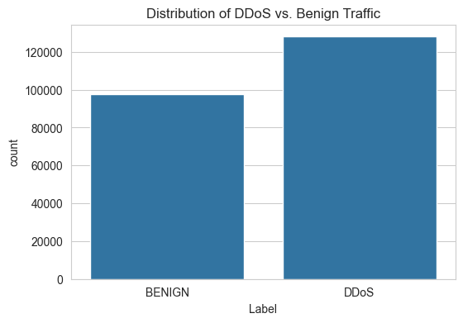
Data & Analysis
Total 85 features(before processing)
“Label” is the target variable – hence a supervised problem.
Use other features to predict the target for incoming traffic.
Target distribution(mild imbalance):
DDoS: 56.7%
Benign: 43.3%
Feature Composition:
80 numerical features
4 identifier columns removed (Flow ID, Source IP, Destination IP, Timestamp)

Slide 5
Data Quality Issues
Column names were stripped to remove spaces
Missing values (0.015%) dropped – in pipeline
Duplicate rows (0.02%) removed – in pipeline
Infinite values modified by replacing with NaN – in pipeline
34 rows with inf values (32: BENIGN & 2: DDoS)

Slide 6
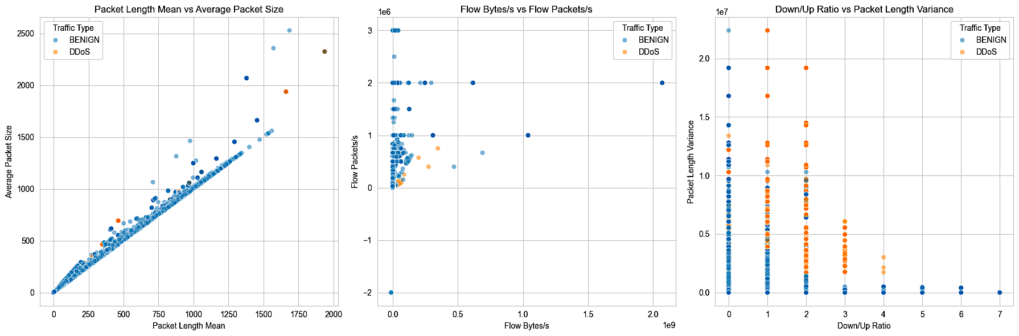
Data Insights
Packet Length Mean vs. Average Packet Size
Strong linear correlation between packet length mean and average packet size.
BENIGN traffic (blue) follows a linear trend.
DDoS traffic (orange) mildly deviates from this trend, showing variations in packet sizes within attack traffic.
The linear relationship suggests that normal traffic follows expected transmission behavior, but DDoS traffic introduced variations.

Slide 7
Data Insights
Flow Bytes/s vs. Flow Packets/s
Most data points are clustered near the origin, indicating lower packet rates for many traffic flows.
Some DDoS points (orange) show higher Flow Packets/s, suggesting rapid transmission of small packets, which is common in attack traffic.
Some outliers exist with extremely high Flow Bytes/s, potentially representing high-volume attacks.

Slide 8
Data Insights
Down/Up Ratio vs. Packet Length Variance
DDoS traffic (orange) appears more concentrated at specific Down/Up ratio values.
Higher packet length variance for DDoS traffic suggests irregular patterns in packet sizes.
BENIGN traffic (blue) is more spread out, showing a more balanced network behavior.

Slide 9
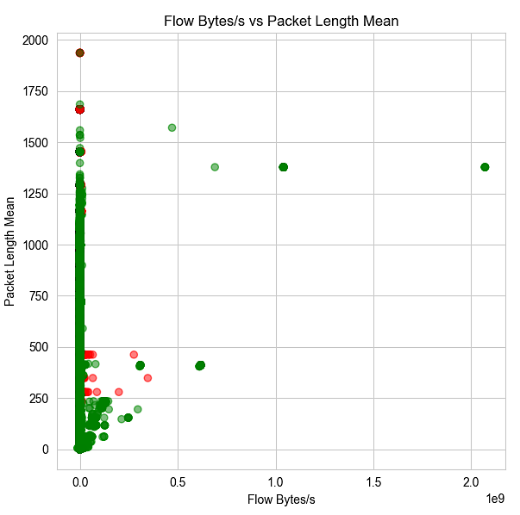
Data Insights
Flow Bytes/s vs Packet Length Mean
Most DDoS points (red) are concentrated at low Flow Bytes/s and low Packet Length Mean.
Some extreme outliers exist with high Packet Length Mean, likely representing malicious traffic bursts.
DDoS attacks often involve high packet rates but smaller packet sizes.

Slide 10

Data Insights
Down/Up Ratio vs Idle Mean
DDoS traffic (red) is clustered at specific Down/Up Ratios with higher Idle Mean.
Benign traffic (green) is more spread out across different values.
DDoS attacks show consistent Down/Up ratios, likely due to sending packets at fixed intervals.
The high Idle Mean suggests that during attack periods, there are significant traffic bursts followed by idle times.

Slide 11
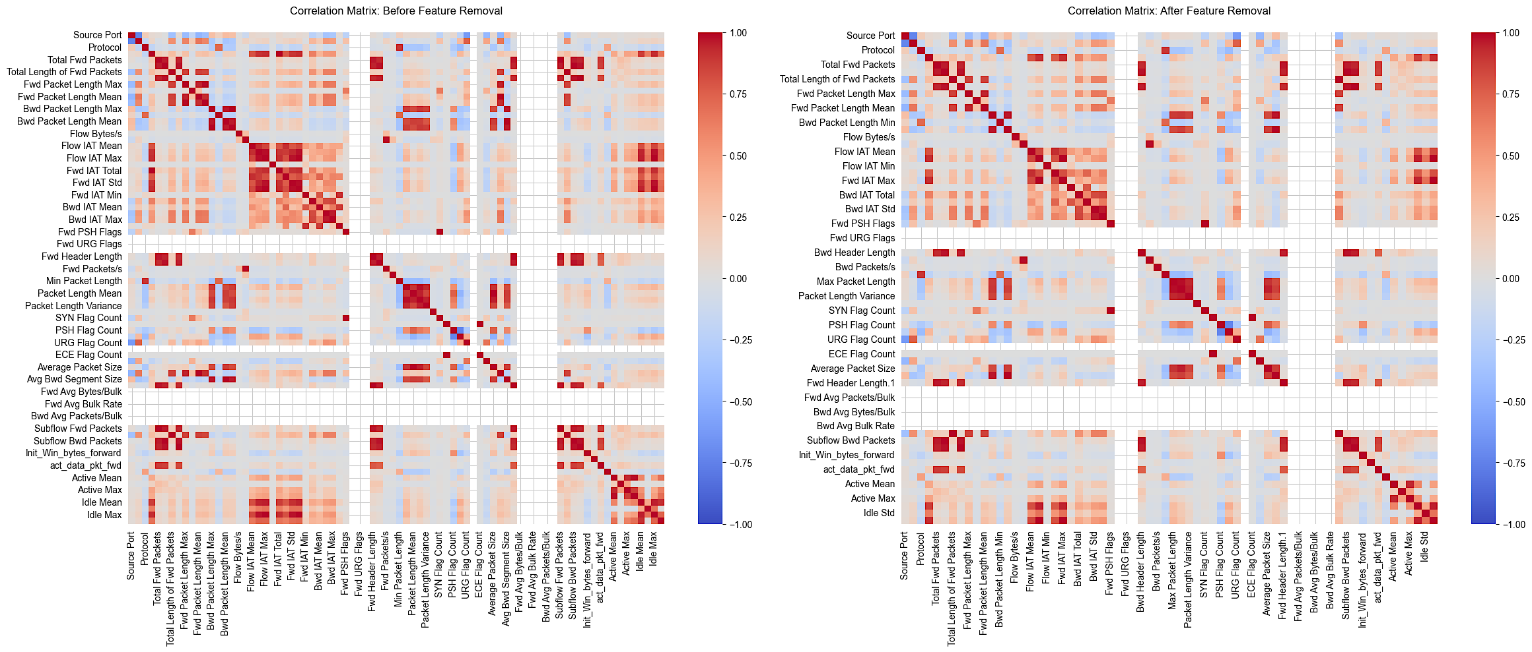
Feature Selection & Correlation Analysis
Highly correlated features can introduce multicollinearity, which affects model interpretability.
Reducing redundant features improves training efficiency and prevents overfitting.
Impact of Feature Removal:
Before Removal: Many features showed strong correlations, causing redundancy.
After Removal: Reduced multicollinearity and enhanced model generalization.

Slide 12
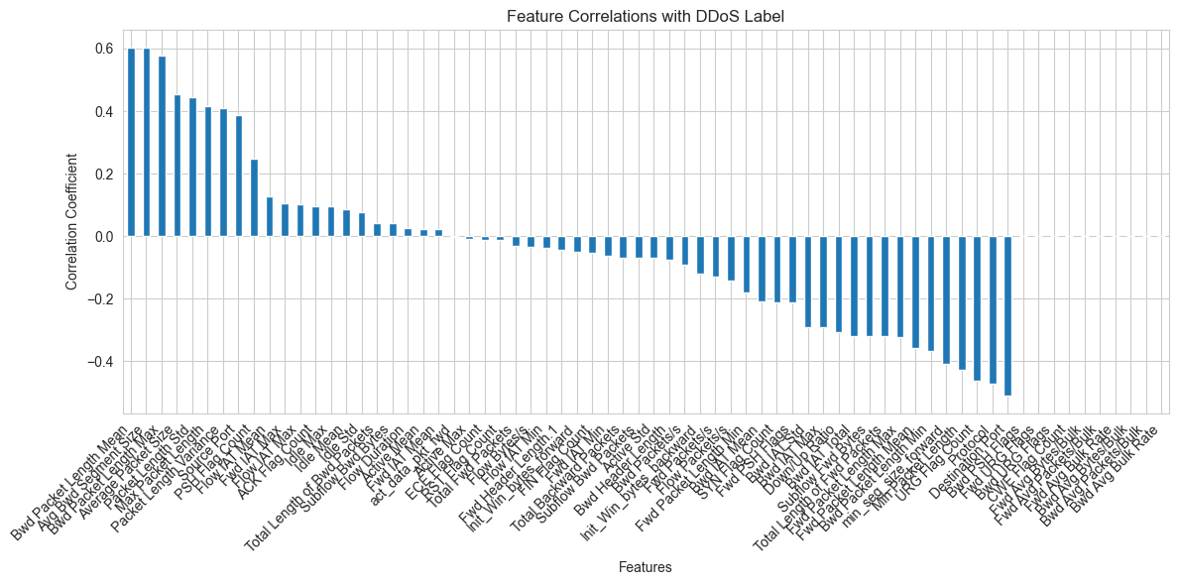
Feature vs Target Correlation
Bar plot visualizes feature correlations with the DDoS attack label (target variable).
Positive values indicate a direct relationship of DDoS attack.
Negative values indicate an inverse relationship of DDoS attack.
Strongest positive correlations, suggesting that attack traffic often consists of larger packet sizes and high data flow rates.
Negative correlation indicating that benign traffic is more structured and consistent in packet sizes.

Slide 13
Model Choices
We observed that mostly all features are numerical – scaling is to be considered.
No specific linear trend observed, mostly outlier detection.
Tree based models require less data processing and can be used as it is.
Options (all tried in preliminary evaluation):
Random Forest (Chosen Model) ✅
XGBoost
Logistic Regression
MLP Neural Network
LSTM (if timestamp is important – not here)
Metric:
Optimized for F1 score because accuracy is not a true representation of a model performance for anomaly detection use case, as we want to avoid False negatives and false positives.
F1 score is a combination(HM) of Precision and Recall

Slide 14
Why Random Forest?
Strengths:
Handles imbalanced data well through class weighting.
Robust to outliers and noise in network traffic.
Does not require extensive preprocessing (feature scaling).
Provides feature importance rankings, improving interpretability.
Performs well on tabular data, making it ideal for network flow analysis.

Slide 15
Alternates & Limitations
XGBoost:
Highly efficient and accurate but requires more hyperparameter tuning.
Can be prone to overfitting if not properly tuned.
Logistic Regression
Computationally expensive and struggles with non-linearity in attack patterns.
Less effective in handling high-dimensional data with many features.
MLP Neural Network
Can model complex patterns but requires significant tuning.
Longer training time and higher computational cost and slow inference speed

Slide 16
Implementation
Data Preprocessing:
Standard scaling (zero mean, unit variance)
Label encoding (Benign → 0, DDoS → 1)
Feature selection based on correlation analysis
Training Strategy:
StratifiedKFold (5-fold cross-validation)
Class Weighting to handle mild class imbalance
Hyperparameter Tuning using GridSearchCV
Model Training Steps:
Data ingestion & cleaning
Feature engineering & transformation
Training and evaluation
Model artifact storage

Slide 17
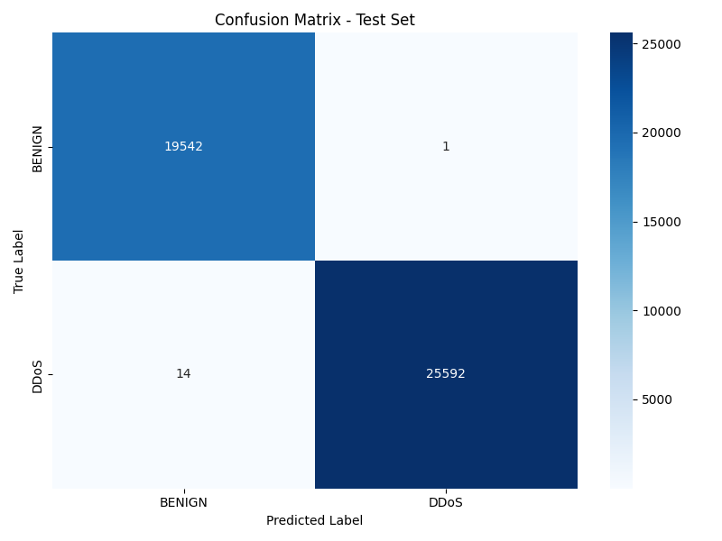
RESULTS
Confusion Matrix - Test set
Key Insights:
Extremely low false positive rate (only 1 misclassification).
Low false negatives (only 14 attacks missed), meaning almost no attacks bypass detection.
Nearly perfect classification, reinforcing the high ROC-AUC score.

Slide 18
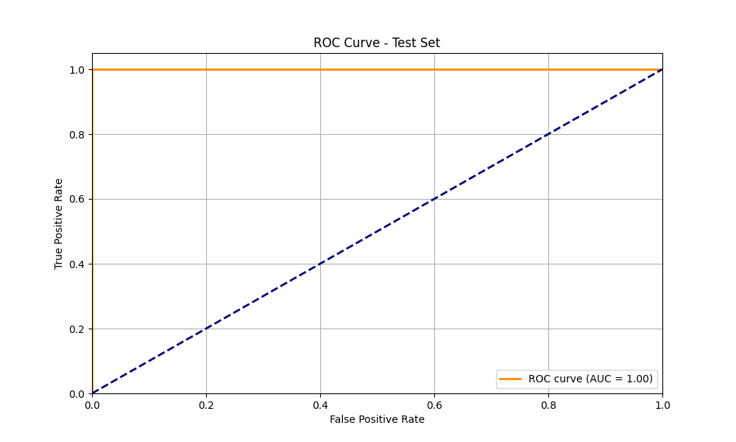
RESULTS
ROC Curve & Performance Scores
The AUC (Area Under the Curve) = 1.00, meaning perfect classification of DDoS vs. Benign traffic.
The model has no false positives or false negatives, making it an ideal detector.
The orange line (ROC Curve) stays at 100% True Positive Rate, indicating all attacks were identified correctly.

Slide 19
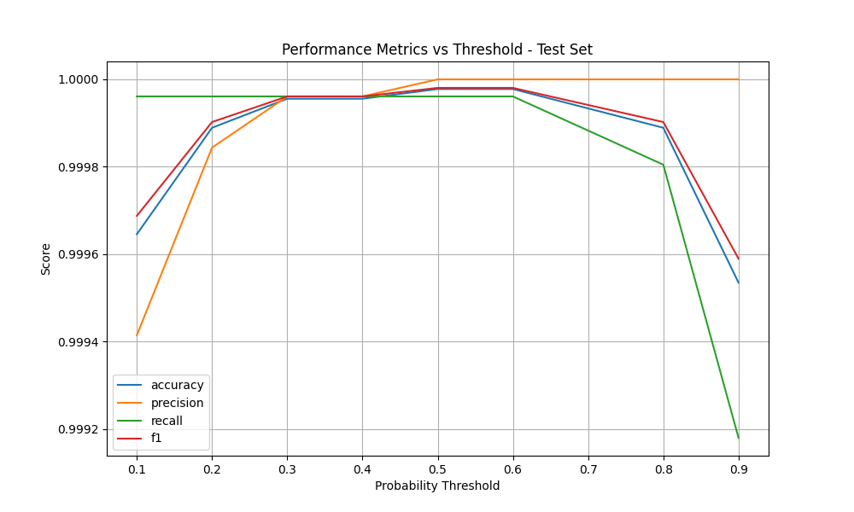
RESULTS
Performance Metrics vs Threshold
Shows how accuracy, precision, recall, and F1-score vary with probability threshold(from RF).
At lower thresholds (0.1-0.2), precision is lower, meaning some false positives occur.
At an optimal threshold (~0.5-0.7), all metrics reach their peak, balancing false positives vs. false negatives.
At very high thresholds (0.9+), recall drops, meaning some DDoS attacks go undetected.
Key Takeaway:
The model performs best when the threshold is tuned around 0.5-0.7, avoiding both false alarms and missed attacks.

Slide 20
Business Impact
F1-Score prioritization:
False negatives (missed attacks) are more costly than false positives
Balance between precision & recall for real-world deployment
Security Implications:
Minimizing false alerts avoids unnecessary shutdowns
Maximizing detection accuracy prevents attacks from going unnoticed

Slide 21
Thanks for the opportunity ☺
Questions?
Thank you! Feel free to ask any questions.
GitHub Repository: https://github.com/Apurva3509/DuneSec
Email: amp2365@columbia.edu
Website: www.patelapurva.com

