Slide 1
Game Café in Hyderabad, India
Apurva Ponnapalli

Slide 2
Contents
Introduction
Business Problem
Target Audience
Data
Sources Used
Methodology
Analysis
Results
Discussion
Limitations and Suggestions for Future Research
Conclusion

Slide 3
Introduction
Gaming cafes are a great way to relax and enjoy during weekends and holidays.
Opening a new cafe requires serious consideration of location and the way it has to be operated successfully.
The objective of this project is to analyze and select the best locations in the city of Hyderabad, India, to open a new gaming cafe.

Slide 4
Business Problem
Finding and recommend an appropriate Location for opening a gaming café.

Slide 5
Target Audience
Gaming Companies.
Start-up Companies interested in gaming café.
Gamers who are interested in playing in such cafes.

Slide 6
Data
List of neighborhoods in Hyderabad.
To plot the map latitude and longitude coordinates are required.
To perform clustering, we need venue data related to gaming cafes in Hyderabad.

Slide 7
Sources Used
Wikipedia
Foursquare API

Slide 8
Methodology
Getting the list of neighborhood of the city by Scrapping the webpage.
Getting the geographical coordinates of the city and its neighborhood.
Populate the pandas DataFrame.
Visualize the neighborhoods in the form of maps.
Using the Foursquare API for getting the venues.
Performing clustering on the data by using K-mean clustering algorithm.

Slide 9
Analysis
Step 1: Import required Libraries.
Numpy
Pandas
Geocoder
BeautifulSoup
Folium
Sklearn
Matplotlib

Slide 10
Analysis
Step 2: Web Scrapping the data from below link.
(https://en.wikipedia.org/wiki/Category:Neighbourhoods_in_ Hyderabad,_India)
Send the GET request Step.
Parse data from the html into a beautifulsoup object.
Create a list to store neighbourhood data.
Append the data into the list.
Create a new DataFrame from the list.

Slide 11
Analysis
Step 3: Geographical Coordinates
Defining a function to get coordinates .
Initialize variable to None.
Looping until getting the coordinates.
Call the function to get the coordinates.
Store in a new list using list comprehension.
Create temporary dataframe to populate the coordinates.
Merge the coordinates into the original dataframe.
Getting the Coordinates of Hyderabad.

Slide 12
Analysis
Step 4: Mapping and Visualizing
Create Map of Hyderabad using latitude and longitude values.
Add markers to Map.
Markers for Localities.
Create Map of Hyderabad with Markers.

Slide 13
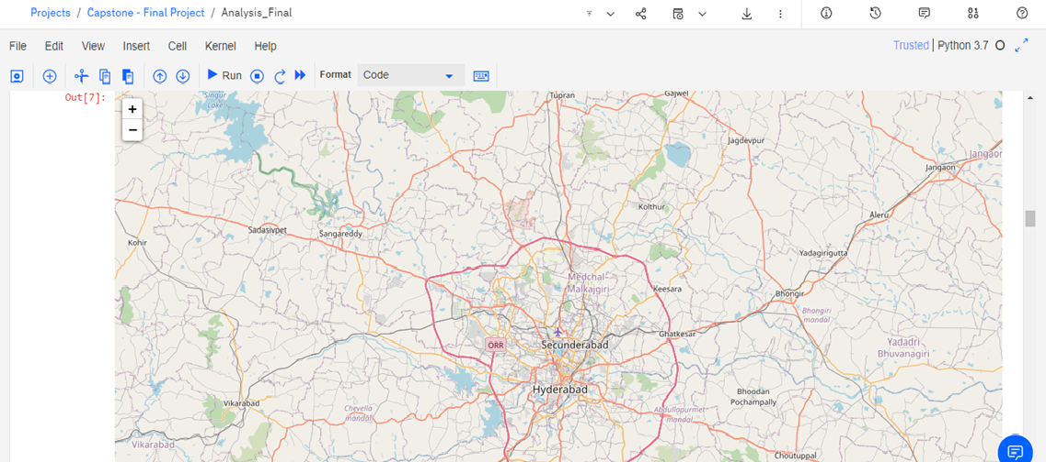
Map of Hyderabad

Slide 14
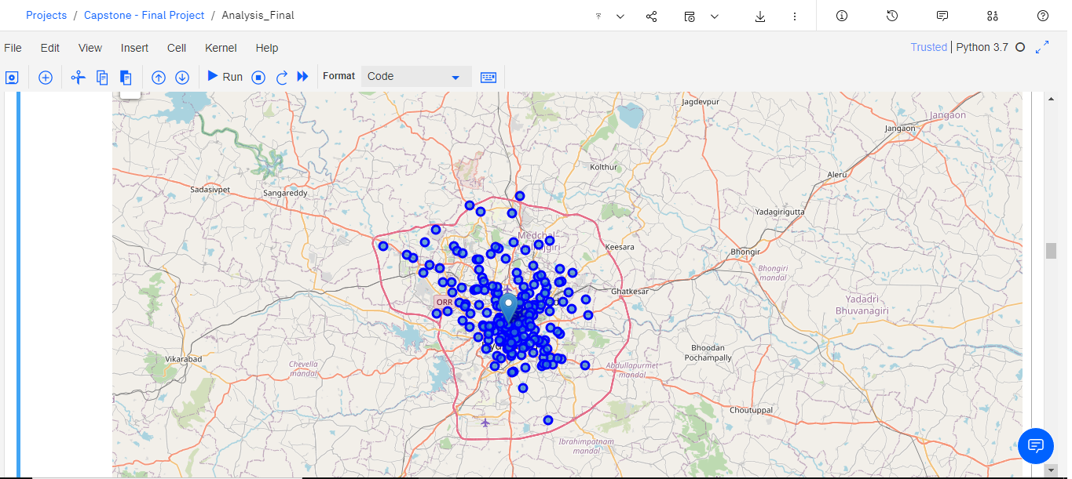
Marked Map of Hyderabad

Slide 15
Analysis
Step 5: Foursqaure API
Create the API request URL.
Make the GET request.
Return only relevant Information for each nearby venue.
Creating a New DataFrame.
Check how many venues were returned for each neighborhood.
Check for unique categories which can be curated from all the returned values.

Slide 16
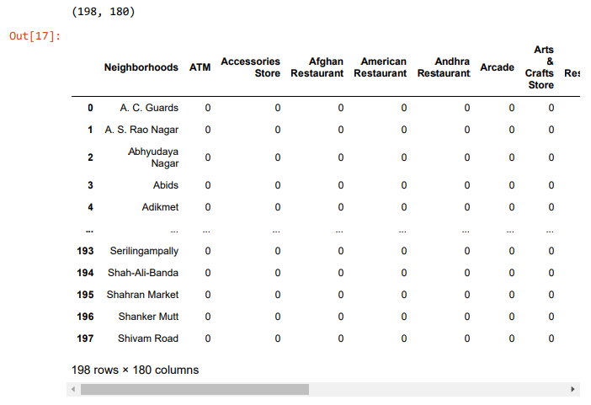
Analysis
Step 6: Analyzing each Neighborhood
By using One hot
encoding group the
neighborhood.
After this Creating a
dataframe for Gaming
Cafe only.

Slide 17
Analysis
Step 7: Clustering
By using K-means Algorithm
Set the number of Clusters.
Run k-means Clustering.
Check cluster labels generated for each row in the dataframe.

Slide 18
Analysis
Step 7: Clustering
Creating a new dataframe that includes the cluster as well as the top10 venues for each neighborhood.
Add the clustering labels.
Adding latitude and longitude values to the existing dataframe.
Sorting the results by Cluster Labels.

Slide 19
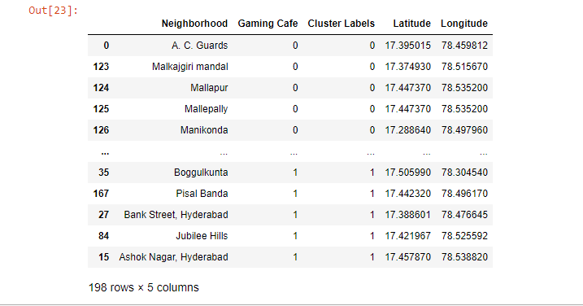
Output of Clustering

Slide 20
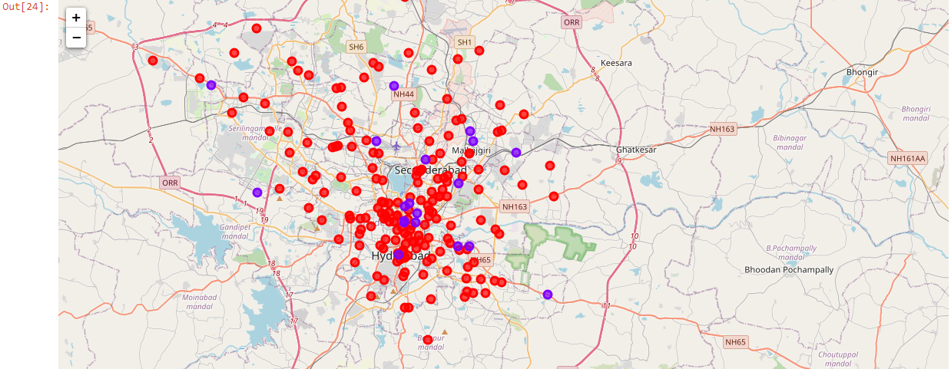
Map of Hyderabad after Clustering
Cluster 0: Red
Cluster 1: Blue

Slide 21
Results
As per the analysis, the neighborhoods are divided into 3 clusters based on the frequency of occurrences for “Gaming Café”:
Cluster 0: Neighborhoods with high number of gaming cafes (179).
Cluster 1: Neighborhoods with low number of gaming cafes (19).
Cluster 2: Neighborhoods with no gaming cafes (0).

Slide 22
Discussion
Cluster 0 has highest number of Gaming Cafes. Hence it is not recommended.
Cluster 1 has low number of Gaming Cafes. Can open a café here but wow point is needed.
Cluster 2 doesn't have any café. Hence, it is apt for opening a gaming café.

Slide 23
Limitations
Only one factor was considered in this project.
The project might lack in giving proper output due to certain limitations.
Further research is required in different angles to select proper locations.

Slide 24
Conclusion
It is recommended to open a gaming café in cluster 3 as there are no cafés present there.

Slide 25


