Slide 1
Stock Control System
Project Supervisor – Prof Anthony Conway
Principal Marker – Dr Paula Severi
Presented by – Apurva Kulkarni (avk7)
Student id - 239064472

Slide 2
INTRODUCTION
PROBLEM STATEMENT:
🏬 Manual inventory tracking in warehouses leads to stockouts and overstocking. 🧾 Supplier order management is error-prone and lacks predictive planning. 📉 No integrated system to forecast product demand or visualize sales trends.
SOLUTION:
A full-stack web application for real-time stock monitoring, intelligent supplier order processing, and AI-powered future sales prediction.

Slide 3
OBJECTIVES
PROJECT AIM The aim of this project is to design and implement a secure, centralized, and intelligent Stock Control System for managing computer warehouse.
It is a web-based application designed to manage and monitor stock levels of computer components in a computer warehouse.
OBJECTIVES
📦 Real-Time Inventory Monitoring & Alerts 📉 Low Stock Detection & Email Alert to Admin 📈 Future Sales prediction using Linear Regression 📬 Email Notifications for Orders & Receipts to Client 📊 Interactive Admin Dashboard with Analytics & Charts

Slide 4
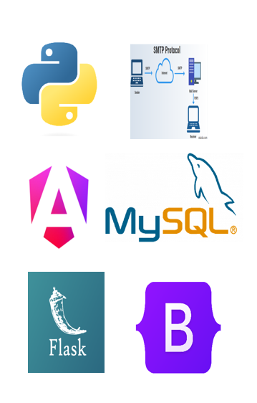
TECH STACK
Frontend - Angular 19
Stand alone application
REST API Integration
Responsive UI using bootstrap
Apex Chart for Data visualization
Backend – Python flask framework
RESTful API routes using flask blueprints
Secure session handling using flask-login and JWT
Handles core logic for order placement, user roles.
Database – MySQL Workbench
SQLAlchemy ORM for interaction
Stores information in different tables

Slide 5
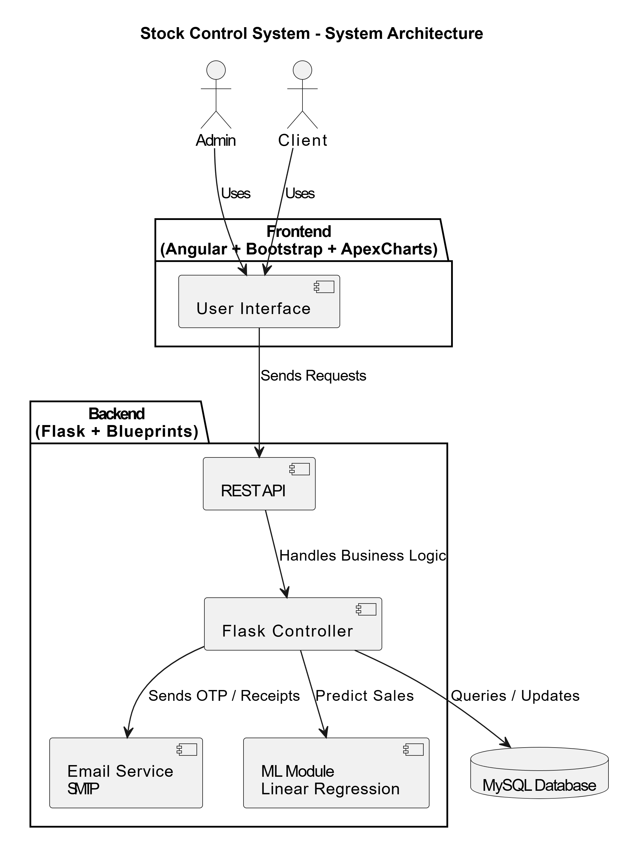
System Architecture
The system follows the MVC (Model-View-Controller) architecture, ensuring a clean separation between data models, user interface, and backend logic.
👤 User Interaction Layer
⚙️ Backend Service Layer (Flask)
🧠 Predictive Analytics Module
🗃️ Data Persistence Layer (MySQL)

Slide 6
Key Features
Centralized Inventory System
Automated Low Stock Alert
Role based access (RBA)
Real time Stock Movement Tracking
Email Validation and Invoicing System

Slide 7
Machine Learning & Email Integration
Machine learning forecasting
Purpose : predict future sales trends for each product using linear regression
Data Used : Last 15 days of sales data from Orderdetails table
Model Output : Forecaste of daily demand for next 30 days
Visualization : Forecaste displayed on Admin dashboard
Email Integration via SMTP
Email OTP Verification : Users verify their identity during registration with a 6-digit OTP (valid for 5 minutes).
Order Receipt Delivery : Backend – Pythons smtplib with Gmail SMTP
Frontend trigger – Angular’s HttpClient -> Flask API

Slide 8
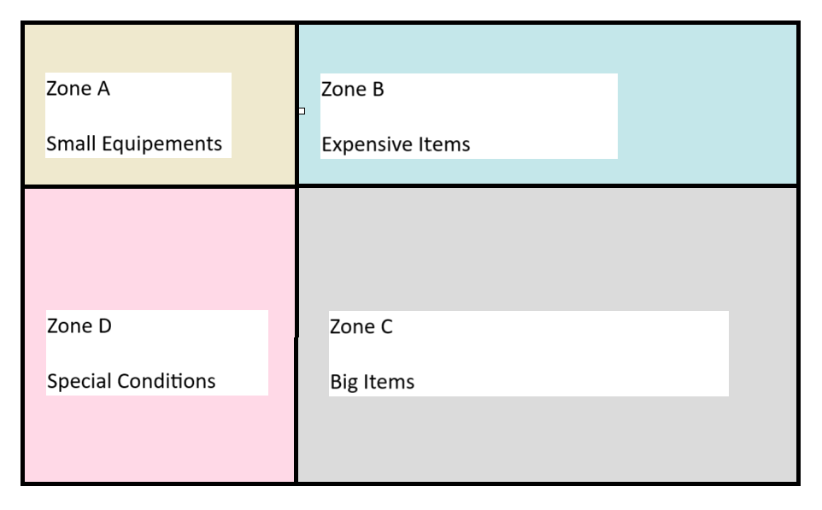
Warehouse Zone and Shelf Management
🗂️ Warehouse Zone Design
Zone A – Small Equipments
Zone B– Expensive Products
Zone C – Big Items
Zone D – Special Condition Products
🧮 Shelf Management Logic
📦 Each product is assigned a shelf inside its zone.
🧱 Each shelf has a fixed capacity of 30 units.
📊 The system uses bar graphs to visually show:
Current stock on each shelf.
Remaining space (available for new stock).
🚨 When capacity nears limit, the admin is notified.
📥 Admin can place orders to suppliers based on real-time shelf status.

Slide 9
Testing Methodology
1.Blackbox testing (API)
Postman API testing which includes routes like /confirm_order, /send_otp, /approve_admin and predict_sales_by_product tested by treating them as black box – verifying input/output correctness without checking internal code logic.
2. Pytest Unit testing
Backend logic (e.g. authentication, order processing) tested using pytest. Routes tested with mock payloads and expected status code for each logic branch. Results validated using assertions like assert response.status_code = 200.
3. UI/UX Validation Angular- based forms tested for input validation and session handling.

Slide 10
Challenges
Setting Up One-to-One Relationships with SQLAlchemy
Email OTP Functionality via Flask Mail
CORS and Cookie Handling in Angular–Flask Communication
Pytest Configuration with Flask App Factory
Seamless Integration of Machine Learning Forecasts into Web Architecture

Slide 11
Future Scope
Cloud deployment of the flask backend
Automated Suppliers order
Dynamic discount system
Chatbot integration
Multilingual Support

Slide 12
Thank you! Questions?
Apurva Kulkarni (avk7)

