Slide 1
INSURANCE POLICY ENDORSEMENT BASED ON ANDROID SYSTEM
Team members:
1.Jenifer Nancy.S
2.Kavithanjali.V
3.Apurvaa.S
Industry Mentor
Mr.Arun Kumar
Faculty Guide:
Mrs.SIVARANJANI
Department of CSE, KGiSL Institute of Technology, Coimbatore

Slide 2
Abstract An insurance endorsement is an amendment to an existing insurance contract, for changing the terms or scope of the original policy. An insurance endorsement may be used to add, delete, exclude or otherwise alter coverage . Insurance endorsement App is going to be a product – oriented software solution covering every business area in Insurance and provides its End users to manage their policy on-the-go without spending separate time for optimizing the policy contents.
Department of CSE, KGiSL Institute of Technology, Coimbatore

Slide 3
Area Introduction-Existing system
For endorsement in the existing system needs each time login of user to view and edit the policy content.
The existing system require person to spend lot of time with computer system to fill up the forms.
Department of CSE, KGiSL Institute of Technology, Coimbatore

Slide 4
Proposed System
Proposed System is to implement latest android cellular technology in making the system still more secure, efficient and effective, for the purpose of insurance policy endorsement.
1.Requirement of onetime user login
2.Manage multiple policy at the same time
3.Manage on-the-go and Renewal alerts
Department of CSE, KGiSL Institute of Technology, Coimbatore

Slide 5
Advantages over existing methods
The system is planned to be built using Android App Technology with kotlin (a light weight scripting Technology)and Jasper for reports generation for speed and Oracle as database
Future Enhancements
1. Enhanced features in Agent portal with renewal alerts and endorsement options .
2. More features help them in auto filling up the forms by means of Googles auto form fill function etc..
3.It fastly processes the data.

Slide 6
Literature Review
Drawbacks of existing methods
Need for computer systems in large scale and user experience in computer systems.
Depends completely on search engine's help.
Doesn't have high processing speed
References
www.icicilombard.com
www.insurance.com
Department of CSE, KGiSL Institute of Technology, Coimbatore

Slide 7
Module Split-up
Module 1:
Data collection
Module 2:
Data analysis
Module 3:
Data Cleaning
Module 4:
Data modification
Department of CSE, KGiSL Institute of Technology, Coimbatore

Slide 8
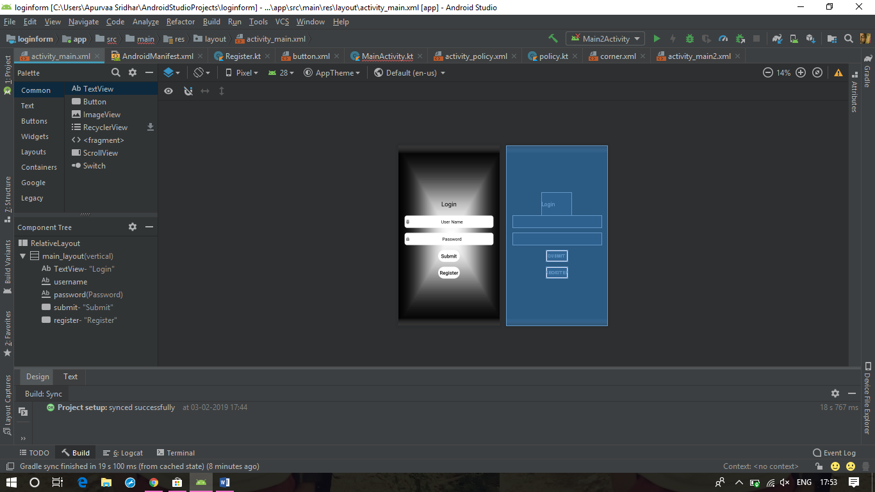
Screen shots of modules under progress. Login Page

Slide 9
Registration Page

Slide 10
LOGIN
Flow chart
DETAILS
OPTION
ENDORSEMENT
CALCULATOR
POLICY DETAILS
PREMIUM
NON-PREMIUM
PAYMENT OPTION
RETURN

Slide 11
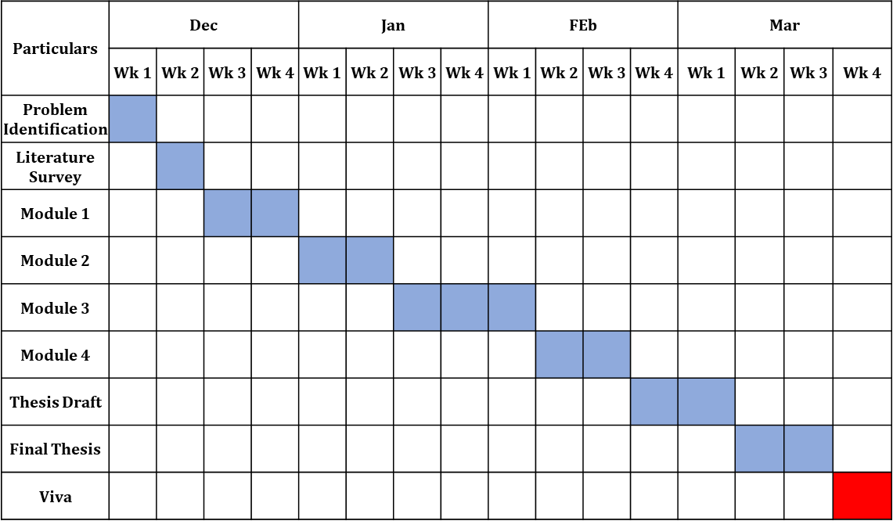
Project Planner / Timeline chart)

Slide 12
THANK YOU

