Slide 1
Tpip-2
Pseudo classes, pseudo elements, text designing
Presented by,
Akhilesh m
Anshul P
Apurva j

Slide 2
Pseudo Classes
CSS pseudo-classes are used to define the special state of an element.
They allow you to style elements based on user interaction, document structure, or specific conditions.
Syntax:
Selector : pseudo-class {
property : value;
}

Slide 3
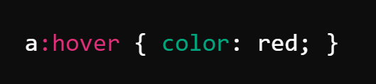
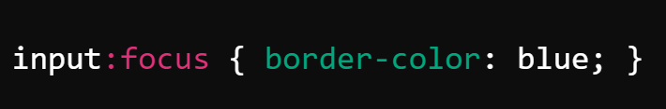
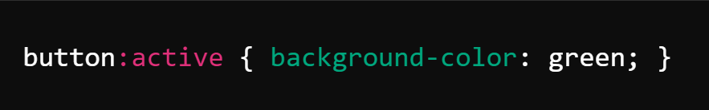
: HOVER Styles the element when the user hovers over it.
: FOCUS Styles an element when it gains focus, such as when a user clicks or tabs into an input field.
: ACTIVE Styles an element when it is being clicked.

Slide 4
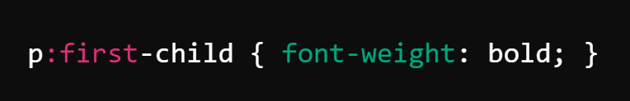
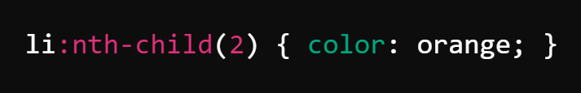
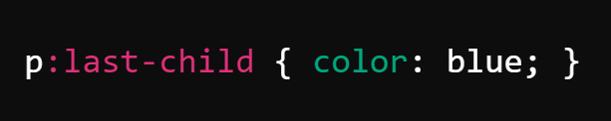
: FIRST-CHILD Styles the first child of a parent element.
: NTH-CHILD(N) Styles elements based on their position in the parent.
: LAST-CHILD Styles the last child of a parent element.

Slide 5
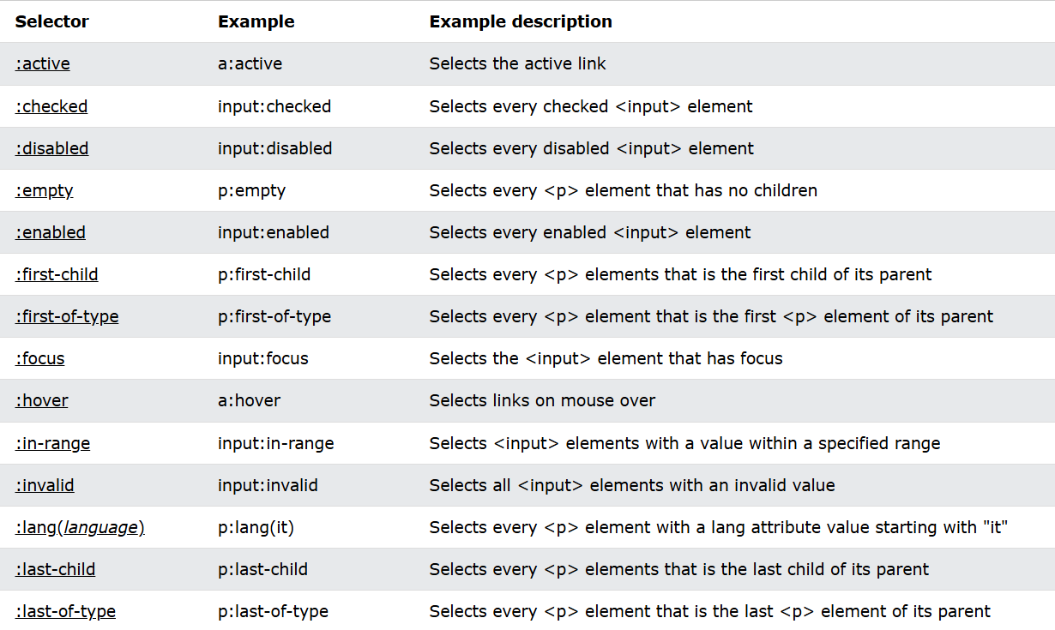

Slide 6
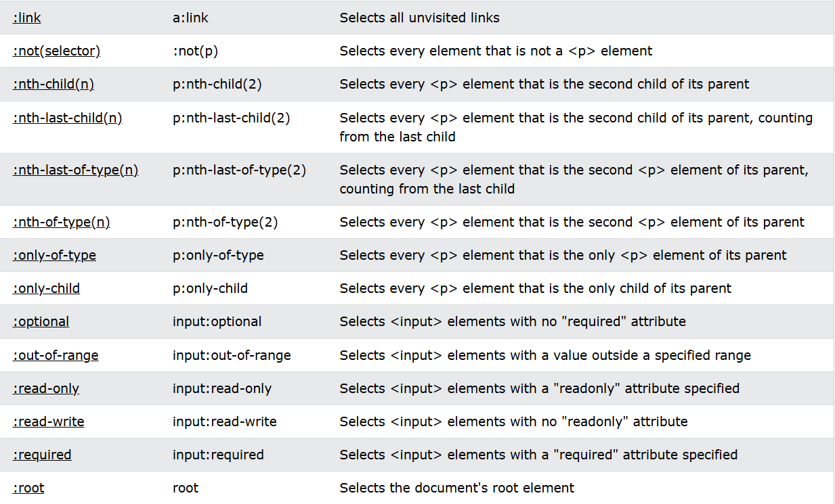

Slide 7
Pseudo elements
A CSS pseudo-element is used to style specified parts of an element.
For example, it can be used to:
Style the first letter, or line, of an element
Insert content before, .or after, the content of an element.
Syntax:
selector::pseudo-element {
property: value;
}

Slide 8
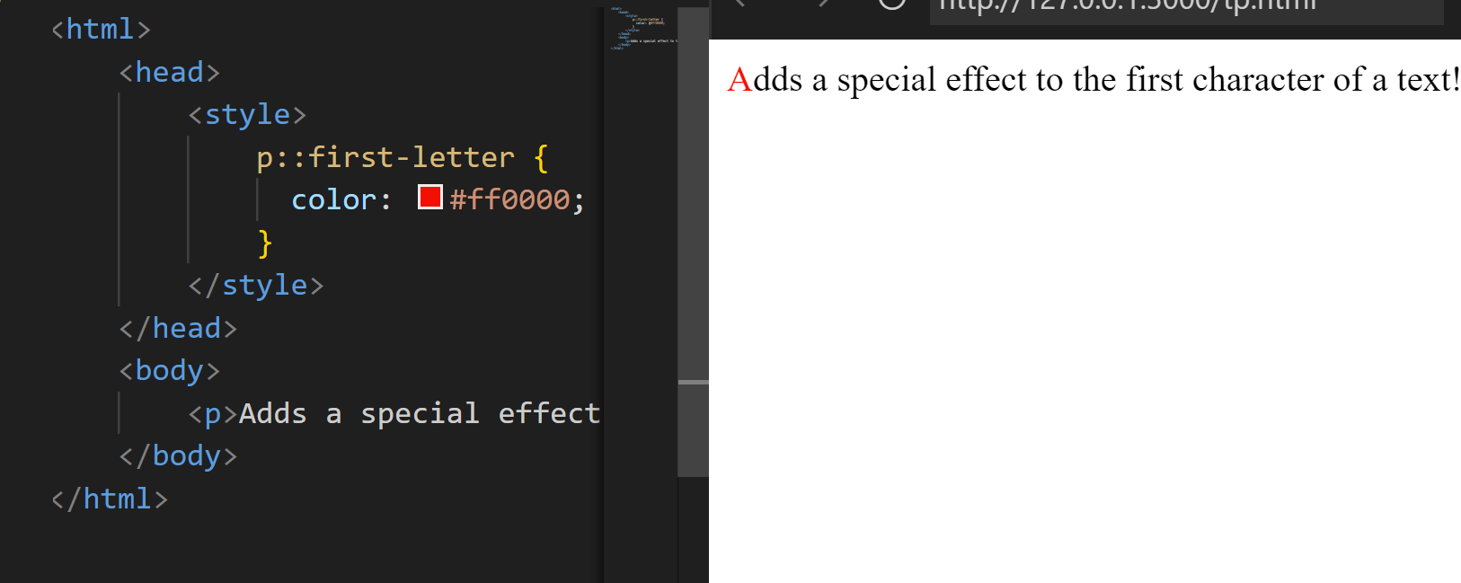
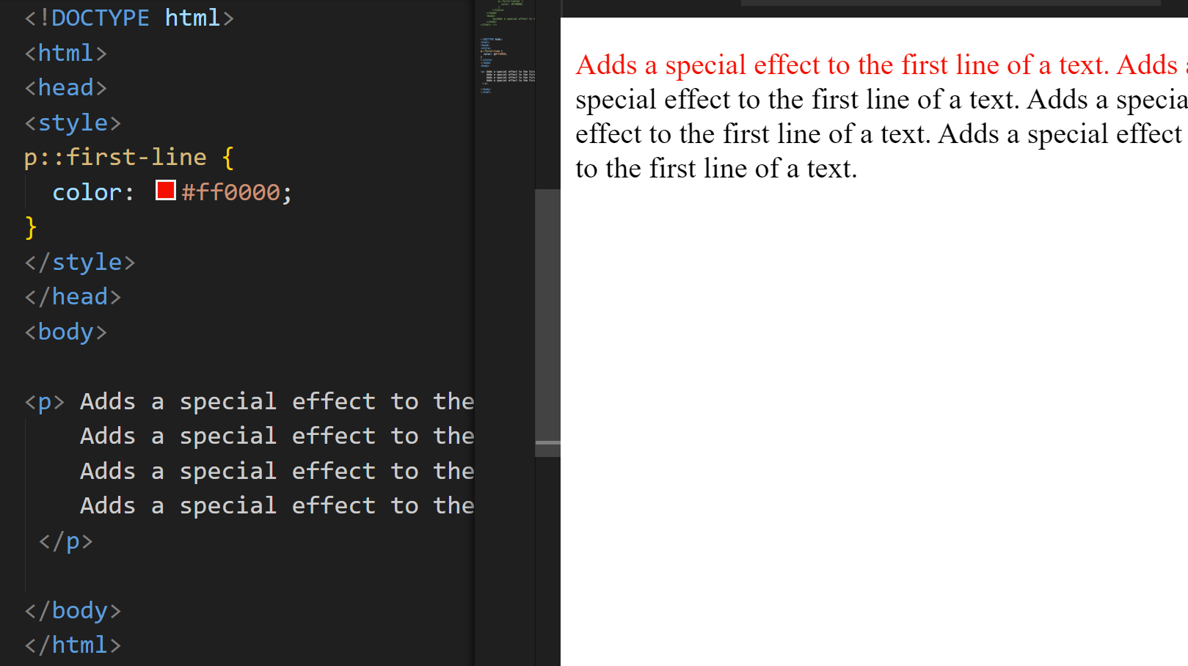
::first-letter and ::First-line
The ::first-letter pseudo-element is used to add a special style to the first letter of a text.
Example:
p::first-letter {
color: #ff0000;}
The ::first-line pseudo-element is used to add a special style to the first line of a text.
Example:
p::first-line {
color: #ff0000;}

Slide 9
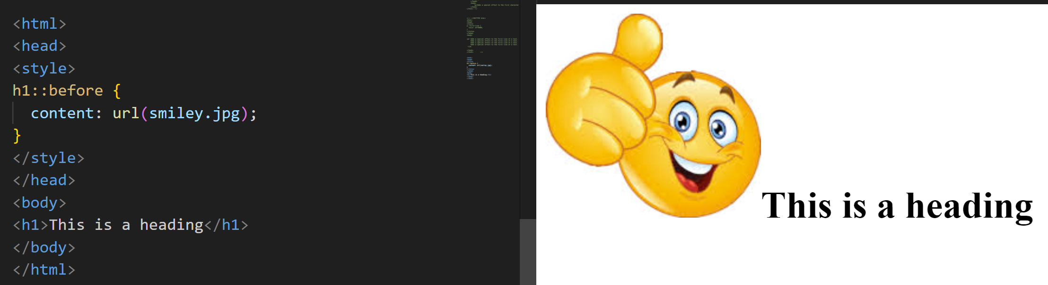
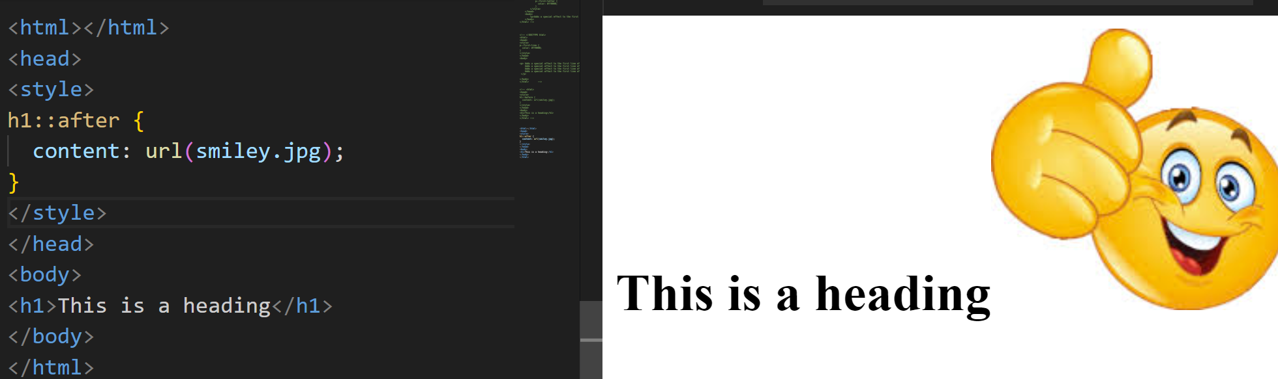
::before and :: after
The ::before pseudo-element can be used to insert some content before the content of an element.
Example:
h1::before {
content: url(smiley.jpg);
}
The ::after pseudo-element can be used to insert some content after the content of an element.
Example:
h1::before {
content: url(smiley.jpg);
}

Slide 10
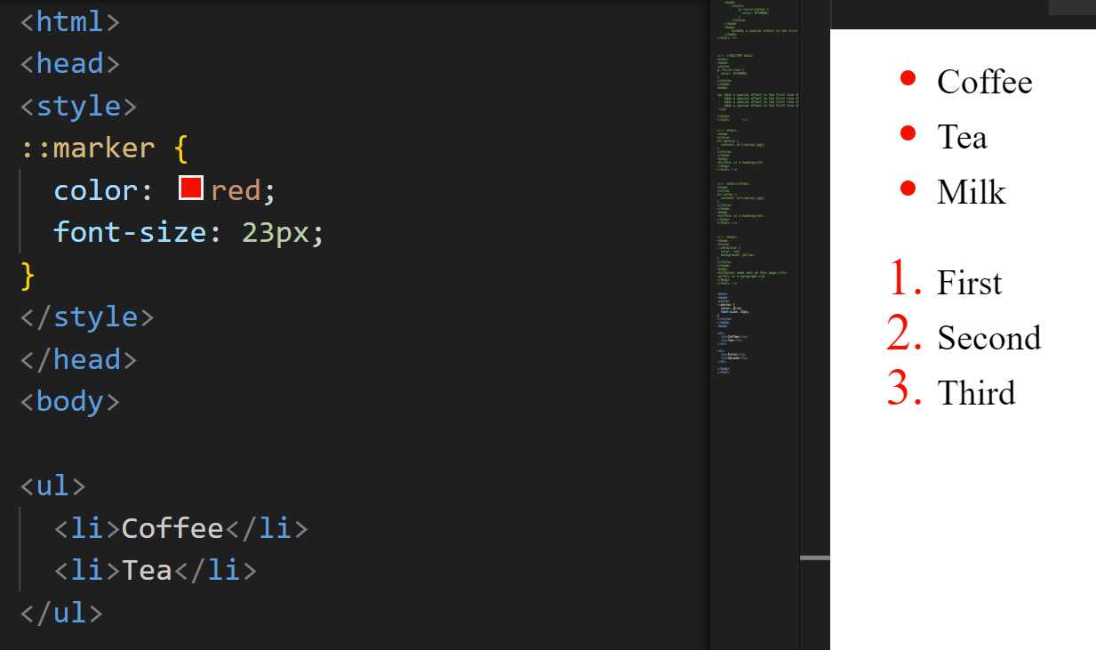
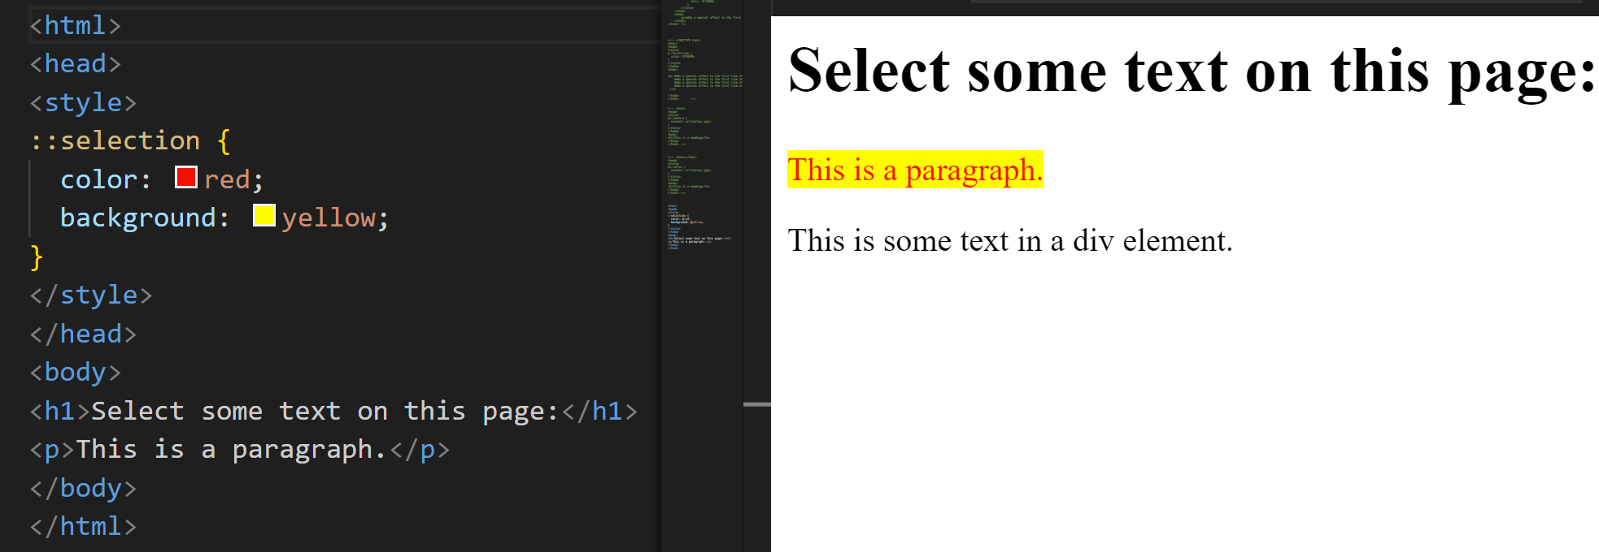
::marker and ::selection
::marker pseudo-element selects the markers of list items.
Example:
::marker {
color: red;}
::selection pseudo-element matches the portion of an element that is selected by a user.
Example:
::selection {
color: red;
background: yellow;}

Slide 11
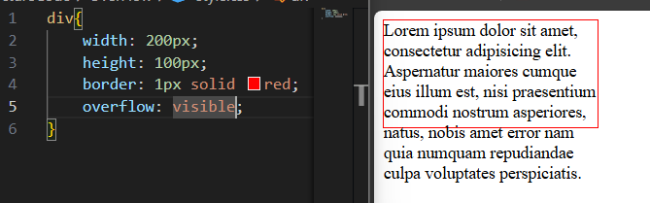
Text designing
Overflow
The overflow property in CSS controls what happens to content that overflows an element’s box.
visible: The overflow is not clipped. It renders outside the element’s box. This is the default value.

Slide 12
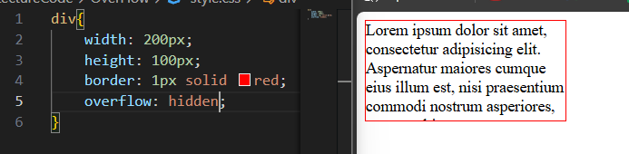
overflow
hidden: The overflow is clipped, and the rest of the content will be invisible.

Slide 13
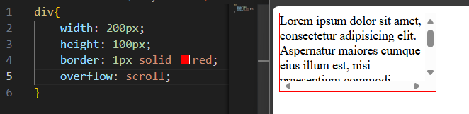
overflow
scroll: The overflow is clipped, but a scrollbar is added to see the rest of the content.

Slide 14
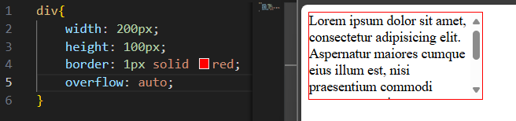
overflow
auto: Similar to scroll, but scrollbars are added only if the content overflows.

Slide 15
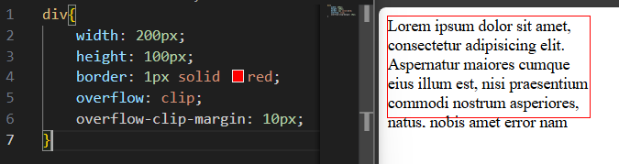
overflow
clip: The overflow is clipped, and the rest of the content will be invisible.

Slide 16
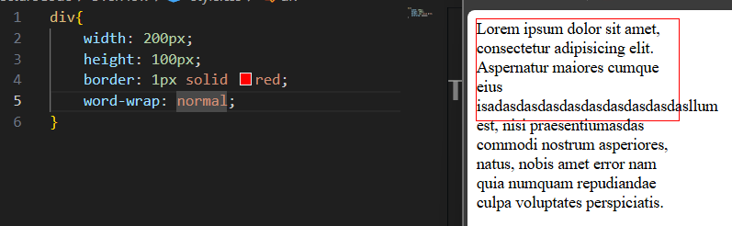
Word-wrap
To handle word wrapping in CSS, you can use the word-wrap property. This property allows long words to be broken and wrapped onto the next line, ensuring that the content fits within its container.
normal : This is the default behavior. Words will not break even if they overflow the container.

Slide 17
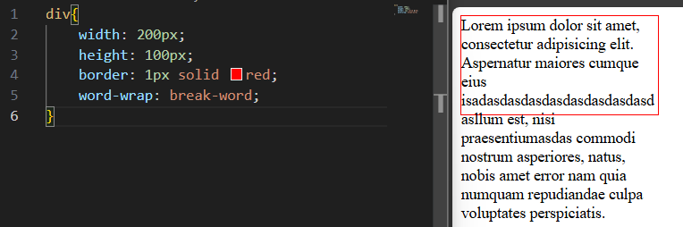
Word-wrap
break-word : Forces long words to break and wrap onto the next line, even if they would otherwise overflow the container.

Slide 18
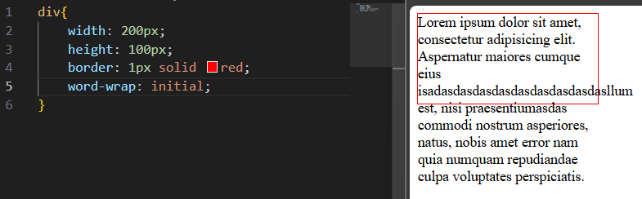
Word-wrap
initial : Resets the property to its default value (normal), meaning no forced breaks. It behaves as if no word-wrap property is applied.

Slide 19
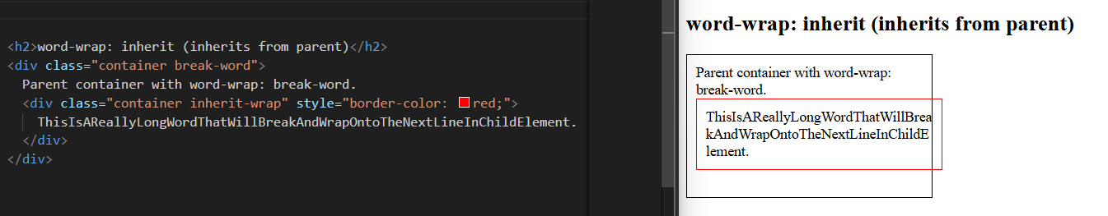
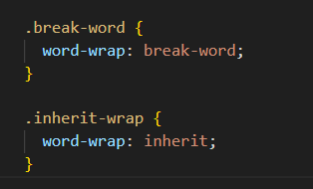
Word-wrap
Inherit : Inherits the word-wrap value from its parent element. If the parent element has a value for word-wrap, the child will use the same value.

