Slide 1

Team Details and Problem Statement
Problem Code : 4005
Domain : Agriculture
Problem Statement Title: Market-Driven Crop Planning
Team Name: Techbugs
Team Leader Name: Hrishikesh Patkar

Slide 2
Idea/Approach Details
The basic idea revolves around obtaining data-driven insights based on crop area, production, yield and harvest price, for various districts of Indian states, to optimize crop planning by farmers.
Through data analysis, we will be able to realize the crops suitable & profitable for market, region wise.
Thus, the crops to be grown can be chosen strategically, and in different combinations depending on the geographical area for climate suitability & market performance.
This analysis can be further presented through a user-friendly interface.

Slide 3
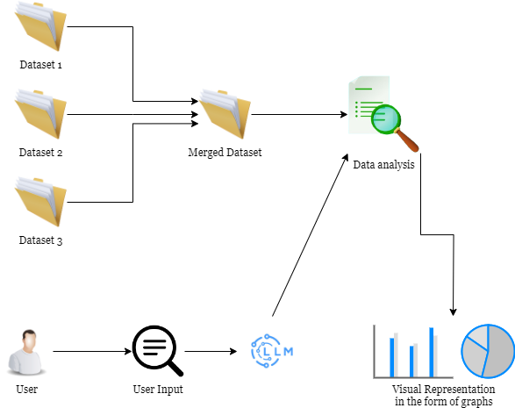
Process flow diagram

Slide 4
Methodology used
Our approach begins by collection of data from reliable sources possessing sufficient entries for data analysis.
Exploratory data analysis is performed on the dataset to analyze trends.
Based on the patterns observed, strategic crop planning patterns and crop combinations can be suggested area-wise, to increase profitability.
The graphical, visual and market performance based recommendations can finally be rendered through a user interface.
The available data is rendered based on regions to ease searching crop price and trends specific to region to identify profitable crops in the given region.

Slide 5
Use cases & description
Aiming marginalized to economically sound farmers
Agriculture department of government
Crop suppliers and retailers
Agriculture pursuing students

Slide 6

Technology stack used
Python –
Pandas
Plotly
Matplotlib
Flask
Streamlit
Langchain
Website-
React
Tailwind-css
Animation on Scroll (aos)

Slide 7
Constraints
The dataset obtained might not be very accurate.
Some areas might have been skipped, or not included in the dataset, given the extensive and diverse land and terrain in India.
For every specific district, the data is available for 50 years. With only 50 entries available, predicting the future harvest is not possible. Even if the number of years are increased, they wouldn’t be sufficient to train a machine learning model.

Slide 8
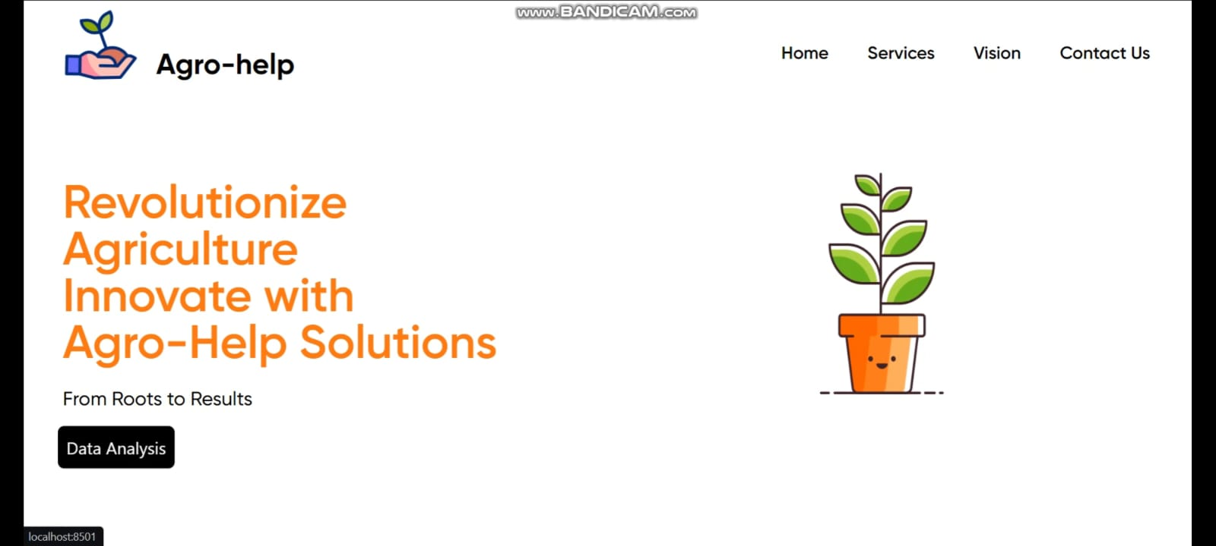
Home Page

Slide 9
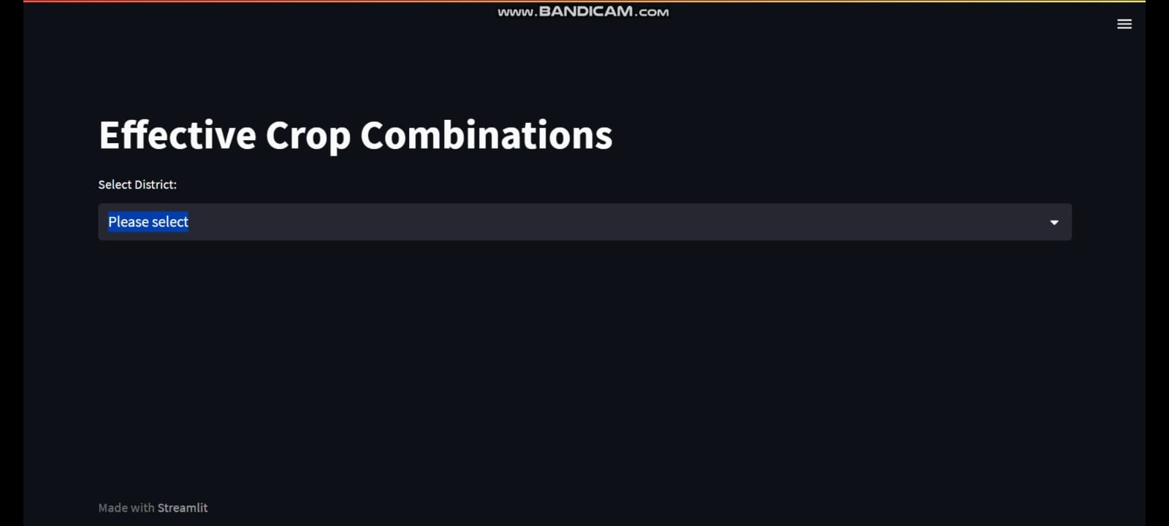
Data Analysis & Visualizations

Slide 10
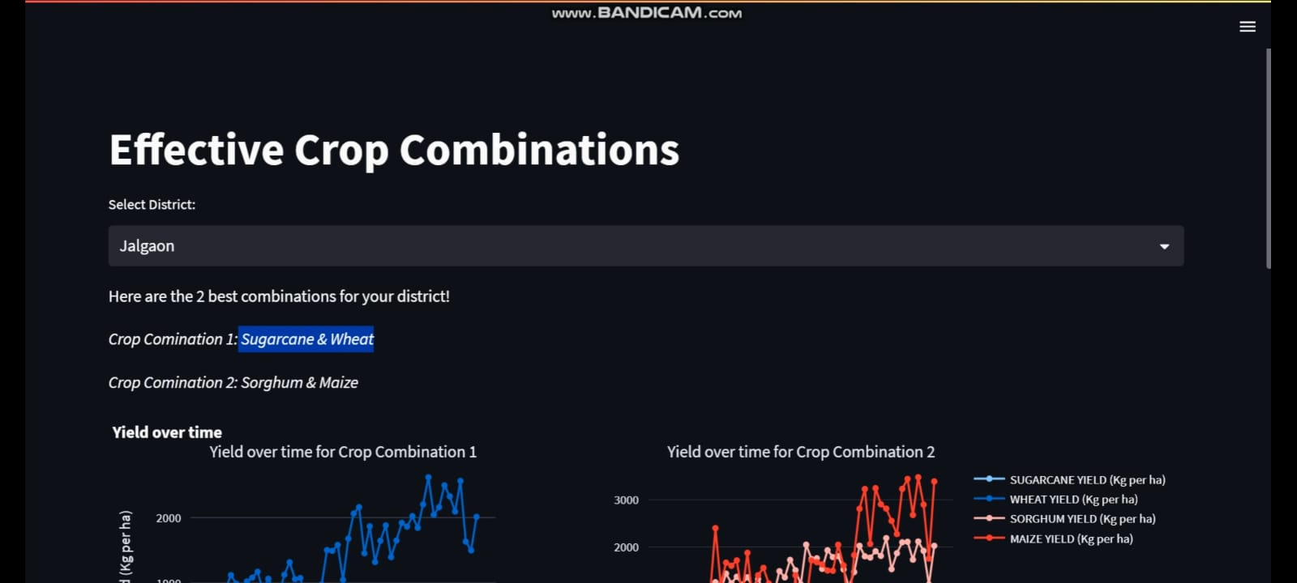

Slide 11
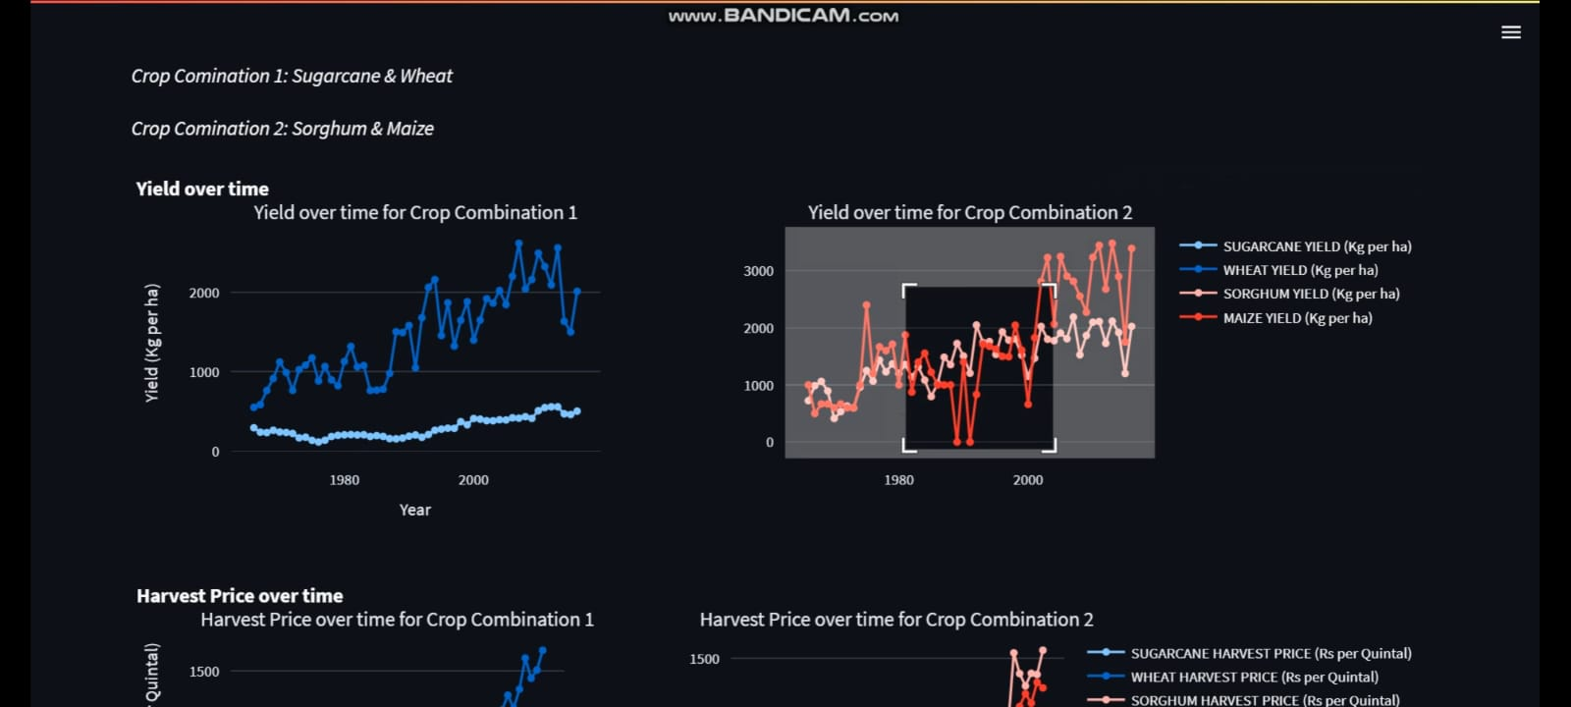

Slide 12
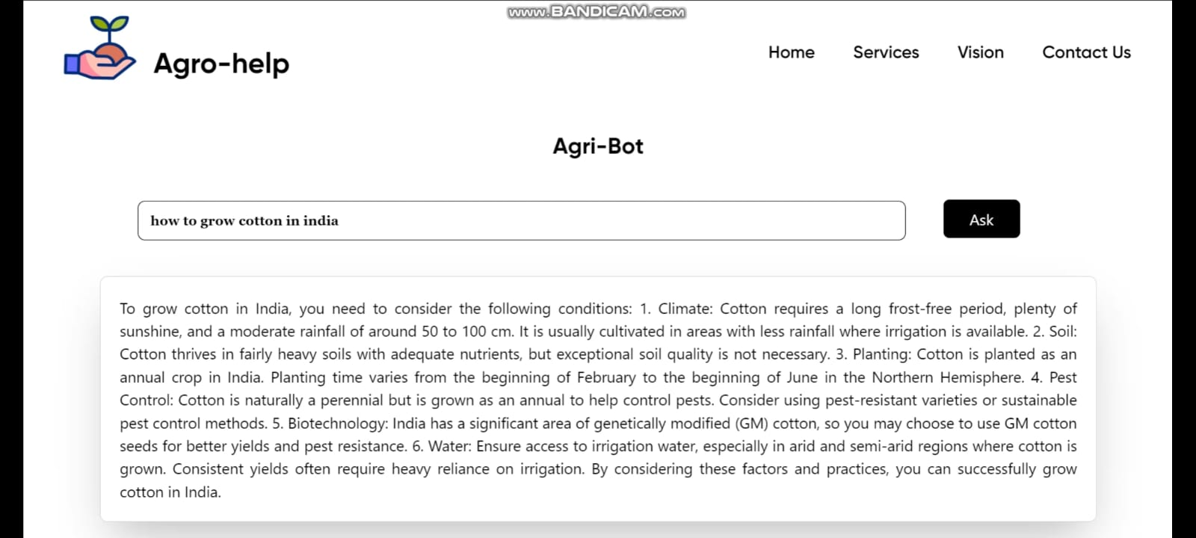

Slide 13

User Dashboard

Slide 14
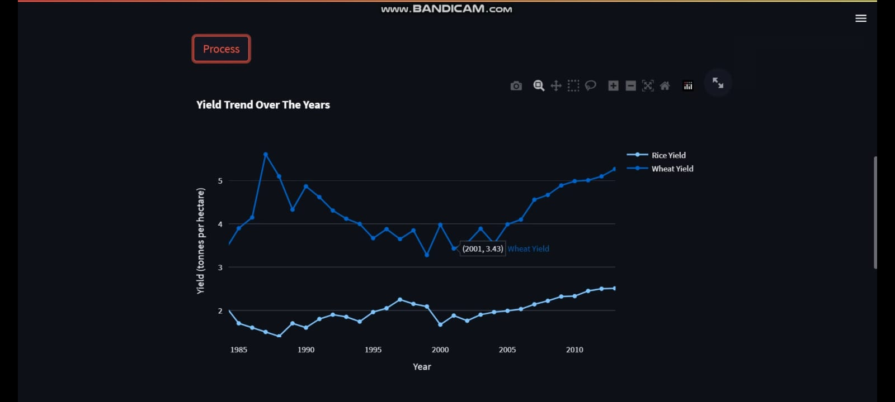

Slide 15
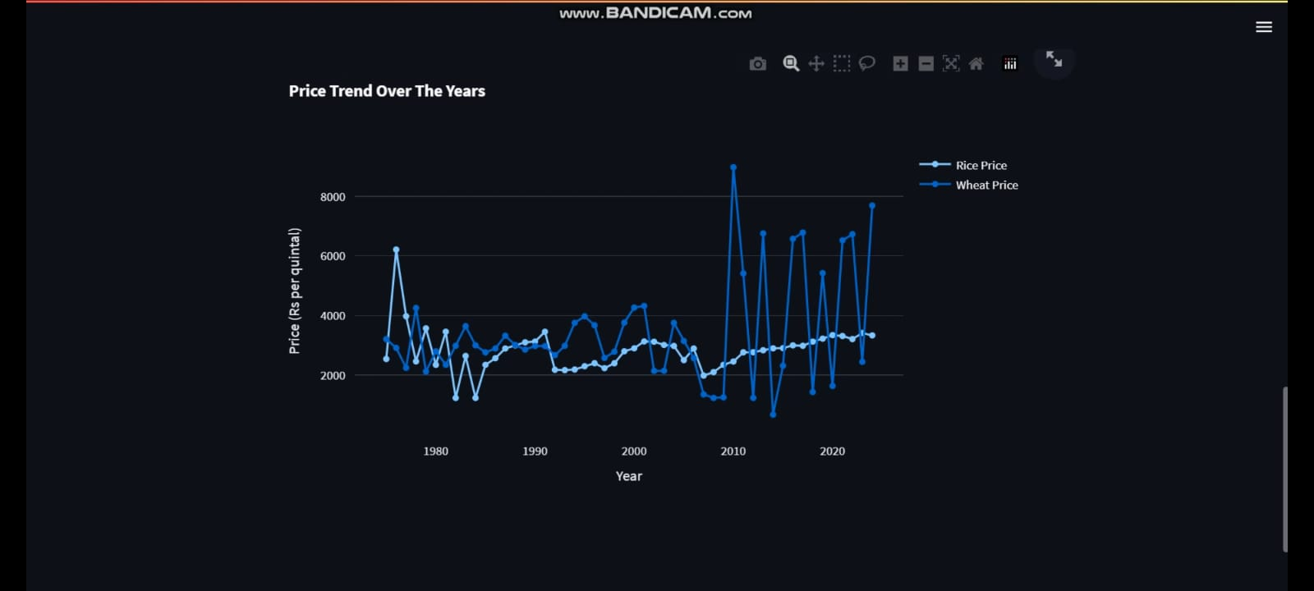

Slide 16
Thank You!

