Slide 1
AI Pipeline for Image Segmentation and Object Analysis
Overview: An end-to-end AI pipeline for segmenting images, identifying objects, extracting text, and summarizing attributes.

Slide 2
agenda
1: Image Segmentation
2: Object Extraction and Storage
3: Object Identification
4: Text/Data Extraction from Objects
5: Summarize Object Attributes
6: Data Mapping
7: Output Generation
Streamlit App Demo
Conclusion, Future Work

Slide 3
Folder Structure
models: Contains all the model scripts.
segmentation_model.py: Segmentation model implementation.
object_extraction.py: Object extraction functions.
object_identification.py: Object identification functions.
text_extraction_model.py: Text extraction functions.
summarization_model.py: Summarization functions.
2. utils: Contains utility scripts.
data_mapping.py: Data mapping functions.
visualization.py: Visualization functions.
3. streamlit_app: Contains Streamlit application code
app.py: Main application script.

Slide 4
Forlder Structure/ Dir
├── data/
│ ├── input_images/ # Directory for input images
│ ├── segmented_objects/ # Directory to save segmented object images
│ └── output/ # Directory for output images and tables
│
├── models/
│ ├── segmentation_model.py # Script for segmentation model
│ ├── identification_model.py # Script for object identification model
│ ├── text_extraction_model.py # Script for text/data extraction model
│ └── summarization_model.py # Script for summarization model
│
├── utils/
│ ├── preprocessing.py # Script for preprocessing functions
│ ├── postprocessing.py # Script for postprocessing functions
│ ├── data_mapping.py # Script for data mapping functions
│ └── visualization.py # Script for visualization functions
│
├── streamlit_app/
│ ├── app.py # Main Streamlit application script
│ └── components/ # Directory for Streamlit components
│
├── tests/
│ ├── test_segmentation.py # Tests for segmentation
│ ├── test_identification.py # Tests for identification

Slide 5
Segmentation & Extraction Process
1. Segmentation:
- Uses a pre-trained segmentation model to segment the input image.
- Converts the image into segments for further processing.
2. Object Extraction:
- Extracts objects from the segmented image.
- Saves extracted objects as separate image files.

Slide 6
Object Identification & Text Extraction
Object Identification:
- Identifies and classifies objects using a pre-trained model.
- Outputs object labels and confidence scores.
2. Text Extraction:
- Uses OCR to extract text from object images.
- Outputs the extracted text for each object.

Slide 7
Summarization, Data Mapping
1. Summarization:
- Combines object descriptions and extracted text into summaries.
- Uses text processing techniques for summarization.
2. Data Mapping:
- Maps extracted data to objects and summarizes the information.
- Saves mapped data in a JSON format for further use.

Slide 8
Flowchart of the Process
Start
Upload Image
Preprocess
Extracting Text/Object
Summarizin Attributes
Output

Slide 9
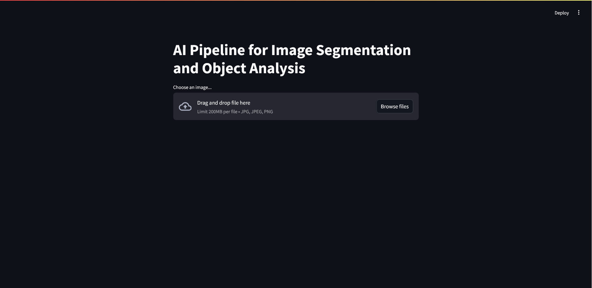
Streamlit App Demo
1. App Overview:
- Upload an image and process it through the pipeline.
- Displays segmentation, object identification, text extraction, and summaries.
2. Features:
- Interactive UI for image upload and processing.
- Visual representation of results and data.

Slide 10
Conclusion, Future Work
1. Conclusion:
- Successful integration of segmentation, object identification, text extraction, and summarization.
- Effective end-to-end pipeline demonstrated through Streamlit app.
2. Future Work:
- Enhance model accuracy and performance.
- Explore additional features like real-time processing and more advanced visualizations.

Slide 11
Thank 🙏🏻🙏🏻🙏🏻 you
Mohit A. Janbandhu
Mo. No.: 8806818081
Email ID: mohitjanbandhu44@gmail.com
LinkedIn: https://www.linkedin.com/in/mohitjanbandhu

