Slide 1
Use of genetic algorithms to evolve thresholds in a directional change approach.
Adrien Marois
Project Libre
November 2018
Notes:
<number>

Slide 2
Introduction
Market Forecasting:
“A statement about what will probably happen in a particular market, used to help make business decisions”
Market Analysis :
“The activity of gathering information about conditions that affect a marketplace.”
<number>
Notes:
In other word it mean that we try to predict the future trends in the market such as a drop or rise of the prise !
<number>

Slide 3
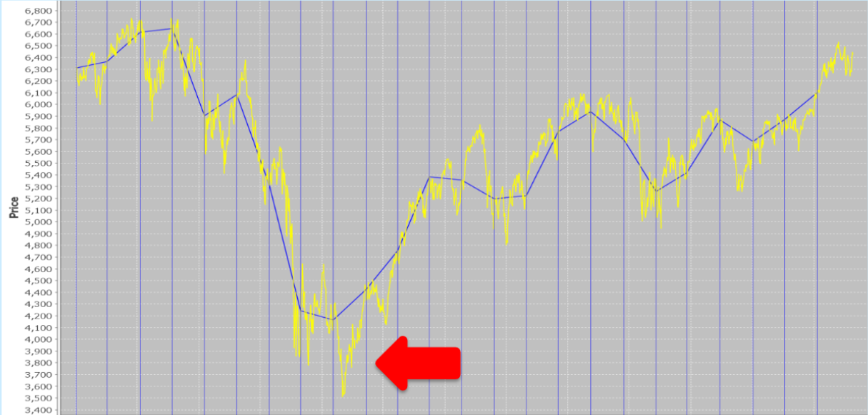
Introduction
Time Series Analysis :
Acknowledgement: Image taken from Tsang, E.P.K. (2010) publication : Directional changes, definitions Available from : http://www.essex.ac.uk/ccfea/research/WorkingPapers/2010/CCFEA%20WP050-
10.Pdf [Accessed 24 February 2018]
<number>

Slide 4
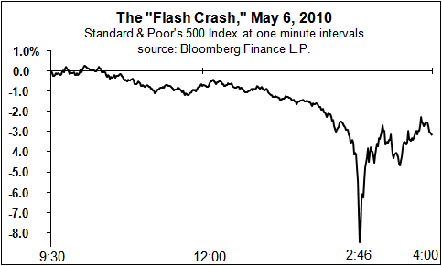
Introduction
Picture Available from : https://seekingalpha.com/article/221998-high-frequency-trading-and-the-flash-crash [Accessed 23 February 2018]
<number>

Slide 5
Directional Changes (DC)
What is Directional Changes ?
Olsen et al. (1997)
Event Based Analysis
  Creating new indicators
  New trading strategies
  Founding new law
<number>

Slide 6
Directional Changes (DC)
What is Directional Changes ?
Olsen et al. (1997)
Event Based Analysis
  Creating new indicators
  New trading strategies
  Founding new law
<number>

Slide 7
Review of DC literature
What DC is used for ?
  Analysis
    Discovered new laws (Glattfelder. et al. 2011).
    Volatility analysis (Ma. et al. 2016).
    Trading Indicators (Tsang et al. 2016).
  Trading strategy
    Improve time series based trading strategy.
    Create trading strategy based on DC (Dupuis & Olsen 2012).
    Use of evolutionary algorithm to improve DC trading strategy (Gypteau et al. 2015).
<number>

Slide 8
Original Approach
Explaine the strategy.
  Beta 1,2,3 Quantity, [Threshold 1 Weight, …, Th 5 Weight]
Evolutionary algorithm (GA)
  Individual
  CrossOver
  Mutation
Weighted thresholds
  Fix value of the thresholds
  Fix number of thresholds
Outperform Benchmarks such as buy and old and eddie
<number>

Slide 9
New Approach (extended version - 1)
Explaine the strategy.
  Beta 1,2,3 Quantity, NbThreshold, [Threshold value, … ]
  Threshold pool
Evolutionary algorithm (GA)
  Individual
  CrossOver
  Mutation
Evolving thresholds
  Evolving value of the thresholds
  Evolving number of thresholds
<number>

Slide 10
New Approach (extended version - 1)
Effecte of the number of threshold (according to the complexity of the data set).
Thresholds pool
  Value of the thresholds
  Number of thresholds
Effecte of Threshold range on the result.
  overFiting
Training the range / weighted training / evolutif training
<number>

Slide 11
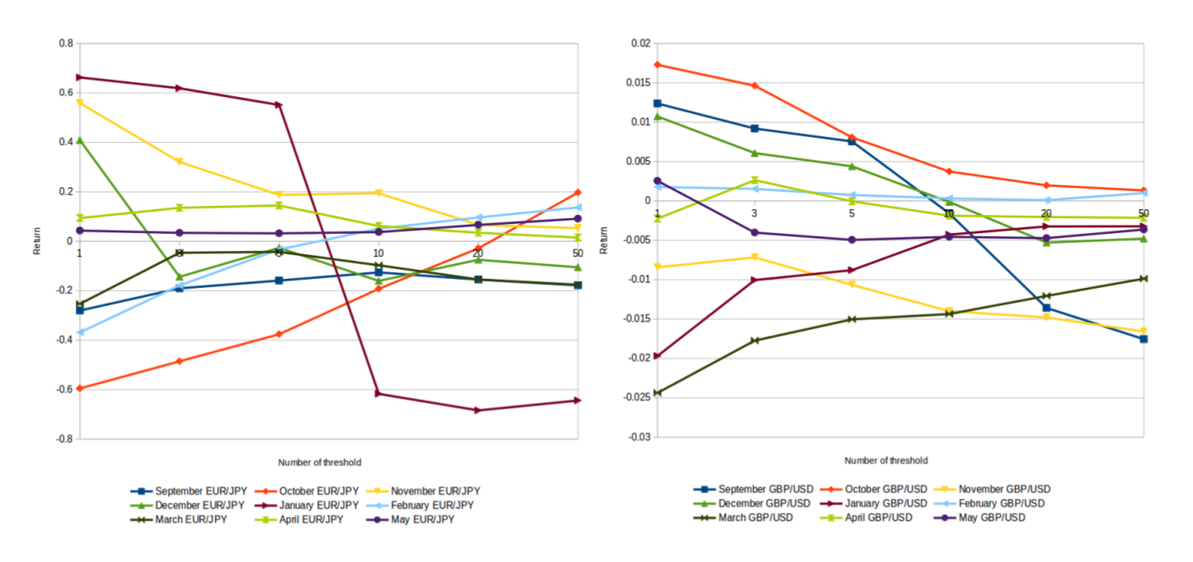

Slide 12
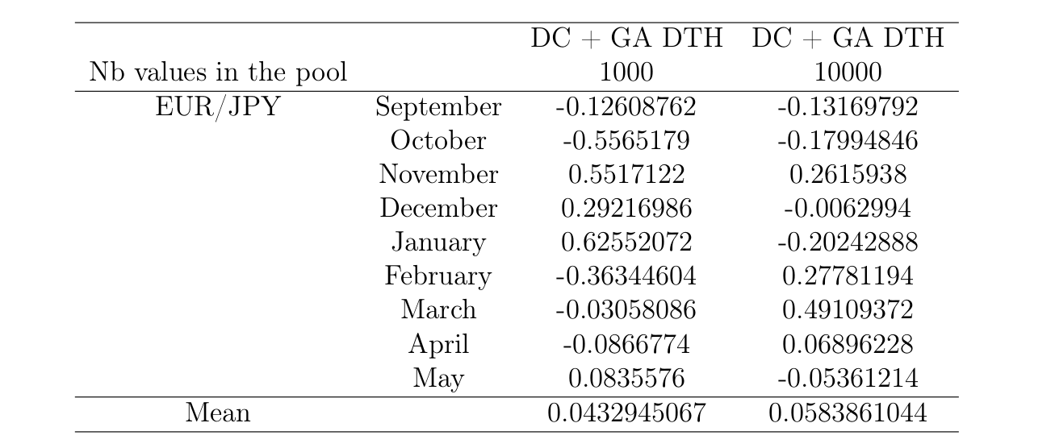

Slide 13
Objectif
Goal 1 :
Event Based IEEE CIFEr 2019 : 2019 IEEE Conference on Computational Intelligence for Financial Engineering and Economics.
Shenzhen, China, May 4-5, 2019.
Goal 2 :
Extends research on the topics, for a later publication.
<number>

Slide 14
Thank you
Q & A
<number>

