Slide 1
Template Matching
Roland Miezianko
Assignment 2
CIS 581
October 30, 2002

Slide 2
Agenda
Template Matching
  Definition and Method
  Bi-Level Image
  Gray-Level Image
Matlab Example
  Gray-Level Template Matching
  Machine Vision Example

Slide 3
Definition
Technique used in classifying objects.
Template Matching techniques compare portions of images against one another.
Sample image may be used to recognize similar objects in source image.

Slide 4
Definition, cont.
If standard deviation of the template image compared to the source image is small enough, template matching may be used.
Templates are most often used to identify printed characters, numbers, and other small, simple objects.

Slide 5
Method
I(x,y)
O(x,y)
x,y
Correlation
x,y
Template Image
Input Image
Output Image
The matching process moves the template image to all possible positions in a larger source image and computes a numerical index that indicates how well the template matches the image in that position.
Match is done on a pixel-by-pixel basis.

Slide 6
Correlation
Correlation is a measure of the degree to which two variables agree, not necessary in actual value but in general behavior.
The two variables are the corresponding pixel values in two images, template and source.

Slide 7

Bi-Level Image TM
Template is a small image, usually a bi-level image.
Find template in source image, with a Yes/No approach.
Template
Source

Slide 8
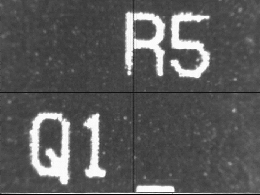

Grey-Level Image TM
When using template-matching scheme on grey-level image it is unreasonable to expect a perfect match of the grey levels.
Instead of yes/no match at each pixel, the difference in level should be used.
Template
Source Image

Slide 9
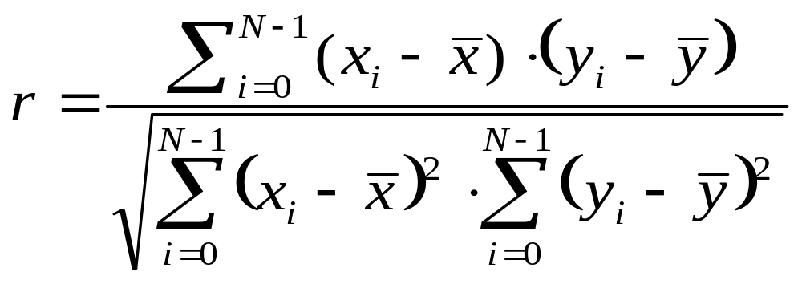
Grey-Level
Correlation Formula
x is the template gray level image
x is the average grey level in the template image
y is the source image section
y is the average grey level in the source image
N is the number of pixels in the section image (section image == template image size) columns * rows
The value r is between –1 and +1, with larger values representing a stronger relationship between the two images.

Slide 10
Correlation is Computation Intensive
Template image size: 53 x 48
Source image size: 177 x 236
Assumption: template image is inside the source image.
Correlation (search) matrix size: 124 x 188 (177-53 x 236-48)
Computation count
  124 x 188 x 53 x 48 = 59,305,728

Slide 11
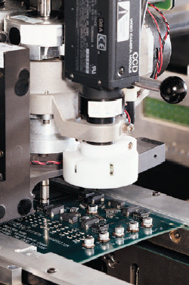
Machine Vision Example
Load printed circuit board into a machine
Teach template image (select and store)
Load printed circuit board
Capture a source image and find template

Slide 12
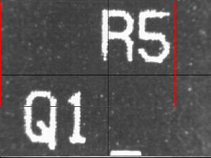
Machine Vision Example
Assumptions and Limitations
1. Template is entirely located in source image
2. Partial template matching was not performed (at boundaries, within image)
3. Rotation and scaling will cause poor matches

Slide 13
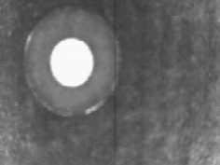
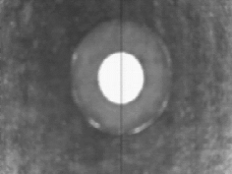

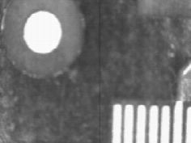
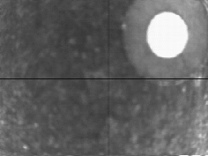
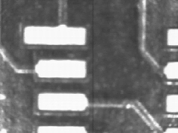
Matlab Example
Matlab Data Set
Template
Data Set 1
Data Set 2
Data Set 3
Data Set 4
Data Set 5

Slide 14
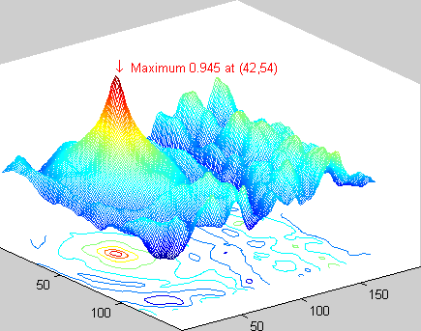
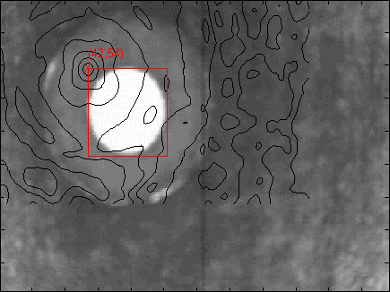
Data Set 1
Correlation Map with Peak
Source Image, Found Rectangle, and Correlation Map

Slide 15
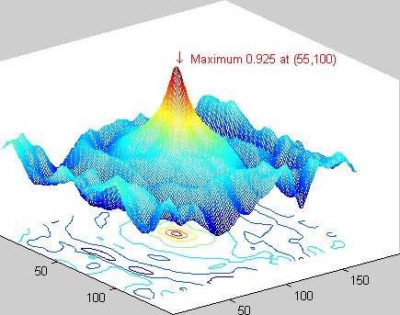
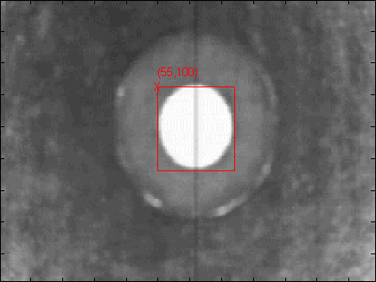
Data Set 2
Correlation Map with Peak
Source Image and Found Rectangle

Slide 16
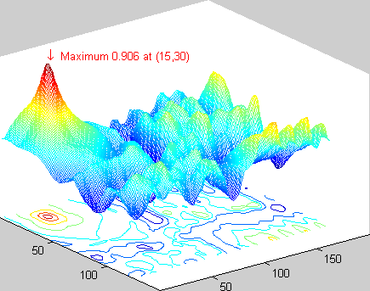
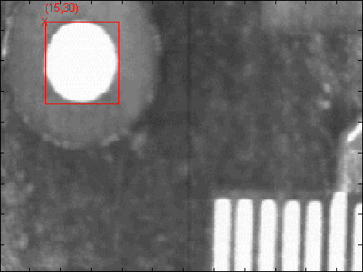
Data Set 3
Correlation Map with Peak
Source Image and Found Rectangle

Slide 17
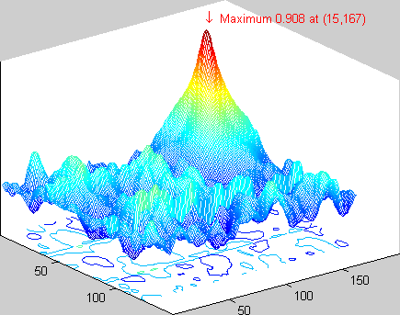
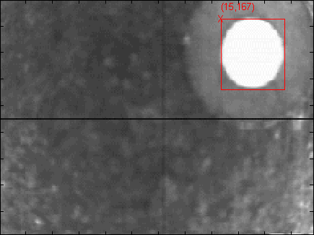
Data Set 4
Correlation Map with Peak
Source Image and Found Rectangle

Slide 18
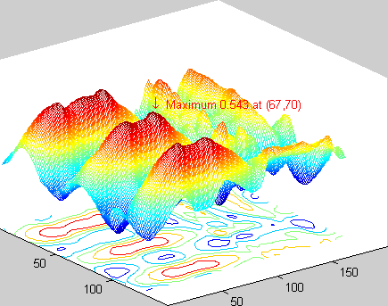
Data Set 5, Corr. Map
Correlation Map with Peak
Source Image

Slide 19
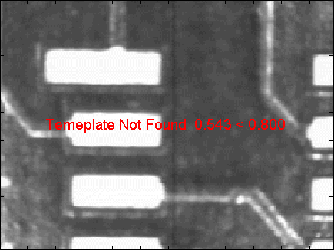
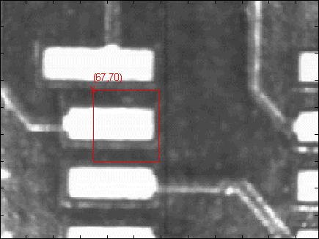
Data Set 5, Results
Threshold set to 0.800
Threshold set to 0.200

Slide 20
Matlab and Data Files
Matlab Files
hw2.m findTemplate.m hw2output.m
Data and Output Files
F06Temp.bmp F08.BMP CircleTemplate.bmp F08CorrMap.bmp F01.BMP F08CorrMap.txt
F01CorrMap.bmp F08Temp.bmp F01CorrMap.txt
PAD1.BMP F01Temp.bmp PAD1CorrMap.bmp
F01TempContour.bmp PAD1CorrMap.txt F05.BMP PAD1TempN.bmp F05CorrMap.bmp PAD1TempY.bmp
F05CorrMap.txt F05Temp.bmp F06.BMP
F06CorrMap.bmp F06CorrMap.txt

Slide 21
Questions and
Answers

