Slide 1

WORLD HAPPINESS
INDEX ANALYSIS
2024 vs 2025 | A Comparative Study
142
5.51
#1
Nations (2025)
Avg Score
Finland
Data Analytics Final Project • Power BI Dashboards • World Happiness Report (WHR) 2024 & 2025

Slide 2




PROJECT OVERVIEW
What Makes Nations Thrive?
Compare Levels
Analyze happiness scores globally across 2024 and 2025
The World Happiness Report is a landmark global survey that ranks countries by how happy their citizens perceive themselves to be.
As data analysts, we transform thousands of rows of global data into clear, actionable dashboards.
Our central questions: Does more wealth mean more happiness? Does personal freedom truly matter?
Find the "Why"
Explore how GDP, health, and freedom shape happiness
Spotlight on India
Where does India stand vs the global average?
Data to Dashboards
Turn raw datasets into powerful Power BI visuals

Slide 3


DATASET & TOOLS
GDP per Capita
Life Expectancy
Perceptions of Corruption
Measures economic output per person — the relationship between national wealth and citizen happiness.
Tracks healthy life years expected. Health is the foundational pillar of well-being.
Measures public trust in government & business. High trust consistently correlates with high happiness.
TOOLS USED
Microsoft Excel — Data cleaning, handling missing values, column formatting & structuring
Power BI — Advanced data modeling, DAX measures, interactive maps & final dashboarding

Slide 4
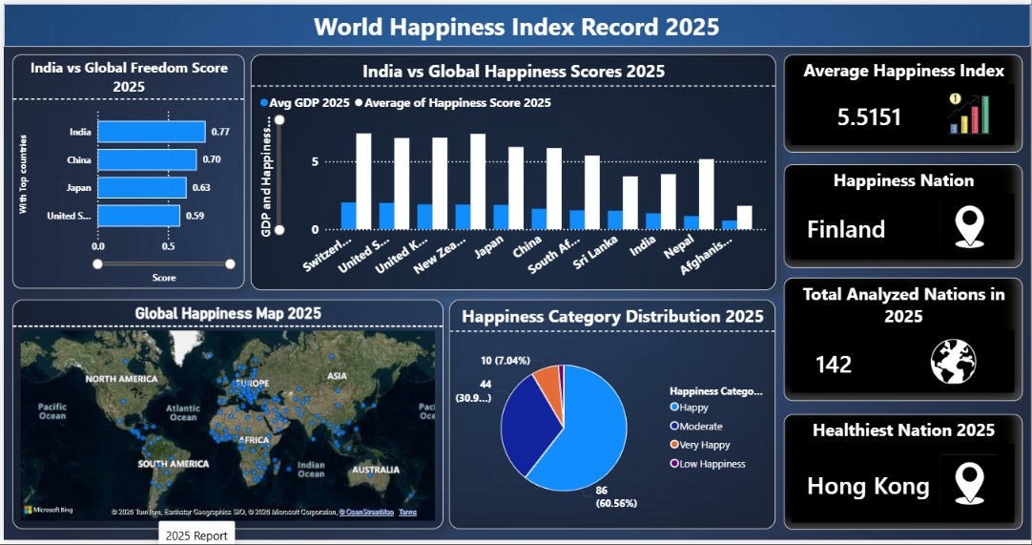
DASHBOARD 1 | 2025 WORLD HAPPINESS OVERVIEW

Slide 5
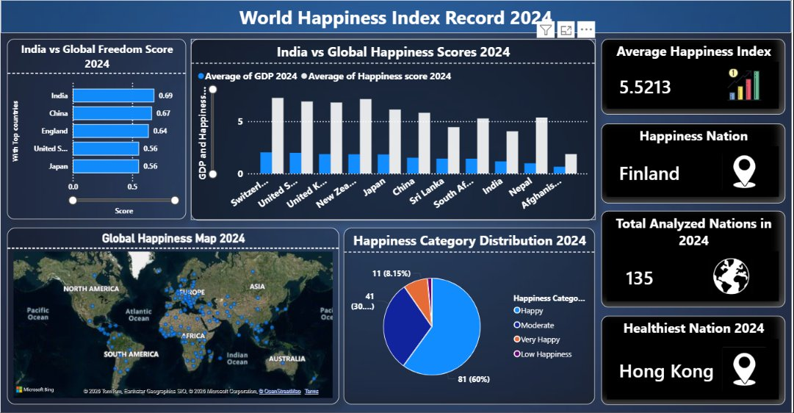
DASHBOARD 2 | 2024 WORLD HAPPINESS OVERVIEW

Slide 6
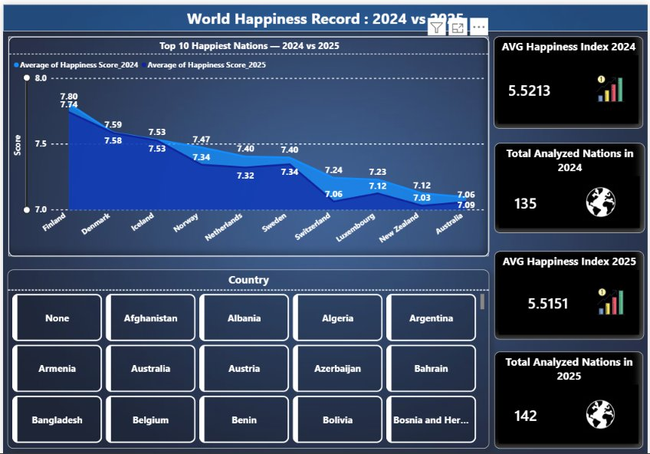
DASHBOARD 3 | 2024 vs 2025 COMPARATIVE VIEW

Slide 7

KEY FINDINGS
GDP Drives Happiness
Health is Wealth
High-income nations score 7.1 vs 3.4 for low-income countries — a direct, strong positive correlation between national wealth and citizen happiness.
The healthiest nations rank consistently in the top 10. Good healthcare and longer life expectancy are non-negotiable pillars of well-being.
Social Support as a Shield
The Corruption Tax
Countries with strong social support networks saw much smaller happiness drops during crises. Community resilience is a powerful buffer.
High corruption perception strongly drags down a nation's score. Trust in institutions is a defining hallmark of the world's happiest countries.

Slide 8

2024 vs 2025 | SCORE COMPARISON
Country / Region | 2024 Score | 2025 Score | Trend
🏆 Finland (Happiest) | 7.74 | 7.78 | ↑ Sustained Lead
🌍 Global Average | 5.52 | 5.51 | → Stable
🇮🇳 India | 4.05 | 4.12 | ↑ Improving
⚠️ Afghanistan (Lowest) | 1.72 | 1.70 | ↓ Declining
India's Upward Journey
India's freedom score rose to 0.77 in 2025 (vs 0.69 in 2024), leading among top nations in this metric. The happiness score improved from 4.05 → 4.12, closing the gap with the global average. India ranks below the global mean but shows a consistent positive trend driven by personal freedom and economic growth.

Slide 9

GDP & HAPPINESS CORRELATION
Key Finding
High-income nations average 7.1 — more than double low-income countries at 3.4
Every income tier jump adds roughly +1.2 to happiness
GDP per capita is the single strongest predictor of happiness
However, wealth alone doesn't guarantee joy — freedom & health matter equally at the top

Slide 10
FUTURE SCOPE
01
02
03
Machine Learning
Real-Time Data Integration
State-Level India Analysis
Implement predictive models (Linear Regression, Random Forest) in Python to forecast future happiness scores based on GDP and health trends.
Connect live APIs for global economic and health data, enabling Power BI dashboards to dynamically refresh with the latest figures.
Conduct a deeper, localized study across India's 28 states to uncover regional happiness patterns and socio-economic disparities.
Conclusion: Happiness is multi-dimensional. It is not just about a strong economy, but building a society with freedom, health, and deep social trust.

Slide 11
Thank You
Data Analytics Final Project • World Happiness Index 2024 & 2025
142
5.51
Finland
Hong Kong
Nations Analyzed
Avg Score 2025
Happiest Nation
Healthiest Nation

