Slide 1
Rules of Inference
Templates for constructing valid arguments
Our basic tools for establishing the truth of statements
Fallacies
common forms of incorrect reasoning which lead to invalid arguments
An argument in propositional logic is a sequence of propositions.
All but the final proposition in the argument are called
premises and the final proposition is called the conclusion.
An argument is valid if the truth of all its premises implies that the conclusion is true.

Slide 2
Continue…
An argument form in propositional logic is a sequence of compound propositions involving propositional variables.
An argument form is valid no matter which particular propositions are substituted for the propositional variables in its premises, the conclusion is true if the premises are all true.

Slide 3
Valid arguments in prepositional logic
“If you have a current password, then you can log onto the network.”
“You have a current password.”
Therefore,
“You can log onto the network.”
Argument form:
p →q
p
∴ q
where ∴ is the symbol that denotes “therefore.”

Slide 4
Argument form
p → q PREMISES
p
∴ q CONCLUSION
To determine whether this is a valid argument, determine whether the conclusion “You can log onto the
network” is true when the premises “If you have a current
password, then you can log onto the network” and “You have a current password” are both true.
“If you have a current password, then you can log onto the network.” “You have a current password.”
∴ “ You can log onto the network.”

Slide 5
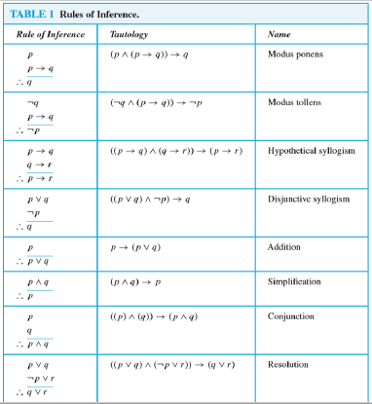
Rule of Inference

Slide 6
Example
State which rule of inference is the basis of the following argument:
“ It is below freezing now.
Therefore, it is either below freezing or raining now. ”
Let p be the proposition “It is below freezing now. ” and q be the proposition “It is raining now. ”

Slide 7
Solution
“ It is below freezing now.
Therefore, it is either below freezing or raining now. ”
Let p be the proposition “It is below freezing now. ” and q be the proposition “It is raining now. ”
Then this argument is of the form
p
∴ p V q
This is an argument that uses the addition rule

Slide 8
Example
State which rule of inference is the basis of the following argument:
“ It is below freezing and raining now. Therefore, it is below freezing now. ”

Slide 9
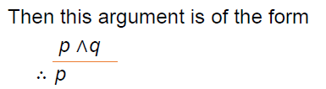
Solution
Let p be the proposition “It is below freezing now. ” and q be the proposition “It is raining now. ”
This is an argument that uses the simplification rule

Slide 10
Example
State which rule of inference is used in the argument:
“ If it rains today, then we will not have a barbeque today.
If we do not have a barbeque today, then we will have a barbecue tomorrow.
Therefore, if it rains today, then we will have a barbecue tomorrow. ”

Slide 11
Solution
Let p be the proposition “It is raining today. ”
let q be the proposition “We will not have a barbecue today.” and r be the proposition “We will have a barbecue tomorrow.”
Then the argument is of the given form:
p → q
q → r
∴ p → r
This argument is a hypothetical syllogism

Slide 12
Formal proof
Definition 2
A formal proof of a conclusion q given hypotheses p1, p2, . . . , pn is a sequence of steps, each of which applies some inference rule to hypotheses or previously proven statements (antecedents) to yield a new true statement (the consequent).
A formal proof demonstrates that if the premises are true, then the conclusion is true.

Slide 13
Using Rule of inference to build Argument
Show that the premises:
“It is not sunny this afternoon and it is colder than yesterday,” “We will go swimming only if it is sunny,”
“If we do not go swimming, then we will take a canoe trip,” and “If we take a canoe trip, then we will be home by sunset”
lead to the conclusion “We will be home by sunset.”
Let p be the proposition “It is sunny this afternoon,”
q the proposition “It is colder than yesterday,”
r the proposition “We will go swimming,”
s the proposition “We will take a canoe trip,”
and t the proposition “We will be home by sunset.”

Slide 14
Solution
“It is not sunny this afternoon and it is colder than yesterday”
￢p ∧ q
“We will go swimming only if it is sunny.” r → p
“If we do not go swimming, then we will take a canoe trip.”
￢r → s
“If we take a canoe trip, then we will be home by sunset.”
s → t
Conclusion: “We will be home by sunset.” t

Slide 15
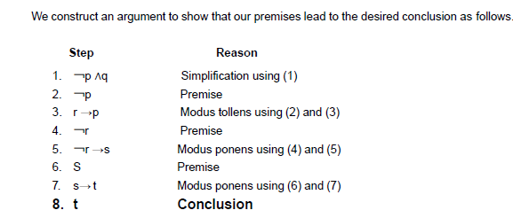
Solution
The premises become
￢p ∧ q
r → p
￢r → s
s → t
The conclusion is simply t

Slide 16
Example
Show that the premises:
“If you send me an e-mail message, then I will finish writing the program,”
“If you do not send me an e-mail message, then I will go to sleep early,” and
“If I go to sleep early, then I will wake up feeling refreshed”
lead to the conclusion “If I do not finish writing the program, then I will wake up feeling refreshed.”

Slide 17
Solution
Let p be the proposition “You send me an e-mail message,” q the proposition “I will finish writing the program,”
r the proposition “I will go to sleep early,”
and s the proposition “I will wake up feeling refreshed.”
“If you send me an e-mail message, then I will finish writing the program” p → q
“If you do not send me an e-mail message, then I will go to sleep early” ￢p → r
“If I go to sleep early, then I will wake up feeling refreshed” r → s
Conclusion: “If I do not finish writing the program, then I will wake up feeling refreshed” ￢q → s

Slide 18
Solution
The premises are
p → q
￢ p → r
r → s
The desired conclusion is ￢ q → s
We need to give a valid argument with premises p → q, ￢p → r, and r → s and conclusion ￢q → s

Slide 19
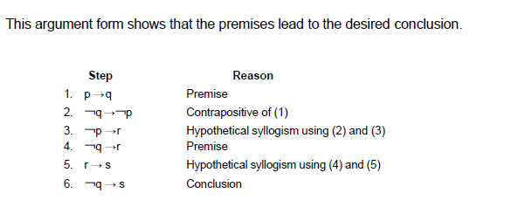
Solution

Slide 20
Resolution
A rule of inference used by many Computer programs to automate the task of reasoning and proving theorems
((p ∨ q) ∧ (￢p ∨ r)) → (q ∨ r)
The final disjunction in the resolution rule, q ∨ r, is called the resolvent.

Slide 21
Example
Show that the premises (p ∧ q) ∨ r and r → s imply the conclusion p ∨ s.
We can rewrite the premises (p ∧ q) ∨ r as two clauses using the Distributive laws:
p ∨ r and q ∨ r
We can also replace r → s using the implication equivalence
￢ r ∨ s
We can use resolution ((p ∨ q) ∧ (￢p ∨ r)) → (q ∨ r) to conclude p ∨ s.

Slide 22
Rules of Inference
)
Universal Instantiation:
This rule is used to conclude that p( c) is true when ∀xP(x) is true
Universal Generalization
This rule states that ∀xP(x) is true , P( c) is true for an arbitrary c
Existential Instantiation:
This rule allow us to conclude that there is some elements c for which p( c) is true when ∃xP(x) is true.
Existential Generalization:
This rule states that ∃xP(x) is true when for particular element c, P( c) is true,
If we know for some element c in the domain , P(c )is true; we also know that ∃xP(x) is true
.

Slide 23
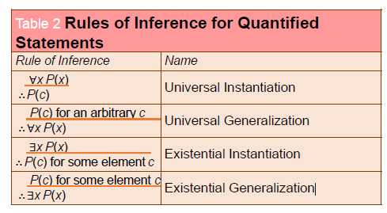
Rules of Inference for Quantified Statements

Slide 24
Example
Show that the premises
“Everyone in this discrete mathematics class has taken a course in computer science” and
“Maria is a student in this class”
imply the conclusion “Maria has taken a course in computer science.”

Slide 25
Solution
Let D(x) denote “x is in this discrete mathematics class,” and let C(x) denote “x has taken a course in computer science.” “Everyone in this discrete mathematics class has taken a course in computer science” ∀x(D(x) → C(x)) and D(Maria)

Slide 26
Example
“Maria is a student in this class”
D(Maria)
“Maria has taken a course in computer science.”
C(Maria)
Premises:
∀x(D(x) → C(x))
D(Maria)
Conclusion: C(Maria)

Slide 27
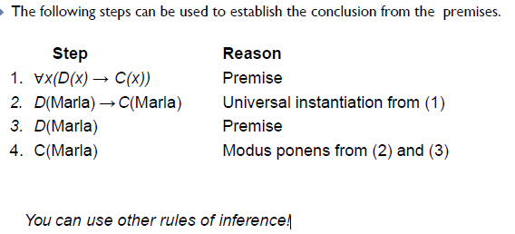
Conclusion

Slide 28
Example
Show that the premises
“A student in this class has not read the book,” and “Everyone in this class passed the first exam”
imply the conclusion “Someone who passed the first exam has not read the book.”

Slide 29
Solution
Let C(x) be “x is in this class,”
B(x) be “x has read the book,” and P(x) be “x passed the first exam.”
“A student in this class has not read the book.”
∃x(C(x)∧￢B(x))
“Everyone in this class passed the first exam” ∀x(C(x) → P(x))
Conclusion: “Someone who passed the first exam has not read the book.”
∃x(P(x)∧￢B(x))

Slide 30
Solution
Premises:
∃x(C(x)∧￢B(x))
∀x(C(x) → P(x))
Conclusion:
∃x(P(x)∧￢B(x))

Slide 31
Solution
Step | Reason
∃x(C(x)∧￢B(x)) | Premise
C(a)∧￢B(a) | Existential instantiation from 1
C(a) | Simplification from 2
∀x(C(x) → P(x)) | Premise
C(a) → P(a) | Universal instantiation from 4
P(a) | Modus ponens from 3 and 5
￢B(a) | Simplification form 2
P(a)∧￢B(a) | Conjunction from 6 and 7
∃x(P(x)∧￢B(x)) | Existential generalization form 8

Slide 32
Combining Rules of Inference for Propositions and Quantified Statements
Universal Modus Ponens
∀x(P(x) → Q(x))
P(a), where a is a particular element in the domain
∴ Q(a)
Universal Modus Tollens
∀x(P(x) → Q(x))
¬Q(a), where a is a particular element in the domain
∴ ¬P(a)

Slide 33
LECTURE # 4
EXAMPLE
  An interesting teacher keeps me awake.
  I stay awake in Calculus class.
  Therefore, my Calculus teacher is interesting.
  Is the above argument valid?
  Now we define what is an argument.
ARGUMENT
  An argument is a list of statements called premises (or assumptions or hypotheses) followed by a statement called the conclusion.
        P₁ Premise
        P₂ Premise
        P₃ Premise
        . . . . .. . . . .
        P_{n} Premise
        ______________
        C Conclusion
  NOTE The symbol ∴ read “therefore,” is normally placed just before the conclusion.
  But not always ,sometimes we use thus, so etc instead of therefore.

Slide 34
VALID AND INVALID ARGUMENT
  An argument is valid if the conclusion is true when all the premises are true.
  Alternatively, an argument is valid if conjunction of its premises imply conclusion.
  That is (P₁∧ P₂ ∧ P₃ ∧ . . . ∧ P_{n}) → C is a tautology.
  An argument is invalid if the conclusion is false when all the premises are true.
  Alternatively, an argument is invalid if conjunction of its premises does not imply conclusion.
REMARK:
A valid argument may have true premises and a true conclusion, or false premises and a false conclusion, or false premises and a true conclusion but it cannot have all true premises and yet a false conclusion.
It is not part of logic to determine the truth or falsity of the premises of arguments.
Arguments should never be described as true or false; and statements should never be described as valid or invalid.

Slide 35
EXAMPLE
  Show that the following argument form is valid:
  p → q
  p
  ∴ q
  SOLUTION
        We will construct the truth table for premise and the conclusion.
        Now first row is such that both the premises have truth value T and hence that row is the critical row and the conclusion also have truth value T so the argument is valid.
p | q | p→q | p | q
T | T | T | T | T
T | F | F | T | F
F | T | T | F | T
F | F | T | F | F
EXERCISE
Show that the following argument form is invalid:
p→q
q
∴ p
SOLUTION
First of all we will construct the truth table for premises and conclusion.

Slide 36
p | q | p→q | q | p
T | T | T | T | T
T | F | F | F | T
F | T | T | T | F
F | F | T | F | F
  Now in the above table first and third rows are critical because both of our premises are true in these rows. But the argument is invalid because in the third row our conclusion is false.
EXAMPLE
  Use truth table to determine the argument form
  p ∨ q
  p → ~q
  p → r
  ∴ r is valid or invalid.
  SOLUTION:First of all note that in our argument there are three statements are involved namely p , q and r , and we have three premises so our table will have eight rows (means as there are 3 variables, so total no of combinations are 8) and seven columns (note these seven columns does not have the column for ~q). Now the truth table for the arguments and conclusion is given below

Slide 37
In the above table we note that there are three critical rows and conclusion
It has truth value F against one critical row(which is 6th row) consequently our argument is invalid.
p | q | r | p∨q | p→~q | p→r | r
T | T | T | T | F | T | T
T | T | F | T | F | F | F
T | F | T | T | T | T | T
T | F | F | T | T | F | F
F | T | T | T | T | T | T
F | T | F | T | T | T | F
F | F | T | F | T | T | T
F | F | F | F | T | T | F

Slide 38
Word Problem
If Tariq is not on team A, then Hameed is on team B.
If Hameed is not on team B, then Tariq is on team A.
    Tariq is not on team A or Hameed is not on team B.
SOLUTION
Let
t = Tariq is on team A
h = Hameed is on team B
Then the argument is
        ~ t → h
        ~ h → t
        ∴ ~ t ∨ ~ h

Slide 39
t | h | ~t → h | ~h → t | ~t ∨~h
T | T | T | T | F
T | F | T | T | T
F | T | T | T | T
F | F | F | F | T
Argument is invalid. Because there are three critical rows ( Remember that the critical rows are those rows where the premises have truth value T) and in the first critical row conclusion has truth value F. (Also remember that we say an argument is valid if in all critical rows conclusion has truth value T)

Slide 40
Exercise
  If at least one of these two numbers is divisible by 6, then the product of these two numbers is divisible by 6.
  Neither of these two numbers is divisible by 6.
  The product of these two numbers is not divisible by 6.
  SOLUTION
  Let d = at least one of these two numbers is divisible by 6.
  p = product of these two numbers is divisible by 6.
  Then the argument become in these symbols
  d → p
  ~ d
  ∴ ~ p
  We will made the truth table for premises and conclusion as given below

Slide 41
d | p | d → p | ~d | ~p
T | T | T | F | F
T | F | F | F | T
F | T | T | T | F
F | F | T | T | T
The Argument is invalid
EXERCISE
  If I got an Eid bonus, I’ll buy a stereo.
  If I sell my motorcycle, I’ll buy a stereo.
  If I get an Eid bonus or I sell my motorcycle, then I’ll buy a stereo.
  SOLUTION:
  Let e = I got an Eid bonus
  s = I’ll buy a stereo
  m = I sell my motorcycle
  The argument is
  e → s
  m → s
  ∴e ∨ m → s

Slide 42
e | s | m | e →s | m →s | e∨m | e∨m →s
T | T | T | T | T | T | T
T | T | F | T | T | T | T
T | F | T | F | F | T | F
T | F | F | F | T | T | F
F | T | T | T | T | T | T
F | T | F | T | T | F | T
F | F | T | T | F | T | F
F | F | F | T | T | F | T
The argument is valid. Because there are five critical rows
( Remember that the critical rows are those rows where the premises have truth value T) and in all critical row conclusion has truth value T. (Also remember that we say an argument is valid if in all critical rows conclusion has truth value T)

Slide 43
EXERCISE
  An interesting teacher keeps me awake. I stay awake in Discrete Mathematics class. Therefore, my Discrete Mathematics teacher is interesting.
  Solution:
  t: my teacher is interesting a: I stay awake
  m: I am in Discrete Mathematics class
  the argument to be tested is t → a,
  a ∧ m
  Therefore m ∧ t
t | a | m | t → a | a ∧ m | m ∧ t
T | T | T | T | T | T
T | T | F | T | F | F
T | F | T | F | F | T
T | F | F | F | F | F
F | T | T | T | T | F
F | T | F | T | F | F
F | F | T | T | F | F
F | F | F | T | F | F
Argument is not valid

