Slide 1
FUNCTION
  A function f from a set X to a set Y is a relationship between elements of X and elements of Y such that each element of X is related to a unique element of Y, and is denoted f : X →Y. The set X is called the domain of f and Y is called the co-domain of f.

Slide 2


ARROW DIAGRAM OF A FUNCTION
  NOTE
  The unique element y of Y that is related to x by f is denoted f(x) and is called f of x, or the value of f at x, or the image of x under f
  The definition of a function implies that the arrow diagram for a function f has the following two properties:
  1. Every element of X has an arrow coming out of it 2. No two elements of X has two arrows coming out of it that point to two different elements of Y.
  EXAMPLE
  Let X = {a,b,c} and Y={1,2,3,4}. Define a function f from X to Y by the arrow diagram.
f
a .
b .
c .
. 1
. 2
. 3
. 4
X
Y
You can easily note that the above diagram satisfy the two conditions of a function hence a graph of the function.
Note that f(a) = 2, f(b) = 4,and f(c) = 2

Slide 3
FUNCTIONS AND NONFUNCTIONS
Which of the arrow diagrams define functions from X = {2,4,5}
to Y = {1,2,4,6}.
a.
b.
2 .
4 .
5 .
. 1
. 2
. 4
. 6
. 1
. 2
. 4
. 6
2 .
4 .
5 .
X
Y
X
Y
The relation given in the diagram (a) is Not a function because there is no arrow coming out of of 5∈X to any element of Y.
The relation in the diagram (b) is Not a function, because there are two arrows coming out of 4∈X. i.e.,4∈X is not related to a unique element of Y.
RANGE OF A FUNCTION
  Let f: X→Y. The range of f consists of those elements of Y that are image of elements of X.
  Symbolically: Range of f = {y ∈Y| y = f(x), for some x ∈X}
  NOTE
  1. The range of a function f is always a subset of the co-domain of f.
  2. The range of f: X →Y is also called the image of X under f.
  3. When y = f(x), then x is called the pre-image of y.
  4. The set of all elements of X, that are related to some y ∈Y is called the inverse image of y.

Slide 4
EXERCISE
Determine the range of the functions f, g, h from X = {2,4,5} to
Y = {1,2,4,6} defined as:
f
1.
X
Y
2 .
4 .
5 .
. 1
. 2
. 4
. 6
2. g = {(2,6), (4,2), (5,1)}
  3. h(2) = 4, h (4) = 4, h(5) = 1
SOLUTION
1. Range of f = {1, 6} 2. Range of g = {1, 2, 6}
3. Range of h = {1, 4}
GRAPH OF A FUNCTION
  Let f be a real-valued function of a real variable. i.e. f:R →R. The graph of f is the set of all points (x,y) in the Cartesian coordinate plane with the property that x is in the domain of f and y = f(x).
EXAMPLE
We have to draw the graph of the function f given by the relation y=x² in order to draw the graph of the function we will first take some elements from the domain will see the image of them and then plot then on the graph as follows

Slide 5
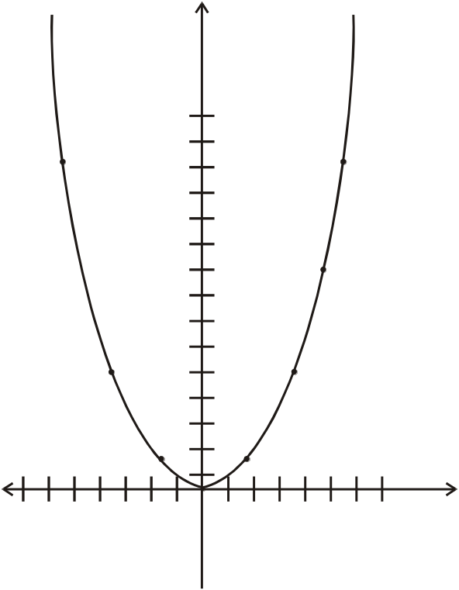
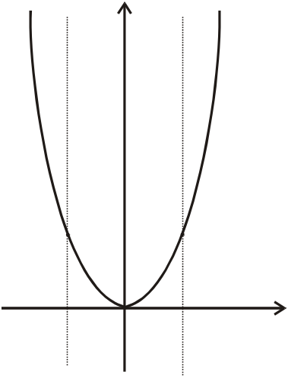
VERTICAL LINE TEST FOR THE GRAPH OF A FUNCTION
Graph of y = x²
y
y = x²
x | y=f(x)
-3 | 9
-2 | 4
-1 | 1
0 | 0
+1 | 1
+2 | 4
+3 | 9
(-3,9)
(3,9)
(x , f(x))
(-2,4)
(2,4)
(-1,1)
(1,1)
O
(o,o)
x
  For a graph to be the graph of a function, any given vertical line in its domain intersects the graph in at most one point.
  EXAMPLE:
  The graph of the relation y = x² on R defines a function by vertical line test.
y
y=x²
O
x

Slide 6
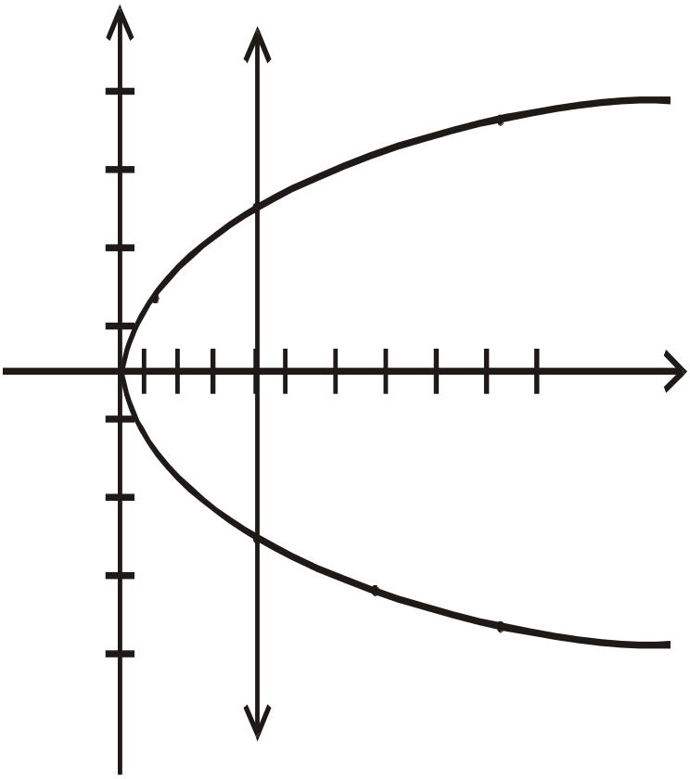

EXERCISE
  Define a binary relation P from R to R as follows:
  for all real numbers x and y (x, y) ∈ P ⇔ x = y² Is P a function? Explain.
  SOLUTION
  The graph of the relation x = y² is shown below. Since a vertical line intersects the graph at two points; the graph does not define a function.
x | Y
9 | -3
4 | -2
1 | -1
0 | 0
1 | 1
4 | 2
9 | 3
4
3
(4,2)
2
1
0
-1
1
2
3
4
5
6
7
8
9
10
x
-2
-3
(4,-2)
-4
EXERCISE
Find all functions from X = {a,b} to Y = {u,v}
SOLUTION
1.
X
Y
a
u
2.
a
u
X
Y
b
v
b
v

Slide 7
3.
4.
a
u
a
u
b
v
b
v
X
Y
X
Y
EXERCISE
  Find four binary relations from X = {a,b}to Y = {u,v}that are not functions.
  SOLUTION: The four relations are
1.
.u
2.
a.
a.
.u
b.
.v
b.
.v
X
Y
X
Y
3.
X
Y
4.
X
Y
a.
u.
a.
u.
b.
v.
b.
v.

Slide 8
EXERCISE
  How many functions are there from a set with three elements to a set with four elements.
  SOLUTION
  Let X = {x₁, x₂, x₃} and Y= {y₁, y₂, y₃,y₄}
  Then x₁ may be related to any of the four elements y₁, y₂, y₃, y₄ of Y. Hence there are 4 ways to relate x₁ in Y. Similarly x₂ may also be related to any one of the 4 elements in Y. Thus the total number of different ways to relate x₁ and x₂ to elements of Y are 4 × 4 = 16. Finally x₃ must also has its image in Y and again any one of the 4 elements y₁, or y₂ or y₃ or y₄ could be its image.
  Therefore the total number of functions from X to Y are
  4 × 4 × 4 = 4³ = 64.
EXERCISE
  Suppose A is a set with m elements and B is a set with n elements.
  How many binary relations are there from A to B?
  How many functions are there from A to B?
  What fraction of the binary relations from A to B are functions?
  SOLUTION
  Number of elements in A × B = m.n
  Therefore, number of binary relations from A to B = Number of all subsets of A × B = 2^{mn}
  Number of functions from A to B = n.n.n. … .n (m times)
  = n^{m}
  3. Fraction of binary relations that are functions = n^{m} / 2^{mn}

Slide 9
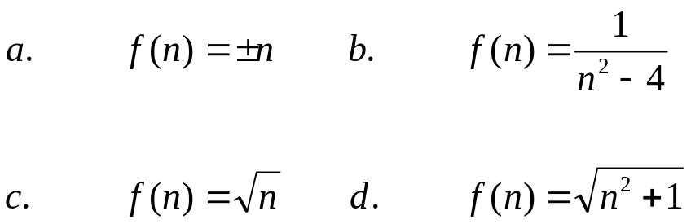

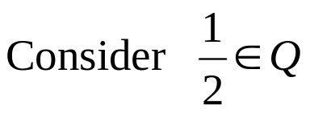
FUNCTIONS NOT WELL DEFINED
Determine whether f is a function from Z to R if
  SOLUTION
  a. f is not well defined since each integer n has two images +n and -n
  b. f is not well defined since f(2) and f(-2) are not defined.
  c. f is not defined for n < 0 since f then results in imaginary values (not real)
  d. f is well defined because each integer has unique (one and only one) image in R under f.
EXERCISE
Student C tries to define a function h : Q → Q by the rule.
for all integers m and n with n ≠ 0
  Students D claims that h is not well defined. Justify students D’s claim.
  SOLUTION:
  The function h is well defined if each rational number has a unique (one and only one) image.

Slide 10
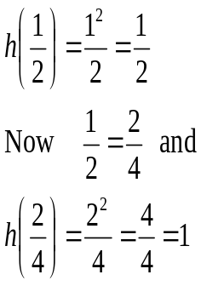
  Hence an element of Q has more than one images under h. Accordingly h is not well defined.
  REMARK:
  A function f: X → Y is well defined iff ∀ x₁, x₂ ∈X, if x₁ = x₂ then f(x₁) = f(x₂)
EXERCISE
  Let g: R→R⁺ be defined by g(x) = x² +1
  1. Show that g is well defined.
  2. Determine the domain, co-domain and range of g.
  SOLUTION
  1. g is well defined:
  Let x₁, x₂ ∈R and suppose x₁ = x₂
  ⇒ x₁² = x₂² (squaring both sides)
  ⇒ x₁² + 1 = x₂² + 1 (adding 1 on both sides)
  ⇒ g (x₁) = g(x₂) (by definition of g)
  Thus if x₁ = x₂ then g (x₁) = g(x₂). According g:R → R⁺ is well defined.

Slide 11
  2. g:R →R⁺ defined by g(x) = x² + 1.
  Domain of g = R (set of real numbers)
  Co-domain of g = R⁺ (set of positive real numbers)
  The range of g consists of those elements of R⁺ that appear as image points.
  Since x² ≥0 ∀ x ∈R
  x² + 1≥ 1 ∀ x ∈R
  i.e. g(x) = x² + 1≥ 1 ∀ x ∈R
  Hence the range of g is all real number greater than or equal to 1, i.e., the internal [1,∝)
IMAGE OF A SET
  Let f : X →Y is function and A ⊆ X.
  The image of A under f is denoted and defined as:
  f(A) = {y∈Y|y=f(x), for some x in A}
  EXAMPLE Let f: X →Y be defined by the arrow diagram
f
1
.a
Let A = {1,2}and B = {2,3} then
f(A)={b} and f(B) = {b,c} under the function defined in the Diagram then we say that image set of A is {b} and I mage set of B is {b,c}.
2
b
3
4
c
X
Y

Slide 12
INVERSE IMAGE OF A SET
  Let f: X →Y is a function and C ⊆ Y. The inverse image of C under f is denoted and defined as:
  f⁻¹(C)={x ∈X | f(x) ∈C}
  EXAMPLE
  Let f: X →Y be defined by the arrow diagram.
X
f
Y
1
a
b
Let C = {a},D = {b,c},E = {d} then
f⁻¹(C)={1,2}, f⁻¹(D) = {3,4}, and
f⁻¹(E) =∅
2
3
c
4
d
SOME RESULTS
  Let f: X →Y is a function. Let A and B be subsets of X and C and D be subsets of Y.
  1. if A⊆ B then f(A) ⊆ f(B)
  2. f(A∪B) = f(A) ∪f(B)
  3. f(A∩B) ⊆ f(A) ∩ f(B)
  4. f(A-B) ⊃ f(A) - f(B)
  5. if C ⊆ D, then f⁻¹(C) ⊆ f⁻¹(D)
  6. f⁻¹(C∪D) = f⁻¹(C) ∪ f⁻¹(D)
  7. f⁻¹(C∩D) = f⁻¹(C) ∩f⁻¹(D)
  8. f⁻¹(C-D) = f⁻¹ (C) - f⁻¹ (D)

Slide 13
BINARY OPERATIONS
  A binary operation “*” defined on a set A assigns to each ordered pair (a,b) of elements of A, a uniquely determined element a*b of A.
  That is, a binary operation takes two elements of A and maps them to a third element of A.
  EXAMPLE
  1. “+” and “.” are binary operations on the set of natural numbers N.
  2. “-” is not a binary operation on N.
  3. “-” is a binary operation on Z, the set of integers.
  “÷” is a binary operation on the set of non-zero rational numbers
  Q-{0}, but not a binary operation on Z.
BINARY OPERATION AS FUNCTION
  A binary operation “*” on a set A is a function from A * A to A.
  i.e. *: A ×A →A.
  Hence *(a,b) = c, where a, b, c ∈A.
  NOTE
  *(a,b) is more commonly written as a*b.
  EXAMPLES
  The set operations union ∪, intersection ∩ and set difference -,
  are binary operators on the power set P(A) of any set A.
  The logical connectives ∨, ∧, →, ↔ are binary operations on
  the set {T, F}

Slide 14


  3. The logic gates OR and AND are binary operations on {0,1}
A
A+B
A
A⋅B
OR
AND
B
B
A | B | A+B
1 | 1 | 1
1 | 0 | 1
0 | 1 | 1
0 | 0 | 0
A | B | A⋅B
1 | 1 | 1
1 | 0 | 0
0 | 1 | 0
0 | 0 | 0
4. The logic gate NOT is a uniary operation on {0,1}
A
A
NOT
A | A
1 | 0
0 | 1

