Slide 1


LECTURE
INJECTIVE FUNCTION or
ONE-TO-ONE FUNCTION
  Let f: X →Y be a function. f is injective or one-to-one if, and only if,
  ∀ x₁, x₂ ∈X, if x₁ ≠ x₂ then f(x₁) ≠ f(x₂) That is, f is one-to-one if it takes distinct points of the domain to distinct points of the co-domain.
f
x₁
f(x₁)
x₂
f(x₂)
X=domain of f
Y=co-domain of f
A one-to-one function separates points.
FUNCTION NOT ONE-TO-ONE
  A function f: X →Y is not one-to-one iff there exist elements x₁ and x₂ in X such that
  x₁ ≠ x₂ but f(x₁) = f(x₂)
  That is, if distinct elements x₁ and x₂ can be found in domain of f that have the same function value.

Slide 2
EXAMPLE
f
x₁
X=domain of f
f(x₁)=f(x₂)
Y=co-domain of f
x₂
A function that is not one-to-one collapses points together.
Which of the arrow diagrams define one-to-one functions?
f
g
a
1
a
1
b
2
b
2
3
3
c
4
c
4
X
Y
X
Y
  SOLUTION f is clearly one-to-one function, because no two different elements of X are mapped onto the same element of Y.
  g is not one-to-one because the elements a and c are mapped onto the same element 2 of Y.

Slide 3
ALTERNATIVE DEFINITION FOR ONE-TO-ONE FUNCTION
  A function f: X →Y is one-to-one iff
  ∀ x₁, x₂ ∈X, if x₁ ≠ x₂ then f(x₁) ≠ f(x₂)
  The equivalent contra-positive statement for this implication is
  ∀ x₁, x₂ ∈X, if f(x₁) = f(x₂), then x₁ = x₂
  REMARK
  f: X →Y is not one-to-one iff
  ∃ x₁, x₂ ∈X with f(x₁) = f(x₂) but x₁ ≠ x₂
EXAMPLE
  Define f: R →R by the rule
  f(x) = 4x - 1 for all x ∈R
  Is f one-to-one? Prove or give a counter example.
  SOLUTION:
  Let x₁, x₂ ∈R such that
  f(x₁) = f(x₂)
  ⇒ 4x₁ - 1 = 4 x₂ – 1 (by definition of f)
  ⇒ 4 x₁ = 4 x₂ (adding 1 to both sides)
  ⇒ x₁ = x₂ (dividing both sides by 4)
  Thus we have shown that if f(x₁) = f(x₂) then x₁=x₂
  Therefore, f is one-to-one

Slide 4
EXAMPLE
  Define g : Z → Z by the rule g(n)=n² for all n ∈Z
  Is g one-to-one? Prove or give a counter example.
  SOLUTION
  Let n₁, n₂ ∈Z and suppose
  g(n₁) = g(n₂)
  ⇒ n₁² = n₁² (by definition of g)
  ⇒ either n₁ = + n_{2 or} n₁ = - n₂
  Thus g(n₁) = g(n₂) does not imply n₁ = n₂ always.
  As a counter example, let n₁ = 2 and n₂ = -2. Then
  g(n₁) = g(2) = 2² = 4 and also g(n₂) = g(-2) = (-2)² = 4
  Hence g(2) = g(-2) where as 2 ≠-2 and so g is not one-to-one.
EXERCISE
  Find all one-to-one functions from X = {a,b} to Y = {u,v}
  SOLUTION
  There are two one-to-one functions from X to Y defined by the arrow diagrams.
f
g
a
u
a
u
b
v
b
X
v
Y
Y
X

Slide 5
EXERCISE
  How many one-to-one functions are there from a set with three elements to a set with four elements.
  SOLUTION
  Let X = {x₁,x₂, x₃} and Y = {y₁,y₂,y₃,y₄}
x₁.
.y₁
x₂.
.y₂
.y₃
x₃.
.y₄
X
Y
  x₁ may be mapped to any of the 4 elements of Y. Then x₂ may be mapped to any of the remaining 3 elements of Y & finally x₃ may be mapped to any of the remaining 2 elements of Y.
  Hence, total no. of one-to-one functions from X to Y are
  4 × 3 × 2 = 24(by using the product rule)
EXERCISE
  How many one-to-one functions are there from a set with three elements to a set with two elements.
  SOLUTION Let X = {x₁, x₂, x₃} and Y = {y₁, y₂}
x₁.
.y₁
x₂.
x₃.
.y₂
Y
X

Slide 6
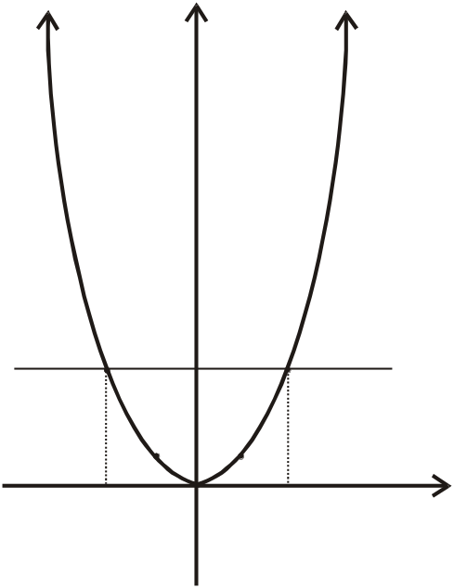
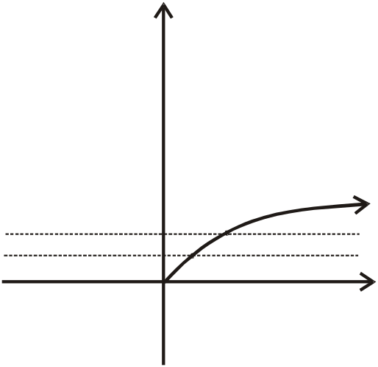

GRAPH OF ONE-TO-ONE FUNCTION
  Two elements in X could be mapped to the two elements in Y separately. But there is no new element in Y to which the third element in X could be mapped. Accordingly there is no one-to-one function from a set with three elements to a set with two elements.
  A graph of a function f is one-to-one iff every horizontal line intersects the graph in at most one point.
  EXAMPLE
y
y=x²
y
(-2,4)
(2,4)
0
x
-2
0
+2
x
ONE-TO-ONE FUNCTION
from R⁺ to R
NOT ONE-TO-ONE FUNCTION
From R to R⁺
In the first figure, if we draw every horizontal line then it intersect the graph at only one point.
In the second figure, the every horizontal line intersect the graph at two points, so it is called not one-one.
SURJECTIVE FUNCTION or
ONTO FUNCTION
  Let f: X→Y be a function. f is surjective or onto if, and only if,
  ∀ y ∈ Y, ∃ x ∈X such that f(x) = y.
  That is, f is onto if every element of its co-domain is the image of some element(s) of its domain.i.e., co-domain of f = range of f

Slide 7
FUNCTION NOT ONTO
f
.
.
.
x.
.
.
.
. y = f(x)
X=domain of f
Y=co-domain of f
Each element y in Y equals f(x) for at least one x in X.
  A function f:X→Y is not onto iff there exists y ∈Y such that
  ∀ x ∈X, f(x)≠y.
  That is, there is some element in Y that is not the image of any element in X.
f
.
.
.
.
.
.
.
X=domain of f
Y=co-domain of f

Slide 8
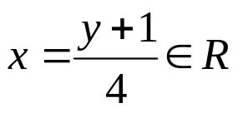
EXAMPLE
f
Which of the arrow diagrams define onto functions?
f
g
a
1
a
1
b
2
b
c
2
c
.3
d
3
X
Y
X
Y
SOLUTION f is not onto because 3 ≠ f(x) for any x in X. g is clearly onto because each element of Y equals g(x) for some x in X. 1 = g(c);,2 = g(d);3 = g(a) = g(b)
EXAMPLE
  Define f: R →R by the rule
  f(x) = 4x-1 for all x ∈R
  Is f onto? Prove or give a counter example.
  SOLUTION
  Let y ∈R. We search for an x ∈ R such that
  f(x) = y
  or 4x-1 = y (by definition of f)
  Solving it for x, we find . Hence for every y ∈R, there
  exists such that

Slide 9
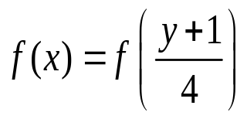
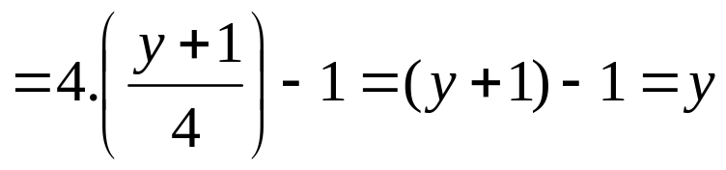
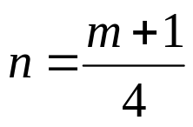
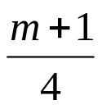
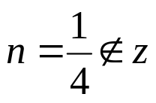
Hence f is onto.
EXAMPLE
  Define h: Z →Z by the rule
  h(n) = 4n - 1 for all n ∈ Z
  Is h onto? Prove or give a counter example.
  SOLUTION
  Let m ∈Z. We search for an n ∈Z such that h(n) = m.
  or 4n - 1 = m (by definition of h)
  Solving it for n, we find
  But is not always an integer for all m ∈Z.
  As a counter example, let m = 0∈ Z, then
  h(n) = 0
  ⇒ 4n-1 = 0
  ⇒ 4n = 1
  ⇒ .Hence there is no integer n for which h(n) = 0.
  Accordingly, h is not onto.
  Note:It shows that 0 is not the image of any integer in Z under the rule h.

Slide 10
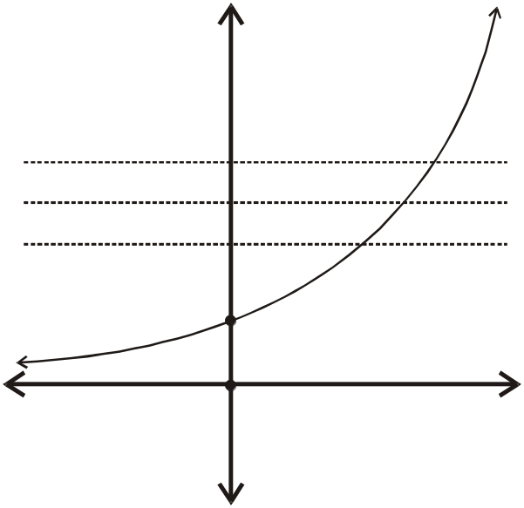
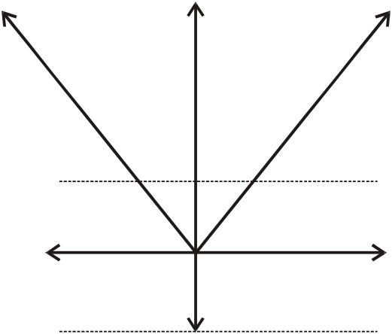
GRAPH OF ONTO FUNCTION
  A graph of a function f is onto iff every horizontal line intersects the graph in at least one point.
  EXAMPLE
y
y=e^{x}
y
y = |x|
O
x
O
x
ONTO FUNCTION
from R to R⁺
NOT ONTO FUNCTION FROM
R to R
EXERCISE
  Let X = {1,5,9} and Y = {3,4,7}.Define g: X →Y by specifying that
  g(1) = 7, g(5) = 3, g(9) = 4
  Is g one-to-one? Is g onto?
  SOLUTION
  g is one-to-one because each of the three elements of X are mapped to a different elements of Y by g.
  g(1) ≠ g(5), g(1) ≠ g(a), g(5) ≠ g(a)
  g is onto as well, because each of the three elements of co-domain Y of g is the image of some element of the domain of g.
  3 = g(5), 4 = g(9), 7 = g(1)

Slide 11
EXERCISE
  Define f: P({a,b,c})→Z as follows:
  for all A∈P ({a,b,c}), f(A)= the number of elements in A.
  a. Is f one-to-one? Justify.
  b. Is f onto? Justify.
  SOLUTION
  a. f is not one-to-one because f({a}) = 1 and f({b}) = 1 but {a}≠ {b}
  b. f is not onto because, there is no element of P({a,b,c}) that is mapped to 4 ∈Z.
EXERCISE
  Determine if each of the functions is injective or surjective.
  a. f: Z →Z⁺ define as f(x) = |x|
  b. g: Z⁺ → Z⁺ × Z⁺ defined as g(x) = (x,x+1)
  SOLUTION
  a. f is not injective, because
  f(1) = |1| = 1 and f(-1) = |-1| = 1
  i.e., f(1) = f(-1) but 1 ≠ -1
  f is onto, because for every a∈Z⁺, there exist –a and +a in Z such that
  f(-a) = |-a| = a
  and f(a) = |a| = a

Slide 12
  b. g: Z⁺ → Z⁺ × Z⁺ defined as g(x) = (x,x+1)
  Let g(x₁) = g(x₂) for x₁, x₂ ∈Z⁺
  ⇒ (x₁, x₁ +1) = (x₂, x₂+1) (by definition of g)
  ⇒ x₁ = x₂ and x₁ + 1 = x₂ + 1
  (by equality of ordered pairs)
  ⇒ x₁ = x₂
  Thus if g(x₁) = g(x₂) then x₁ = x₂
  Hence g is one-to-one.
  g is not onto because (1,1) ∈Z⁺×Z⁺ is not the image of any element of Z⁺.
  Similarly (2,2),(2,4)are not the images of any element of Z⁺ etc.
BIJECTIVE FUNCTION or
ONE-TO-ONE CORRESPONDENCE
  A function f: X→Y that is both one-to-one (injective) and onto (surjective) is called a bijective function or a one-to-one correspondence.
  EXAMPLE The function f: X→Y defined by the arrow diagram is both one-to-one and onto; hence a bijective function.
f
a
1
b
2
c
.3
X
Y

Slide 13
EXERCISE
  Let f: R →R be defined by the rule f(x) = x³.Show that f is a bijection.
  SOLUTION
  f is one-to-one
  Let f(x₁) = f(x₂) for x₁, x₂∈R
  ⇒ x₁³ = x₂³
  ⇒ x₁³ - x₂³ = 0
  ⇒ (x₁ -x₂) (x₁² + x₁x₂ + x₂²) = 0
  ⇒ x₁ - x₁ = 0 or x₁² + x₁x₂ + x₂²=0
  ⇒ x₁ = x₂ (the second equation gives no real solution)
  Accordingly f is one-to-one.
  f is onto
  Let y ∈R. We search for a x ∈R such that
  f(x)=y
  ⇒ x³ = y (by definition of f)
  or x = (y)^{1/3}
  Hence for y ∈R, there exists x = (y)^{1/3} ∈ R such that
  f(x) = f((y)^{1/3})
  = ((y)^{1/3})³ = y
  Accordingly f is onto.
  Thus, f is a bijection.

Slide 14
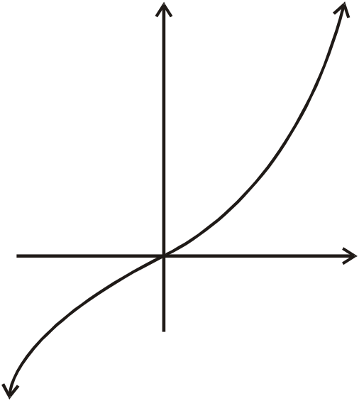
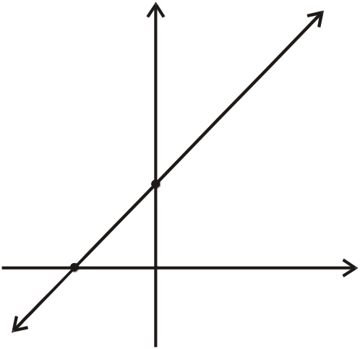
GRAPH OF BIJECTIVE FUNCTION
  A graph of a function f is bijective iff every horizontal line intersects the graph at exactly one point.
y
y=x³
y
y = x + 5
(0,5)
0
x
(5,0)
O(0,0)
BIJECTIVE FUNCTION
from R to R
BIJECTIVE FUNCTION from R to R
IDENTITY FUNCTION ON A SET
  Given a set X, define a function i_{x} from X to X by
  i_{x}(x) = x from all x ∈X
  The function i_{x} is called the identity function on X because it sends each element of X to itself.
  EXAMPLE
  Let X = {1,2,3,4}. The identity function i_{x} on X is represented by the arrow diagram
i_{x}
1
1
2
2
3
3
X
X
4
4

Slide 15
EXERCISE
  Let X be a non-empty set. Prove that the identity function on X is bijective.
  SOLUTION
  Let i_{x}: X →X be the identity function defined as i_{x}(x) = x ∀∈X
  1. i_{x} is injective (one-to-one)
  Let i_{x}(x₁) = i_{x}(x₂) for x₁, x₂ ∈X ⇒ x₁ = x₂ (by definition of i_{x}) Hence i_{x} is one-to-one.
  2. i_{x} is surjective (onto)
  Let y ∈X (co-domain of i_{x}) Then there exists y ∈X (domain of i_{x}) such that i_{x} (y) = y Hence i_{x} is onto. Thus, i_{x} being injective and surjective is bijective.
CONSTANT FUNCTION
  A function f:X→Y is a constant function if it maps (sends) all elements of X to one element of Y. i.e. ∀ x ∈X, f(x) = c, for some c ∈ Y
  EXAMPLE The function f defined by the arrow diagram is constant.
f
X
Y
1
2
.7
3
.8
4
.9

Slide 16
  REMARK
  1. A constant function is one-to-one iff its domain is a singleton.
  2. A constant function is onto iff its co-domain is a singleton.
f
X
Y
a
1
Now the above function f which is a constant function, also called a
bijective function.

