Slide 1
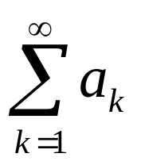
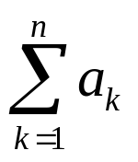
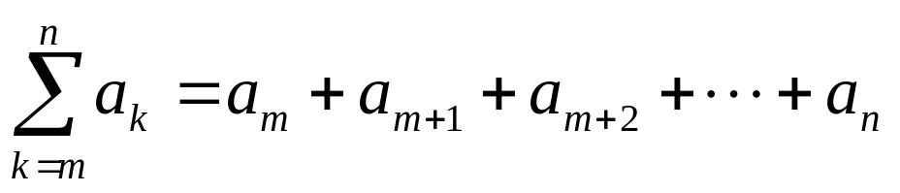
SERIES
  The sum of the terms of a sequence forms a series. If
  a₁, a₂, a₃, …
  represent a sequence of numbers, then the corresponding series is
  a₁ + a₂ + a₃ + …
=
SUMMATION NOTATION
  The capital Greek letter sigma ∑ is used to write a sum in a short hand notation.
  where k varies from 1 to n represents the sum given in expanded form by
  = a₁ + a₂ + a₃ + … + a_{n}
  More generally if m and n are integers and m ≤ n, then the summation from k equal m to n of a_{k} is
  Here k is called the index of the summation; m the lower limit of the summation and n the upper limit of the summation.

Slide 2
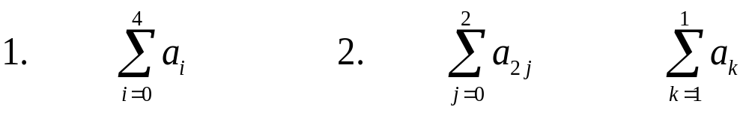
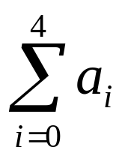
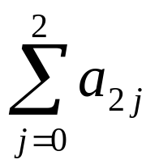
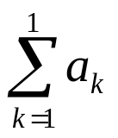
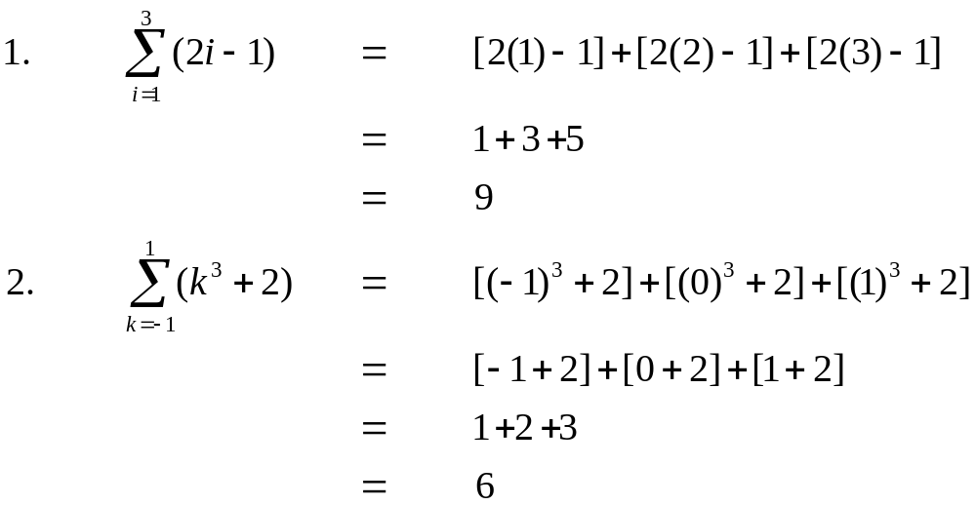
COMPUTING SUMMATIONS
  Let a₀ = 2, a₁ = 3, a₂ = -2, a₃ = 1 and a₄ = 0. Compute each of the summations:
  SOLUTION
  1. = a₀ + a₁ + a₂ + a₃ + a₄
  = 2 + 3 + (-2) + 1 + 0 = 4
  2. = a₀ + a₂ + a₄
  = 2 + (-2) + 0 = 0
  3. = a₁
  = 3
EXERCISE
  Compute the summations

Slide 3
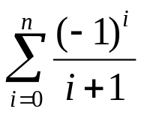
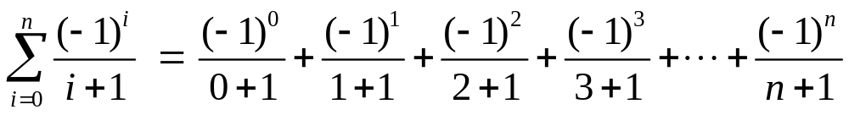
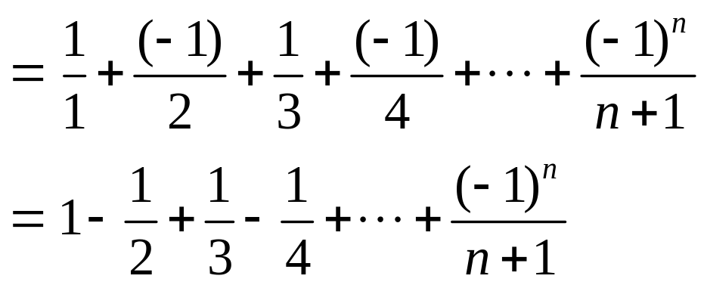
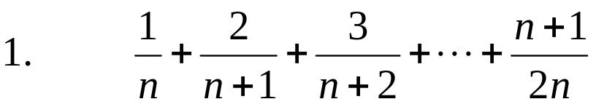
SUMMATION NOTATION TO EXPANDED FORM
  Write the summation to expanded form:
  SOLUTION
EXPANDED FORM TO SUMMATION NOTATION
  Write the following using summation notation:
  SOLUTION
  We find the kth term of the series.
  The numerators forms an arithmetic sequence 1, 2, 3,…, n+1, in which
  a = first term = 1
  & d = common difference = 1
  ∴ a_{k} = a + (k - 1)d
  = 1 + (k - 1) (1) = 1 + k - 1 = k

Slide 4
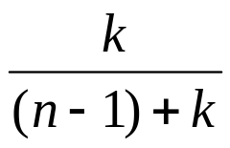
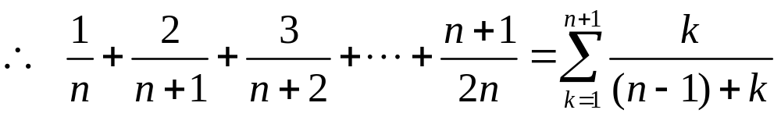
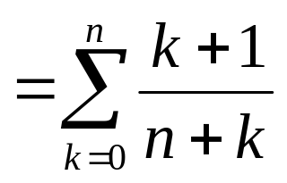
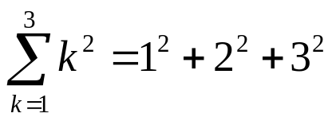
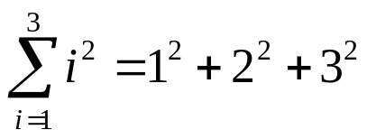
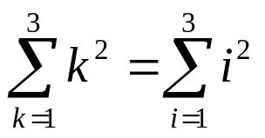
  Similarly, the denominators forms an arithmetic sequence
  n, n+1, n+2, …, 2n, in which
  a = first term = n
  d = common difference = 1
  ∴ a_{k} = a + (k - 1) d
  = n + (k - 1) (1)
  = k + n - 1
  Hence the kth term of the series is
  And the expression for the series is given by
TRANSFORMING A SUM BY A CHANGE OF VARIABLE
Consider
and
Hence

Slide 5
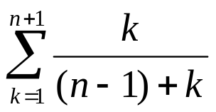
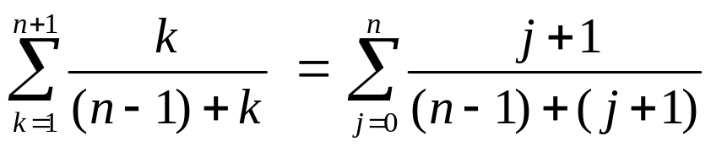
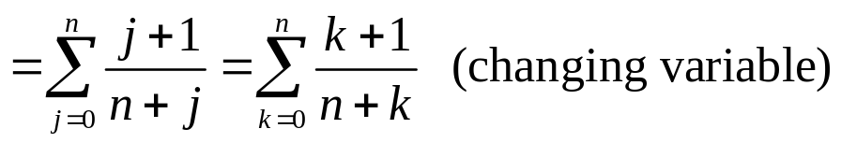
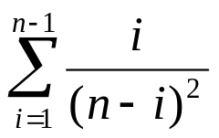
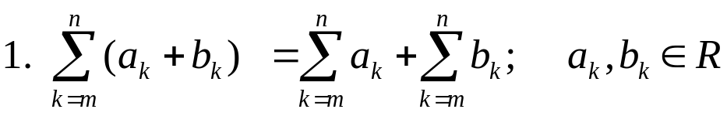
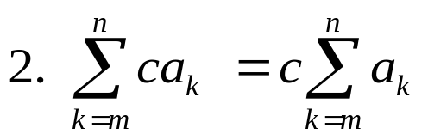
EXERCISE
  The index of a summation can be replaced by any other symbol. The index of a summation is therefore called a dummy variable.
  Consider
  Substituting k = j + 1 so that j = k – 1
  When k = 1, j = k - 1 = 1 - 1 = 0
  When k = n + 1, j = k - 1 = (n + 1) - 1 = n
  Hence
  Transform by making the change of variable j = i - 1, in the summation
PROPERTIES OF SUMMATIONS
c∈R

Slide 6
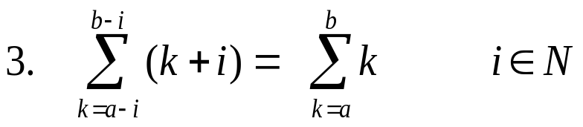
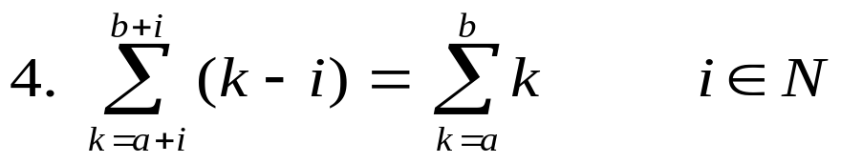
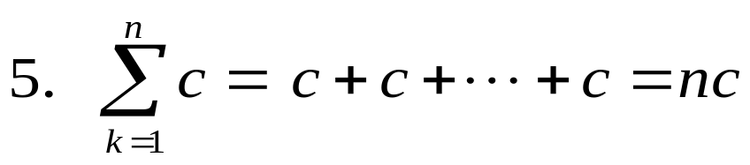
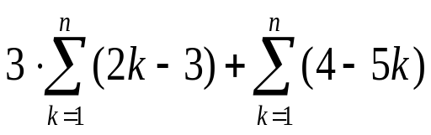
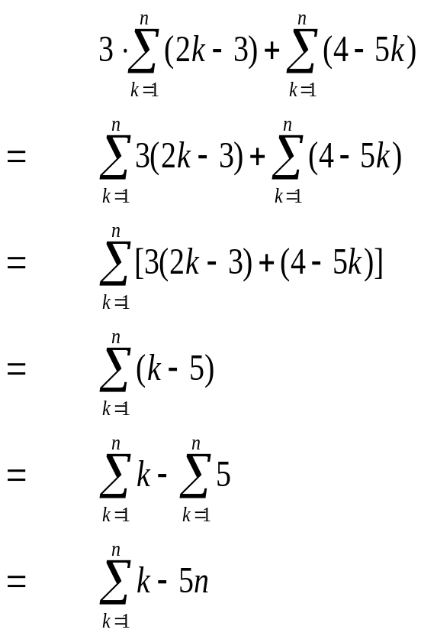
PROPERTIES OF SUMMATIONS
n terms
EXERCISE
Express the following summation more simply:
SOLUTION

Slide 7
ARITHMETIC SERIES
  The sum of the terms of an arithmetic sequence forms an arithmetic series (A.S). For example
  1 + 3 + 5 + 7 + …
  is an arithmetic series of positive odd integers.
  In general, if a is the first term and d the common difference of an arithmetic series, then the series is given as:
  a + (a+d) + (a+2d) +…
SUM OF n TERMS OF AN ARITHMETIC SERIES
  Let a be the first term and d be the common difference of an arithmetic series. Then its nth term is:
  a_{n} = a + (n - 1)d; n ≥ 1
  If S_{n} denotes the sum of first n terms of the A.S, then
  S_{n} = a + (a + d) + (a + 2d) + … + [a + (n-1) d]
  = a + (a+d) + (a + 2d) + … + a_{n}
  = a + (a+d) + (a + 2d) + … + (a_{n} - d) + a_{n} ………(1)
  where a_{n} = a + (n - 1) d
  Rewriting the terms in the series in reverse order,
  S_{n} = a_{n} + (a_{n} - d) + (a_{n} - 2d) + … + (a + d) + a ……….(2)
  Adding (1) and (2) term by term, gives
  2 S_{n} = (a + a_{n}) + (a + a_{n}) + (a + a_{n}) + … + (a + a_{n}) (n terms)
  2 S_{n} = n (a + a_{n})
  S_{n} = n(a + a_{n})/2
  S_{n} = n(a + l)/2…………………..(3)

Slide 8
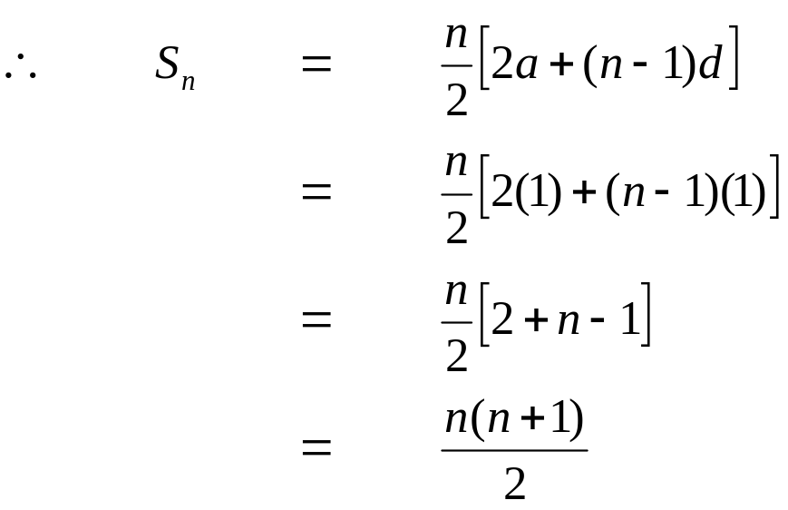
  where l = a_{n} = a + (n - 1)d
  Therefore
  S_{n}= n/2 [a + a + (n - 1) d]
  S_{n}= n/2 [2 a + (n - 1) d]……….(4)
EXERCISE
  Find the sum of first n natural numbers.
  SOLUTION
  Let S_{n} = 1 + 2 + 3 + … + n
  Clearly the right hand side forms an arithmetic series with
  a = 1, d = 2 - 1 = 1 and n = n
EXERCISE
  Find the sum of all two digit positive integers which are neither divisible by 5 nor by 2.
  SOLUTION
  The series to be summed is:
  11 + 13 + 17 + 19 + 21 + 23 + 27 + 29 + … + 91 + 93 + 97 + 99
  which is not an arithmetic series.

Slide 9
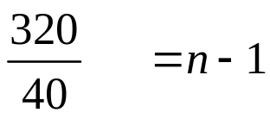
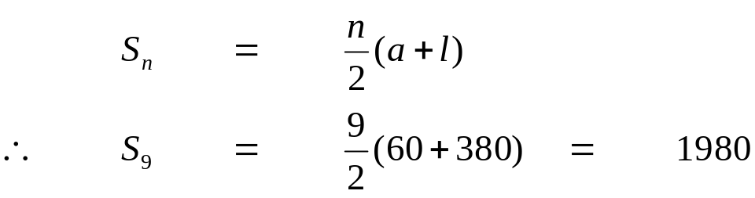
  If we make group of four terms we get
  (11 + 13 + 17 + 19) + (21 + 23 + 27 + 29) + (31 + 33 + 37 + 39) + … + (91 + 93 + 97 + 99)
  = 60 + 100 + 140 + … + 380
  which now forms an arithmetic series in which
  a = 60; d = 100 - 60 = 40 and l = a_{n} = 380
  To find n, we use the formula
  a_{n} = a + (n - 1) d
  ⇒ 380 = 60 + (n - 1) (40)
  ⇒ 380 - 60 = (n - 1) (40)
  ⇒ 320 = (n - 1) (40)
    8 = n - 1
    ⇒ n = 9
    Now

Slide 10
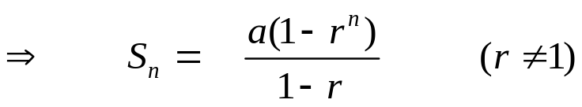
GEOMETRIC SERIES
  The sum of the terms of a geometric sequence forms a geometric series (G.S.). For example
  1 + 2 + 4 + 8 + 16 + …
  is geometric series.
  In general, if a is the first term and r the common ratio of a geometric series, then the series is given as:
  a + ar + ar² + ar³ + …
SUM OF n TERMS OF A GEOMETRIC SERIES
  Let a be the first term and r be the common ratio of a geometric series. Then its nth term is:
  a_{n} = ar^{n-1}; n ≥ 1
  If S_{n} denotes the sum of first n terms of the G.S. then
  S_{n} = a + ar + ar² + ar³ + … + ar^{n-2} + ar^{n-1}……………(1)
  Multiplying both sides by r we get.
  r S_{n} = ar + ar² + ar³ + … + ar^{n-1} + ar^{n-1}………………(2)
  Subtracting (2) from (1) we get
  S_{n} - rS_{n} = a - ar^{n}
  ⇒ (1 - r) S_{n} = a (1 - r^{n})

Slide 11
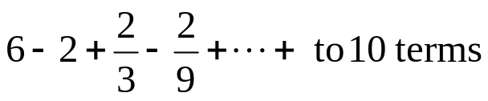
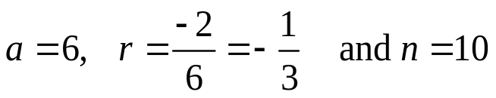
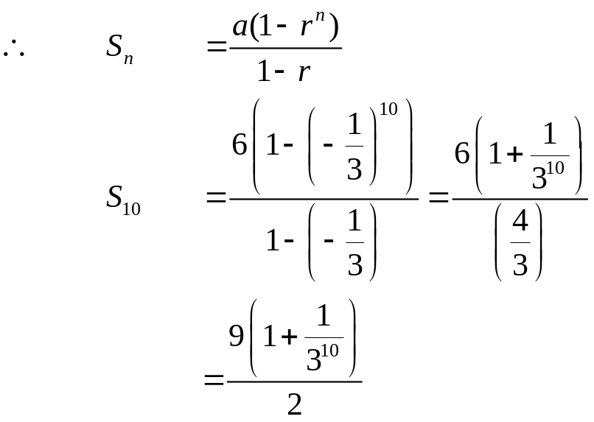
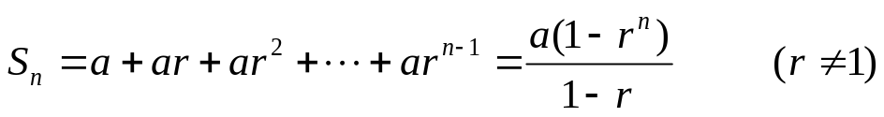
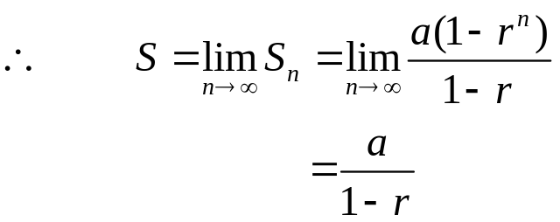
EXERCISE
  Find the sum of the geometric series
  SOLUTION
  In the given geometric series
INFINITE GEOMETRIC SERIES
  Consider the infinite geometric series
  a + ar + ar² + … + ar^{n-1} + …
  then
  If S_{n} → S as n → ∞, then the series is convergent and S is its sum.
  If |r| < 1, then r^{n} → 0 as n → ∞

Slide 12
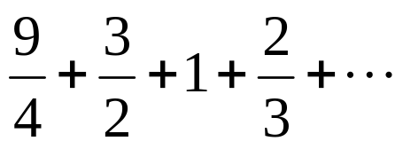
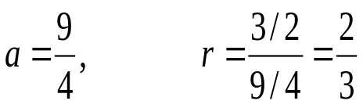
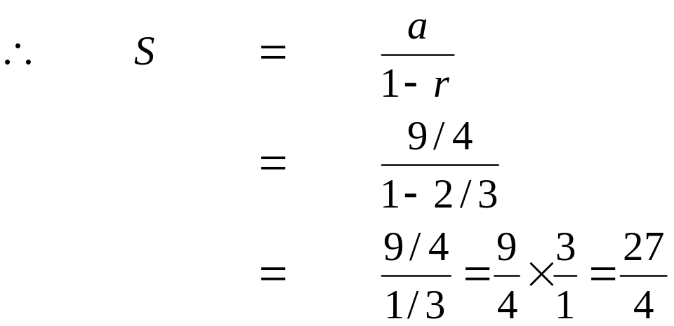
EXERCISE
  If S_{n} increases indefinitely as n becomes very large then the series is said to be divergent.
  Find the sum of the infinite geometric series:
SOLUTION
Here we have
Note that |r| < 1 So we can use the above formula.

Slide 13
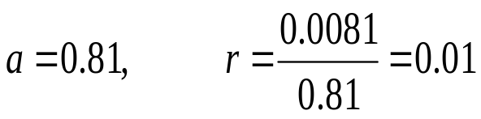
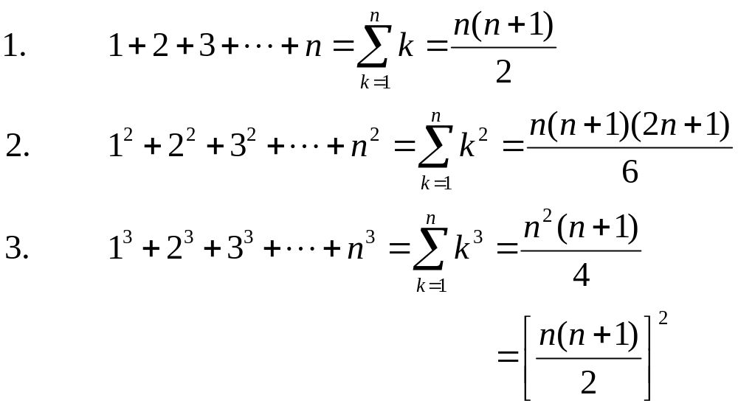
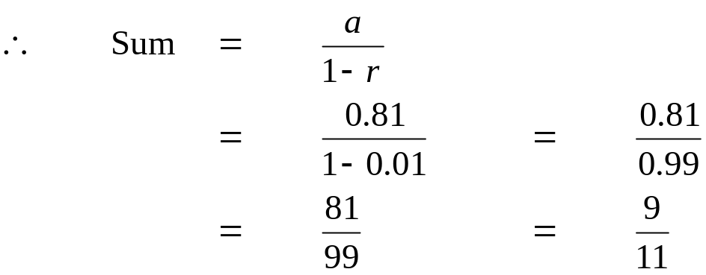
EXERCISE
  Find a common fraction for the recurring decimal 0.81
  SOLUTION
  0.81= 0.8181818181 …
  = 0.81 + 0.0081 + 0.000081 + …
  which is an infinite geometric series with
IMPORTANT SUMS

Slide 14
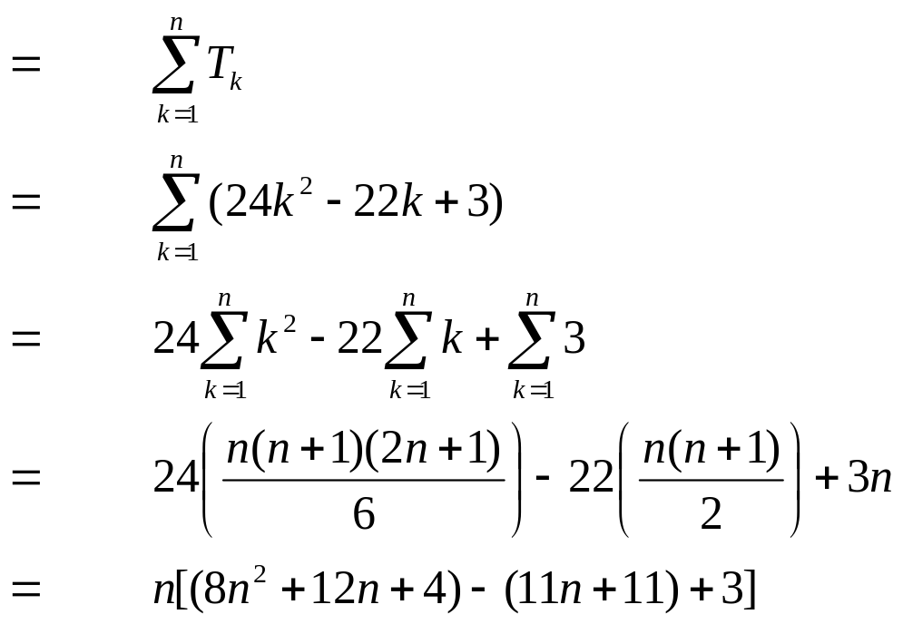
EXERCISE
  Sum to n terms the series
  1⋅5+5 ⋅11+9 ⋅17+…
  SOLUTION
  Let T_{k} denote the kth term of the given series.
  Then T_{k}= [1+(k-1)4] [5+(k-1)6]
  = (4k-3)(6k-1)
  = 24k² - 22k + 3
  Now S_{n} = T₁ + T₂ + T₃ + … + T_{n}

