Slide 1
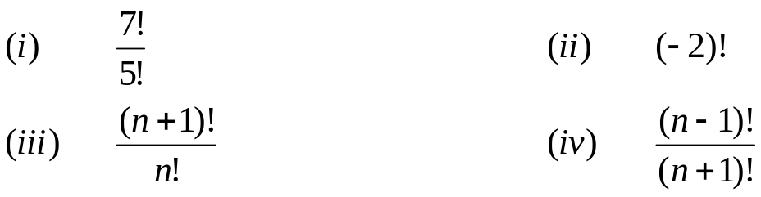
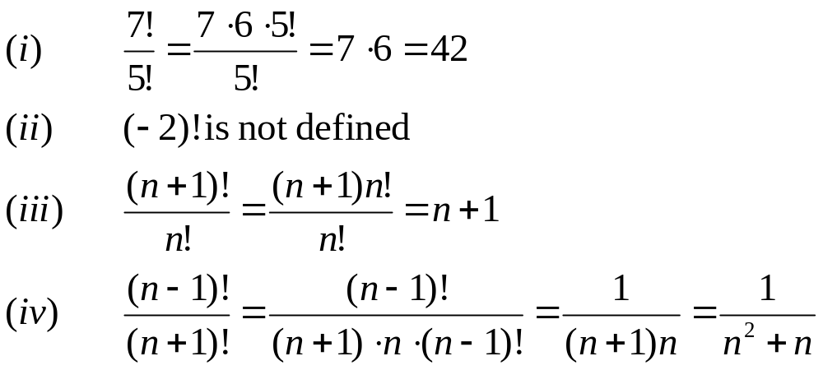
LECTURE #
FACTORIAL OF A POSITIVE INTEGER
  For each positive integer n, its factorial is defined to be the product of all the integers from 1 to n and is denoted n!. Thus
  n! = n(n - 1) (n - 2) … 3⋅2 ⋅1
  In addition, we define
  0! = 1
  REMARK
  n! can be recursively defined as
  Base: 0! = 1
  Recursion n! = n (n - 1)! for each positive integer n.
  Compute each of the following
SOLUTION

Slide 2
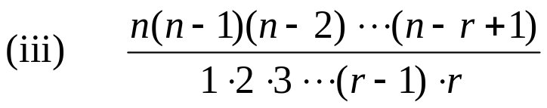
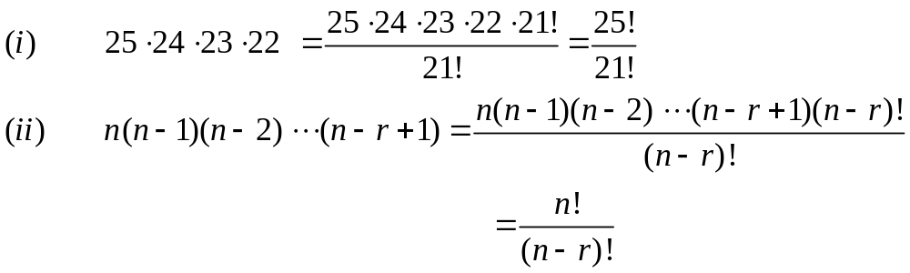
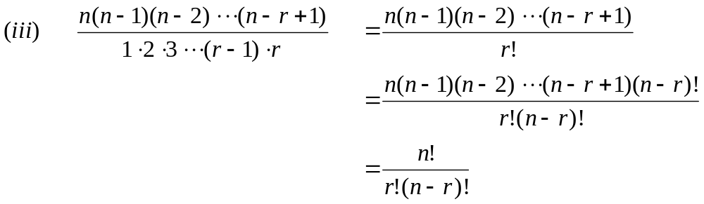
EXERCISE
  Write in terms of factorials.
  (i) 25⋅24 ⋅23 ⋅22 (ii) n(n-1)(n-2) … (n - r + 1)
SOLUTION
COUNTING FORMULAS
  From a given set of n distinct elements, one can choose k elements in different ways. The number of selections of elements varies according as:
  (i) elements may or may not be repeated.
  (ii) the order of elements may or may not matter.
  These two conditions therefore lead us to four counting methods summarized in the following table.

Slide 3
K-SAMPLE
 | ORDER MATTERS | ORDER DOES NOT MATTER
REPETITION ALLOWED | k-sample | k-selection
REPETITION NOT ALLOWED | k-permutation | k-combination
  A k-sample of a set of n elements is a choice of k elements taken from the set of n elements such that the order of elements matters and elements can be repeated.
  REMARK
  With k-sample, repetition of elements is allowed, therefore, k need not be less than or equal to n.
  i.e. k is independent of n.
FORMULA FOR K-SAMPLE
  Suppose there are n distinct elements and we draw a k-sample from it.
  The first element of the k-sample can be drawn in n ways.
  Since, repetition of elements is allowed, so the second element can also be drawn in n ways.
  Similarly each of third, fourth, …, k-th element can be drawn in n ways.
  Hence, by product rule, the total number of ways in which a k-sample can be drawn from n distinct elements is
  n ⋅ n ⋅ n ⋅ … ⋅ n (k-times)
  = n^{k}

Slide 4
EXERCISE
  How many possible outcomes are there when a fair coin is tossed three times.
  SOLUTION
  Each time a coin is tossed it’s outcome is either a head (H) or a tail (T). Hence in successive tosses, H and T are repeated. Also the order in which they appear is important. Accordingly, the problem is of 3-samples from a set of two elements H and T. [k = 3, n = 2]
  Hence number of samples = n^{k}
  = 2³ = 8
  These 8-samples may be listed as:
  HHH, HHT, HTH, THH, HTT, THT, TTH, TTT
EXERCISE
  Suppose repetition of digits is permitted.
  (a) How many three-digit numbers can be formed from the six digits 2, 3, 4, 5, 7 and 9
  SOLUTION
  Given distinct elements = n = 6
  Digits to be chosen = k = 3
  While forming numbers, order of digits is important. Also digits may be repeated.
  Hence, this is the case of 3-sample from 6 elements.
  Number of 3-digit numbers = n^{k} = 6³ = 216

Slide 5
  (b) How many of these numbers are less than 400?
  SOLUTION
  From the given six digits 2, 3, 4, 5, 7 and 9, a three-digit number would be less than 400 if and only if its first digit is either 2 or 3.
  The next two digits positions may be filled with any one of the six digits.
  Hence, by product rule, there are
  2⋅6 ⋅6 = 72
  three-digit numbers less than 400.
  (c) How many are even?
  SOLUTION
  A number is even if its right most digit is even. Thus, a 3-digit number formed by the digits 2, 3, 4, 5, 7 and 9 is even if it last digit is 2 or 4. Thus the last digit position may be filled in 2 ways only while each of the first two positions may be filled in 6 ways.
  Hence, there are
  6 ⋅ 6 ⋅ 2 = 72
  3-digit even numbers.
  (d) How many are odd?
  SOLUTION
  A number is odd if its right most digit is odd. Thus, a 3-digit number formed by the digits 2, 3, 4, 5, 7 and 9 is odd if its last digit is one of 3, 5, 7, 9. Thus, the last digit position may be filled in 4 ways, while each of the first two positions may be filled in 6 ways.
  Hence, there are
  6 ⋅ 6 ⋅ 4 = 144
  3-digit odd numbers.

Slide 6
  (e) How many are multiples of 5?
  SOLUTION
  A number is a multiple of 5 if its right most digit is either 0 or 5. Thus, a 3-digit number formed by the digits 2, 3, 4, 5, 7 and 9 is multiple of 5 if its last digit is 5.
  Thus, the last digit position may be filled in only one way, while each of the first two positions may be filled in 6 ways.
  Hence, there are
  6 ⋅ 6 ⋅1 = 36
  3-digit numbers that are multiple of 5.
EXERCISE
  A box contains 10 different colored light bulbs. Find the number of ordered samples of size 3 with replacement.
  SOLUTION
  Number of light bulbs = n = 10
  Bulbs to be drawn = k = 3
  Since bulbs are drawn with replacement, so repetition is allowed. Also while drawing a sample, order of elements in the sample is important.
  Hence number of samples of size 3 = n^{k}
  = 10³
  = 1000

Slide 7
EXERCISE
  A multiple choice test contains 10 questions; there are 4 possible answers for each question.
  (a) How many ways can a student answer the questions on the test if every question is answered?
  (b) How many ways can a student answer the questions on the test if the student can leave answers blank?
SOLUTION
  (a) Each question can be answered in 4 ways. Suppose answers are labeled as A, B, C, D. Since label A may be used as the answer of more than one question. So repetition is allowed. Also the order in which A, B, C, D are choosed as answers for 10 questions is important. Hence, this is the one of k-sample, in which
  n = no. of distinct labels = 4
  k = no. of labels selected for answering = 10
  ∴ No. of ways to answer 10 questions = n^{k}
  = 4¹⁰
  = 1048576
  (b) If the student can leave answers blank, then in addition to the four answers, a fifth option to lever answer blank is possible. Hence, in such case
  n = 5
  and k = 10 (as before)
  ∴ No. of possible answers = n^{k}
  = 5¹⁰
  = 9765625

Slide 8
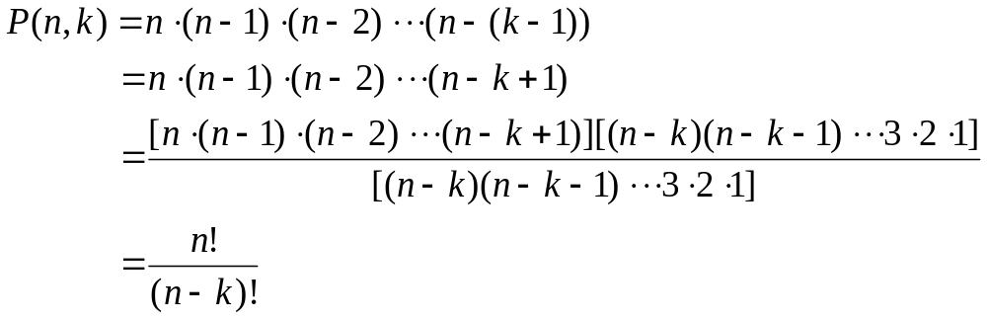
k-PERMUTATION
  A k-permutation of a set of n elements is a selection of k elements taken from the set of n elements such that the order of elements matters but repetition of the elements is not allowed. The number of k-permutations of a set of n elements is denoted P(n, k) or ^{n}P_{k}.
  REMARK
  1. With k-permutation, repetition of elements is not allowed, therefore k ≤ n.
  2. The wording “number of permutations of a set with n elements” means that all n elements are to be permuted, so that k = n.
FORMULA FOR k-PERMUTATION
  Suppose a set of n elements is given. Formation of a k-permutation means that we have an ordered selection of k elements out of n, where elements cannot be repeated.
  1st element can be selected in n ways
  2nd element can be selected in (n-1) ways
  3rd element can be selected in (n-2) ways
  ………………………………….
  kth element can be selected in (n-(k-1)) ways
  Hence, by product rule, the number of ways to form a k-permutation is

Slide 9
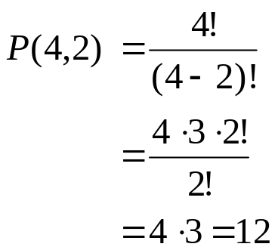
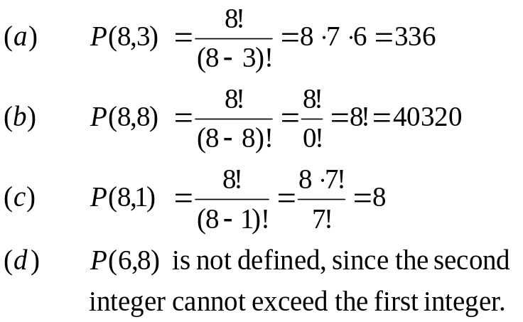
EXERCISE
  How many 2-permutation are there of {W, X, Y, Z}?
  Write them all.
  SOLUTION
  Number of 2-permutation of 4 elements is
  These 12 permutations are:
        WX, WY, WZ,
        XW, XY, XZ,
        YW, YX, YZ,
        ZW, ZX, ZY.
EXERCISE
  Find (a) P(8, 3) (b) P(8,8)
  (c) P(8,1) (d) P(6,8)
  SOLUTION

Slide 10
EXERCISE
  Find n if
  P(n,2) = 72
  (b) P(n,4) = 42 P (n, 2)
  SOLUTION
  (a) Given P(n,2) = 72
  ⇒ n ⋅ (n-1) = 72
  ⇒ n² -n = 72
  ⇒ n² - n - 72 = 0
  ⇒ n = 9, -8
  Since n must be positive, so the only acceptable value of n is 9.
  (b) Given P(n,4) = 42P(n,2)
  ⇒ n (n-1) (n-2) (n-3) = 42 n (n - 1)
  ⇒ (n-2) (n-3) = 42 if n ≠0, n ≠1
  ⇒ n² - 5n + 6 = 42
  or n² - 5n - 36 = 0
  or (n-9) (n+4) = 0
  ⇒ n = 9, -4
  Since n must be positive, the only answer is n = 9

Slide 11
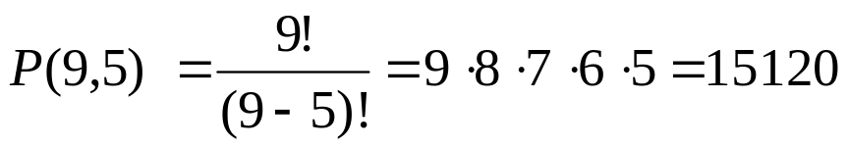
EXERCISE
  Prove that for all integers n ≥ 3
  P (n + 1, 3) - P(n, 3) = 3 P (n, 2)
  SOLUTION
  Suppose n is an integer greater than or equal to 3
  Now LHS = P (n + 1, 3) - P(n, 3)
  = (n + 1) (n) (n-1) - n (n - 1)(n - 2)
  = n (n - 1) [(n + 1) - (n - 2)]
  = n (n - 1) [n + 1 - n + 2]
  = 3 n (n - 1)
  RHS = 3P (n, 2)
  = 3⋅n(n-1)
  Thus LHS = RHS. Hence the result.
EXERCISE
  (a) How many ways can five of the letters of the word ALGORITHM be selected and written in a row?
  (b) How many ways can five of the letters of the word ALGORITHM be selected and written in a row if the first two letters must be TH?
  SOLUTION
  (a) The answer equals the number of 5-permutation of a set of 9 elements and

Slide 12
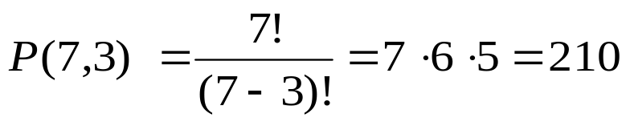
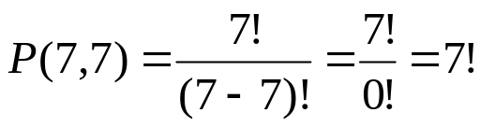
  (b) Since the first two letters must be TH hence we need to choose the remaining three letters out of the left 9 - 2 = 7 alphabets.
  Hence, the answer is the number of 3-permutations of a set of seven elements which is
EXERCISE
  Find the number of ways that a party of seven persons can arrange themselves in a row of seven chairs.
  SOLUTION
  The seven persons can arrange themselves in a row in P(7,7) ways.
  Now
EXERCISE
  A debating team consists of three boys and two girls. Find the number n of ways they can sit in a row if the boys and girls are each to sit together.
  SOLUTION
  There are two ways to distribute them according to sex: BBBGG or GGBBB. In each case the boys can sit in P(3,3) = 3! = 6 ways, and
  the girls can sit in
  P(2,2) = 2! = 2 ways
  Thus
  n = 2 ⋅ 3! ⋅ 2!
  = 2 ⋅6 ⋅2 = 24

Slide 13
EXERCISE
  Find the number n of ways that five large books four medium sized book, and three small books can be placed on a shelf so that all books of the same size are together.
  SOLUTION
  In each case, the large books can be arranged among themselves in P(5,5) = 5! ways, the medium sized books in P(4,4) = 4! ways, and the small books in P(3,3) = 3! ways.
  The three blocks of books can be arranged on the shelf in P(3,3) = 3! ways.
  Thus
  n = 3!⋅5! ⋅4! ⋅3!
  = 103680

