Slide 1


  With a k-combinations the order in which the elements are selected does not matter and the elements cannot repeat.
  DEFINITION
  A k-combination of a set of n elements is a choice of k elements taken from the set of n elements such that the order of the elements does not matter and elements can’t be repeated.
  The symbol C(n, k) denotes the number of k-combinations that can be chosen from a set of n elements.
  NOTE
  k-combinations are also written as or
REMARK
  With k-combinations of a set of n elements repetition of elements is not allowed, therefore, k must be less than or equal to n, i.e., k ≤ n.
  EXAMPLE
  Let X = {a, b, c}. Then 2-combinations of the 3 elements of the set X are:
  {a, b}, {a, c}, and {b, c}. Hence
  C(3,2) = 3.

Slide 2
EXERCISE
  Let X = {a, b, c, d, e}.
  List all 3-combinations of the 5 elements of the set X, and hence find the value of C(5,3).
  SOLUTION
  Then 3-combinations of the 5 elements of the set X are:
  {a, b, c}, {a, b, d}, {a, b, e}, {a, c, d}, {a, c, e},
  {a, d, e}, {b, c, d}, {b, c, e}, {b, d, e}, {c, d, e}
  Hence C(5, 3) = 10
PERMUTATIONS AND COMBINATIONS
  EXAMPLE
  Let X = {A, B, C, D}.
  The 3-combinations of X are:
  {A, B, C}, {A, B, D}, {A, C, D}, {B, C, D}
  Hence C(4, 3) = 4
  The 3-permutations of X can be obtained from 3-combinations of X as
  follows.
  ABC, ACB, BAC, BCA, CAB, CBA
  ABD, ADB, BAD, BDA, DAB, DBA
  ACD, ADC, CAD, CDA, DAC, DCA
  BCD, BDC, CBD, CDB, DBC, DCB
  So that P(4, 3) = 24 = 4 · 6 = 4 · 3!
  Clearly P(4, 3) = C(4, 3) · 3!
  In general we have,
  P(n, k) = C(n, k) · k!

Slide 3
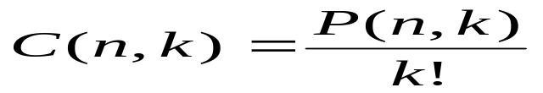
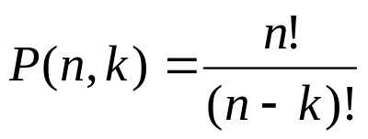
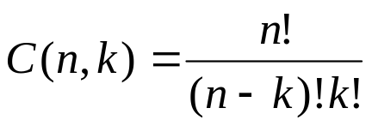
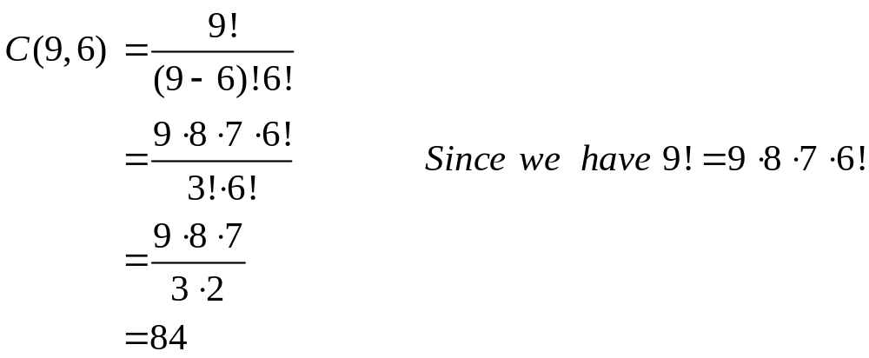
  In general we have,
  P(n, k) = C(n, k) · k!
  or
  But we know that
  Hence,
COMPUTING C(n, k)
  EXAMPLE
  Compute C(9, 6).
  SOLUTION
  By using formula we can write

Slide 4
SOME IMPORTANT RESULTS
      (a) C(n, 0) = 1
      (b) C(n, n) = 1
      (c) C(n, 1) = n
      (d) C(n, 2) = n(n-1)/2
      (e) C(n, k) = C(n, n – k)
      (f) C(n, k) + C(n, k + 1) = C(n + 1, k + 1)
      The above formulas can be derived easily using the definition of the C(n,k) and we leave these to you as an exercise.
EXERCISE
    A student is to answer eight out of ten questions on an exam.
    (a) Find the number m of ways that the student can choose the eight questions.
    (b) Find the number m of ways that the student can choose the eight questions, if the first three questions are compulsory.
    SOLUTION
    (a) The eight questions can be answered in
    m = C(10, 8) = 45 ways.
    (b) The eight questions can be answered in
    m = C(7, 5) = 21 ways.

Slide 5
EXERCISE
  An examination paper consists of 5 questions in section A and 5 questions in section B.
  A total of 8 questions must be answered. In how many ways can a student select the questions if he is to answer at least 4 questions from section A.
  SOLUTION
  There are two possibilities:
  (a) The student answers 4 questions from section A and 4 questions from section B.
  The number of ways 8 questions can be answered taking 4 questions from section A and 4 questions from section B are
  C(5, 4) · C(5, 4) =5 · 5 = 25.
  (b) The student answers 5 questions from section A and 3 questions from section B.
  The number of ways 8 questions can be answered taking 5 questions from section A and 3 questions from section B are
  C(5, 5) · C(5, 3) =1 · 10 = 10.
  Thus there will be a total of 25 + 10 = 35 choices.
EXERCISE
  A computer programming team has 14 members.
  (a) How many ways can a group of seven be chosen to work on a project?
  (b) Suppose eight team members are women and six are men
  (i) How many groups of seven can be chosen that contain four women and three men?
  (ii) How many groups of seven can be chosen that contain at least one man?
  (iii)How many groups of seven can be chosen that contain at most three women?
  (c) Suppose two team members refuse to work together on projects. How many groups of seven can be chosen to work on a project?
  (d) Suppose two team members insist on either working together or not at all on projects. How many groups of seven can be chosen to work on a project?

Slide 6
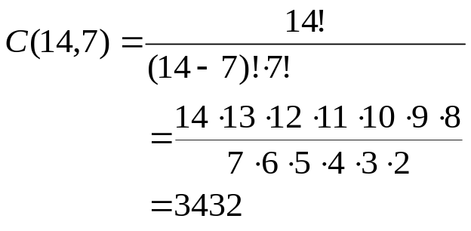
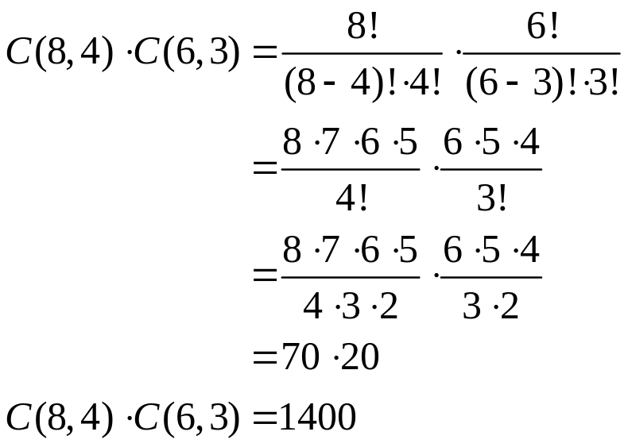
  (a) How many ways a group of 7 be chosen to work on a project?
  SOLUTION
  Number of committees of 7
  (b) Suppose eight team members are women and six are men
  (i) How many groups of seven can be chosen that contain four women and three men?
  SOLUTION
  Number of groups of seven that contain four women and three men

Slide 7
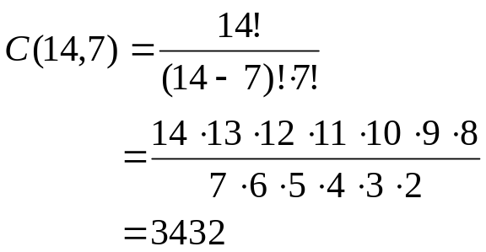
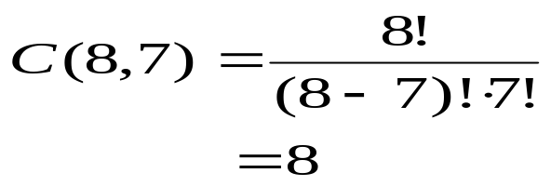
  (b) Suppose eight team members are women and six are men
  (ii) How many groups of seven can be chosen that contain at least one man?
  SOLUTION
  Total number of groups of seven
  Number of groups of seven that contain no men
  Hence, the number of groups of seven that contain at least one man
  C(14,7) – C(8, 7) = 3432 – 8 =3424
  (b) Suppose eight team members are women and six are men
  (iii) How many groups of seven can be chosen that contain at most three women?
  SOLUTION
  Number of groups of seven that contain no women = 0
  Number of groups of seven that contain one woman = C(8,1) ⋅ C(6,6)
  = 8 ⋅ 1 = 8
  Number of groups of seven that contain two women = C(8,2) ⋅ C(6,5)
  = 28 ⋅ 6 = 168

Slide 8
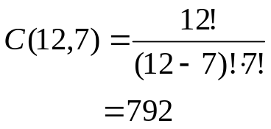
  Number of groups of seven that contain three women = C(8,3) ⋅ C(6,4)
  = 56 ⋅ 15 = 840
  Hence the number of groups of seven that contain at most three women
  = 0 + 8 + 168 + 840 = 1016
(c) Suppose two team members refuse to work together on projects. How many groups of seven can be chosen to work on a project?
SOLUTION
Call the members who refuse to work together A and B.
Number of groups of seven that contain neither A nor B
Number of groups of seven that contain A but not B
        C(12, 6) = 924
        Number of groups of seven that contain B but not A
        C(12,6) = 924 Hence the required number of groups are
        C(12,7) + C(12,6) + C(12, 6)
        = 792 + 924 + 924
        = 2640
  Suppose two team members insist on either working together or not at all on projects.
  How many groups of seven can be chosen to work on a project?
  SOLUTION
  Call the members who insist on working together C and D.
  Number of groups of seven containing neither C nor D
  C(12, 7) = 792
  Number of groups of seven that contain both C and D
  C(12, 5) = 792
  Hence the required number
  = C(12, 7) + C(12, 5)
  = 792 + 792 = 1584

Slide 9
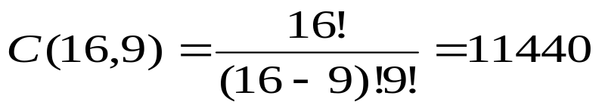
EXERCISE
  (a) How many 16-bit strings contain exactly 9 1’s?
  (b) How many 16-bit strings contain at least one 1?
  SOLUTION
  (a)
  (b) Total no. of 16-bit strings = 2¹⁶
  Hence number of 16-bit strings that contain at least one 1
  2¹⁶ – 1 = 65536 – 1
  = 65535
K-SELECTIONS
  k-selections are similar to k-combinations in that the order in which the elements are selected does not matter, but in this case repetitions can occur.
  DEFINITION
  A k-selection of a set of n elements is a choice of k elements taken from a set of n elements such that the order of elements does not matter and elements can be repeated.
  REMARK
  1. k-selections are also called k-combinations with repetition allowed or multisets of size k.
  2. With k-selections of a set of n elements repetition of elements is allowed. Therefore k need not to be less than or equal to n.
THEOREM
  The number of k-selections that can be selected from a set of n elements is
  C(k+n−1, k) or
k+n-1
k

Slide 10
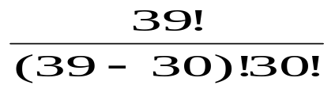
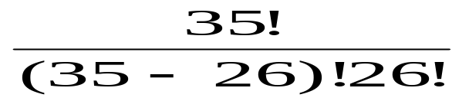
EXERCISE
  A camera shop stocks ten different types of batteries.
  (a) How many ways can a total inventory of 30 batteries be distributed among the ten different types?
  (b) Assuming that one of the types of batteries is A76, how many ways can a total inventory of 30 batteries be distributed among the 10 different types if the inventory must include at least four A76 batteries?
  SOLUTION
  (a) k = 30
  n = 10
  The required number is
  C(30 + 10 – 1, 30) = C(39, 30)
  =
  = 211915132
  (b) k = 26
  n = 10
  The required number is
  C(26 + 10 – 1, 26) = C(35, 26)
  =
  = 70607460
WHICH FORMULA TO USE?
 | ORDER MATTERS | ORDER DOES NOT MATTER
REPETITION ALLOWED | k-sample n^{k} | k-selection C(n+k-1, k)
REPETITION NOT ALLOWED | k-permutation P(n, k) | k-combination C(n, k)

