Slide 1
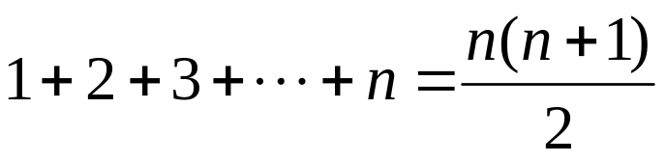
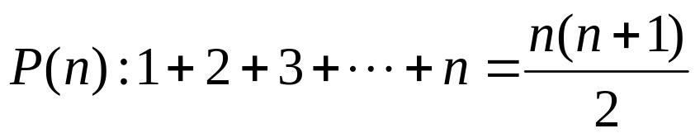
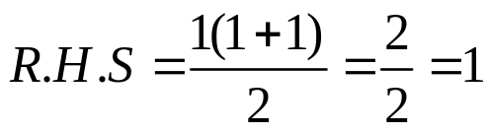
LECTURE # 12a
PRINCIPLE OF MATHEMATICAL INDUCTION
  Let P(n) be a propositional function defined for all positive integers n. P(n) is true for every positive integer n if
  Basis Step:
  The proposition P(1) is true.
  Inductive Step:
  If P(k) is true then P(k + 1) is true for all integers k ≥ 1.
  i.e. ∀ k p(k) → P(k + 1)
EXAMPLE
Use Mathematical Induction to prove that
for all integers n ≥1
  SOLUTION
  Let
  1. Basis Step: P(1) is true.
  For n = 1, left hand side of P(1) is the sum of all the successive integers starting at 1 and ending at 1, so LHS = 1 and RHS
so the proposition is true for n = 1.

Slide 2
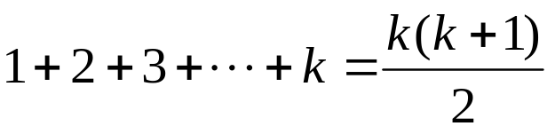
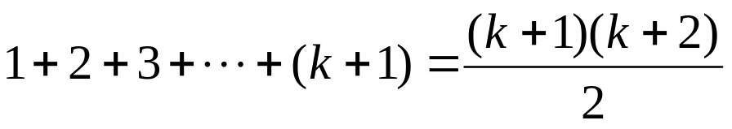
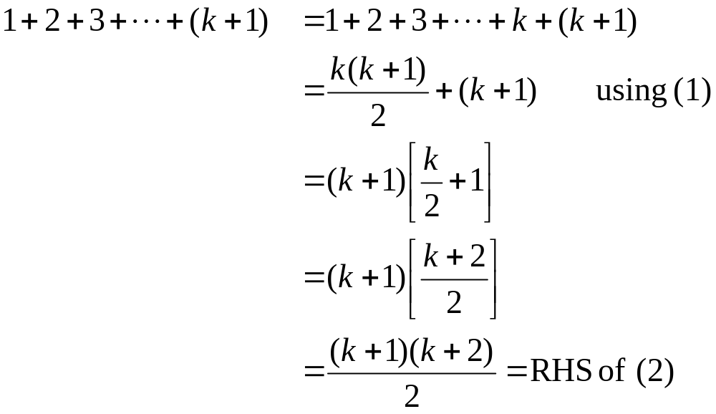
2. Inductive Step: Suppose P(k) is true for, some integers k ≥ 1.
(1)
To prove P(k + 1) is true. That is,
(2)
Consider L.H.S. of (2)
  Hence by principle of Mathematical Induction the given result true for all integers greater or equal to 1.

Slide 3
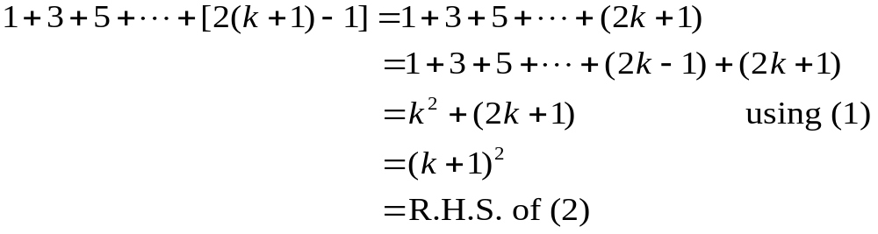
EXERCISE
  Use mathematical induction to prove that
  1+3+5+…+(2n -1) = n² for all integers n ≥1.
  SOLUTION
  Let P(n) be the equation
  1+3+5+…+(2n -1) = n²
  1. Basis Step: P(1) is true
  For n = 1, LHS of P(1) = 1and
  RHS = 1² = 1
  Hence the equation is true for n = 1
  2. Inductive Step: Suppose P(k) is true for some integer k ≥ 1. That is,
  1 + 3 + 5 + … + (2k - 1) = k² …………………(1)
  To prove P(k+1) is true; i.e.,
  1 + 3 + 5 + … +[2(k+1)-1] = (k+1)² ………….……(2)
  Consider L.H.S. of (2)
  Thus P(k+1) is also true. Hence by mathematical induction, the given
  equation is true for all integers n≥1.

Slide 4
EXERCISE
  Use mathematical induction to prove that
  1+2+2² + … + 2^{n} = 2^{n+1} - 1 for all integers n ≥0
  SOLUTION
  Let P(n): 1 + 2 + 2² + … + 2^{n} = 2^{n+1} - 1
  1. Basis Step: P(0) is true.
  For n = 0
  LHS of P(0) = 1
  RHS of P(0) = 2⁰⁺¹ - 1 = 2 - 1 = 1
  Hence P(0) is true.
  2. Inductive Step Suppose P(k) is true for some integer k ≥ 0; i.e.,
  1+2+2²+…+2^{k} = 2^{k+1} – 1……………………(1)
  To prove P(k+1) is true, i.e.,
  1+2+2²+…+2^{k+1} = 2^{k+1+1} – 1…………………(2)
  Consider LHS of equation (2)
  1+2+2²+…+2^{k+1} = (1+2+2²+…+2^{k}) + 2^{k+1}
  = (2^{k+1} - 1) +2^{k+1}
  = 2·2^{k+1} - 1
  = 2^{k+1+1} - 1 = RHS of (2)
  Hence P(k+1) is true and consequently by mathematical induction the given propositional function is true for all integers n≥0.

Slide 5
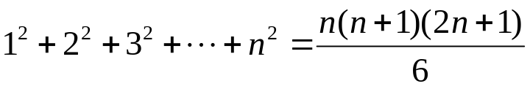
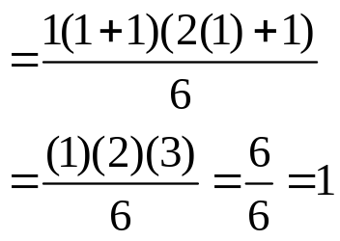
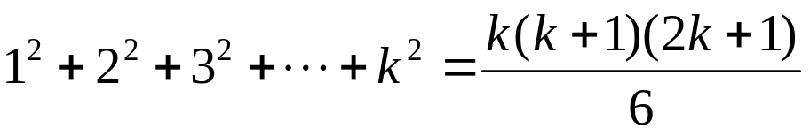
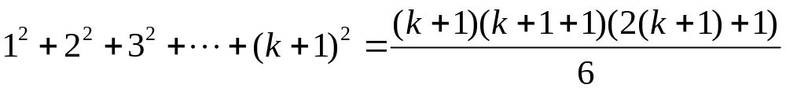
EXERCISE
Prove by mathematical induction
for all integers n ≥1.
  SOLUTION
  Let P(n) denotes the given equation
  1. Basis step: P(1) is true
  For n = 1
  LHS of P(1) = 1² = 1
  RHS of P(1)
So LHS = RHS of P(1).Hence P(1) is true
  2. Inductive Step: Suppose P(k) is true for some integer k ≥1;
………(1)
To prove P(k+1) is true; i.e.;
…(2)

Slide 6
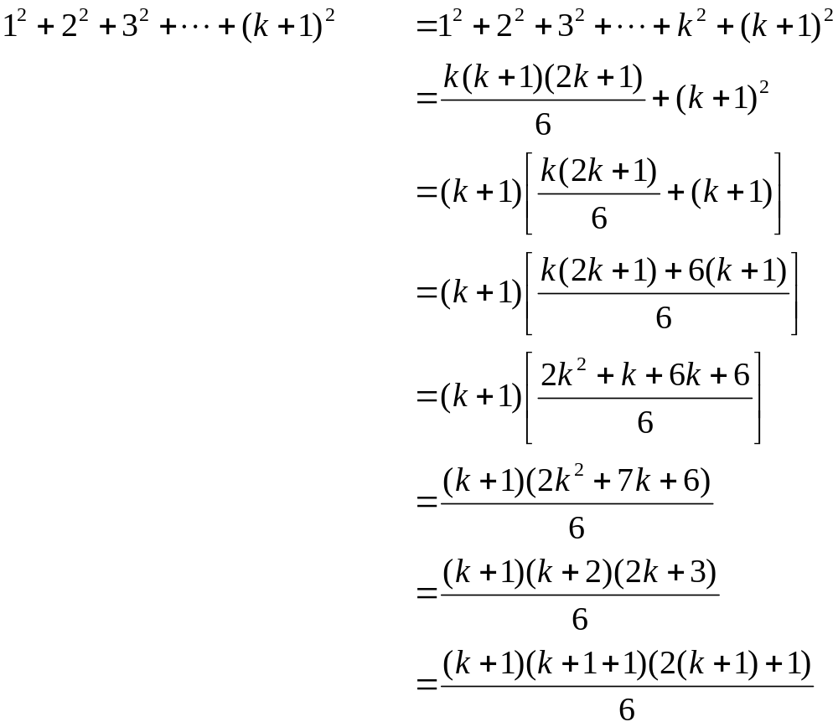
Consider LHS of above equation (2)
Hence P(k+1) is true and by principle of Mathematical Induction we can say that the given proposition is true. That is
n ≥1.
Using (1)
= RHS of (2)

Slide 7
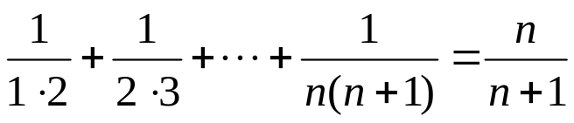
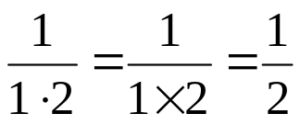
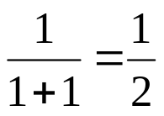
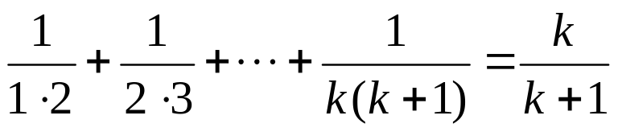
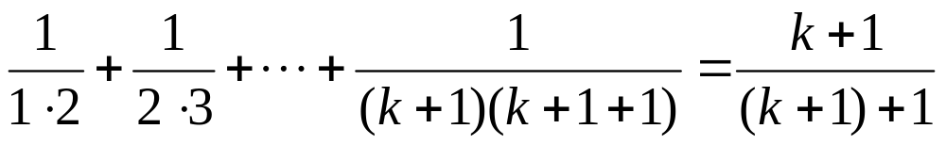
EXERCISE
Prove by mathematical induction
for all integers n≥1
  SOLUTION
  Let P(n) be the given equation.
  1. Basis Step: P(1) is true
  For n = 1
  LHS of P(1) =
RHS of P(1) =
Hence P(1) is true
  Inductive Step: Suppose P(k) is true, for some integer k≥1. That is
  Now we will consider the L.H.S of the equation (2) and will try to get the R.H.S by using equation ( 1) and some simple computation.
…………….(1)
To prove P(k+1) is true. That is
……..(2)

Slide 8
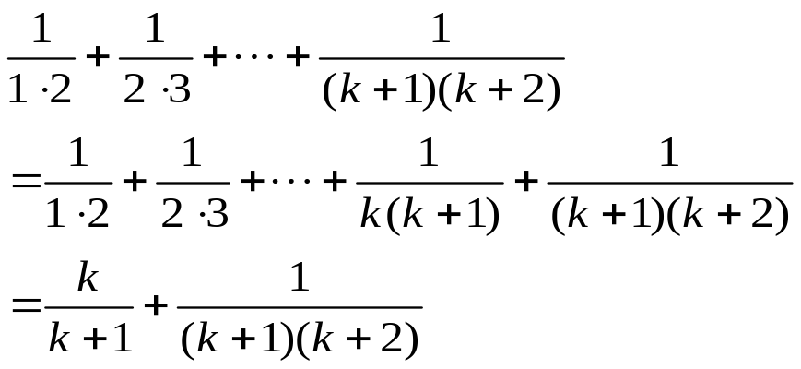
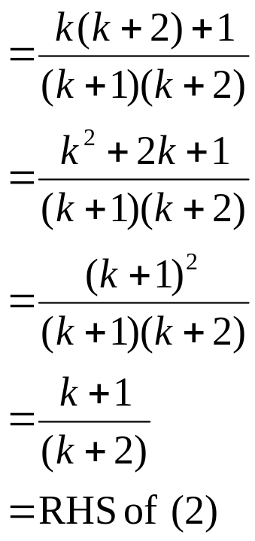
Consider LHS of (2)
  Hence P(k+1) is also true and so by Mathematical induction the given equation is true for all integers n ≥1.

Slide 9
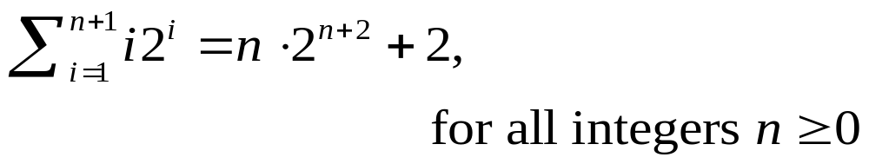
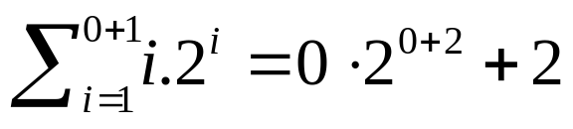
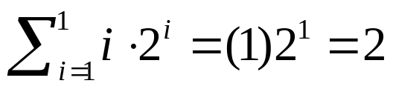
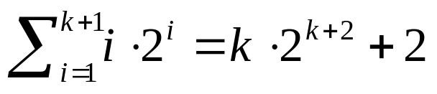
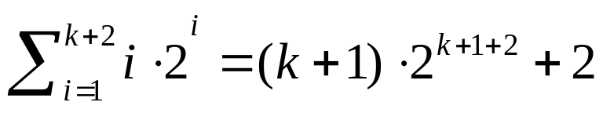
EXERCISE
Use mathematical induction to prove that
  SOLUTION
  1. Basis Step: To prove the formula for n = 0, we need to show that
Now, LHS =
  RHS = 0·2² + 2 = 0 + 2 = 2
  Hence the formula is true for n = 0
2. Inductive Step: Suppose for some integer n=k ≥0
………………(1)
We must show that
………..(2)

Slide 10
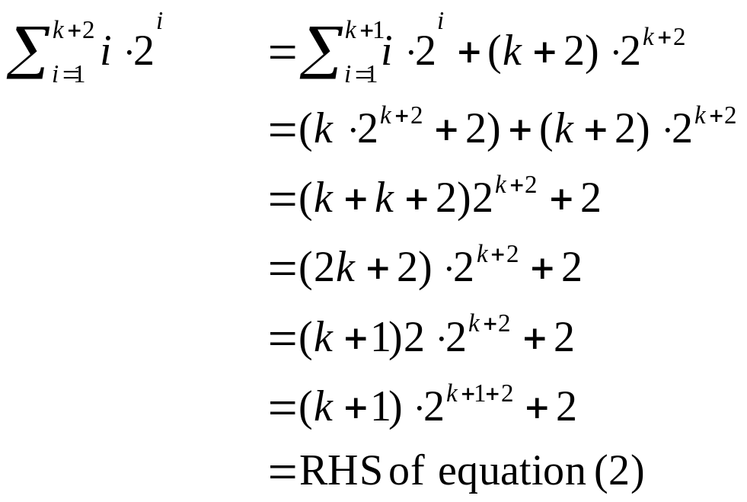
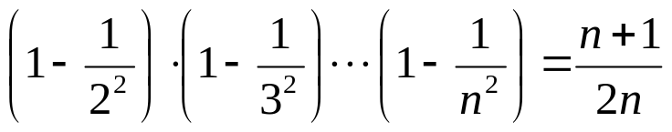
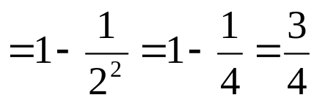
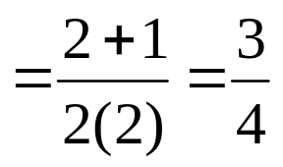
Consider LHS of (2)
  Hence the inductive step is proved as well. Accordingly by mathematical induction the given formula is true for all integers n≥0.
EXERCISE
Use mathematical induction to prove that
for all integers n ≥2
  SOLUTION
  1. Basis Step: For n = 2
  LHS
RHS
  Hence the given formula is true for n = 2

Slide 11
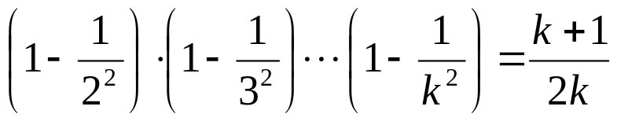
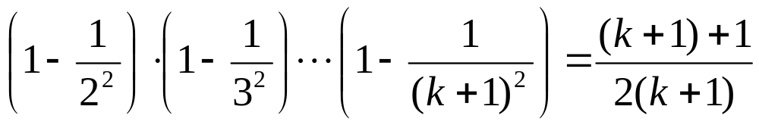
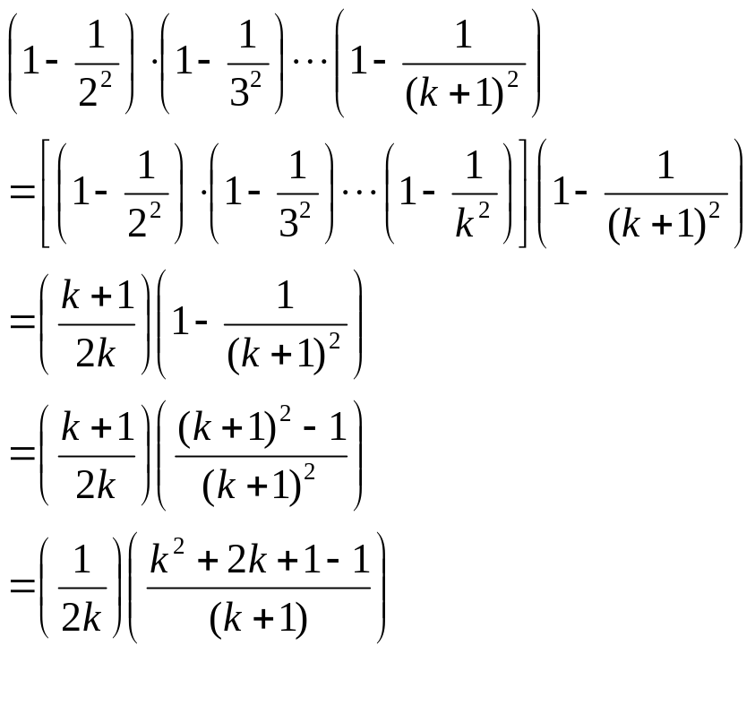
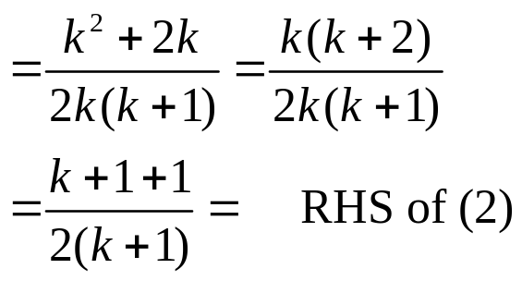
  2. Inductive Step: Suppose for some integer k ≥2
………………….(1)
  We must show that
…………..(2)
Consider LHS of (2)
using (1)
  Hence by mathematical induction the given equation is true

Slide 12
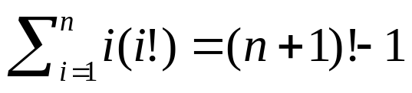
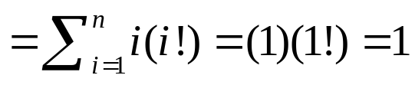
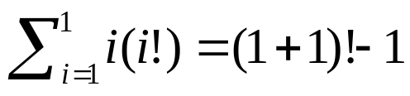
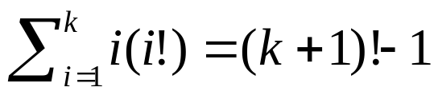
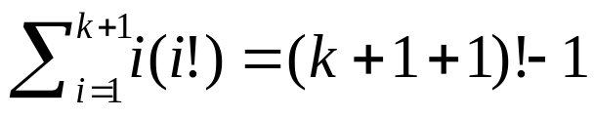
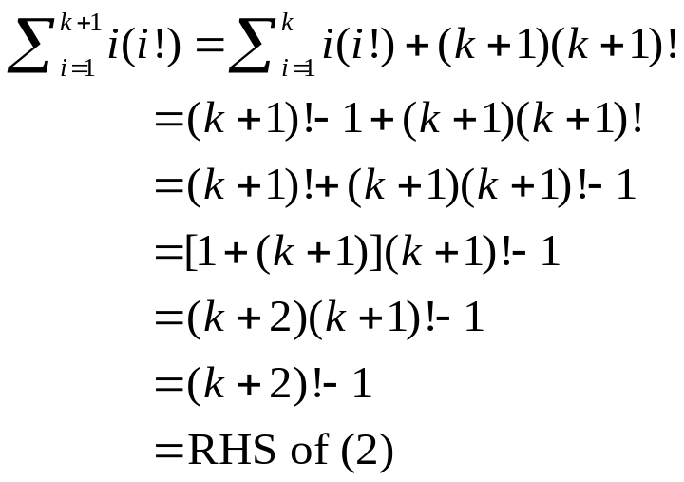
EXERCISE
  Prove by mathematical induction
for all integers n≥1
  SOLUTION
  1. Basis step: For n = 1
  LHS
  RHS = (1+1)! - 1 = 2! - 1
  = 2 -1 = 1
  Hence
  which proves the basis step.
  2. Inductive Step: Suppose for any integer k ≥1
………………………..(1)
  We need to prove that
……………………(2)
Consider LHS of (2)
Using (1)

Slide 13
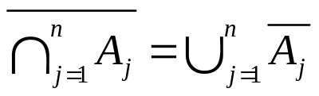
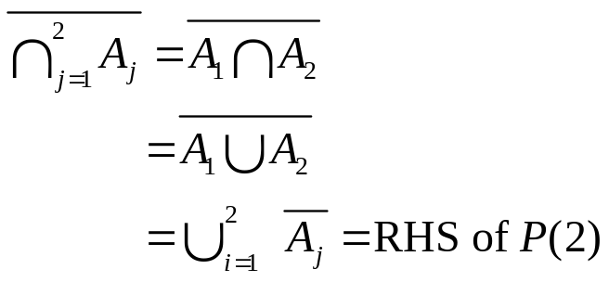
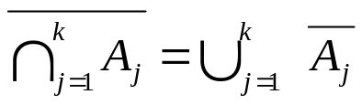
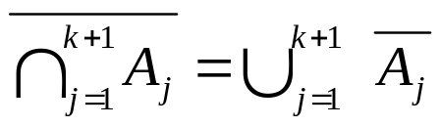
  Hence the inductive step is also true.
  Accordingly, by mathematical induction, the given formula is true for all integers n ≥1.
EXERCISE
  Use mathematical induction to prove the generalization of the following DeMorgan’s Law:
  where A₁, A₂, …, A_{n} are subsets of a universal set U and n≥2.
  SOLUTION
  Let P(n) be the given propositional function
  1. Basis Step: P(2) is true.
  LHS of P(2) =
By DeMorgan’s Law
  2. Inductive Step: Assume that P(k) is true for some integer k ≥2; i.e.,
………………….(1)
  where A₁, A₂, …, A_{k} are subsets of the universal set U. If A_{k+1} is another set of U, then we need to show that
………………..(2)

Slide 14
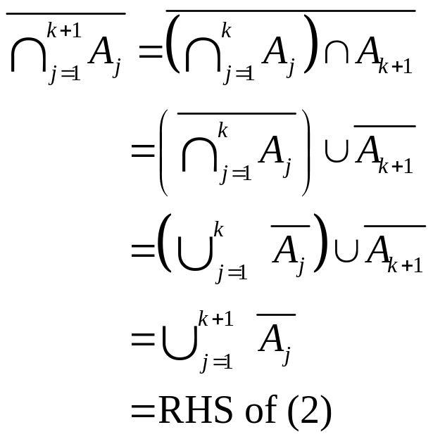
  Consider LHS of (2)
By DeMorgan’s Law
  Hence by mathematical induction, the given generalization of DeMorgan’s Law holds.

