Slide 1
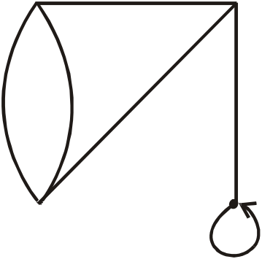
LECTURE # 14
INTRODUCTION
  Graph theory plays an important role in several areas of computer science such as:
    switching theory and logical design
    artificial intelligence
    formal languages
    computer graphics
    operating systems
    compiler writing
    information organization and retrieval.
GRAPH
  A graph is a nonempty set of points called vertices and a set of line segments joining pairs of vertices called edges.
  Formally, a graph G consists of two finite sets:
  (i) A set V=V(G) of vertices (or points or nodes)
  (ii) A set E=E(G) of edges; where each edge corresponds to a pair of vertices.
v₁
e₁
v₂
e₃
e₂
e₄
e₅
v₅
v₃
v₄
e₆
The graph G with
V(G) = {v₁, v₂, v₃, v₄, v₅} and
E(G) = {e₁, e₂, e₃, e₄, e₅, e₆}

Slide 2
SOME TERMINOLOGY
  We are taking the same graph which we take in the previous example to introduce some terminology.
v₁
e₁
v₂
e₃
e₂
e₄
e₅
v₅
v₃
v₄
e₆
  An edge connects either one or two vertices called its endpoints.
  (edge e₁ connects vertices v₁ and v₂ described as {v₁, v₂}).
  2. An edge with just one endpoint is called a loop. That is a loop is an edge that connects a vertex to itself (e.g., edge e₆)
  3. Two vertices that are connected by an edge are called adjacent; and a vertex that is an endpoint of a loop is said to be adjacent to itself.
  4. An edge is said to be incident on each of its endpoints.
  5. A vertex on which no edges are incident is called isolated. (e.g., v₅)
  6. Two distinct edges with the same set of end points are said to be parallel. (e₂ & e₃).

Slide 3
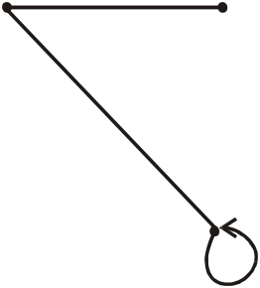
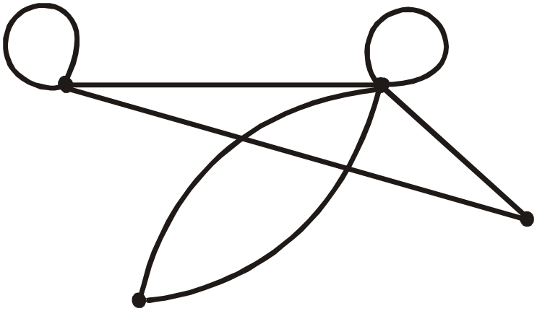
EXAMPLE
  Define the following graph formally by specifying its vertex set, its edge set, and a table giving the edge endpoint function.
v₁
e₁
v₂
e₂
v₄
v₃
e₃
  SOLUTION Vertex Set = {v₁, v₂, v₃, v₄}
  Edge Set = {e₁, e₂, e₃}
  Edge - endpoint function:
Edge | Endpoint
e₁ | {v₁, v₂}
e₂ | {v₁, v₃}
e₃ | {v₃}
EXAMPLE
  For the graph shown
e₁
e₃
e₂
v₂
v₁
e₆
e₄
e₇
e₅
v₃
v₅
v₄

Slide 4
  (i) find all edges that are incident on v₁.
  (ii) find all vertices that are adjacent to v_{3.}
  (iii) find all loops.
  (iv) find all parallel edges.
  (v) find all isolated vertices.
e₁
e₃
e₂
v₂
v₁
e₆
e₄
e₇
e₅
v₃
v₅
v₄
  SOLUTION
  (i) Since we know that edges incidence on a vertices v are those e which has v as an end point so from above diagram it is quite clear that edges incident on v₁ are e₁, e₂ and e₇
  (ii) Remember that we say that two vertices are adjacent if there is an edge between them thus from diagram we can say vertices adjacent to v₃ are v₁ and v_{2..}
  (iii) loops are e₁ and e₃
  (iv) Two edges are said to be parallel if they have the same end points. Hence from diagram it is clear that only edges e₄ and e₅ are parallel
  (v) only isolated vertex is v₄

Slide 5

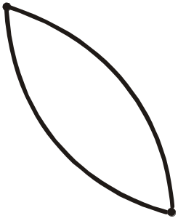
DRAWING PICTURE FOR A GRAPH
  Draw picture of Graph H having vertex set {v₁, v₂, v₃, v₄, v₅} and edge set {e₁, e₂, e₃, e₄} with edge endpoint function
Edge | Endpoint
e₁ | {v₁}
e₂ | {v₂,v₃}
e₃ | {v₂,v₃}
e₄ | {v₁,v₅}
  SOLUTION
  Given V(H) = {v₁, v₂, v₃, v₄ , v₅}
  and E(H) = {e₁, e₂, e₃, e₄}
  First of all we note that there are 5 vertices so we made three dots and label them as v1, v₁, v₃, v₄, v₅ as vertices. Now we will proceed and draw the graph by noting the edge point function as
  Since e₁ edge has only one end
  point it means that there is a loop at the
  Vertex v_{1.}
  Then e₂ has its end points {v₂,v₃} so
  we made an edge between these
  two vertices.
  Similarly we draw all the edges and find the graph as in front of us.
e₁
v₂
v₁
e₄
e₂
v₅
e₃
v₄
v₃

Slide 6
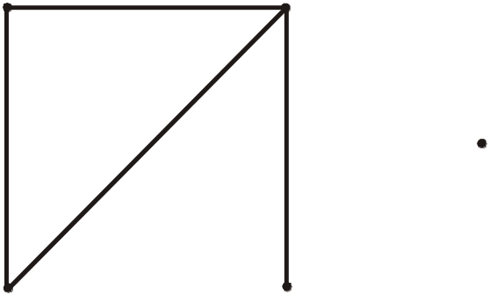
SIMPLE GRAPH
  A simple graph is a graph that does not have any loop or parallel edges.
  EXAMPLE
v₁
e₁
v₂
v₅
e₂
e₃
e₄
v₄
v₃
A simple graph H
  V(H) = {v₁, v₂, v₃, v₄, v₅}
  E(H) = {e₁, e₂, e₃, e₄}
EXERCISE
  Draw all simple graphs with the four vertices {u, v, w, x} and two edges, one of which is {u, v}.
  SOLUTION
  There are C(4,2) = 6 ways of choosing two vertices from 4 vertices. These edges may be listed as:
  {u,v}, {u,w}, {u,x}, {v,w}, {v,x}, {w,x}
  One edge of the graph is specified to be {u,v}, so any of the remaining five from this list may be chosen to be the second edge. This required graphs are:

Slide 7
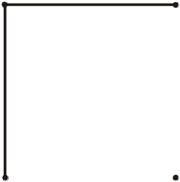
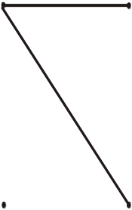
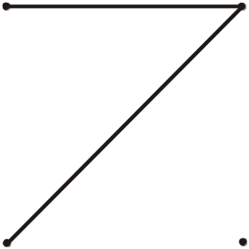


DEGREE OF A VERTEX
1.
u
v
2.
u
v
w
x
w
x
3.
u
v
4.
5.
u
v
w
x
u
v
w
x
w
x
  Let G be a graph and v a vertex of G. The degree of v, denoted deg(v), equals the number of edges that are incident on v, with an edge that is a loop counted twice.
  The total degree of G is the sum of the degrees of all the vertices of G.

Slide 8

THE HANDSHAKING THEOREM
EXAMPLE
v₂
. v₁
  For the graph shown
  deg (v₁) = 0, since no edge is incident on v₁.
  deg (v₂) = 2, since both e₁ and e₂ are incident on v₂.
  deg (v₃) = 4, since both e₁ and e₂ are incident on v₃.
  and the loop e₃ is also incident on v₃.
  total degree of G = deg(v₁) + deg(v₂) + deg(v₃)
  = 0 + 2 + 4
  = 6
  REMARK
  The total degree of G, which is 6, equals twice the number of edges of G, which is 3.
e₁
e₂
v₃
e₃
  If G is any graph, then the sum of the degrees of all the vertices of G equals twice the number of edges of G.
  Specifically, if the vertices of G are v₁, v₂, …, v_{n}, where n is a positive integer, then
  the total degree of G = deg(v₁) + deg(v₂) + … + deg(v_{n})
  = 2 . (the number of edges of G)
  The proof of the theorem is in the next page.

Slide 9
EXERCISE
  PROOF
  Each edge “e” of G connects its end points v_{i} and v_{j}. This edge, therefore contributes 1 to the degree of v_{i} and 1 to the degree of v_{j}.
  If “e” is a loop, then it is counted twice in computing the degree of the vertex on which it is incident.
  Accordingly, each edge of G contributes 2 to the total degree of G.
  Thus,
  the total degree of G = 2. (the number of edges of G)
  COROLLARY
  The total degree of G is an even number.
  NOTE:
  Here you should remember the definition of even numbers “ Even numbers are those numbers which are divisible by 2” Obviously the total number of degree of a graph is an even number, because it has factor 2.
  Draw a graph with the specified properties or explain why no such graph exists.
  (i) Graph with four vertices of degrees 1, 2, 3 and 3
  (ii) Graph with four vertices of degrees 1, 2, 3 and 4
  (iii) Simple graph with four vertices of degrees 1, 2, 3 and 4

Slide 10
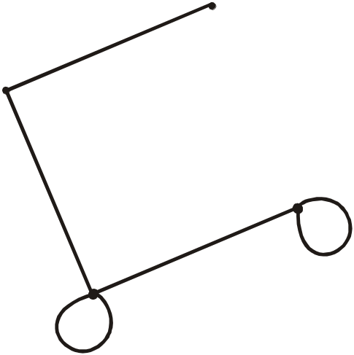
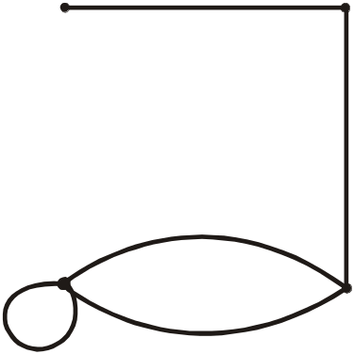
  SOLUTION
  (i) total degree of graph = 1 + 2 + 3 + 3
  = 9 an odd integer
  Since, the total degree of a graph is always even, hence no such graph is possible.
  (ii) Two graphs with four vertices of degrees 1, 2, 3 & 4 are
1.
a
a
b
2.
b
c
d
c
d
  The vertices a, b, c, d have degrees 1,2,3, and 4 respectively.
  (iii) Suppose there were a simple graph with four vertices of degrees 1, 2, 3, and 4. Then the vertex of degree 4 would have to be connected by edges to four distinct vertices other than itself because of the assumption that the graph is simple (and hence has no loop or parallel edges.) This contradicts the assumption that the graph has four vertices in total.
  Hence there is no simple graph with four vertices of degrees 1, 2, 3, and 4.

Slide 11
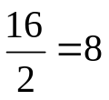
EXERCISE
  Suppose a graph has vertices of degrees 1, 1, 4, 4 and 6. How many edges does the graph have?
  SOLUTION
  The total degree of graph = 1 + 1 + 4 + 4 + 6
  = 16
  Since, the total degree of graph = 2.(number of edges of graph)
  ⇒ 16 = 2.(number of edges of graph)
  ⇒ Number of edges of graph =
EXERCISE
  In a group of 15 people, is it possible for each person to have exactly 3 friends? Explain.
  SOLUTION
  Suppose that in a group of 15 people, each person had exactly 3 friends. Then we could draw a graph representing each person by a vertex and connecting two vertices by an edge if the corresponding people were friends.
  But such a graph would have 15 vertices each of degree 3, for a total degree of 45 (not even) which is not possible.
  Hence, in a group of 15 people it is not possible for each to have exactly three friends.

Slide 12
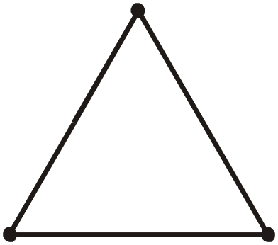
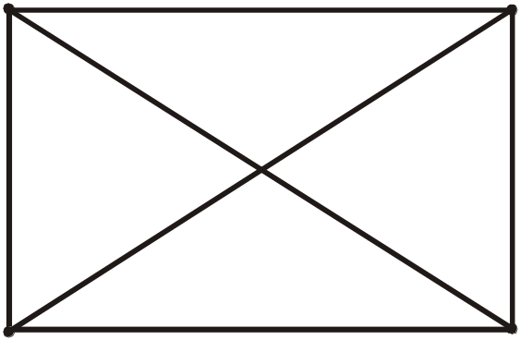
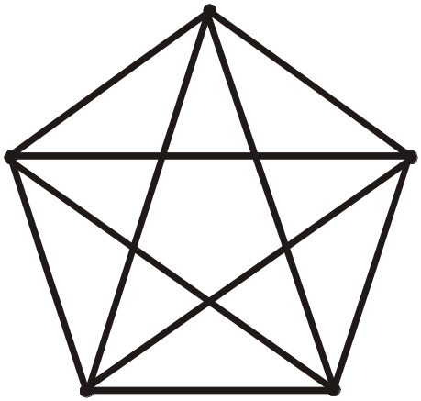
COMPLETE GRAPH
  A complete graph on n vertices is a simple graph in which each vertex is connected to every other vertex and is denoted by K_{n}.
  The following are complete graphs K₁, K₂,K₃, K₄ and K₅.
v₁
v₁
v₂
K₁
K₂
v₁
v₂
v₃
K₃
v₁
v₄
v₂
v₁
v₅
v₂
v₃
v₃
v₄
K₄
K₅

Slide 13
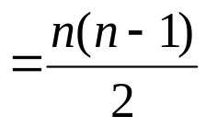

EXERCISE
  For the complete graph K_{n}, find
  (i) the degree of each vertex
  (ii) the total degrees
  (iii) the number of edges
  SOLUTION
  (i) Each vertex v is connected to the other (n-1) vertices in K_{n}; hence deg (v) = n - 1 for every v in K_{n}.
  (ii) Each of the n vertices in K_{n} has degree n - 1; hence, the total degree in
  K_{n} = (n - 1) + (n - 1) + … + (n - 1) n times
  = n (n - 1)
  (iii) Each pair of vertices in K_{n} determines an edge, and there are C(n, 2) ways of selecting two vertices out of n vertices. Hence,
  Number of edges in K_{n} = C(n, 2)
  Alternatively,
  The total degrees in graph K_{n} = 2 (number of edges in K_{n})
  ⇒ n(n-1) = 2(number of edges in K_{n})
  ⇒ Number of edges in K_{n}

Slide 14
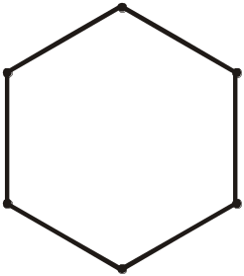
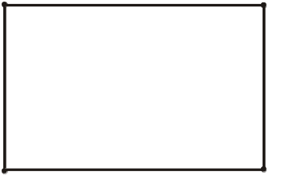
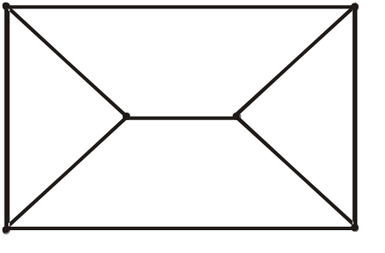
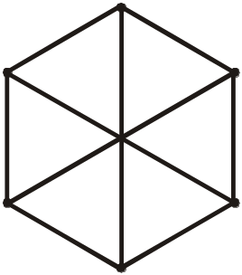
REGULAR GRAPH
  A graph G is regular of degree k or k-regular if every vertex of G has degree k.
  In other words, a graph is regular if every vertex has the same degree.
  Following are some regular graphs.
(i) 0-regular
(ii) 1-regular
(iii) 2-regular
  REMARK The complete graph K_{n} is (n-1) regular.
  Every complete graph is a regular graph.
EXERCISE
  Draw two 3-regular graphs with six vertices.
  SOLUTION
  Note that there are so many graphs which can be made three regular and we are drawing two of them.
a
c
b
a
c
b
f
f
d
e
d
e

Slide 15
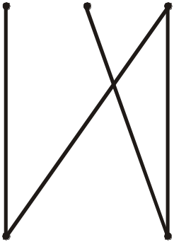
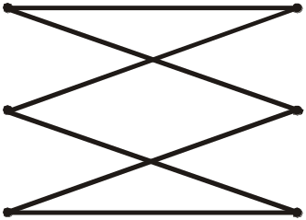
BIPARTITE GRAPH
  A bipartite graph G is a simple graph whose vertex set can be partitioned into two mutually disjoint non empty subsets A and B such that the vertices in A may be connected to vertices in B, but no vertices in A are connected to vertices in A and no vertices in B are connected to vertices in B.
  The following are bipartite graphs
  In it, you can partition the set of vertices in two subsets.
v₁
v₂
v₃
A
B
A
v₁
v₄
v₂
v₅
v₃
v₆
B
v₄
v₅
DETERMINING BIPARTITE GRAPHS
  The following labeling procedure determines whether a graph is bipartite or not.
  1. Label any vertex a
  2. Label all vertices adjacent to a with the label b.
  3. Label all vertices that are adjacent to a vertex just labeled b with label a.
  4. Repeat steps 2 and 3 until all vertices got a distinct label (a bipartite graph) or there is a conflict i.e. a vertex is labeled with a and b (not a bipartite graph).

Slide 16
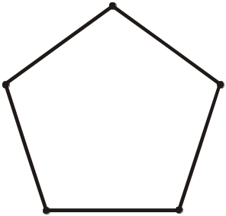
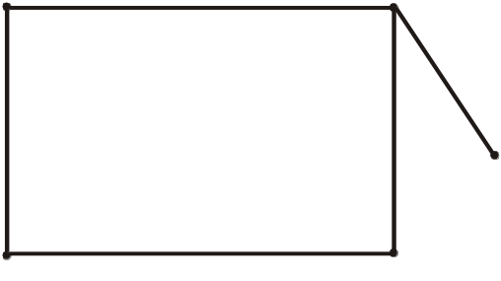
EXERCISE
  Find which of the following graphs are bipartite. Redraw the bipartite graph so that its bipartite nature is evident.
  SOLUTION
  (i)
a
b b
a
a,b (conflict)
  The graph is not bipartite.

Slide 17
(ii)
b
a
b
a
b
  By labeling procedure, each vertex gets a distinct label. Hence the graph is bipartite. To redraw the graph we mark labels a’s as a₁, a₂ and b’s as b₁, b₂, b₃
b₃
a₁
b₁
a₂
b₂
  Redrawing graph with bipartite nature evident.
b₁
a₁
b₂
a₂
b₃

Slide 18
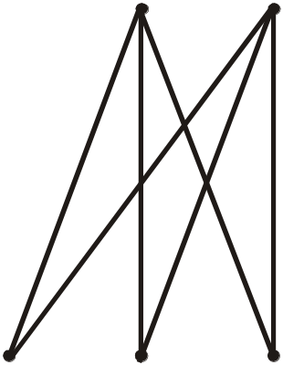
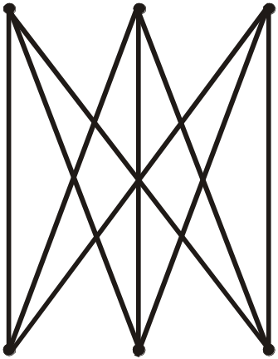
COMPLETE BIPARTITE GRAPH
  A complete bipartite graph on (m,n) vertices denoted K_{m,n} is a simple graph whose vertex set can be partitioned into two mutually disjoint non empty subsets A and B containing m and n vertices respectively, such that each vertex in set A is connected (adjacent) to every vertex in set B, but the vertices within a set are not connected.
K_{2,3}
K_{3,3}

Slide 19
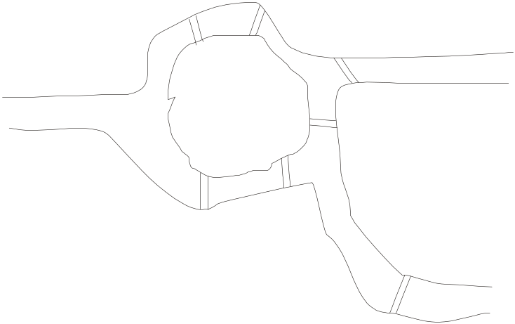
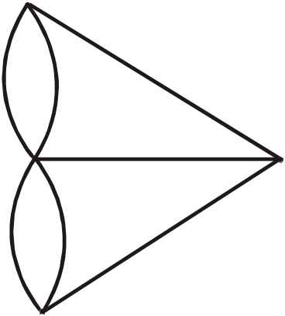
LECTURE # 15
KONINGSBERG BRIDGES PROBLEM
A
B
C
D
  It is possible for a person to take a walk around town, starting and ending at the same location and crossing each of the seven bridges exactly once?
A
A
B
C
D
C
D
B
  Is it possible to find a route through the graph that starts and ends at some vertex A, B, C or D and traverses each edge exactly once?
  Equivalently:
  Is is possible to trace this graph, starting and ending at the same point, without ever lifting your pencil from the paper?

Slide 20
DEFINITIONS
  Let G be a graph and let v and w be vertices in graph G.
  1. WALK
  A walk from v to w is a finite alternating sequence of adjacent vertices and edges of G.
  Thus a walk has the form
  v₀e₁v₁e₂ … v_{n} - ₁e_{n}v_{n}
  where the v’s represent vertices, the e’s represent edges v₀=v , v_{n}=w, and for all i = 1, 2 … n, v_{i-1} and v_{i} are endpoints of e_{i}.
  The trivial walk from v to v consists of the single vertex v.
  2. CLOSED WALK
  A closed walk is a walk that starts and ends at the same vertex.
  3. CIRCUIT
  A circuit is a closed walk that does not contain a repeated edge. Thus a circuit is a walk of the form
  v₀e₁v₁e₂ … v_{n-1} e_{n} v_{n}
  where v₀ = v_{n} and all the e_{i,s} are distinct.
  4. SIMPLE CIRCUIT
  A simple circuit is a circuit that does not have any other repeated vertex except the first and last.
  Thus a simple circuit is a walk of the form
  v₀e₁v₁e₂ … v_{n-1} e_{n} v_{n}
  where all the e_{i,s} are distinct and all the v_{j,s} are distinct except that v₀ = v_{n}

Slide 21
  5. PATH
  A path from v to w is a walk from v to w that does not contain a repeated edge.
  Thus a path from v to w is a walk of the form
  v = v₀e₁v₁e₂ … v_{n-1} e_{n} v_{n} = w
  where all the e_{i},s are distinct (that is e_{i} ≠ e_{k} for any i ≠k).
  6. SIMPLE PATH
  A simple path from v to w is a path that does not contain a repeated vertex.
  Thus a simple path is a walk of the form
  v = v₀e₁v₁e₂ … v_{n-1} e_{n} v_{n} = w
  where all the e_{i,s} are distinct and all the v_{j,s} are also distinct
  (that is, v_{j} ≠ v_{m} for any j ≠ m).
SUMMARY
 | Repeated Edge | Repeated Vertex | Starts and Ends at Same Point
walk | allowed | allowed | allowed
closed walk | allowed | allowed | yes
circuit | no | allowed | yes
simple circuit | no | first and last only | yes
path | no | allowed | allowed
simple path | no | no | no

Slide 22
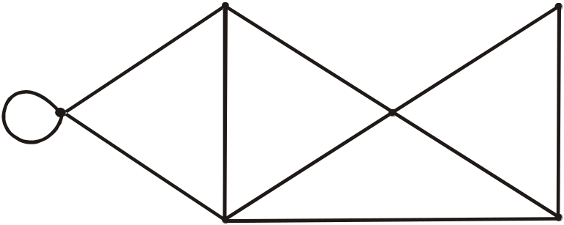
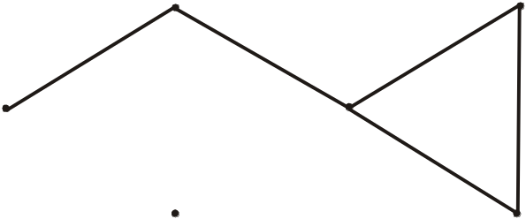
EXERCISE
  In the graph below, determine whether the following walks are paths, simple paths, closed walks, circuits, simple circuits, or are just walks.
        (a) v₁e₂v₂e₃v₃e₄v₄e₅v₂e₂v₁e₁v₀
        (b) v₁v₂v₃v₄v₅v₂
        (c) v₄v₂v₃v₄v₅v₂v₄
        (d) v₂v₁v₅v₂v₃v₄v₂
        (e) v₀v₅v₂v₃v₄v₂v₁
        (f) v₅v₄v₂v₁
v₁
v₃
e₁
e₂
e₃
v₀
v₂
e₁₀
e₉
e₇
e₄
e₅
e₈
v₅
e₆
v₄
(a)
v₁e₂v₂e₃v₃e₄v₄e₅v₂e₂v₁e₁v₀
v₁
v₃
e₁
e₂
e₃
v₀
v₂
e₄
e₅
v₅
v₄
The graph is just a walk.

Slide 23
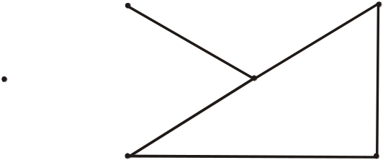
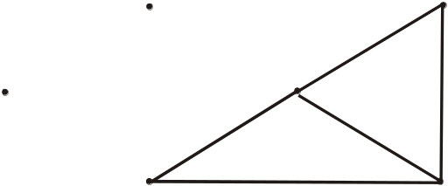
Original Graph Given in the question is
v₁
v₃
e₁
e₂
e₃
v₀
v₂
e₉
e₇
e₄
e₅
e₈
v₅
e₆
v₄
(b) v₁v₂v₃v₄v₅v₂
(c) v₄v₂v₃v₄v₅v₂v₄
v₁
v₃
v₁
v₃
v₀
v₂
v₀
v₂
v₅
v₄
v₅
v₄
Here v₂ is visited two times
So The graph is a path.
The graph is a closed walk.
Because we start from the
vertex v₄ and ends at v₄.

Slide 24
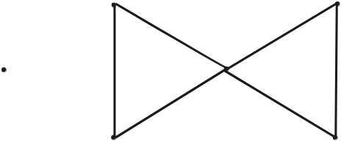
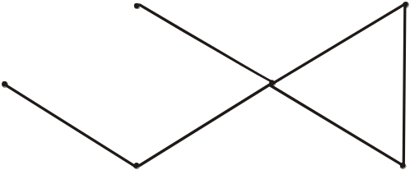
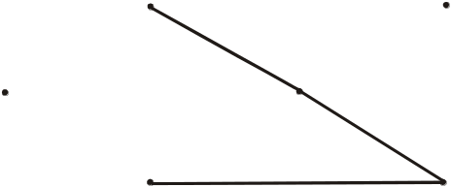
Original Graph Given in the question is
v₁
v₃
e₁
e₂
e₃
v₀
v₂
e₉
e₇
e₄
e₅
e₈
v₅
e₆
v₄
(d) v₂v₁v₅v₂v₃v₄v₂
(e) v₀v₅v₂v₃v₄v₂v₁
v₁
v₃
v₀
v₂
v₁
v₃
v₀
v₂
v₅
v₄
The graph is a circuit.
v₅
v₄
v₀
(f) v₅v₄v₂v₁
The graph is a path.
v₁
v₃
v₀
v₂
v₅
v₄
The graph is a path.

Slide 25
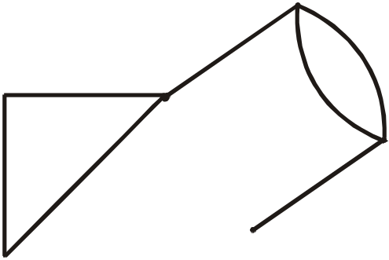
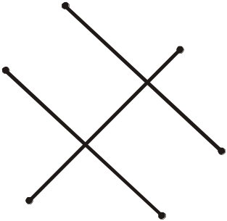
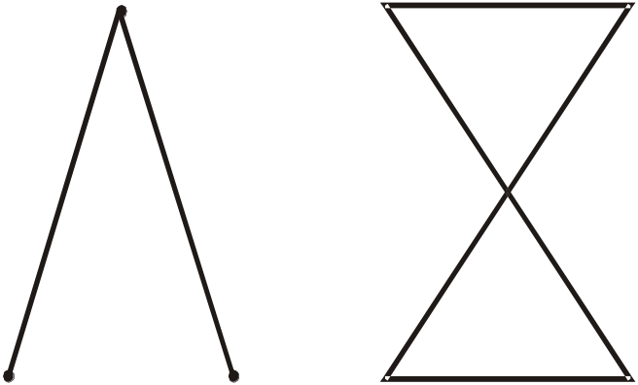
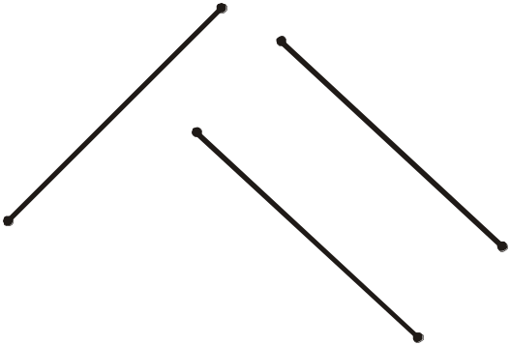
CONNECTEDNESS
  Let G be a graph. Two vertices v and w of G are connected if, and only if, there is a walk from v to w.
  The graph G is connected if, and only if, given any two vertices v and w in G, there is a walk from v to w.
  Symbolically:
  G is connected ⇔ ∀ vertices v, w ∈ V(G), ∃ a walk from v to w.
EXAMPLE
Which of the following graphs have a connected.
(a)
v₄
(b)
v₃
v₂
v₃
v₂
v₄
v₅
v₅
v₁
v₆
v₁
v₆
Not Connected
Connected
(d)
(c)
v₂
v₅
v₆
v₄
v₃
v₂
v₄
v₁
v₅
v₁
v₃
v₈
v₇
v₆
Not Connected
Not Connected

Slide 26
EULER CIRCUITS
  DEFINITION
  Let G be a graph.
  An Euler circuit for G is a circuit that contains every vertex and every edge of G.
  That is, an Euler circuit for G is sequence of adjacent vertices and edges in G that starts and ends at the same vertex uses every vertex of G at least once, and used every edge of G exactly once.
  EULER RESULT
  A graph G has an Euler circuit if, and only if, G is connected and every vertex of G has an even degree.
KONINGSBERG BRIDGES PROBLEM
A
A
B
B
C
C
D
D
D

Slide 27
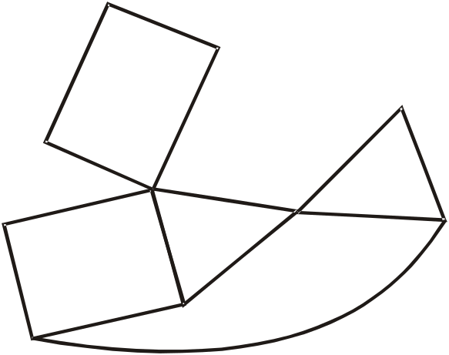
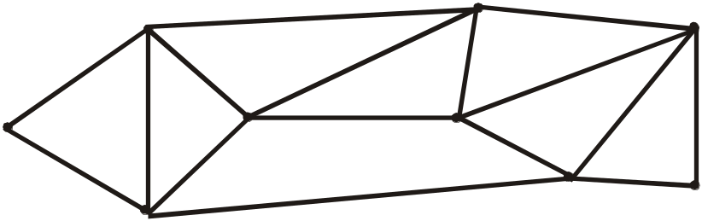
EXERCISE
  Determine whether the following graph has Euler circuit.
v₃
v₄
v₆
v₂
v₅
v₀
v₁
v₇
v₈
v₉
  SOLUTION:
  Since we know that a graph contains a Euler circuit if the graph is connected and every vertex of the graph has even degree. Now in the above graph note that vertices v₈ and v₉ are of degree 3 which is not even number. Consequently the graph does not contain Euler circuit.
EXERCISE
Determine whether the following graph has Euler circuit.
b
c
d
a
h
g
i
f
e
  a=2, b=4, c=4, d=4, e=2, f=4, g=4, h=4, i=4
  every vertex is of even degree, so clearly Euler theorem is applicable.
  One such circuit is:
  a b c d e f g d f i h c g h b i a

Slide 28
EULER PATH
  DEFINITION
  Let G be a graph and let v and w be two vertices of G.
  An Euler path from v to w is a sequence of adjacent edges and vertices that starts at v, and end at w, passes through every vertex of G at least once, and traverses every edge of G exactly once.
  COROLLARY
  Let G be a graph and let v and w be two vertices of G.
  There is an Euler path from v to w if, and only if, G is connected,
  v and w have odd degree and all other vertices of G have even degree.
HAMILTONIAN CIRCUITS
  DEFINITION
  Given a graph G, a Hamiltonian circuit for G is a simple circuit that includes every vertex of G.
  That is, a Hamiltonian circuit for G is a sequence of adjacent vertices and distinct edges in which every vertex of G appears exactly once.

Slide 29
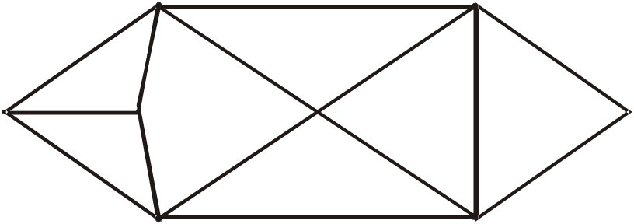
EXERCISE
  Find Hamiltonian Circuit for the following graph.
b
d
a
h
c
e
g
f
  Remember the definition of Simple circuit and that of Hamiltonian circuit we not that the circuit abdefcgha is a Simple circuit which contains all the vertices of the given graph so graph contains a Hamiltonian Circuit.
PROPOSITION
  If a graph G has a Hamiltonian circuit then G form a sub-graph H with the following properties:
  1. H contains every vertex G
  2. H is connected
  3. H has the same number of edges as vertices
  4. Every vertex of H has degree 2

Slide 30
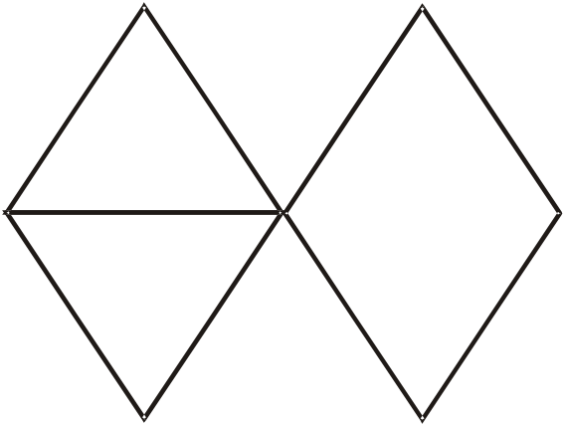
EXERCISE
  Show that the following graph does not have a Hamiltonian circuit.
b
d
a
c
e
g
f
SOLUTION:
Here deg(c)=5,if we remove 3 edges from vertex c then deg(b)< 2 , deg(g)< 2 or deg(f)< 2,deg(d)< 2.
note that we take the vertex c but there is another vertex a of the degree 3 but by removing the edge {a , c} the degree of a becomes 2.
and does not violate any other condition but at that time the degree of c is 4 then again by removing any edge from the graph we get the same condition as above .
It means that this graph does not satisfy the desired properties as given in the proposition so the graph does not have a Hamiltonian circuit.

Slide 31
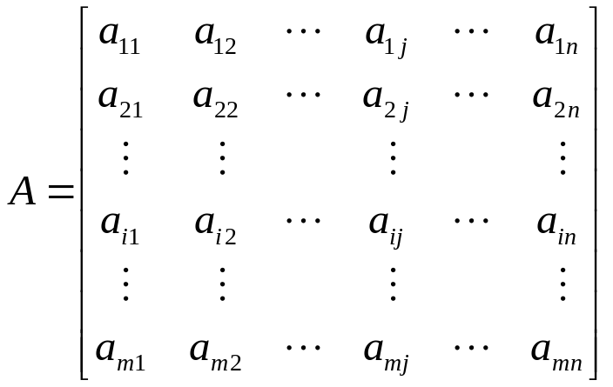
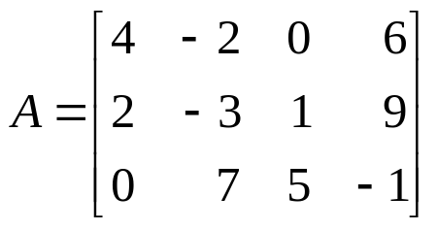
LECTURE # 15 b
MATRIX
  An m × n matrix A over a set S is a rectangular array of elements of S arranged into m rows and n columns:
← ith row of A
↑
jth column of A
  Briefly, it is written as:
  A = (a_{ij})_{m×n}
EXAMPLE
  A is a matrix having 3 rows and 4 columns. We call it a 3 × 4 matrix, or matrix of size 3 × 4 or matrix of order 3 × 4 .
  Note that
  a₁₃ = 0, a₂₃ = 1, a₃₂ = 7

Slide 32

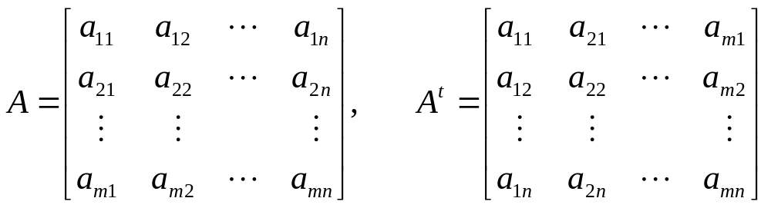
SQUARE MATRIX
  A matrix for which the number of rows and columns are equal is called a square matrix. A square matrix A with n rows and n columns (size n × n) has the form:
  The main diagonal of A consists of all the entries
  a₁₁, a₂₂, a₃₃, …, a_{ii},…, a_{nn}
TRANSPOSE OF A MATRIX
  The transpose of a matrix A of size m × n, is the matrix A^{t} of size n × m, obtained by writing the rows of A, in order, as columns. Thus if

Slide 33
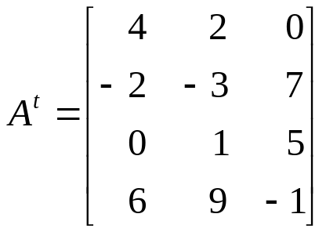
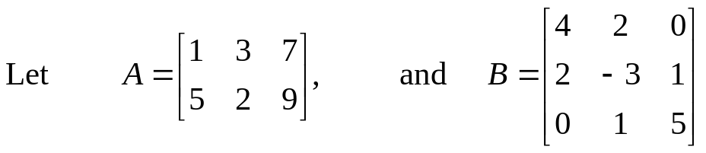
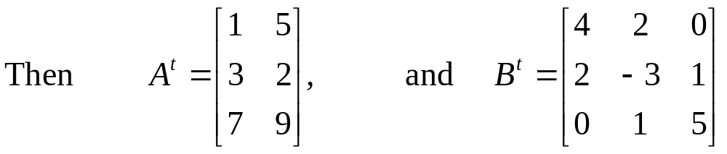
EXAMPLE
  Find transpose of the following matrix
  Then its transpose is obtained by changing rows of A into columns. Thus
  Note that the order of A is 3 x 4 where as order of A^{t} is 4 x 3. In fact if A has order m x n then A^{t} will have order n x m.
SYMMETRIC MATRIX
  A square matrix A = (a_{ij}) of size n × n is called symmetric if, and only if,
  A^{t} = A i.e., for all i, j = 1, 2, …, n, a_{ij} = a_{ji}
  EXAMPLE
  Note that B^{t} = B, so that B is a symmetric matrix. But A is not equal to A^{t} hence A is not symmetric.

Slide 34
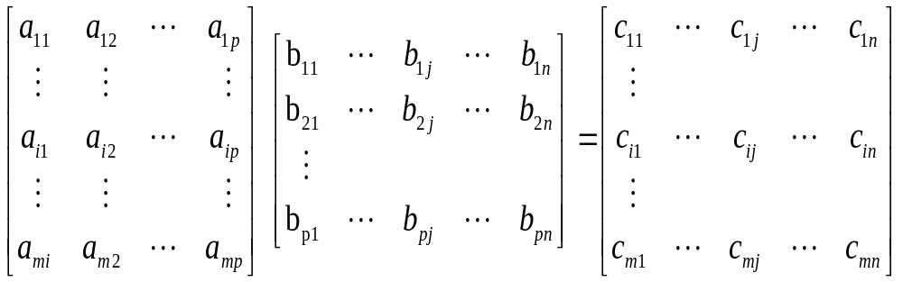
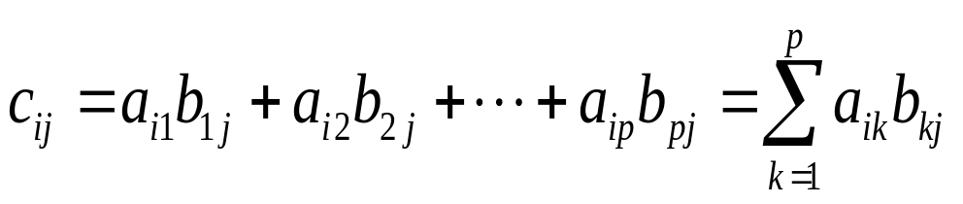
MATRIX MULTIPLICATION
  Suppose A and B are two matrices such that the number of columns of A is equal to the number of rows of B, say A is an m × p matrix and B is a p × n matrix.
  Then the product of A and B, written AB, is the m × n matrix whose ijth entry is obtained by multiplying the elements of the ith row of A by the corresponding elements of the jth column of B and then adding;
  where
  REMARK
  If the number of columns of A is not equal to the number of rows of B, then the product AB is not defined.

Slide 35




EXAMPLE
  Find the product AB and BA of the matrices
  SOLUTION
  Size of A is 2 × 2 and of B is 2 × 3, the product AB is defined as a 2 × 3 matrix. But BA is not defined, because
  no. of columns of B = 3 ≠ 2 = no. of rows of A.
EXAMPLE
  Find AA^{t} and A^{t}A, where
  SOLUTION
  A^{t} is obtained from A by rewriting the rows of A as columns:

Slide 36



Now
and
  Which are the required matrices you can note that AA^{t} is not equal to the A^{t}A. Which shows that the operation of Matrix multiplication is not commutative in General.

Slide 37


ADJACENCY MATRIX OF A GRAPH
  Let G be a graph with ordered vertices v₁, v₂,.., v_{n}. The adjacency matrix of G is the matrix A = (a_{ij}) over the set of non-negative integers such that
  a_{ij} = the number of edges connecting v_{i} and v_{j}
  for all i, j = 1, 2, …, n
EXAMPLE
  A graph with it’s adjacency matrix is shown.
v₁
v₂
e₁
e₃
e₄
e₅
v₄
v₃
e₂
Adjacency Matrix
  Note that the nonzero entries along the main diagonal of A indicate the presence of loops and entries larger than 1 correspond to parallel edges.
  Also note A is a symmetric matrix.

Slide 38



EXERCISE
  Find a graph that have the following adjacency matrix.
  SOLUTION
  Let the three vertices of the graph be named v₁, v₂ and v₃. We label the adjacency matrix across the top and down the left side with these vertices and draw the graph accordingly.
v₂
v₁
v₃
DIRECTED GRAPH
  A directed graph or digraph, consists of two finite sets: a set V(G) of vertices and a set D(G) of directed edges,
  where each edge is associated with an ordered pair of vertices called its end points.
  If edge e is associated with the pair (v, w) of vertices, then e is said to be the directed edge from v to w and is represented by drawing an arrow from v to w.

Slide 39


ADJACENCY MATRIX OF A DIRECTED GRAPH
EXAMPLE
v₂
e₁
v₁
e₃
e₂
v₄
e₅
v₃
e₄
e₆
  In the above figure we have a directed graph note that there is an edge from
  v₂ to v₃ but no edge from v₃ to v₂.
  Let G be a graph with ordered vertices v₁, v₂, …, v_{n}.
  The adjacency matrix of G is the matrix A = (a_{ij}) over the set of non-negative integers such that
  a_{ij} = the number of arrows from v_{i} to v_{j}
  for all i, j = 1, 2, …, n.
EXAMPLE
  A directed graph with its adjacency matrix is shown
v₂
e₁
e₄
v₁
e₃
e₂
v₄
e₅
v₃
e₆

Slide 40



EXERCISE
  Find directed graph that has the adjacency matrix
  SOLUTION
  The 4 × 4 adjacency matrix shows that the graph has 4 vertices say v₁, v₂, v₃ and v₄ labeled across the top and down the left side of the matrix.
A corresponding directed graph is
  Since we know that in the matrix we have the value corresponding to v₁v₄ is 2. It means that we will have two directed edges from v1 to v₄.
  Similarly you can see that the entry in the v₃v₂ has the entry 2 thus we have two directed arrows from v₃ to v₂.
  Following the same procedure we will get the graph given in the front.
v₁
v₂
v₄
v₃

Slide 41


THEOREM
  If G is a graph with vertices v₁, v₂, …,v_{m} and A is the adjacency matrix of G, then for each positive integer n,
  the ijth entry of A^{n} = the number of walks of length n from v_{i} to v_{j}
  for all integers i,j = 1, 2, …, n
EXERCISE
  be the adjacency matrix of a graph G with vertices v₁, v₂, and v₃. Find
  (a) the number of walks of length 2 from v₂ to v₃
  (b) the number of walks of length 3 from v₁ to v₃
  Draw graph G and find the walks by visual inspection for (a)
SOLUTION
  Since we have to find out the number of walks of length 2 from v₂ to v₃ which will be the 23rd element of A² (By using the above Theorem) So first we will calculate A².
  Hence, number of walks of length 2 from v₂ to v₃
  = the entry at (2,3) of A² = 2

Slide 42




(b) Similarly we can find out the walks of length 3 from v₁ to v₃.
  Hence, number of walks of length 3 from v₁ to v₃
  = the entry at (1,3) of A³ = 15
  Hence there are 15 walks of length 3 from v₁ to v₃.
  Walks from v₂ to v₃ by visual inspection of graph
e₁
e₂
v₂
v₁
e₃
e₅
e₄
  Two Walks of length 2 from v₂ to v₃ are
  (i) v₂ e₂ v₁ e₃ v₃
  (ii) v₂ e₂ v₁ e₄ v₃
v₃
INCIDENCE MATRIX OF A SIMPLE GRAPH
  Let G be a graph with vertices v₁, v₂, …, v_{n} and edges e₁, e₂, …, e_{m}. The incidence matrix of G is the matrix M = (m_{ij}) of size n × m defined by

Slide 43

EXAMPLE
  A graph with its incidence matrix is shown.
INCIDENCE MATRIX
v₁
v₂
e₁
e₄
e₅
e₃
v₄
e₂
v₃
  REMARK In the incidence matrix
  Multiple edges are represented by columns with identical entries
  (e₄ & e₅)
  2. Loops are represented using a column with exactly one entry equal to 1, corresponding to the vertex that is incident with this loop and other zeros (e₂).

Slide 44




  LECTURE # 43
  Consider the following Graph (on the left side) of K₄ ,note that the two edges (Corresponds to the diagonal ) in the graph crosses each other.
  Now note that we can draw one of the diagonal out side the square, such that no edge of the graph intersects. Now we define Planar Graph,
DEFINITION
  A graph is called planar if it can be drawn in the plane without any edge crossing. Such a drawing is called a plane drawing of the graph.
EXAMPLES
K₄ is planar.

Slide 45


EXAMPLE
  The graph below is planar.
a
b
w
x
d
c
z
y
  This graph is called 3-cube and is denoted Q₃. Note that in the given graph appears to be non Planar because there are so many edges crossing each other. We will try to redraw it in such a way that no two edges crosses each other.
  A plane drawing of the graph is given below and we find it by extending the edges “wx” upwards ,”zy” downwards and “xy” to the right and “wz” to the left.
w
x
a
b
d
c
z
y

Slide 46



EXERCISE
  Determine whether the graph below is planar. If so, draw it so that no edges cross.
a
b
c
d
e
f
  SOLUTION
  We will redraw the graph such that no two edges cross each other. For this first of all we find out the largest circuit in the graph note that In the given graph we have “afcebda” is a circuit in the given graph, so first of all we will draw this circuit, then we have only two edges remaining which are “ae” and “dc” and these are inside the hexagon and also crossing each other as shown in the graph below.
a
f
a
f
d
c
or
d
c
e
b
e
b
  Now these two edges cross each other, finally we draw one edge “ae” out side the Hexagon, now you can easily see that we redraw the graph in such a way that no two edges cross each other.
  Hence the given graph is planar

Slide 47


THEOREM
  K_{3,3} is not planar.
  PROOF
  As you know that K3,3 is Complete Bipartite Graph
  and its graph is drawn below.
a
b
c
x
y
z
  K_{3,3} can be re-drawn as
a
z
c
We re-draw the edge “ay” so that it does not cross any other edge.
x
a
z
b
y
x
c
Note that bz cannot be drawn without crossings. Hence, K_{3,3} is not planar.
b
y

Slide 48


THEOREM
  K₅ is non planar.
  PROOF
  First of all remember that K₅ is the complete Graph over 5 vertices. First of we will draw the graph.
  We draw the vertices in side the pentagon by the dotted lines because we will try to draw these vertices such that no two edges Crosses each other .Let us draw the two vertices “vy” and “vx” out side the pentagon, such that
  We are left with two vertices crossing each other inside the pentagon. Now if we draw any of these vertices outside the pentagon it will intersect the other edge. For example if we draw “wy” outside the pentagon then it will cross “vx” and if we draw “zx” outside pentagon then it will cross “vy”.
  It means that we can't redraw K₅ without edge crossing. Consequently K₅ in non-Planar.
v
z
w
y
x
v
z
w
y
x

Slide 49


DEFINITION
  A plane drawing of a planar graph divides the plane into regions, including an unbounded region, called faces. The unbounded region is called the infinite face.
  The above planar graph has 6 faces out of which is unbounded region and all other are bounded region. Where as I the Planar graph give below,
  In the above graph we have unbounded face and all other faces are bounded.
EXAMPLES
f₄
f₆
f₂
f₃
f₁
f₅
f₆
f₅
f₄
f₆
f₁
f₃
f₈
f₇
f₂
f₅

Slide 50


EULER’S FORMULA
  THEOREM
  Let G be a connected planar simple graph with e edges and v vertices. Let f be the number of faces in a plane drawing of G. Then
  f = e – v + 2
EXERCISE
  Suppose that a connected planar simple graph has 30 edges. If a plane drawing of this graph has 20 faces, how many vertices does this graph have?
  SOLUTION
  Given that e = 30, and f = 20. Substituting these values in the Euler’s Formula f = e – v + 2 we get
  20 = 30 – v + 2
  Hence,
  v = 30 – 20 + 2 = 12
  Consider the two Planar Graphs we want to color them and the scheme of coloring is such that no two regions which are connected can take the same color. Let us color first graph
GRAPH COLORING
B
G
A
B
C
D
F
C
A
D
E
E

Slide 51
B
G
C
D
F
A
E
  Note that in the above Planar graph we have the region A is adjacent with B, C,D and E, let we give the region A color blue, then we have to assign a different color to the regions B. Let we assign the color red to the region B. Now region C is adjacent with both the regions A and B so we color it a different color say we color it Green,. Now region D is adjacent with all these vertices A ,B ,and with C so we color it with a different color so we color it Purple. Now the region E is adjacent with A and D, but not adjacent with B and C so can color the region by one of the colors of B and C. Let we color E with red. Now the region F is adjacent with E and D so we can color it green or blue. Let we color it with Blue. Finally we color the region G “green”. (Because we have only Green color left for us)
  Similarly we color the second Graph.
A
B
C
D
E

Slide 52


Now we will draw these planar Graphs in terms of vertices and edge and will also color the vertices.
The graph corresponding to the above region is
Similarly the graph corresponding to the second region is drawn below,
B
G
C
D
F
A
E
B
C
D
G
A
F
E
A
B
B
C
A
C
E
D
E
D

Slide 53


DEFINITION
  A coloring of a simple graph is the assignment of a color to each vertex of the graph so that no two adjacent vertices are assigned the same color.
  The chromatic number of a graph is the least number of colors for coloring of this graph.
EXAMPLE
  What is the chromatic number of the graphs G and H shown below?
G
H
b
e
b
e
a
d
g
d
a
g
c
f
c
f
G
H
b Blue
e Green
b Blue
e Green
a
Red
d Red
g Red
a
Red
d Red
g Purple
c Green
f Blue
c Green
f Blue
Clearly the chromatic number of G is 3 and chromatic number of H is 4

Slide 54

THE FOUR COLOR THEOREM
  The chromatic number of a simple planar graph is no greater than four.
APPLICATION OF GRAPH COLORING
  EXAMPLE
  Suppose that a chemist wishes to store five chemicals a,b,c,d and e in various areas of a warehouse. Some of these chemicals react violently when in contact, and so must be kept in separate areas. In the following table, an asterisk indicates those pairs of chemicals that must be separated. How many areas are needed?
  SOLUTION
  We draw a graph whose vertices corresponds to the five chemicals, with two vertices adjacent whenever the corresponding chemicals are to be kept apart.

Slide 55

b
Blue
a
c
e
Green
Red
Red
d
Purple
  We draw the Graph by noting the above table and made two vertices adjacent only when these chemicals cannot be kept together. And color them by the same technique.
  Clearly the chromatic number is 4 and so four areas are needed to store the chemicals.

