Slide 1
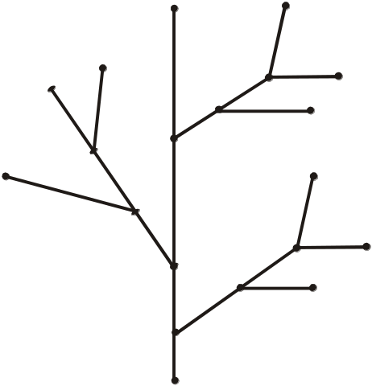
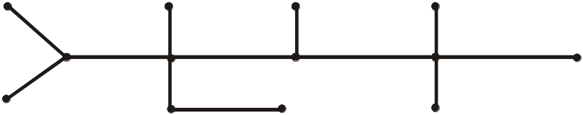
APPLICATION AREAS OF TREES
  Trees are used to solve problems in a wide variety of disciplines. In computer science trees are employed to
  construct efficient algorithms for locating items in a list.
  construct networks with the least expensive set of telephone lines linking distributed computers.
  construct efficient codes for storing and transmitting data.
  model procedures that are carried out using a sequence of decisions, which are valuable in in the study of sorting algorithms.
TREE
  A tree is a connected graph that does not contain any nontrivial circuit. (i.e., it is circuit-free)
  A trivial circuit is one that consists of a single vertex.
.
TREE
TREE
TREE

Slide 2
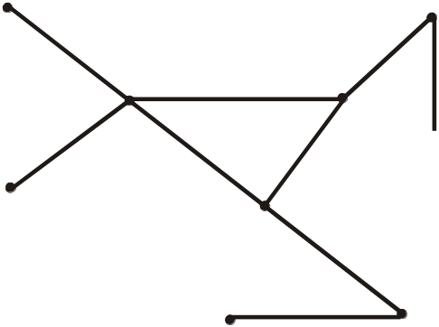


EXAMPLES OF NON TREES
(a) Graph with a circuit
(b) Disconnected graph
(c) Graph with a circuit
SOME SPECIAL TREES
  1. TRIVIAL TREE
  A graph that consists of a single vertex is called a trivial tree or degenerate tree.
  2. EMPTY TREE
  A tree that does not have any vertices or edges is called an empty tree.
  3. FOREST
  A graph is called a forest if, and only if, it is circuit-free.
  Hence, the connected components of a forest are trees.

Slide 3
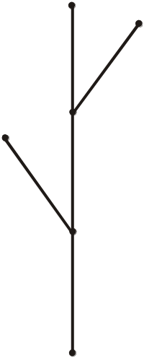

A forest
  In the above example of forest it has only two trees in it and not a very thick forest.
PROPERTIES OF TREES
  1. A tree with n vertices has n - 1 edges.
  2. Any connected graph with n vertices and n - 1 edges is a tree.
  3. A tree has no nontrivial circuit; but if one new edge is added to it, then the resulting graph has exactly one nontrivial circuit.
  4. A tree is connected, but if any edge is deleted from it, then the resulting graph is not connected.
  5. Any tree that has more than one vertex has at least two vertices of degree 1.
  6. A graph is a tree iff there is a unique path between any two of its vertices.

Slide 4

EXERCISE
  Explain why graphs with the given specification do not exist.
  1. tree, twelve vertices, fifteen edges.
  2. tree, five vertices, total degree 10.
  SOLUTION
  1. Any tree with 12 vertices will have 12 - 1 = 11 edges, not 15.
  2. Any tree with 5 vertices will have 5 - 1 = 4 edges.
  Since, total degree of graph = 2 (No. of edges)
  = 2(4) = 8
  Hence, a tree with 5 vertices would have a total degree 8, not 10.
EXERCISE
  Find all non isomorphic trees with four vertices.
  SOLUTION
  Any tree with four vertices has three edges. Thus, the total degree of a tree with 4 vertices must be 6.
  Also, every tree with more than one vertex has at least two vertices of degree 1, so the only possible combinations of degrees for the vertices of the trees are 1, 1, 1, 3 and 1, 1, 2, 2.
  The corresponding trees (clearly non-isomorphic) are
and

Slide 5


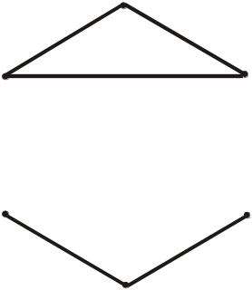
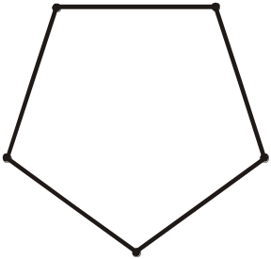
EXERCISE
  Find all non-isomorphic trees with five vertices.
  SOLUTION
  There are three non-isomorphic trees with five vertices as shown.
(a)
(b)
(c)
EXERCISE
  Draw a graph with six vertices, five edges that is not a tree.
  SOLUTION
  Two such graphs are:
(Disconnected graphs with a circuit)

Slide 6
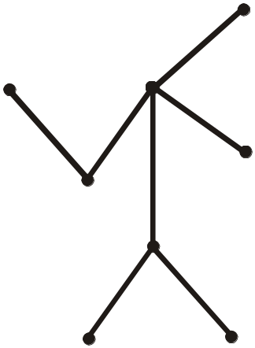
DEFINITION
  A vertex of degree 1 in a tree is called a terminal vertex or a leaf and a vertex of degree greater than 1 in a tree is called an internal vertex or a branch vertex.
  EXAMPLE
  The terminal vertices of the tree are v₁, v₂, v₅, v₆ and v₈ and internal vertices are v₃, v₄, v₇
v₂
v₁
v₄
v₅
v₃
v₇
v₆
v₈
ROOTED TREE
  A rooted tree is a tree in which one vertex is distinguished from the others and is called the root.
  The level of a vertex is the number of edges along the unique path between it and the root.
  The height of a rooted tree is the maximum level to any vertex of the tree.
  The children of any internal vertex v are all those vertices that are adjacent to v and are one level farther away from the root than v.
  If w is a child of v, then v is called the parent of w.
  Two vertices that are both children of the same parent are called siblings.
  Given vertices v and w, if v lies on the unique path between w and the root, then v is an ancestor of w and w is a descendant of v.

Slide 7
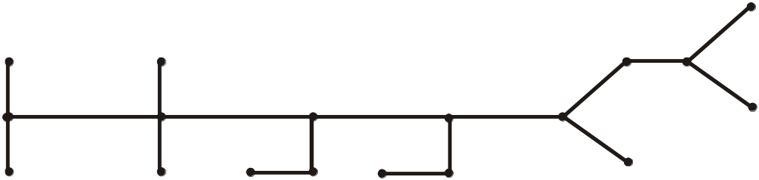
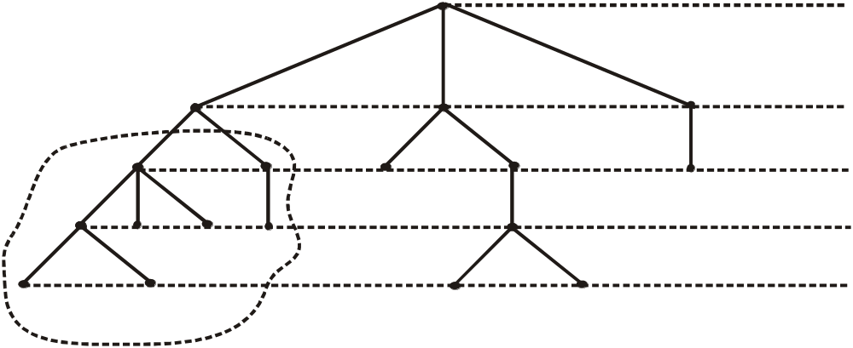
Examples
  Consider the graph tree given below
  We redraw the tree as and see what are the relations, in order to redraw the graph we choose a vertex as root and draw the graph from upward to downward as given below.
root
level 0
u
level 1
v
w
level 2
level 3
level 4
Vertices in enclosed region
are descendants of u, which
is an ancestor of each
v is a child of u
u is the parent of v
v and w are siblings
height = 4

Slide 8
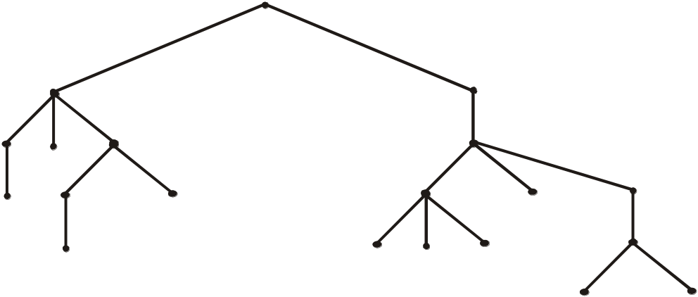
EXERCISE
  Consider the rooted tree shown below with root v₀
  a. What is the level of v₈? b. What is the level of v₀?
  c. What is the height of this tree? d. What are the children of v₁₀?
  e. What are the siblings of v₁? f. What are the descendants of v₁₂?
v₀
Level 0
v₁
v₂
Level 1
Level 2
v₃
v₅
v₆
v₄
v₁₀
v₁₂
Level 3
v₈
v₉
v₁₁
v₇
v₁₇
Level 4
v₁₃
v₁₄
v₁₅
v₁₆
Level 5
v₁₈
v₁₉
  What is the level of v₈?
  From above figure it is clear that the level of v₈ is 3.
  What is the level of v₀?
  Clearly its level is 0.
  What is the height of this tree?
  Height of the tree is 5. Because maximum level is 5.
  What are the children of v₁₀?
  Clearly the children of v₁₀ are v₁₄,v₁₃,v₁₆.
  What are the siblings of v₁?
  v₂ is only sibling of the v₁.
  (f) What are the descendants of v₁₂? Decedents of are v_{17,}v₁₈,v₁₉.

Slide 9
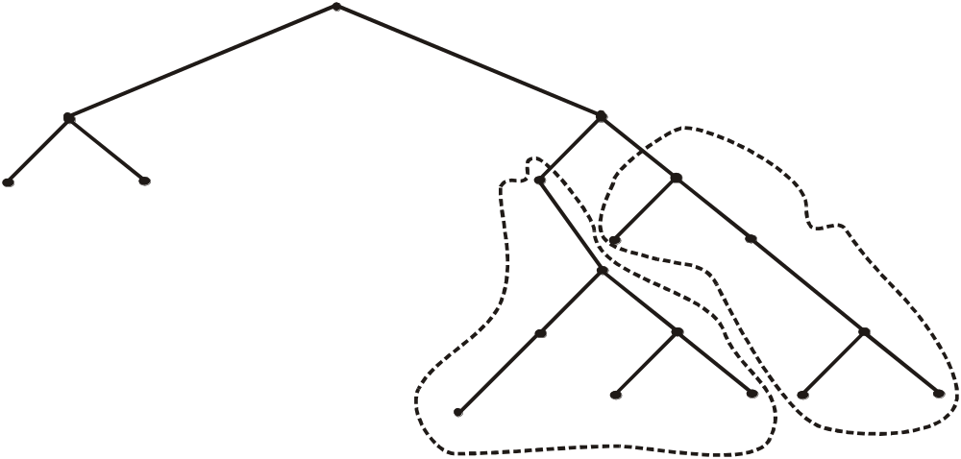
BINARY TREE
  A binary tree is a rooted tree in which every internal vertex has at most two children.
  Every child in a binary tree is designated either a left child or a right child.
  A full binary tree is a binary tree in which each internal vertex has exactly two children.
EXAMPLE
root
u
w
v
x
left subtree of w
right subtree of w
THEOREMS
  1. If k is a positive integer and T is a full binary tree with k internal vertices, then T has a total of 2k + 1 vertices and has k + 1 terminal vertices.
  2. If T is a binary tree that has t terminal vertices and height h, then
  t ≤ 2^{h}
  Equivalently,
  log₂ t ≤ h

Slide 10
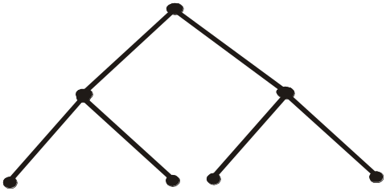
EXERCISE
  Explain why graphs with the given specification do not exist.
  1. full binary tree, nine vertices, five internal vertices.
  2. binary tree, height 4, eighteen terminal vertices.
  SOLUTION
  Any full binary tree with five internal vertices has six terminal vertices, for a total of eleven, not nine vertices in all.
  Thus there is no full binary tree with the given properties.
  Any binary tree of height 4 has at most 2⁴ = 16 terminal vertices.
  Hence, there is no binary tree that has height 4 and eighteen terminal vertices.
EXERCISE
  Draw a full binary tree with seven vertices.
  SOLUTION
  Total vertices = 2k + 1 = 7
  ⇒ k = 3
  Hence, number of internal vertices = k = 3
  and number of terminal vertices = k + 1 = 4. Hence, a full binary tree with seven vertices is
a (root)
b
c
d
e
f
g

Slide 11
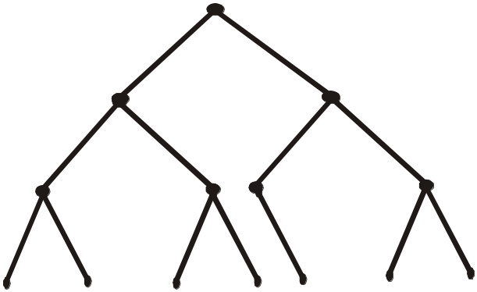
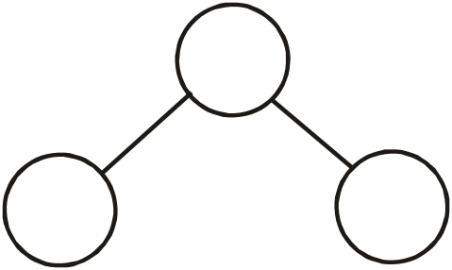
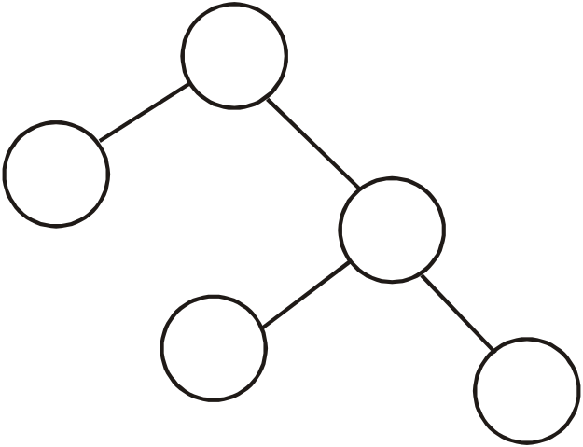
EXERCISE
  Draw a binary tree with height 3 and having seven terminal vertices.
  SOLUTION
a
c
b
d
e
f
g
h
i
j
k
l
m
n
REPRESENTATION OF ALGEBRAIC EXPRESSIONS BY BINARY TREES
/
/
a
b
a
+
Binary tree for a/b
c
d
Binary tree for a/(c+d)

Slide 12
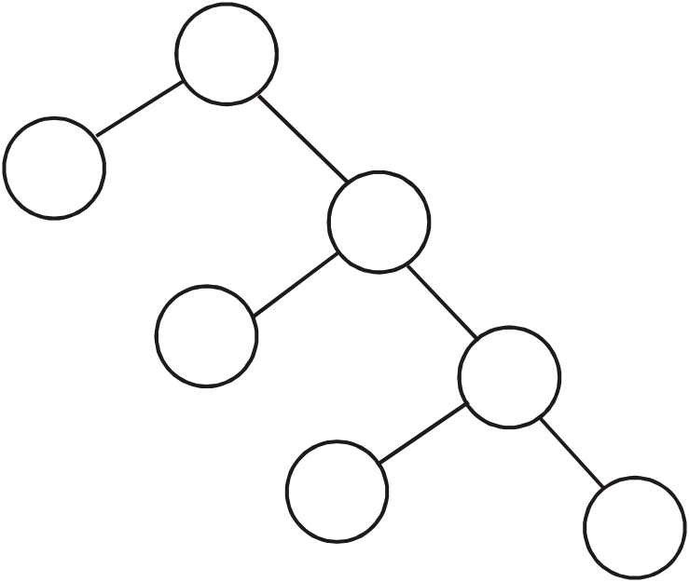
EXERCISE
  Draw a binary tree to represent the following expression
  a/(b-c.d)
  SOLUTION
a
b
c
d
  Note that the internal vertices are arithmetic operators, the terminal vertices are variables and the operator at each vertex acts on its left and right sub trees in left-right order.

