Slide 1
0-to-hero
01/10 Mentors <> 01/10 Sessions

Slide 2
Zeynal Zeynalov
Zetes - Panasonic
Data Technologies
Nivel Solutions - Cready
Azercell
ASBank
Bites
Middle East Technical University – CS (bachelor of science)
linkedin.com/in/zeynal

Slide 3
Software Design Patterns
A design pattern is a practical proven solution to a recurring design problem.
In software engineering, a software design pattern is a general, reusable solution to a commonly occurring problem within a given context in software design.^{[1]}

Slide 4
Why should I learn patterns?
tried and tested solutions
common language between team members^{[2]}

Slide 5


History - GoF
Gang of Four (GoF)

Slide 6
Gang of Four’s pattern catalogue
23 patterns
Pattern categories:
Creational – object creation methods
Structural – integration of objects to large structures
Behavioral – efficient interactions between objects

Slide 7
GoF – Creational patterns
Singleton
Factory method
Abstract factory
Builder
Prototype

Slide 8
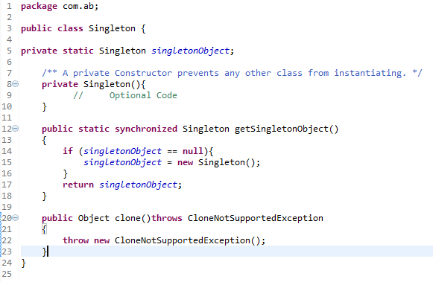
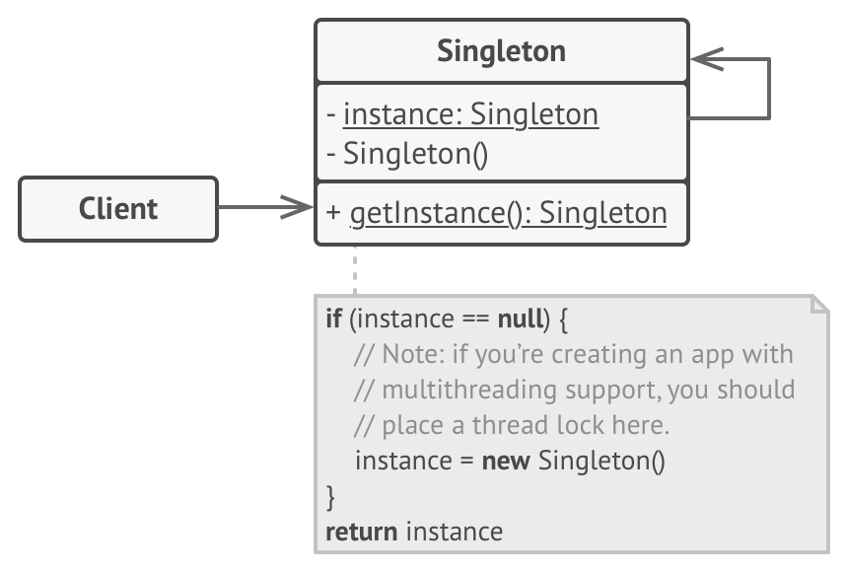
GoF – Creational patterns - Singleton

Slide 9
GoF – Structural patterns
Adapter
Composite
Decorator
Façade
Bridge
Proxy
Flyweight

Slide 10
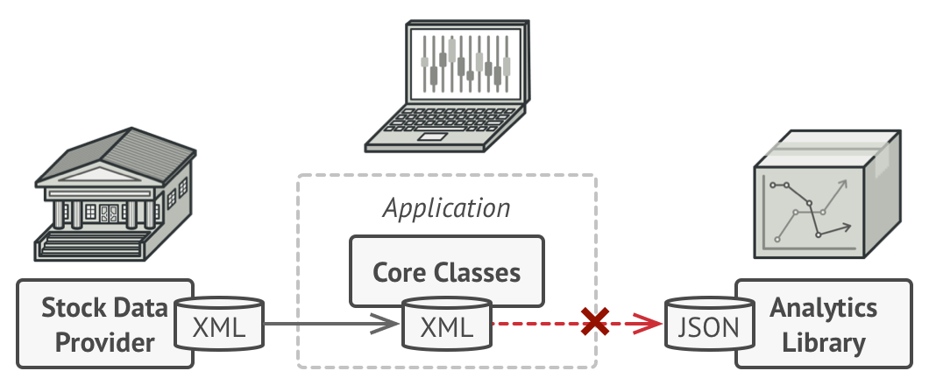
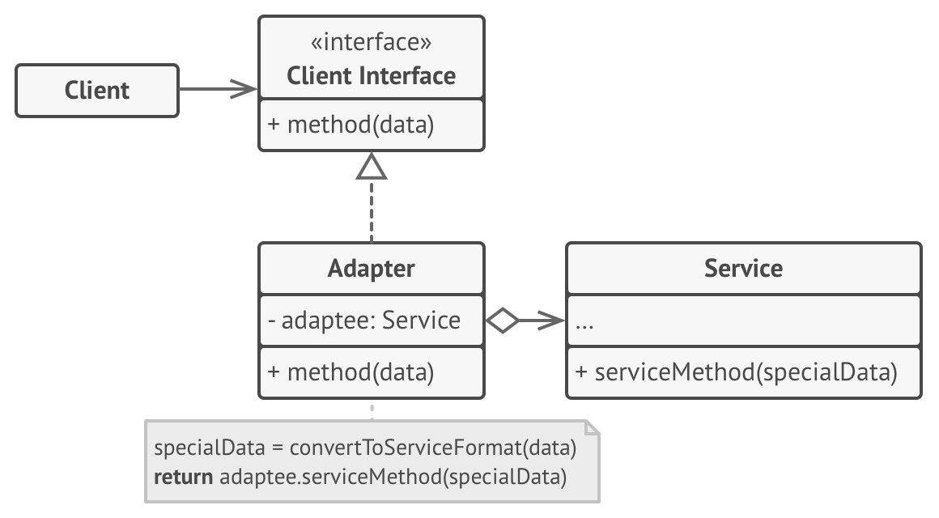
GoF – Structural patterns - Adapter

Slide 11
GoF – Behavioral patterns
Chain of responsibility
Command
Iterator
Mediator
Memento
Observer
State
Strategy
Template method
Visitor

Slide 12
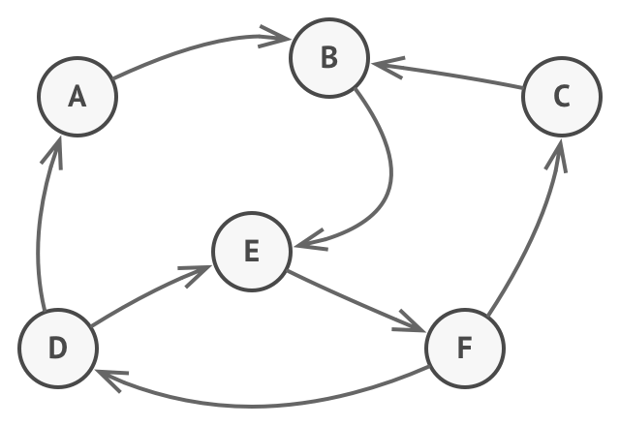
GoF – Behavioral patterns - State

Slide 13
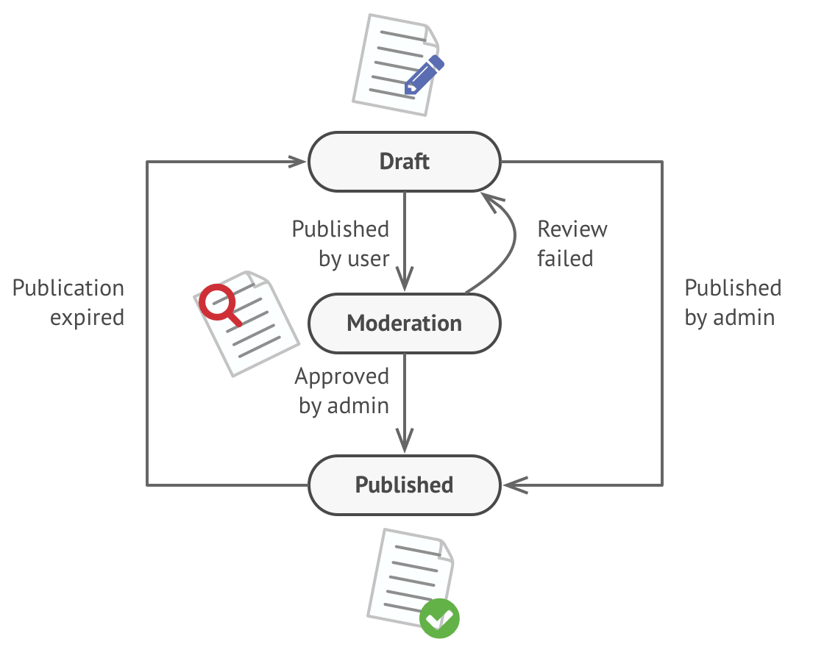
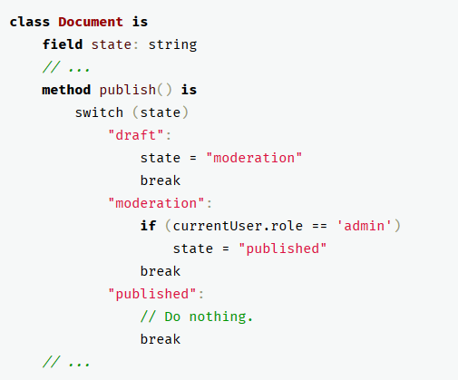
GoF – Behavioral patterns - State

Slide 14
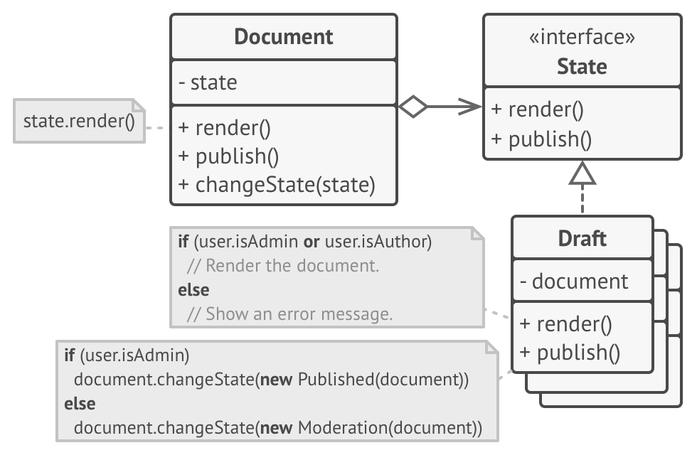
GoF – Behavioral patterns - State

Slide 15
Thanks!
References:
[1] https://en.wikipedia.org/wiki/Software_design_pattern
[2] https://refactoring.guru/design-patterns/why-learn-patterns
https://refactoring.guru/design-patterns/singleton
https://springframework.guru/gang-of-four-design-patterns/
https://www.flickr.com/photos/10591680@N07/1499817187

