Slide 1

Introduction
Vlad Taranov
http://www.aqla.net
wvlad.dev@gmail.com

Slide 2

Designed to create the game logic without programming
Setting the logic directly in the inspector
Using sequences (easier than visual programming with graphs)
Logical units – expression and action
Simple concept “from general to specific"
Ability to use other plug-ins
Integrated yielding (similar to coroutines)
Reusing
Extensibility

Slide 3

Developers without programming skills can create their own game logic.
Possibility to quickly implement new ideas and select the best solution.
Allows game designers to easily use existing logic units created by project programmers,
Improves your skills so you can easy learn how to write scripts in C# and UnityScript.
Makes programming tasks more understandable by the game designer

Slide 4

Every unit has its parameters.
There are two types of unit:
Action – parameter values can use another unit of any kind.
Expression – an action that has return value. Also its parameter values cannot use units of an “expression” kind.

Slide 5

The process of construction with logic units is asking yourself these questions:
What do I want to do?
What do I need for it?
And what do I need now?
...
each time choosing a suitable unit.

Slide 6

The “main” action is bold. Unit name is specified in brackets.
Change color (Set Color)
  of the object (Object = Object Value)
    (specify an object)
  using previously saved color value (Color = Get Variable)
    (select a variable name)
Start a timer (Wait For Game Time)
  for10 seconds (set time period after which continue the execution)
Spawn (Spawn)
  an enemy (Prefab = (select prefab))
  in the position of (Position = Get Position)
    the game object (Object Value)
      «Respawn Location» (specify an object)

Slide 7

Their parameters may contain actions.
For example, the If action starts one of the two sub-actions.
Such actions can’t be “main”.
The “main” action is inside.
The condition of the “main” action execution should be specified before and outside of that action.

Slide 8

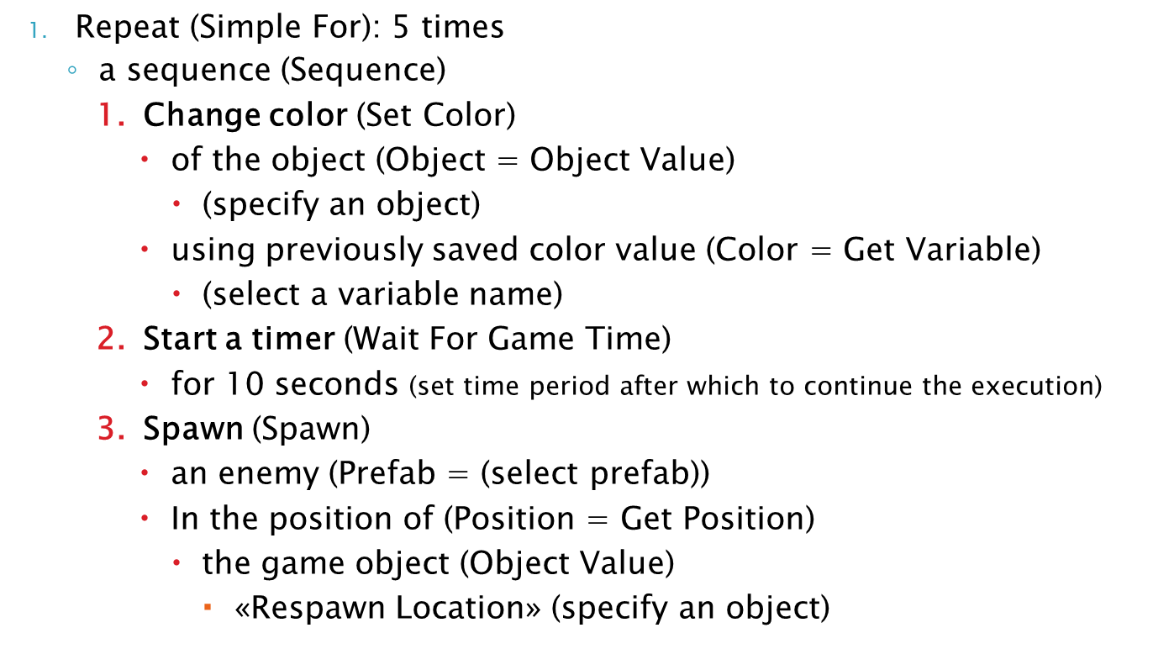

Slide 9

Thanks for watching!
Vlad Taranov
http://www.aqla.net
wvlad.dev@gmail.com

