Slide 1
Bank Customer Churn Prediction
Dashboard Analysis

Slide 2
Introduction
I used a Banking Customer Churn Prediction dataset from Kaggle.
After cleaning and preprocessing the data, I trained a machine learning model.
The model predicts which customers will stay and which will churn based on their previous data.

Slide 3
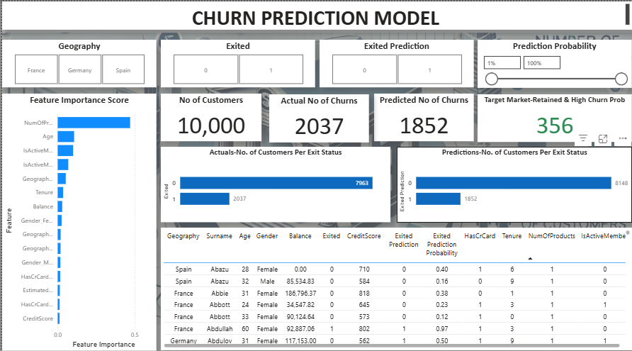
Dashboard Overview
The Power BI dashboard shows churn analysis using different visuals.
We can filter and explore data using slicers and view important features affecting churn.

Slide 4

Slicers Functionality
The slicers allow filtering by Geography, Exited status, and Prediction status.
These slicers help focus on specific customer groups for detailed analysis.

Slide 5
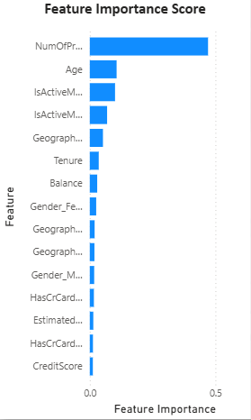
Feature Importance Score
This visual shows which features are most important for churn prediction.
‘NumOfProducts’, ‘Age’, and ‘IsActiveMember’ have high importance scores.
This means these features strongly affect whether a customer will churn or not.

Slide 6
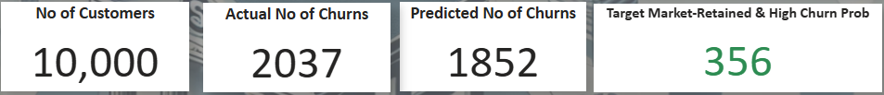
Cards
Total Customers: Shows the total number of customers in the dataset used for analysis.
Actual Churns: Displays how many customers actually left the bank based on real data.
Predicted Churns: Shows how many customers the model predicted will leave the bank.
Target Market: Highlights customers who are still with the bank but have a high chance of leaving.The group that needs more attention.

Slide 7
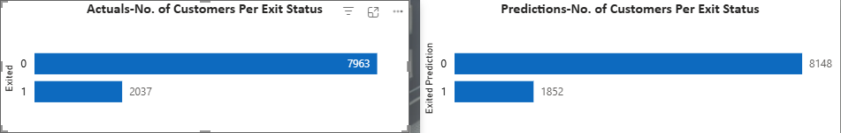
Actual vs Predicted Churns
The left clustered bar chart shows the actual customer status how many customers stayed (0) and how many churned (1) based on real data.
The right clustered bar chart shows the model’s predictions how many customers were predicted to stay (0) and how many were predicted to churn (1).

Slide 8
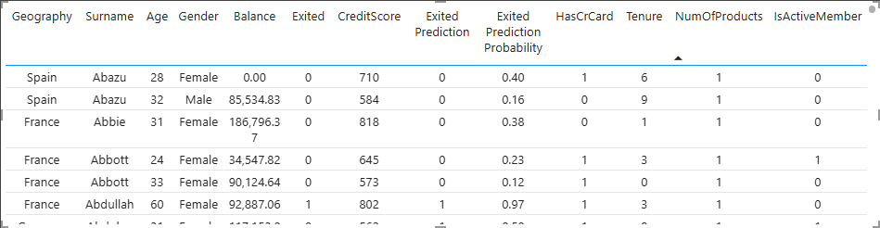
Table
This table shows detailed customer data like age, balance, credit score, and prediction.
We can filter any column to analyze specific patterns or customer segments.

Slide 9
Descriptive Analytics
The dashboard shows what happened in the past.
We can see how many customers churned and how many were retained.
It gives a clear picture of actual and predicted churn numbers.

Slide 10
Diagnostic Analytics
Customers may churn due to low engagement, fewer products, or inactivity.
By analyzing top features like 'NumOfProducts' and 'IsActiveMember',
we can understand why churn happened.

Slide 11
Predictive Analytics
The model predicts future churns based on past data.
Banks should focus on high-risk customers to reduce churn rate.

Slide 12
Prescriptive Analytics
Since ‘NumOfProducts’ has the highest feature importance,
banks should improve and promote their product offerings.
By encouraging customers to use more products, churn can be reduced.

Slide 13
Conclusion
The dashboard provides a clear understanding of customer behavior and churn trends.
By analyzing key factors such as age, balance, number of products, and activity status, we can identify customers most likely to leave the bank.
The predictive model helps in forecasting future churns, allowing management to take proactive steps to retain valuable customers.
Focusing on improving products and customer engagement can effectively reduce churn and increase overall customer satisfaction.

Slide 14
Thank You

