Slide 1


Team Details
  Team name: EmbedDesk
  Team leader name: Shuijing (Water Mirror)
  Problem Statement: Small and mid-sized businesses and device vendors cannot easily embed enterprise-grade, multi-channel AI customer support into their websites. EmbedDesk turns any site into an intelligent, ticket-generating support surface with one line of code.

Slide 2

Note: Please download this template to make your edits and submit the final version.
To download, go to File > Download > Microsoft PowerPoint (.PPTX). Kindly refrain from sending edit requests.

Slide 3
Brief about the idea
EmbedDesk — an embeddable AI customer-service agent built on Google Cloud.
A single <script> tag drops a conversational support widget into any website. The agent answers from a Retrieval-Augmented Generation (RAG) knowledge base, uses tools to look up orders and customers and to file support tickets, and escalates to a human agent through a deterministic HANDOFF token.
One shared LLM core serves every channel — web, embedded iframe, email (IMAP+SMTP) and instant messaging — so a business gets a consistent, 24/7 support presence without building any infrastructure of its own.
Everything runs serverlessly on Cloud Run; the knowledge base and all support data live in Firestore (Firebase); conversations are powered by Gemini.

Slide 4
Opportunities
How different is it from any of the other existing ideas?
How will it be able to solve the problem?
USP of the proposed solution
How different? Developer-first and multi-channel: a real tool-use agent (search knowledge, query order, get customer, create ticket) with a deterministic human-escalation path — deployable as code, not a walled-garden chatbot builder.
How it solves the problem: one embed snippet replaces a whole help-desk stack — RAG answers, order/customer lookups, auto-created tickets with sentiment tagging and SLA, and sales notification, all on serverless Cloud Run.
USP: "One line of code, expert-grade support on any site." Deterministic guardrails (knowledge-gap detection, escalation workflow, auto priority/SLA) make it safe for real customer-facing use — not just a demo.

Slide 5
List of features offered by the solution
1. One-line embeddable chat widget (Shadow DOM, themeable, works on any site)
2. RAG knowledge base — synonym / colloquial query expansion + optional semantic re-ranking
3. Tool-using agent: search_knowledge · query_order · get_customer · create_ticket
4. Multi-channel: web · embed · email (IMAP+SMTP) · IM — one shared agent core
5. Deterministic human handoff (HANDOFF_TOKEN) + agent-created tickets with dedup guard
6. Sentiment detection + smart escalation (automatic priority and SLA)
7. Agent Copilot — real-time reply suggestions for human agents
8. CSAT surveys, insights dashboard (BigQuery) and full LLM call observability

Slide 6
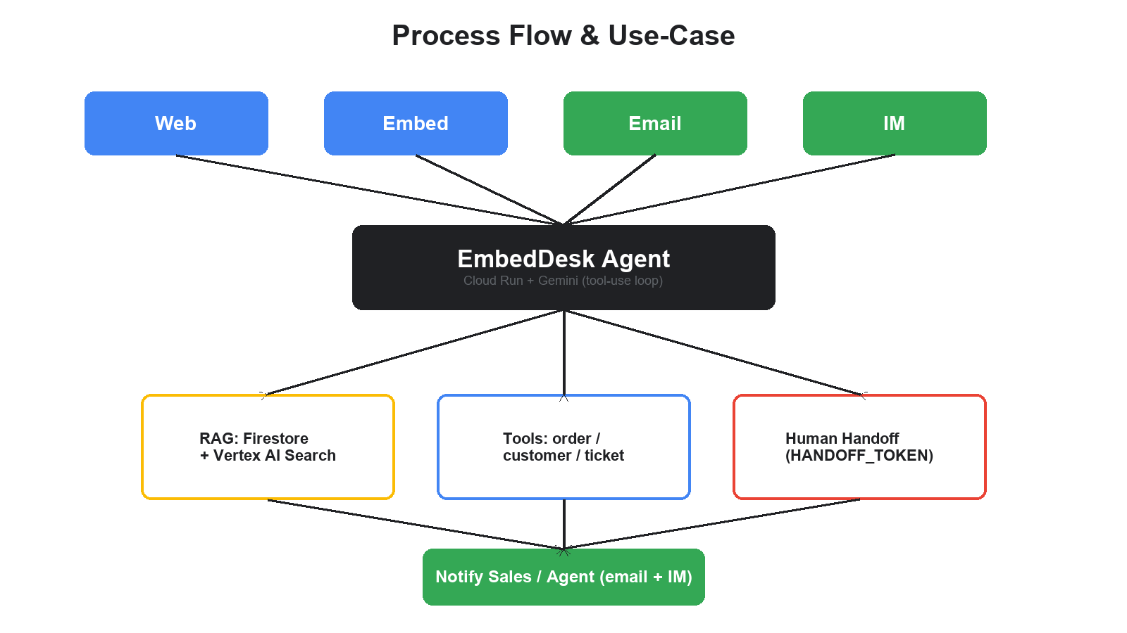
Process flow diagram or Use-case diagram

Slide 7
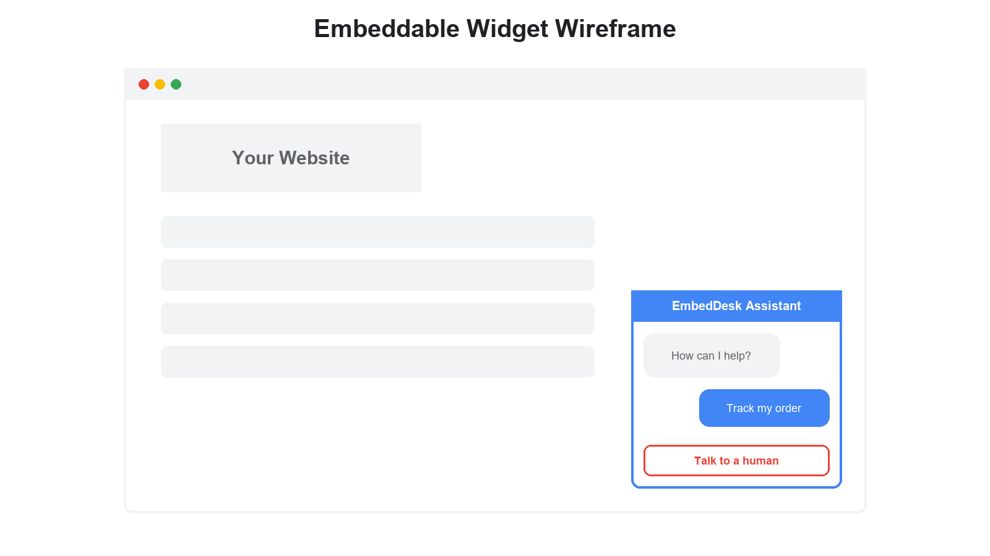
Wireframes/Mock diagrams of the proposed solution (optional)

Slide 8
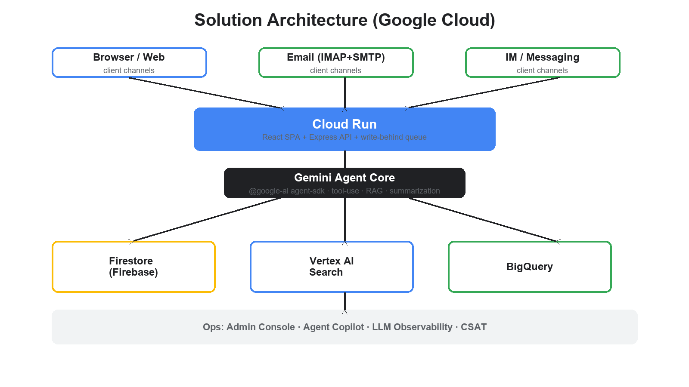
Architecture diagram of the proposed solution

Slide 9
Technologies to be used in the solution
Technologies actually used in the submitted solution:
Google Cloud Run — serverless hosting for the web frontend + API backend — the deployed prototype runs here.
Google Gemini — the large language model powering the agent: tool-use loop, RAG answering, summarization.
Firestore (Firebase) — serverless NoSQL datastore for the knowledge base, sessions, tickets and RAG vectors — the durable data layer of Firebase.
Firebase — the app data platform wrapping Firestore; Firebase Auth / Hosting are the planned next-step integrations.
Vertex AI Search — semantic retrieval (RAG) over the knowledge base with re-ranking.
BigQuery — analytics and insights over ticket and conversation data.

Slide 10
Estimated implementation cost (optional)
Estimated implementation cost: ~$0 per month at demo scale.
Cloud Run free tier (180,000 vCPU-seconds / month) covers the prototype; scale-to-zero when idle.
Gemini API free tier / pay-per-token; Firestore and BigQuery stay within their free allowances.
No minimum spend. Deleting the Cloud Run service after evaluation stops all cost immediately.

Slide 11
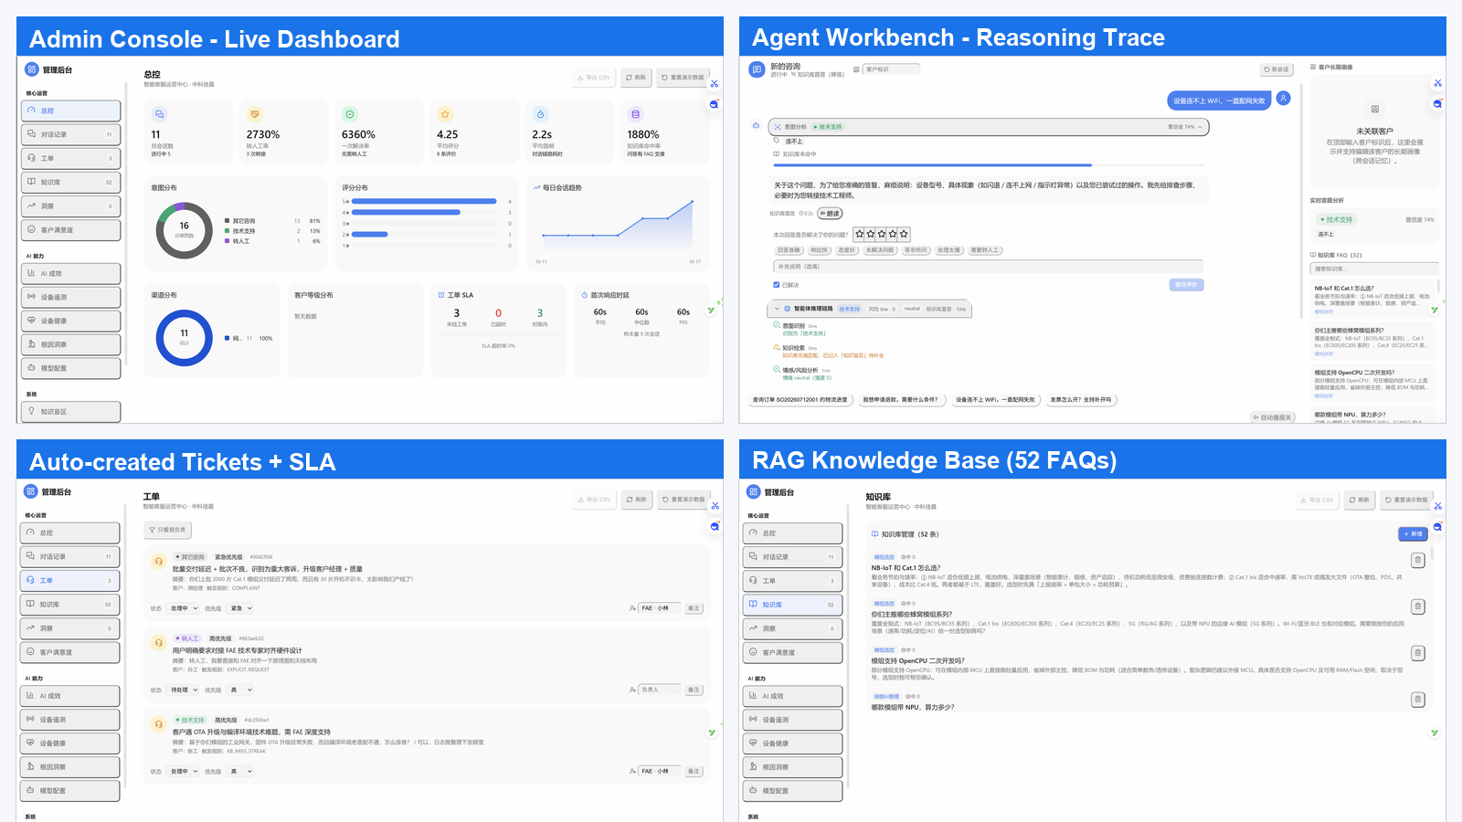
Snapshots of the prototype

Slide 12
Prototype Performance report/Benchmarking
Load test (local, SQLite mode):
~492 requests/s sustained ingest at 100 concurrent connections — p95 latency 267 ms, 0 errors.
~360 requests/s at 400 concurrent connections — no avalanche, graceful degradation.
Bottleneck fixes applied: knowledge-base pre-computation + LRU cache (5,000 entries) + write-behind batch queue.
Observability: every LLM call logged with provider / model / latency / token usage / status (ok · degraded · error).
RAG answer hit-rate and KB cache hit-rate tracked as live metrics.

Slide 13
Additional Details/Future Development (if any)
Current status: production-ready codebase — 9 automated verification suites, all green.
Roadmap:
Firebase Auth for end-customer identity and Firestore multi-tenant data isolation.
Firebase Hosting + Firebase Extensions for one-click install from the Firebase console.
WebSocket token streaming for real-time responses; multilingual support.
Mobile SDK and a self-serve onboarding wizard for non-developers.

Slide 14
Provide links to your:
GitHub Public Repository: https://github.com/Aqr325/embeddesk (branch: hack2skill)
Demo Video Link (3 Minutes): [ PASTE VIDEO URL AFTER UPLOAD ] — embeddesk_demo.mp4 (3 min 40 s, 1920×1080)
Final Product Link: [ PASTE CLOUD RUN URL AFTER DEPLOY ]

Slide 16


