Slide 1
PORTFOLIO
By,
MOHAMMED AQSAN

Slide 2
INTRODUCTION
NAME : MOHAMMED AQSAN
CLASS : IIⁿᵈ YEAR BCA
COLLEGE : MERIT HAJI ISMAIL SAHIB ART & SCIENCE
COLLEGE
SUBJECT : WEB DEVELOPMENT COURSE
PROJECT : MY PORTFOLIO WEBSITE

Slide 3
What is a Portfolio?
Core Definition: A portfolio is a curated collection of work that provides tangible proof of your skills,
accomplishments, and experience. It's evidence of what you can do.
Key Purpose : Its primary goal is to show, not just tell. It demonstrates your abilities to potential employers,
clients, or schools, making you a more credible and compelling candidate.
For Whom ? While essential for creatives (artists, designers) and tech professionals (developers, UX
designers), it's also powerful for writers, marketers, project managers, and others to
showcase projects, reports, and case studies.
Essential Components:
Your Best Work: 5-10 high-quality projects relevant to your goals.
Project Context: For each piece, briefly explain the goal, your role, and the result or impact.
"About Me" Section: A short, professional bio summarizing who you are.
Contact Information: Easy ways for people to reach you.

Slide 4
Common Formats:
Digital Portfolio: The standard. A personal website or a profile on platforms like LinkedIn,
Behance, or GitHub.
Physical Portfolio: A printed book or folder, used primarily in art and design interviews.
PDF Portfolio: A simple, downloadable document for easy emailing.
Key Takeaway: A portfolio is a dynamic tool for personal branding. It tells your professional story more
effectively than a resume alone by providing concrete evidence of your talents and
successes.

Slide 5
How I Started!
Step 1: Plan Your Content (Before Coding!)
First, decide what you want to show the world. Keep it simple. You'll need:
Your Name: Big and clear at the top.
Your Title: “Portfolio", "Aspiring Software Developer", etc.
Short Bio (About Me): 2-3 sentences about what you're passionate about in tech. *Example: "I'm a 2nd-year CS student at [Your University] passionate about building web applications and solving problems with code. I'm currently learning React and Node.js."*
Your Projects: Even 2-3 class projects or small personal projects are perfect.
For each project, have:
A project name
A short description (what it does)
The technologies used (HTML, CSS, Python, Java)
Most Important: A link to the code (GitHub) and a link to a live demo (if possible).
Your Contact Info:
Email address
LinkedIn profile URL
GitHub profile URL

Slide 6
Step 2: Build the Basic Structure with HTML.
Step 3: Make It Look Nice with Basic CSS
Step 4: Put It Online (Deploy for Free!)
A portfolio isn't useful if no one can see it. Use Netlify—it's incredibly easy and free.
Create a GitHub Account (if you haven't already) and create a new repository. Upload your index.html and style.css files.
Go to netlify.com and sign up with your GitHub.
Click "Add new site" -> "Import an existing project".
Connect your GitHub account and choose the repository you just created.
Click "Deploy". Netlify will give your site a random URL (like your-name-123abc.netlify.app).
You are now live on the internet! Share this link everywhere.
skills, and experiences.

Slide 7
PROJECT OVERVIEW
A portfolio website is a personal/professional online platform that showcases your work, skills, achievements, and personality. It serves as a digital resume and branding tool to attract employers, clients, or collaborators.
Key Purposes
Showcase Work: Display your best projects, designs, or case studies.
Build Credibility: Demonstrate expertise, experience, and achievements.
Personal Branding: Reflect your personality and style.
Networking Tool: Provide easy contact options for opportunities.

Slide 8
Website Sample Images

Slide 9
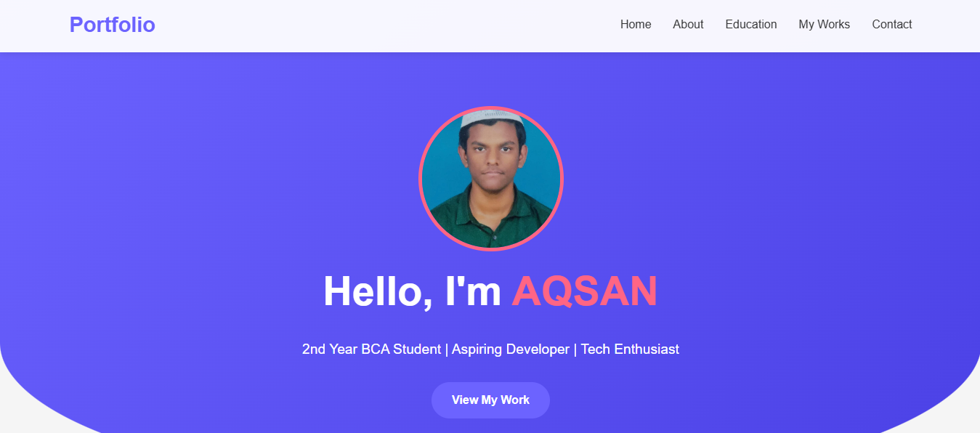
Home Tab:

Slide 10
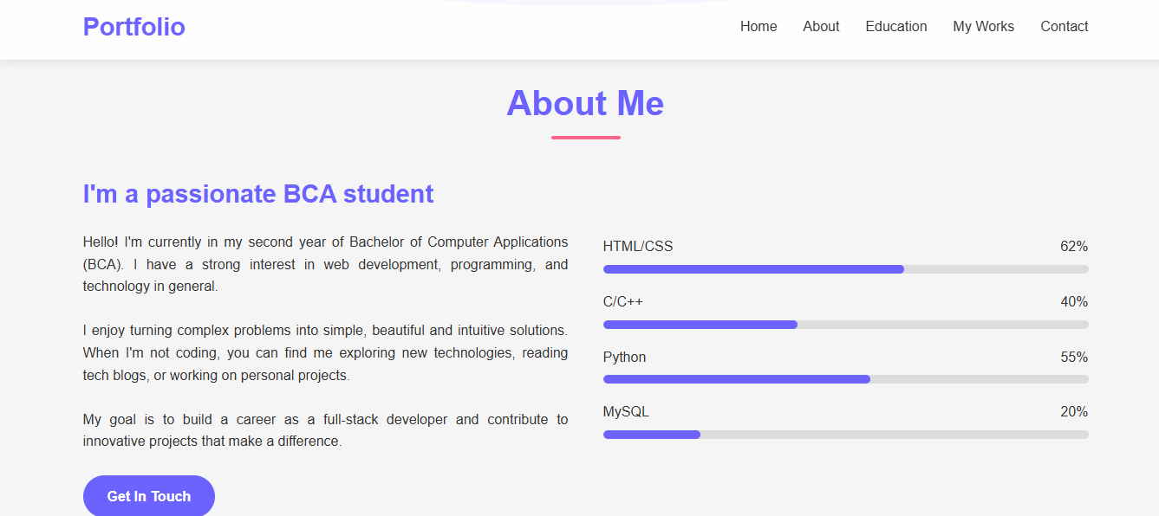
About Tab:

Slide 11
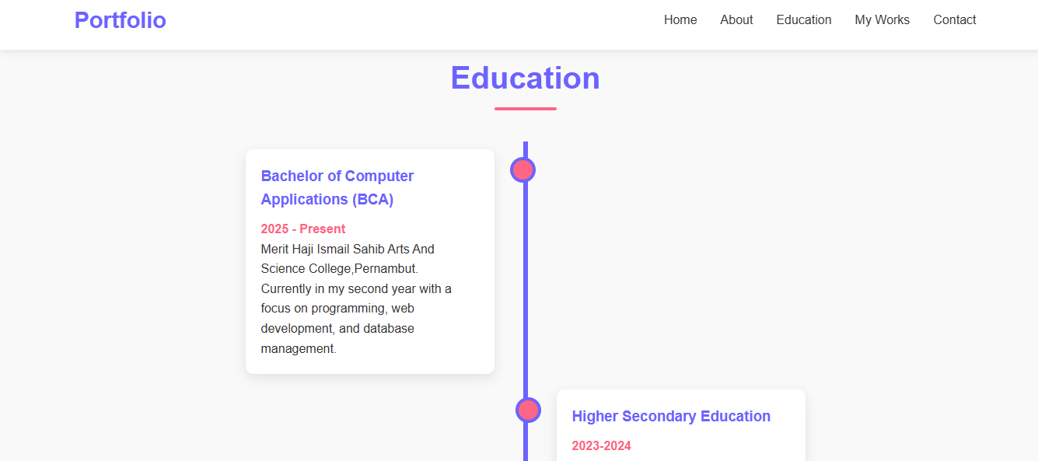
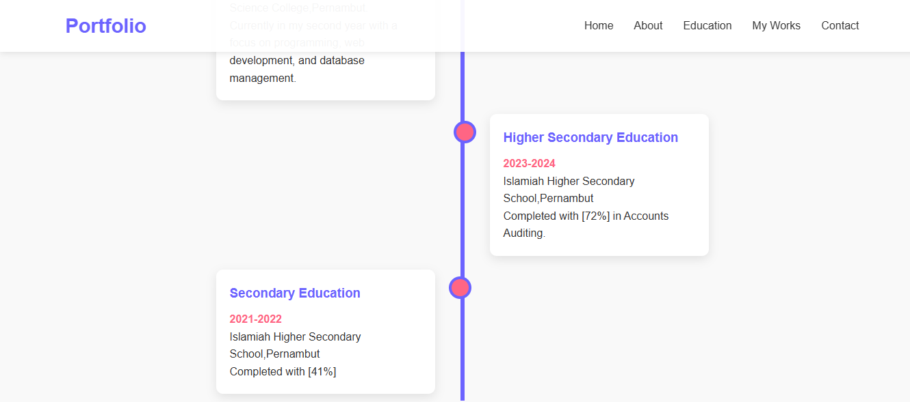
Education Tab:

Slide 12
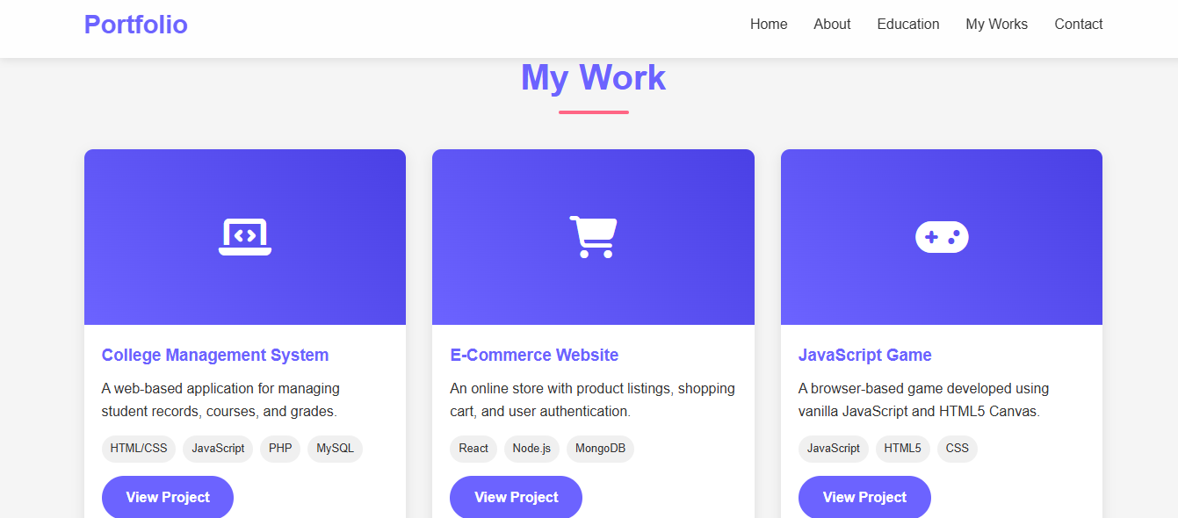
My Work Tab:

Slide 13
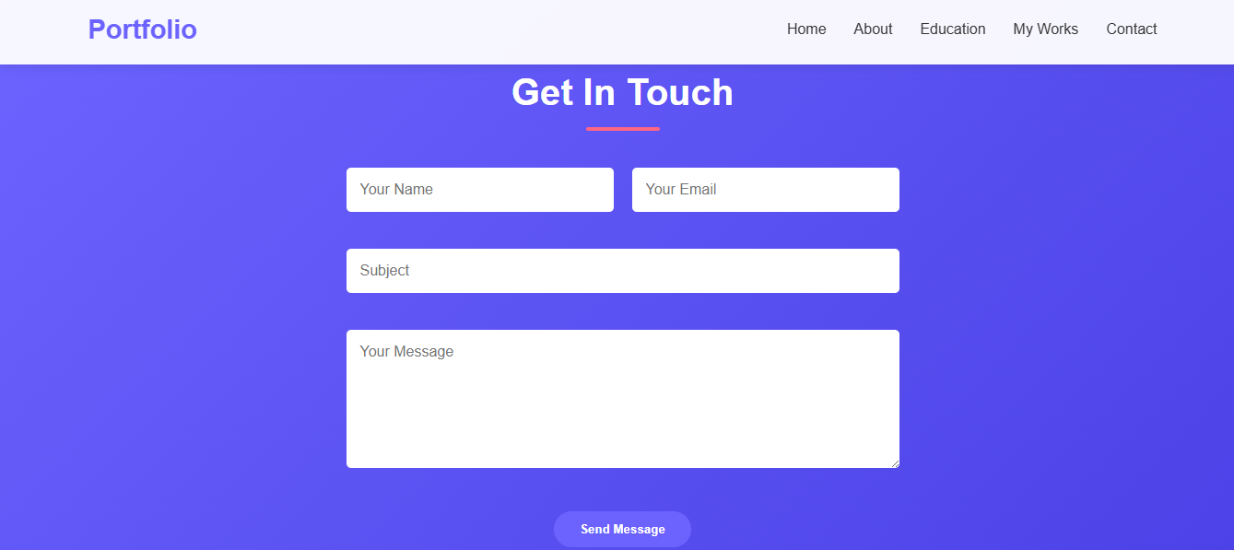
Contact Tab:

Slide 14
THANK YOU

