Slide 1

Text Field
TKK Mobile Apps
Aqshal Nur Ikhsan S.Si., M.Si

Slide 2
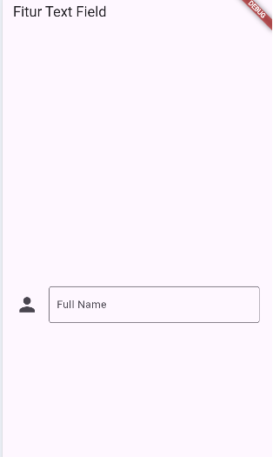
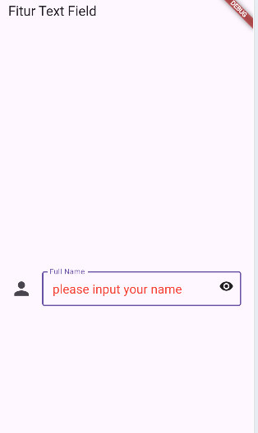
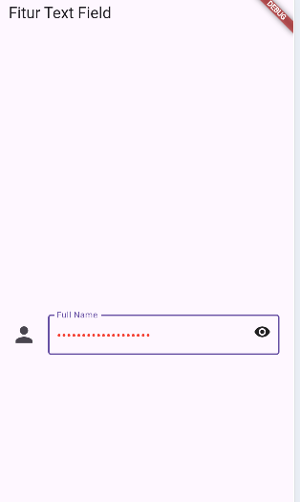
TEXT FIELD

Slide 3
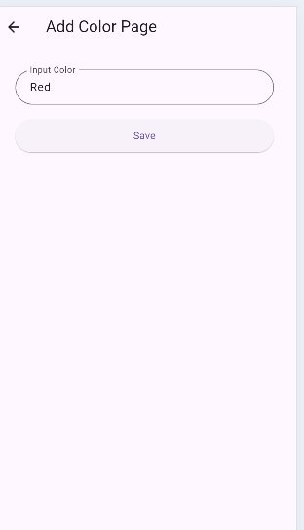
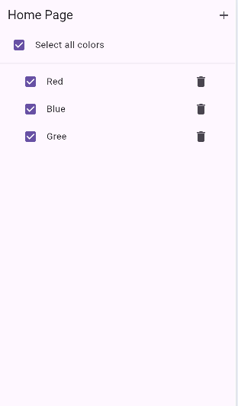
CHECKBOX
Ada Fitur Create, Delete, Save

Slide 4
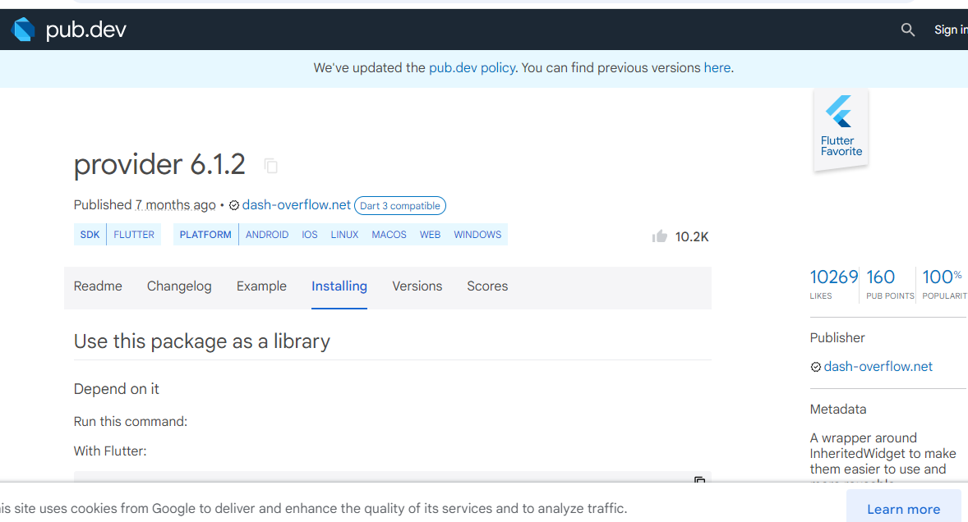

Slide 5
