Slide 1

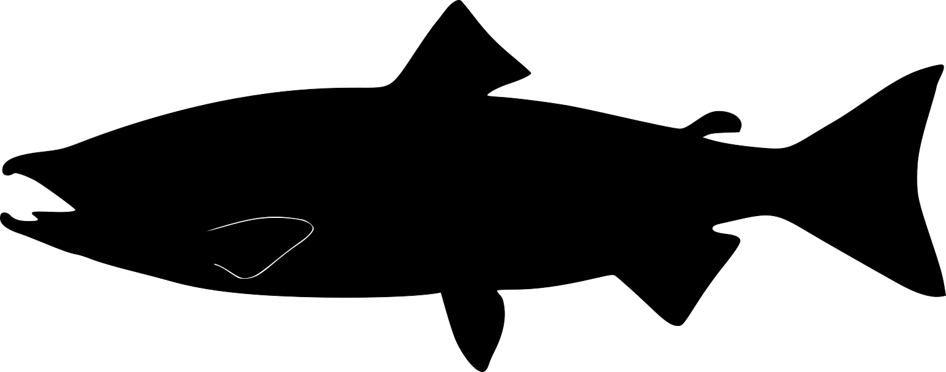
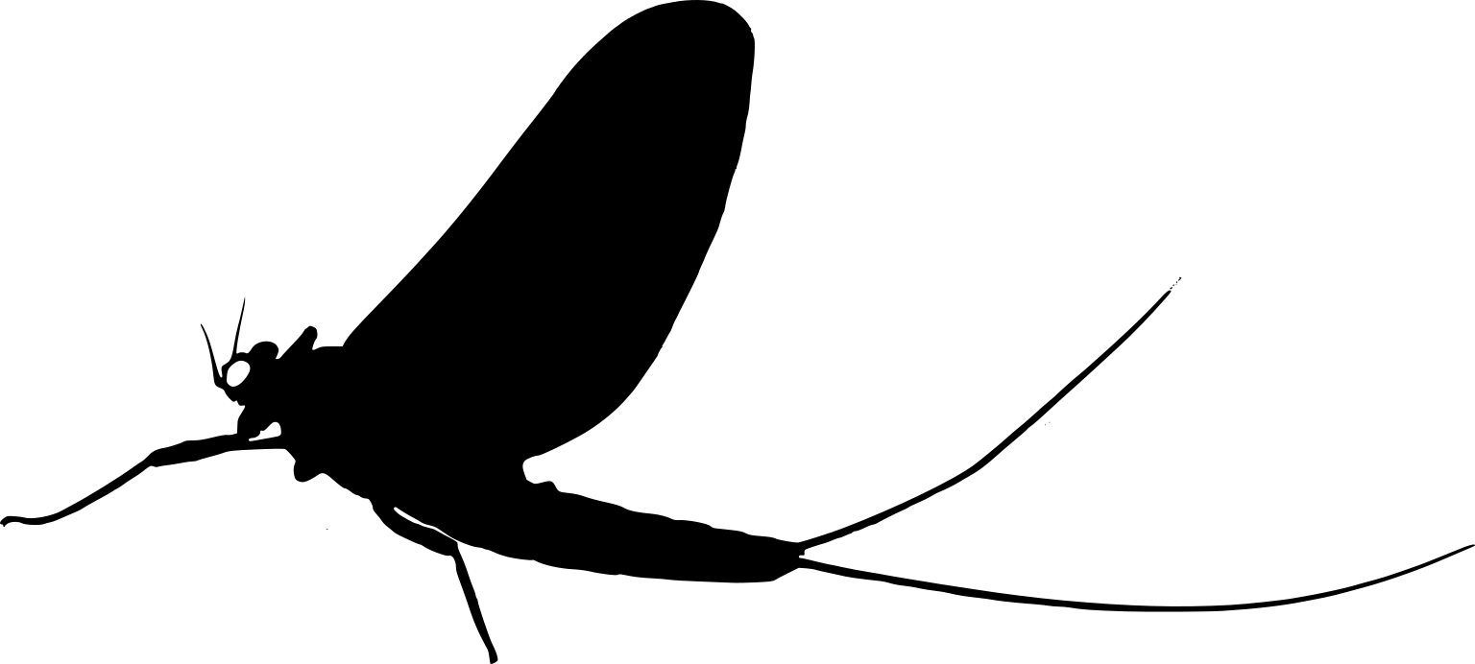
Global export from oceans to land by seabirds (6,300 t y⁻¹) (Doughty et al. 2016)
Global export from rivers to land by emerging aquatic insects (7,000 t y⁻¹) (current study)
Global export from oceans to rivers by anadromous fish (5,600 t y⁻¹) (Doughty et al. 2016)
Figure X. Posterior distribution of phosphorous flux from emerging aquatic insects in freshwater rivers compared to anadromous fish and seabirds. The gray density represents the posterior distribution of insect-mediated phosphorous (P) flux. The dot and horizontal error bars show the median with 66% and 95% credible intervals. The vertical solid line also shows the median P flux by emerging aquatic insects. The dashed and dotted lines show fluxes estimated from Doughty et al. (2016) of P from oceans to rivers by anadromous salmon or from oceans to land by seabirds via guano deposition.

