Slide 1
ASI:one
Fetch Business Integrations
Gmail · HubSpot · Calendly — MVP strategy & feasibility
May 2026 · Fetch Business

Slide 2
Agenda
Why Gmail, HubSpot, and Calendly
Feasibility: free API vs owner cost vs Fetch compliance
BYOA (bring-your-own-account) model
ASI:one consumer POC demo
Risks, recommendations, and next steps

Slide 3
Why these three?

Slide 4
Why Gmail, HubSpot & Calendly
Email is where inbound leads and quotes still land for most SMBs
Without CRM memory, every conversation feels like the first — HubSpot is the default growth CRM
Booking a call is often the real conversion — Calendly closes the scheduling loop
Together they form one funnel: hear → remember → meet → confirm
Deeper than adding dozens of toggles with no story for the business owner

Slide 5
The integration funnel
Gmail
HubSpot
Calendly
Gmail
→
→
→
Inbound & drafts
CRM memory
Book the meeting
Confirm & quote
One natural SMB journey: hear the customer → remember them → meet them → confirm in email
Bring-your-own-account (BYOA): each business connects their own Gmail, HubSpot, and Calendly.

Slide 6
Feasibility

Slide 7
Executive summary
Integration | Free API? | Owner pays? | Partnership? | Main friction
Gmail | Yes | Gmail / Workspace | No | Google OAuth restricted scopes
HubSpot | Yes | Free CRM → paid at scale | Optional | API rate limits
Calendly | Yes | Paid plan for Scheduling API | No | Plan eligibility check

Slide 8
What “feasible” means
Free to build ≠ free to operate
APIs: generally no license fee to Google, HubSpot, or Calendly
Business owner: may need paid Calendly, HubSpot tier, existing Google mailbox
Fetch: engineering + hosting + Gmail OAuth compliance at scale
Partnerships: not required for BYOA MVP; optional for marketplaces later

Slide 9
Gmail — Feasibility
API & owner
Gmail API free to integrate; Gmail MCP in developer preview
Owner uses Gmail or Google Workspace (often already paid)
Fetch platform cost
Restricted scopes: readonly, compose, modify
OAuth verification: brand ~2–3 days; restricted ~6 weeks
Possible security assessment if mail stored on Fetch servers
Verdict & MVP
Partnership: not required
MVP: read + draft only; never auto-send
Production: yes, with compliance budget

Slide 10
HubSpot — Feasibility
API & owner
CRM v3 API, OAuth, private apps; remote MCP server
Free CRM tier includes API with rate limits
Heavy agent usage may need paid HubSpot or API add-on
Fetch platform cost
Low: developer app registration
No revenue share for basic CRM read/write
Verdict & MVP
Partnership: optional (App Marketplace)
Strongest production path of the three
Ship contacts, deals, notes, activities first

Slide 11
Calendly — Feasibility
API & owner
API v2 + Scheduling API (documented for AI agents)
Scheduling API requires owner paid Calendly plan
Free Calendly ≠ agent can auto-book meetings
Fetch platform cost
Low: OAuth app in Calendly developer portal
Verdict & MVP
Partnership: not required
MVP: yes when owner has paid plan
Fallback: scheduling link in Gmail draft
Detect Scheduling API at connect time

Slide 12
Who pays what?
Bearer | Gmail | HubSpot | Calendly
Fetch | OAuth compliance, engineering | App maintenance | OAuth app
Business owner | Google account | CRM tier if needed | Paid Calendly plan
End customer | — | — | —

Slide 13
Comparison at a glance
 | Gmail | HubSpot | Calendly
Best for | Inbox & drafts | Pipeline memory | Meeting booking
Hardest part | Google verification | Rate limits | Owner plan check
MVP priority | High value, high compliance | Easiest path | High value w/ gating

Slide 14
Consumer POC

Slide 15
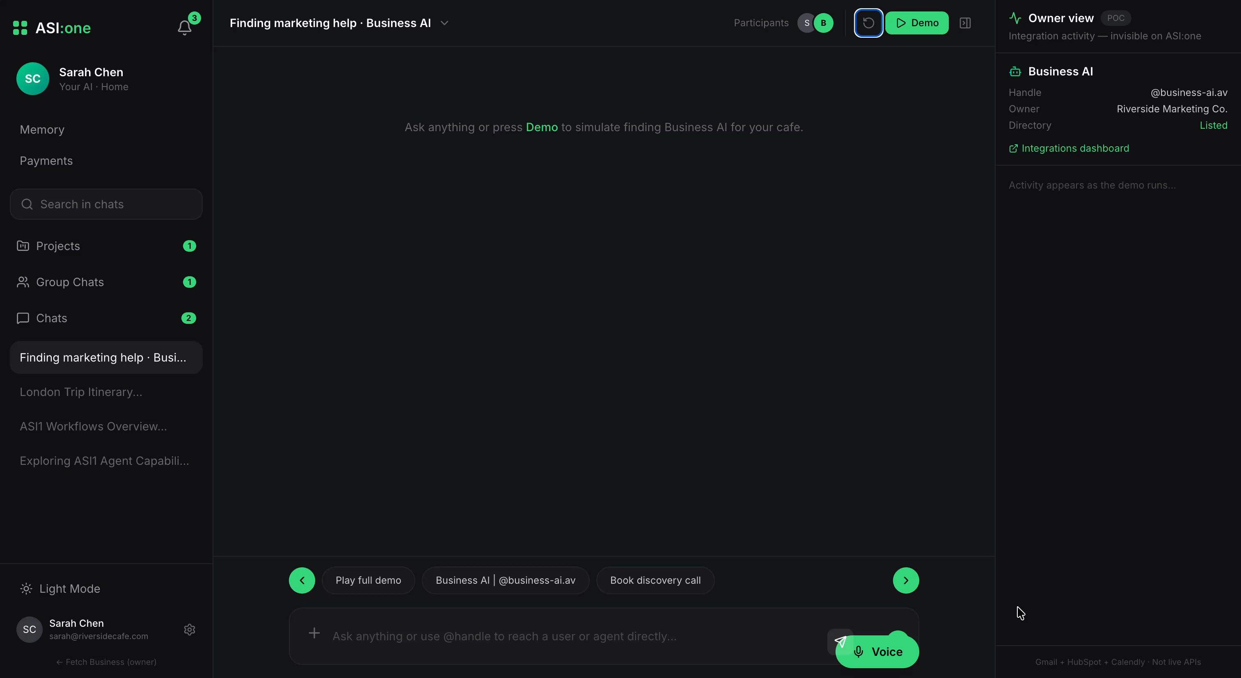
ASI:one Consumer Demo

Slide 16
Risks & next steps

Slide 17
Key risks
Google security assessment — largest cost/timeline unknown for Gmail
HubSpot rate limits on free portals — need caching and backoff
Calendly plan names and API entitlements may change
Vendor AI / autonomous-agent policies evolving

Slide 18
Recommendations
Phase 1 MVP: Gmail (read/draft), HubSpot CRM, Calendly + plan check
BYOA everywhere — businesses connect their own accounts
Honest UI labels: paid Calendly required, Google verification status
Do not promise auto-book on free Calendly or auto-send from Gmail
Confirm plan names and rate limits with vendors before launch commitments

Slide 19
ASI:one
Thank you
Questions?
May 2026 · Fetch Business

