Slide 1
Education Inequality Analysis
Qasim Ali

Slide 2
Introduction
Our task in this assignment was to investigate how a number of variables in the lives of students in the United States impact their educational ability
Our measuring tool, or target, to understand this question in this assignment was their average ACT scores
The features I used to measure these factors included median household income, percentage of free or reduced lunch, marriage percentage, college percentage, and unemployment rate

Slide 3
Initial Questions
What factors are the most telling indicators of average ACT scores?
I predict it will be median income as financials are usually the culprit of inequality in America
Where are ACT scores affected by median income the most in the United States?
I predict that wherever that may be, the richer states will have higher ACT scores due to ability to pay for prep classes and tutoring

Slide 4
Analysis Method
A simple linear regression model was made using the features mentioned earlier
Coefficients for each feature were analyzed to see which features had the most impact on ACT scores
To find more local trends, coefficients were found using data sets divided by state
Simple group-by function was used to do this

Slide 5
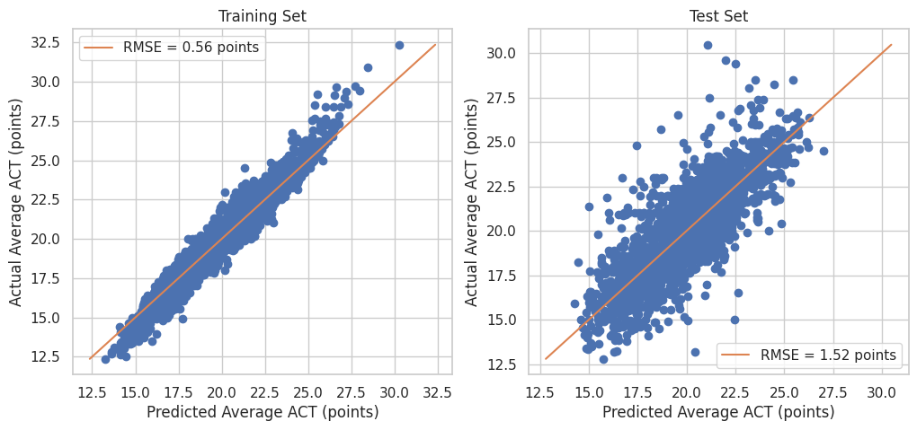
Results: Linear Regression
Training set’s RMSE was decently lower than that of the test set, as expected

Slide 6
Results
Overall trends of the most impactful features
Coefficients:
Free/Reduced Lunch (-1.81)
College percentage (0.25)
Unemployment rate (-0.16)
Marriage percentage (-0.03)
Median Income (0.007)
My initial prediction was that this would be the most impactful, making this a surprise result

Slide 7
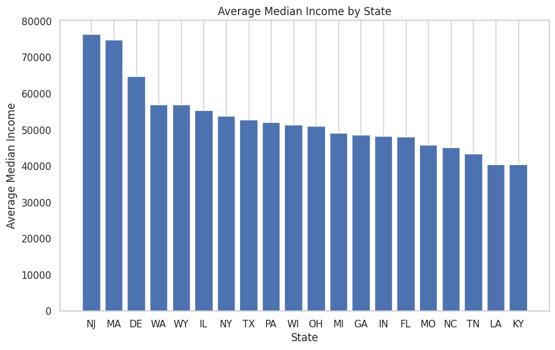
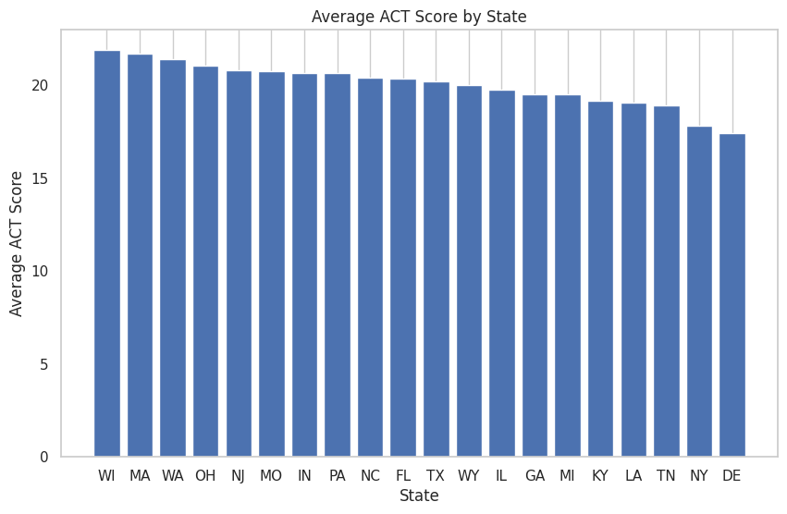
Results: Median Income by State
Top five median income states: NJ, MA, DE, WA, WY
Top five average ACT states: WI, MA, MI, OH, NJ
Bottom five median income states: KY, LA, TN, NC, MO
Bottom five average ACT states: DE, NY, TN, LA, KY

Slide 8
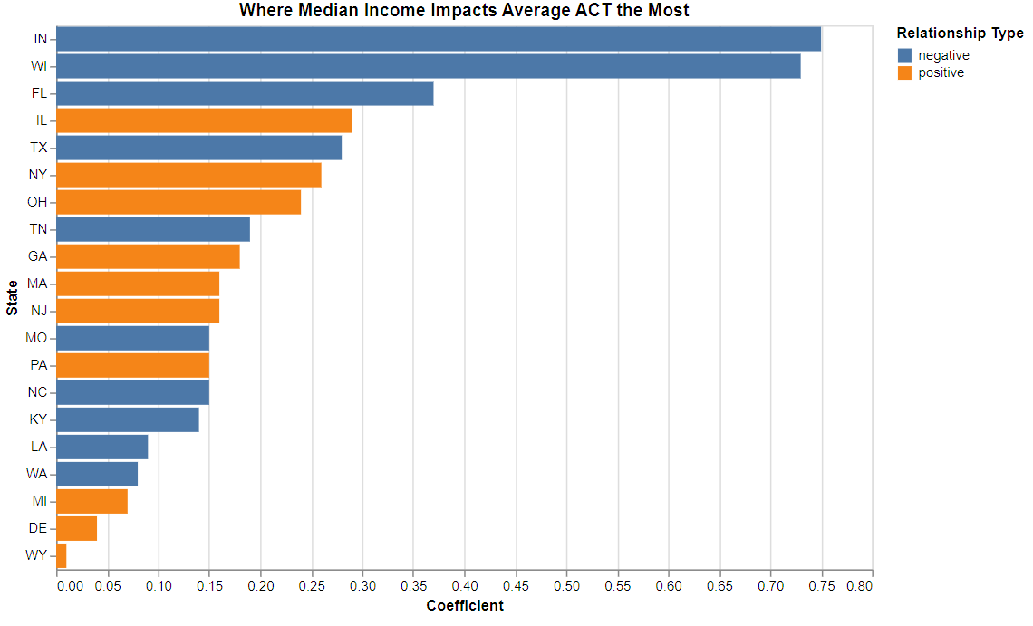
Results: Median Income by State
Plotted: Median income coefficient related to impact on average ACT score
Indiana and Wisconsin are far out ahead, while most states are bunched together
Half the states show negative relationships, meaning more money may mean lower ACT scores in half the states, and that there isn’t a strong correlation between median income and ACT scores

Slide 9
Conclusion
The data refuted my hypothesis regarding median income being the most telling predictor of ACT scores, as it wasn’t very impactful at all and had contradictory results in the end, signaling a weak correlation at best
Free/reduced lunch was instead the most impactful feature
That being said, there are states where median income is more impactful than others, meaning there are states where funds could be being used ineffectively
In an interesting turn, many states display a negative relationship between median income and average ACT
This means that half the states in the set saw an overall trend of higher ACT scores in lower median income areas
We must take this result with a grain of salt though, as we established median income is the least impactful feature in this data and other features are likely driving this trend

