Slide 1
TypeScript
Presentation by:
Filip Markoski 161528
Kristofer Mladenovski 161530

Slide 2
Introduction
JavaScript is the most popular programming language by far, however it is also the most notorious for being quirky and strange.
Because of that reason, languages like TypeScript, CoffeeScript and many others try to amend the pitfalls of JavaScript.
In this project we will explain how TypeScript works and deals with JavaScript’s aforementioned quirkiness

Slide 3
About Transpiling
TypeScript is transpiled as opposed to compiled.
Compiling means translating code into a lower level language, whereas transpiling means translating one language into another language in the same level of abstraction
Whenever you write a TypeScript file, it automatically creates a file of the same name, but with the extension .js, which means that the original TypeScript file gets transpiled into JavaScript

Slide 4
Why use TypeScript?
The biggest selling point of TypeScript is tooling. It provides advanced autocompletion, navigation, and refactoring.
TypeScript, as its name suggests, has specific types, which allow for easier debugging and consistency, however the types are completely optional.
TypeScript has interfaces, which are missing in JavaScript.
TypeScript has more intuitive object-oriented elements.

Slide 5
Why use types?
The term dynamic typing refers to the practice where a programmer needn’t declare the type of a variable when programming his code, because the variable will dynamically be assigned a type when needed.
Static typing is the practice where the programmer is forced into declaring the type of every single variable.
Static typing most of the time leads the programmer to think along the lines of software structure, meaning he needs to understand what variable and more specifically what kind of variable can use a certain function and which cannot.

Slide 6
Basic Types in TypeScript
Boolean (true or false)
Number (decimal, hexadecimal, binary and octal floating point numbers)
String (any textual data)
Array (a list of items)
Tuple (arrays with fixed number of elements)
Enum (enumerator, array of numeric values which have specific names)
Any (can hold any type)
Void (opposite of any, denotes absence of any type)
Null/Undefined (you cannot assign anything to these types)
Never (denotes values that never occur)

Slide 7
Installation Process
TypeScript is very easy, straightforward and convenient to install.
There are 2 main ways to get the TypeScript tools:
With npm(Node.js package manager)
Installing TypeScript’s Visual Studio plugins

Slide 8
Installing TypeScript with npm
To install TypeScript with npm you will need to have NodeJS installed with npm, then you can verify the installation by typing “node -v”.
After the installation has been verified you can type “npm install -g typescript” to install TypeScript itself, the argument “g” meaning global, as in TypeScript will be installed on the whole machine.

Slide 9
Installing TypeScript with Visual Studio
Visual Studio 2017 and Visual Studio 2015 Update 3 include TypeScript by default.
And if you didn’t install TypeScript with Visual Studio, you can simply download it as a plugin.
Many other IDEs like WebStorm and PhpStorm also have TypeScript built-in, so you can just start coding in TypeScript if you have any of these IDEs.

Slide 10
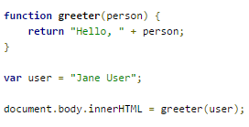
Making your first TypeScript file
Assuming you’ve went through with the installation process, using the editor of your choice type in the following JavaScript code in a file named “greeter.ts”, notice that the extensions is “.ts” instead of “.js”.

Slide 11
Making your first TypeScript file
At the command line, run the TypeScript compiler: “tsc greeter.ts”. The result will be a file greeter.js which contains the same JavaScript that we fed in.
If you want to combine multiple files, you use the line:
” tsc app.ts another.ts someMore.ts”. This will result in files, app.js, another.js and someMore.js.
If you want to compile all the typescript files in the current folder, use the command: “tsc *.ts”

Slide 12
Keywords and Features in TypeScript
let JavaScript variables are function scoped, and the let variable lets you define variables with true block scopes.
const const allows you to be immutable with variables, i.e. create a variable with a value that doesn’t change
for…of for…in in JavaScript does not cycle through items, instead it cycles through the keys of the object passed in, however in TypeScript, for…in correctly iterates over the items.

Slide 13
Keywords and Features in TypeScript
Multiline Strings In JavaScript, creating multiline string was achieved with the escape character ‘\’ and putting a newline manually in the string ‘\n’. In TypeScript, you only need to surround the string with “``”.
Arrow Functions Arrow functions provide an alternate way to create functions, instead of having to write function all the time you only need to write ()=>something

Slide 14
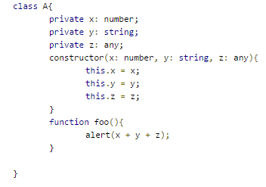
Object-Oriented Programming in Typescript
TypeScript allows for a much simple Object-oriented style of programming as opposed to JavaScript because it doesn’t use the strange syntax of prototyping in JavaScript. In TypeScript defining classes is immediately familiar and straightforward as you can see from the following code example:

Slide 15
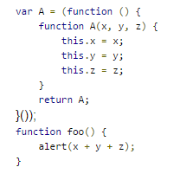
Object-Oriented programming in TypeScript
In contrast, the same code in the previous slide, but in JavaScript, would be translated as:
As we can see, JavaScript creates classes using various functions, and does so in a fairly roundabout way because of its functional nature and the fact that JavaScript was never meant to be an Object-Oriented programming language.

Slide 16
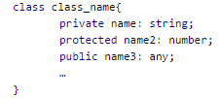
Object-Oriented programming in TypeScript
Creating members of a certain class in TypeScript is pretty simple, we need only to specify whether it’s private, protected or public, then typing the name of the member, and finally, specify the type of the member preceded by colons. For example:

Slide 17
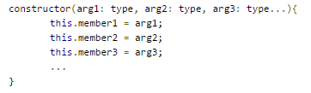
Object-Oriented programming in TypeScript
The syntax for a constructor in TypeScript is pretty straightforward and succinct, as we can see from the following example:

Slide 18
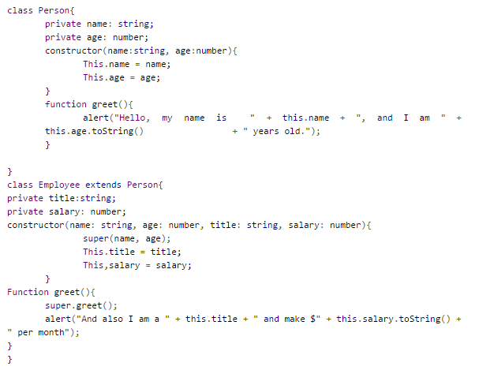
Object-Oriented programming in TypeScript
Here is an example of inheritance with TypeScript:

Slide 19
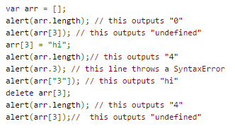
Pitfalls of JavaScript
Array Type: Lets consider the following code

Slide 20
Pitfalls of JavaScript
From the code in the previous slide and the results of it we can conclude that arrays in JavaScript have very strange behavior, they behave like a list, sometimes like an object, and sometimes like an array.
This type of “looseness” isn’t isolated in JavaScript, instead it is present throughout the entire language

Slide 21
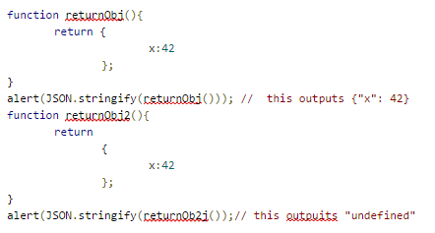
Pitfalls of JavaScript
Another example of JavaScript’s “looseness” is a feature called optional semicolons, consider the following code:

Slide 22
Pitfalls of JavaScript
As we can see from the code, the only difference between the two functions is that in the second functions there is a newline after the return statement, yet the first function works while the second gives an error.
This is because JavaScripts has seemingly random rules as to when it inserts a semicolon, one of those rules is that it always inserts a semicolon after a return statement, causing the previous strange situation.

Slide 23
Conclusion
From all the information in this presentation, we may conclude that every web developer must learn JavaScript because of its ubiquity in the web development world, however since JavaScript was never meant to create big projects, it has many pitfalls associated with it.
TypeScript tries to rectify the problems with JavaScript while still reaping its benefits, it has help a lot of programmers with coding efficient and stable websites.

