Slide 1
OpenGL
2020 Computer Graphics

Slide 2
OpenGL (Open Graphics Library)
A cross-language, multi-platform application programming interface (API)
Rendering 2D and 3D vector graphics
Interact with a graphics processing unit (GPU)
achieve hardware-accelerated rendering

Slide 3
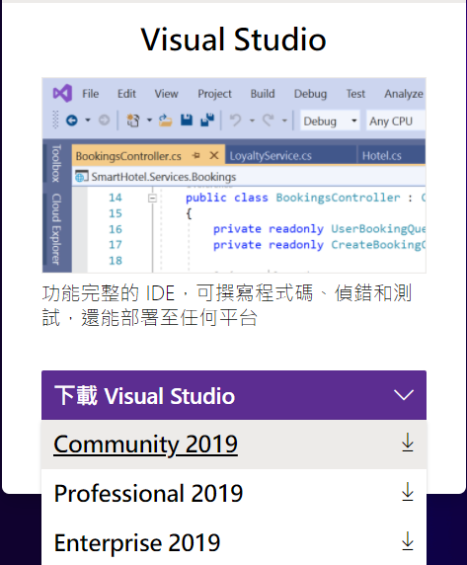

Install Visual Studio
Visual Studio 2019
https://visualstudio.microsoft.com/zh-hant/

Slide 4
Install OpenGL
OpenGL 4.5
make sure your driver is ready https://www.opengl.org/wiki/Getting_Started#Downloading_OpenGL / or
https://www.khronos.org/opengl/wiki/Getting_Started#Downloading_OpenGL
GLFW 3.3.2
download the 32-bit pre-compiled binaries https://www.glfw.org/download.html
FreeGLUT https://www.cs.pu.edu.tw/~tsay/course/cg/tutorial/installFreeGLUT.html

Slide 5
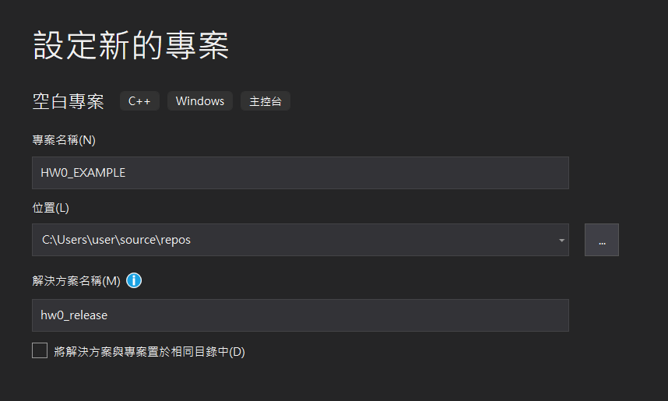
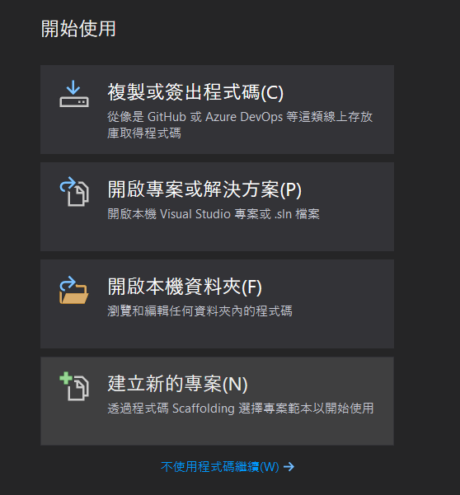
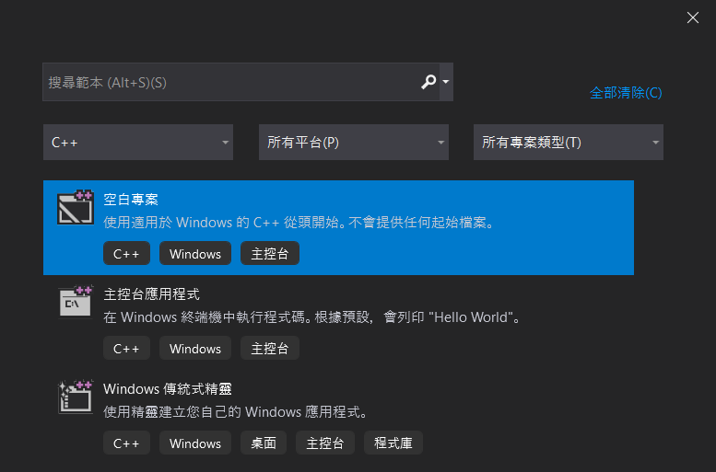
Create New Project
1. Open a new visual studio project
2. Select empty project (c++)
3. Set any project name you want

Slide 6
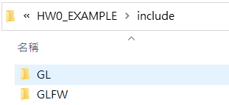
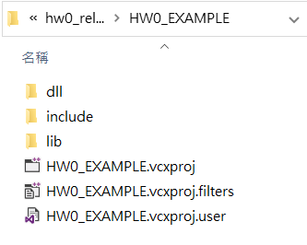
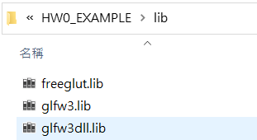
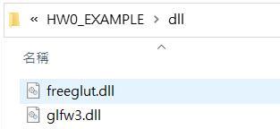
Create New Project
1. Create “include”, “lib”, “dll” directory under the project directory
2. Put the downloaded glfw and freeglut files into corresponding directory
ProjectName
include (all .h files) ▪ GLFW ▪ GL
lib ▪ glfw3.lib ▪ glfw3dll.lib ▪ freeglut.lib
dll ▪ glfw3.dll ▪ freeglut.dll

Slide 7
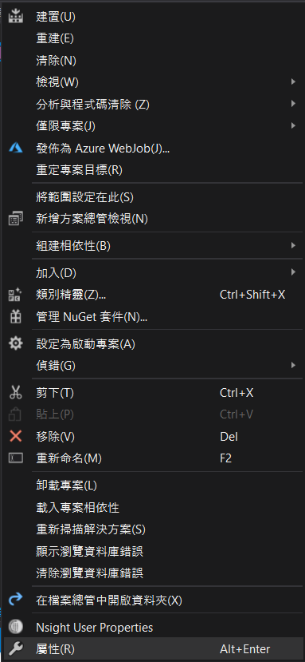
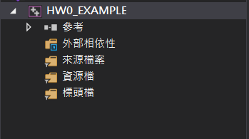
Check Default Path
1. Right click “ProjectName”
2. Click “property”

Slide 8
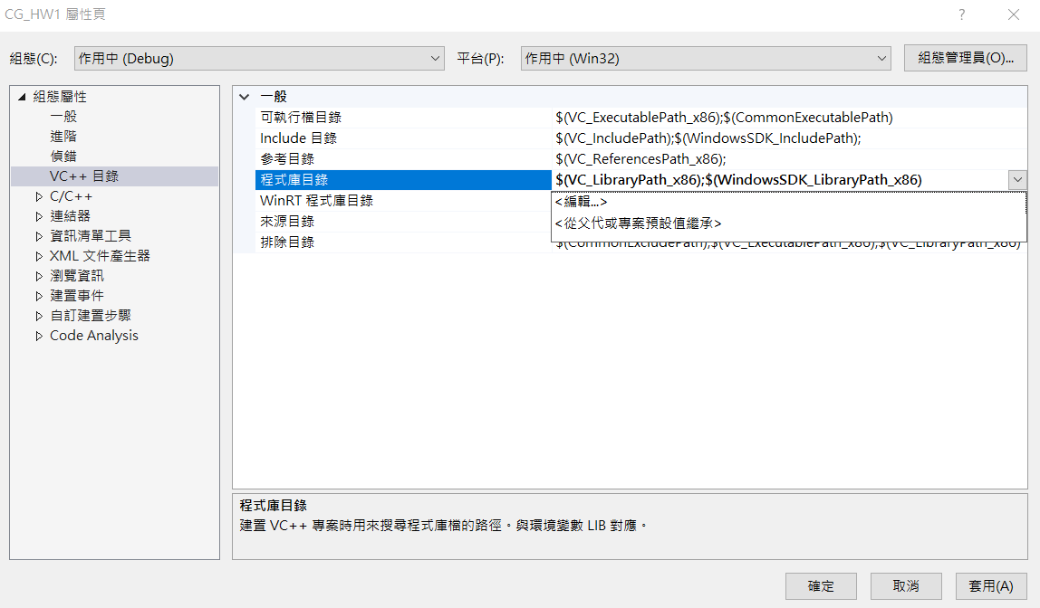
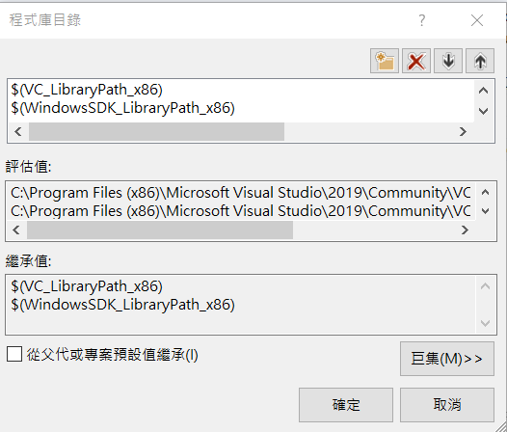
Check Default Path
(include, lib, dll, ...)

Slide 9
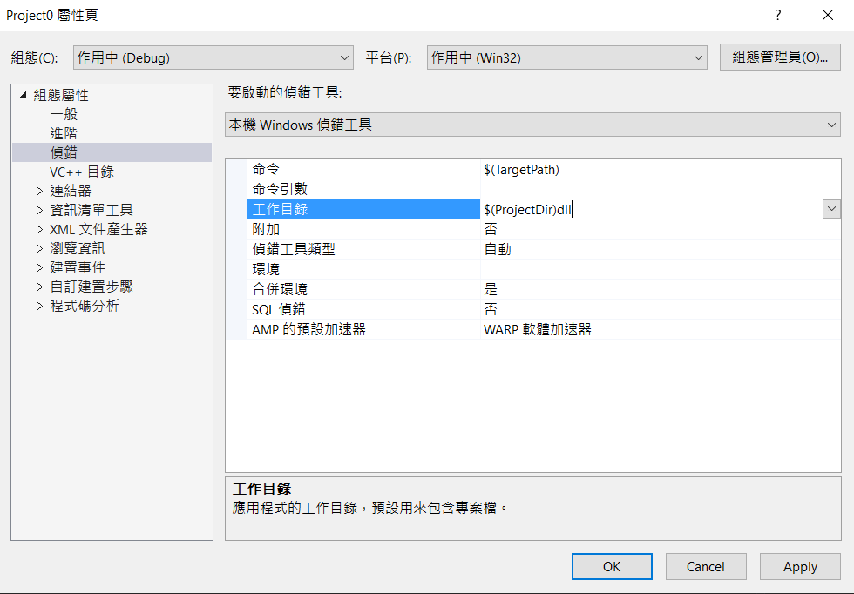
Setting new Environment (dll)
Click “debugging”
Set “working directory” into “$(ProjectDir)dll”

Slide 10
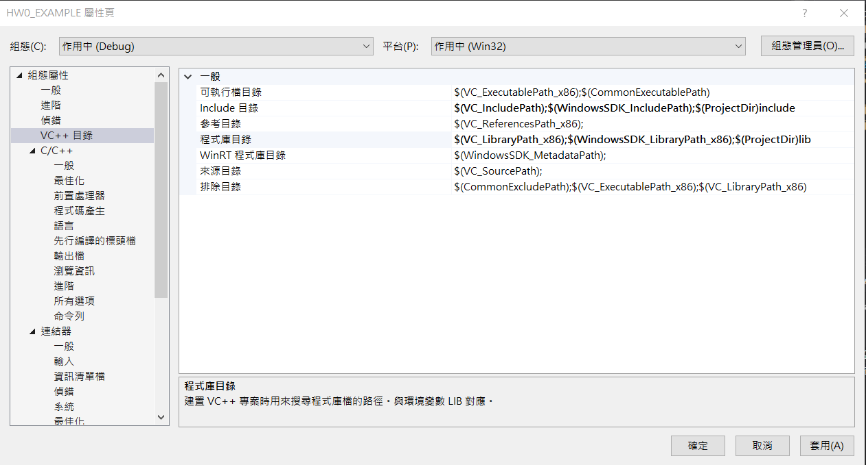
Setting new Environment (include)
Click “VC++ directory”
Set “include directory” into “$(ProjectDir)include”

Slide 11
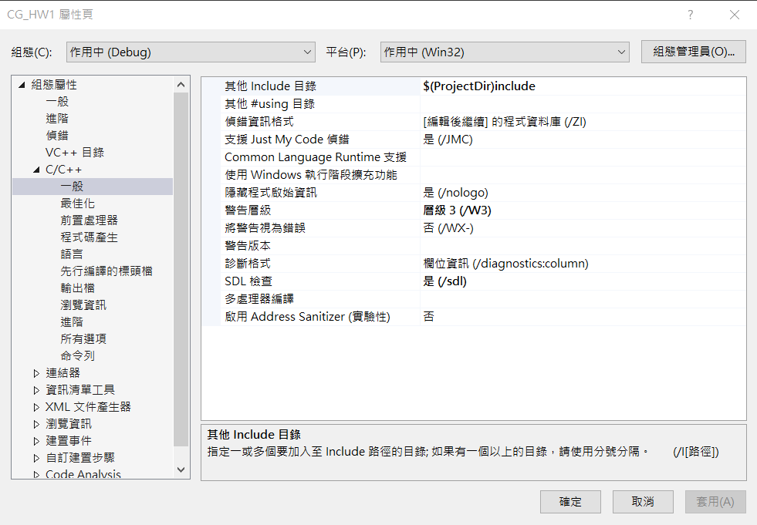
Setting new Environment (include)
Add a new c++ file first. (slide 14)
Click “C/C++ directory” ▸ “general”
Set “include directory” into “$(ProjectDir)include”

Slide 12
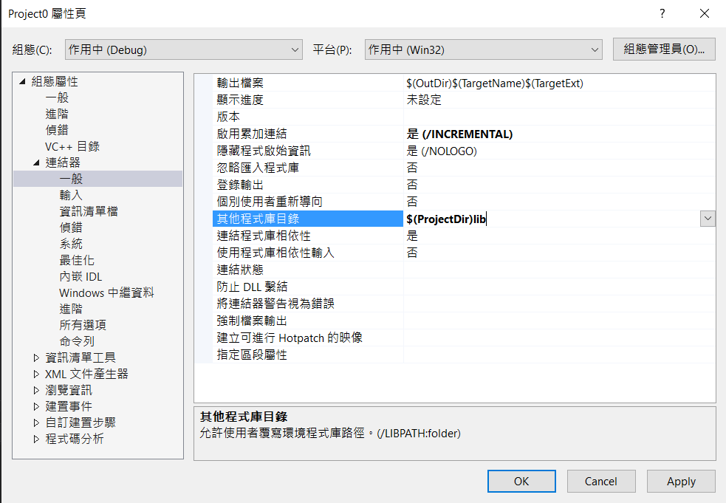
Setting new Environment (lib)
Click “linker” ▸ “general”
Set “additional library directories” into “$(ProjectDir)lib”

Slide 13
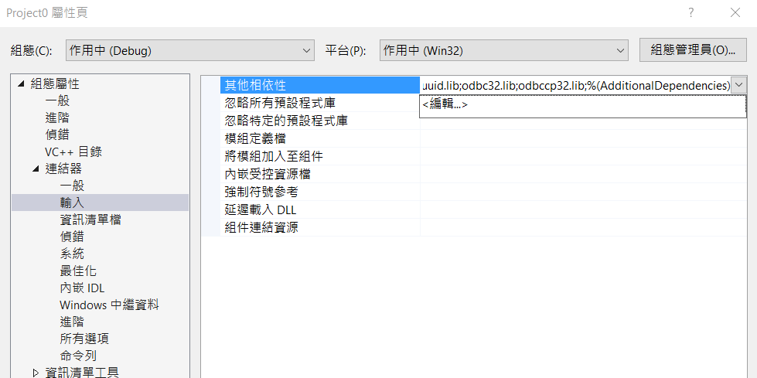
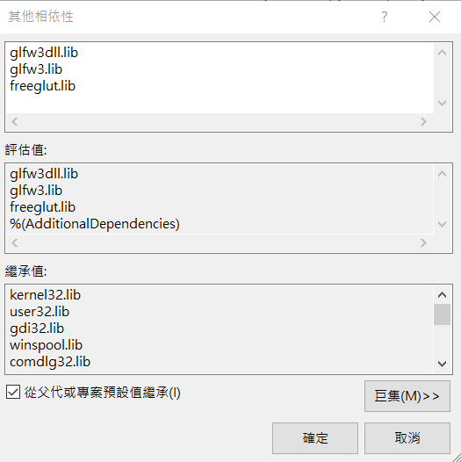
Setting new Environment (lib)
Click “linker” ▸ “input”
Set “additional dependencies” into “glfw3dll.lib;glfw3.lib;freeglut.lib;”

Slide 14
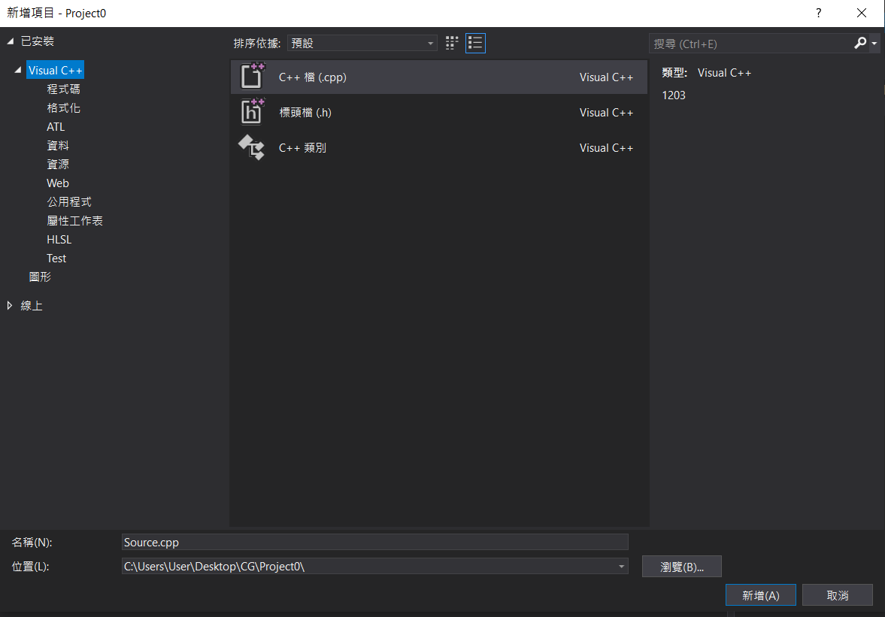
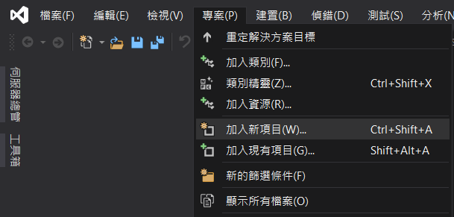
Simple test code
1. Click “project” ▸ “add new items”
2. Create an empty cpp file and run the code on next page

Slide 15
Simple test code
Code
https://www.glfw.org/docs/3.0/quick.html
Add “#include <GL/freeglut.h>“ in the first line

