Slide 1
Home
Menu
Music
Jobs

Slide 2

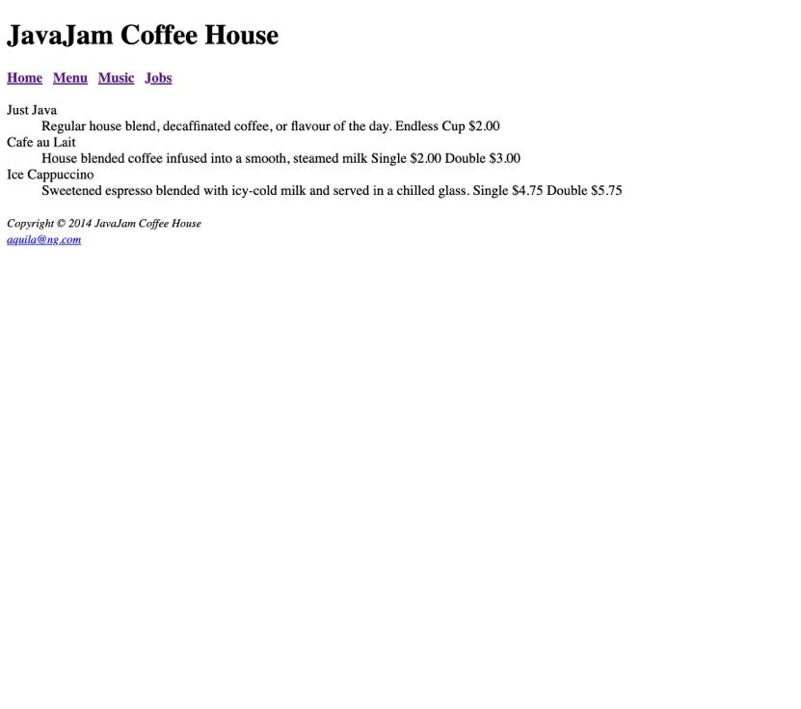
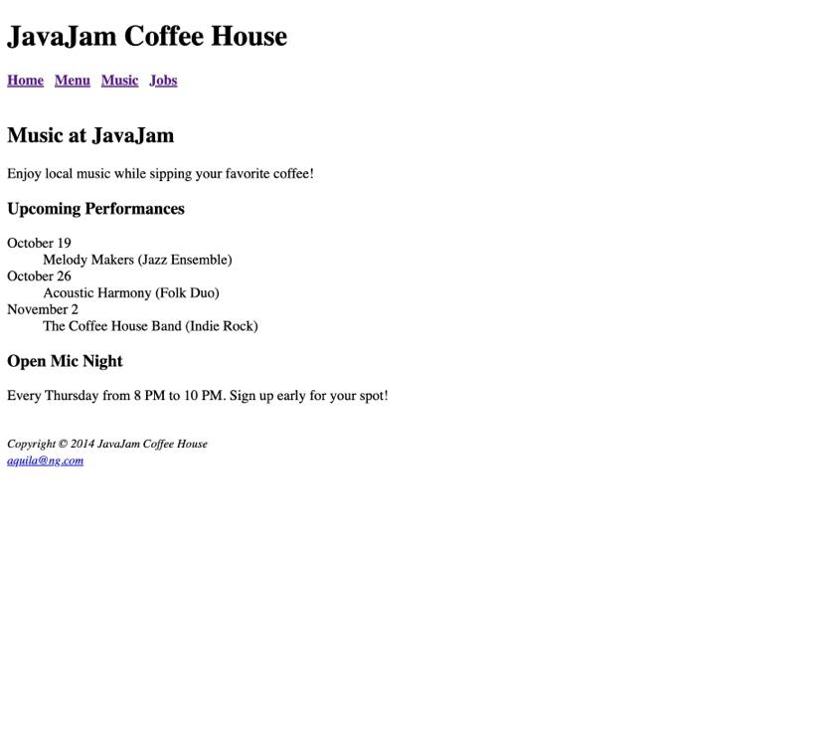
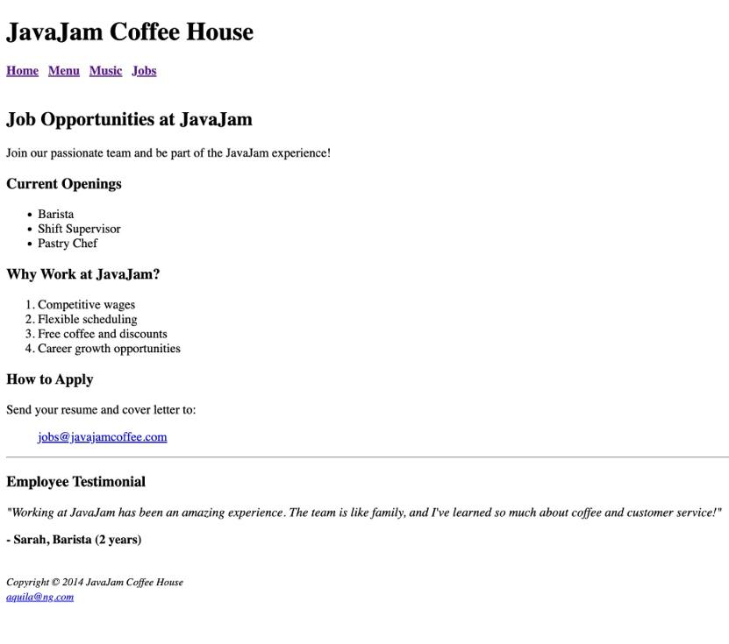
Home
Menu
Music
Jobs
Home

Slide 3
Home
Menu
Music
Jobs
Java Jam Café House
Java Jam Café House
Java Jam Café House
Java Jam Café House
Home Menu Music Jobs
Home Menu Music Jobs
Home Menu Music Jobs
Home Menu Music Jobs
Content
Item Name
Content Header
Content Header
Item Description, Price
Content Description
Content Description
Item Name
Activity Header
Current Openings Header
Item Description, Price
Date
Current Opening List Items
5432 route 42 Eliison Bay, W154210
Copyright © 2014 JavaJam Coffee House aquila@ng.com
Activity Description
Copyright © 2014 JavaJam Coffee House aquila@ng.com
Feature Activity Header
How to apply Header
Feature Activity Description
Send your resume and cover letter to:
aquila@ng.com
Copyright © 2014 JavaJam Coffee House aquila@ng.com
Copyright © 2014 JavaJam Coffee House aquila@ng.com

Slide 4
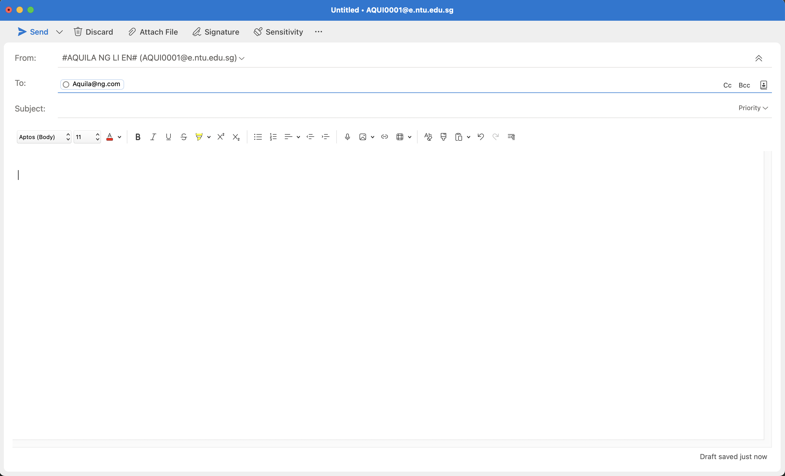
Home
Menu
Music
Jobs
Email Client

