Slide 1
INDIVIDUAL DIGITAL STORY
FOR
CISC3003 SEMESTER PROJECT
DC228011 LIU YUCHEN

Slide 2




PROJECT INTRODUCTION
The objective of this project is to design and develop an online shopping cart system specifically tailored for a mobile phone market. The system will allow customers to browse and purchase mobile phones through a user-friendly web interface. The project will involve creating an efficient platform that provides a seamless shopping experience for users.

Slide 3
01 -SHOPPING CART
KEY
FEATURES
02 - CHECKOUT AND PAYMENT
03 - MOBILE RESPONSIVENESS

Slide 4
SHOPPING CART
Our website will contains a shopping cart system that our customers can add products to their cart, modify quantities, and remove items.

Slide 5
CHECKOUT AND PAYMENT
Also, a secure payment processing for a seamless checkout experience

Slide 6
MOBILE RESPONSIVENESS
As most of our customers will chose using phone to browes our website. The system will be optimized for mobile devices to provide a seamless mobile shopping experience

Slide 7
DESIGN IN DETAILED
BACK-END
For the back-end, we chose to use php and its pugin MySQLI and Ajax to implement it.
BACK
FRONT
DATABSE
FRONT-END
DATABASE
For the front-end, php and bootstrap4 will be used.
We chose MySQL to be our database

Slide 8
RESULTING WEBSITE
Lorna Alvarado

Slide 9
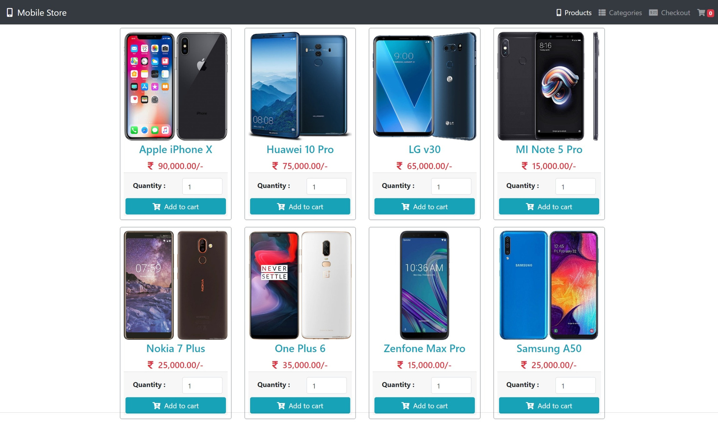
HOME PAGE

Slide 10
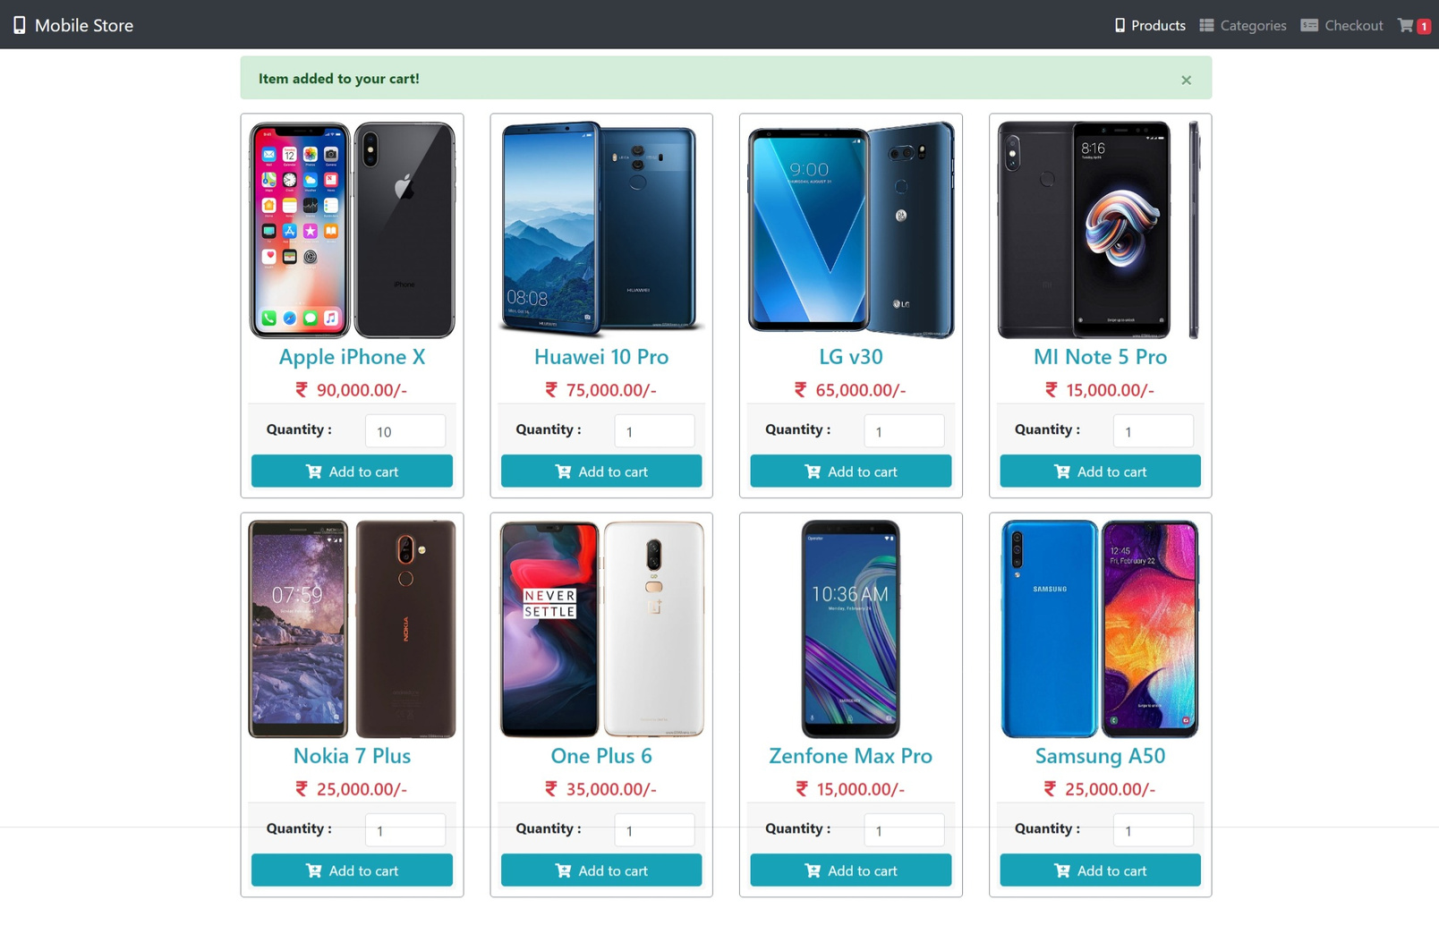
FUNCTION TESTING

Slide 11
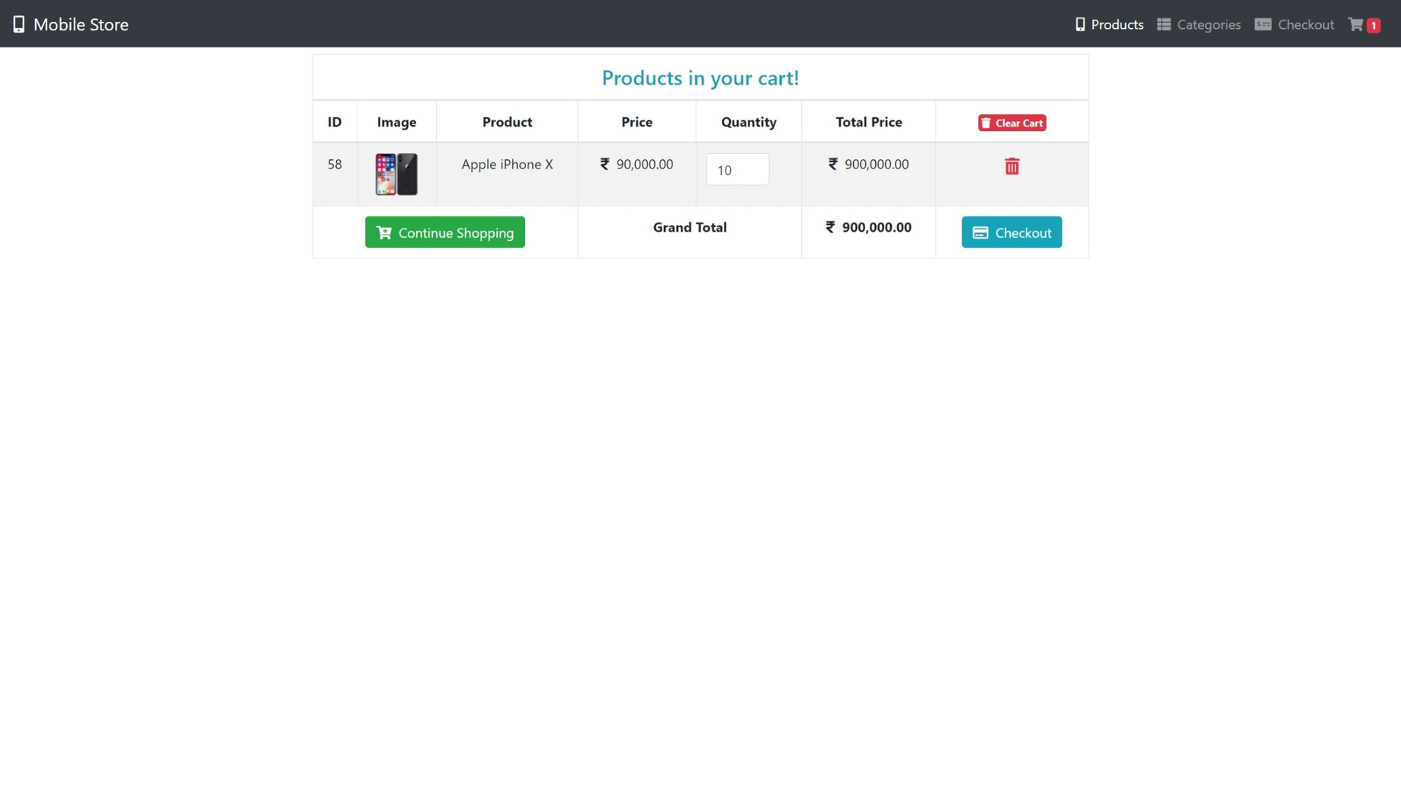
SHOPPING CART

Slide 12
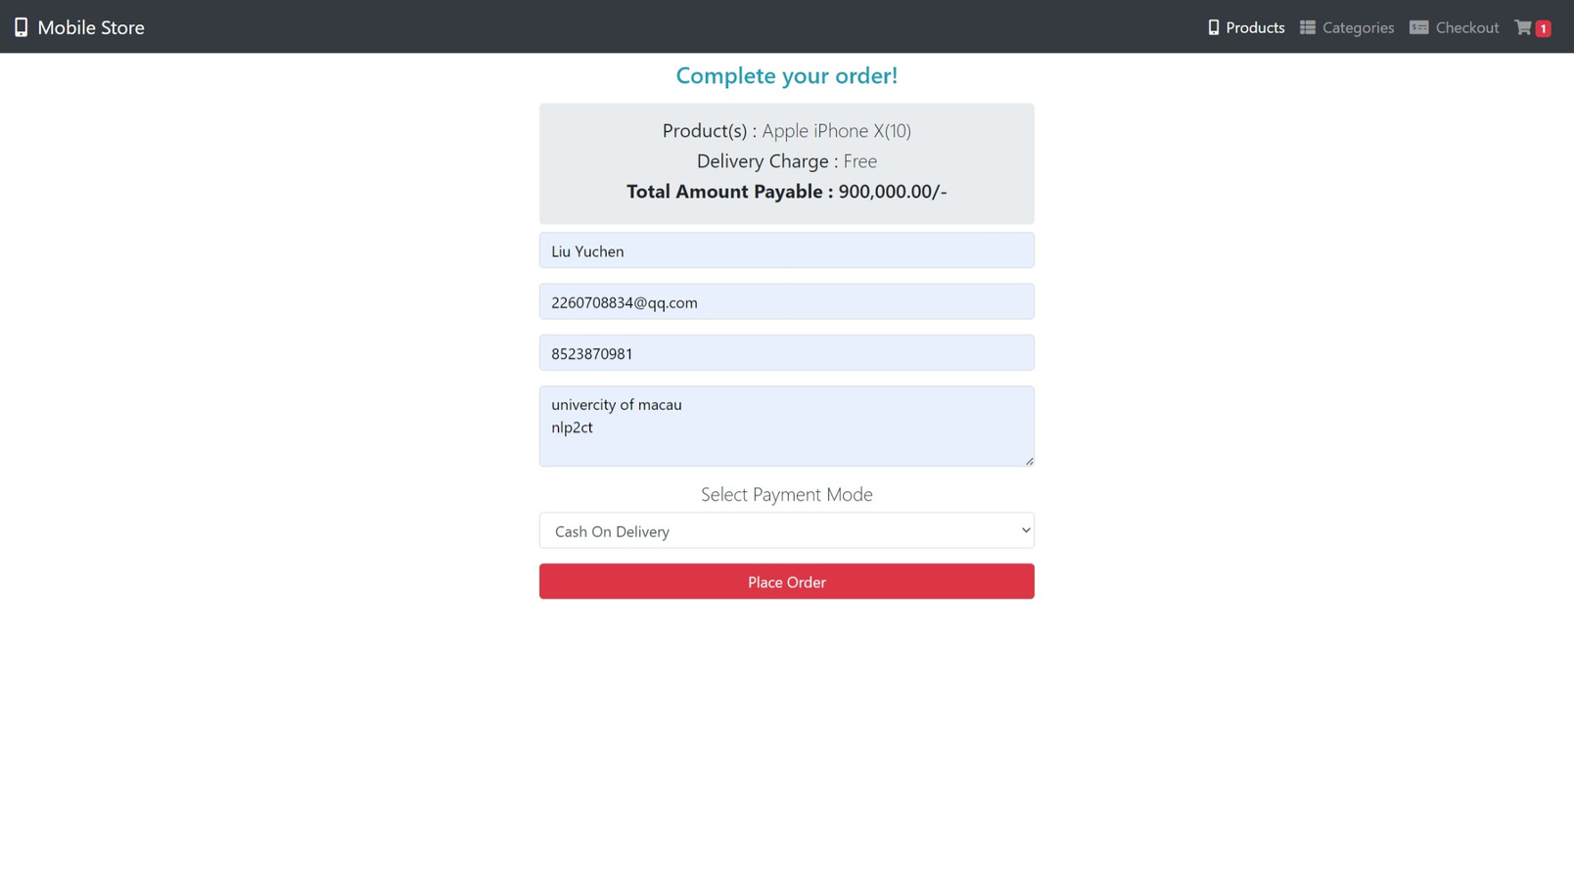
ORDERING PAGE

Slide 13
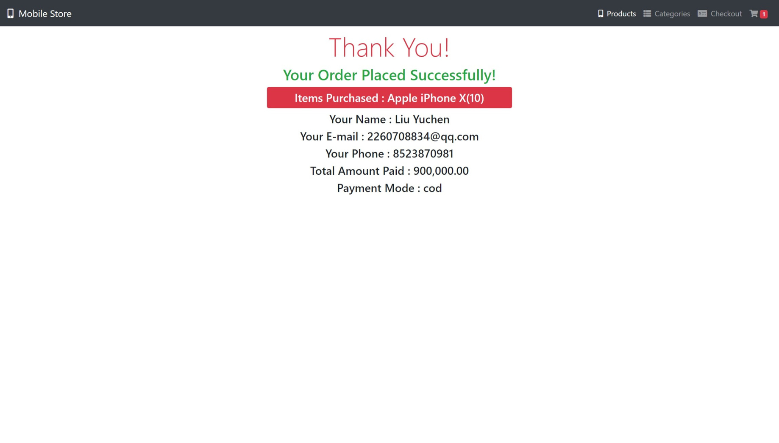
COMFIRM PAGE

Slide 14
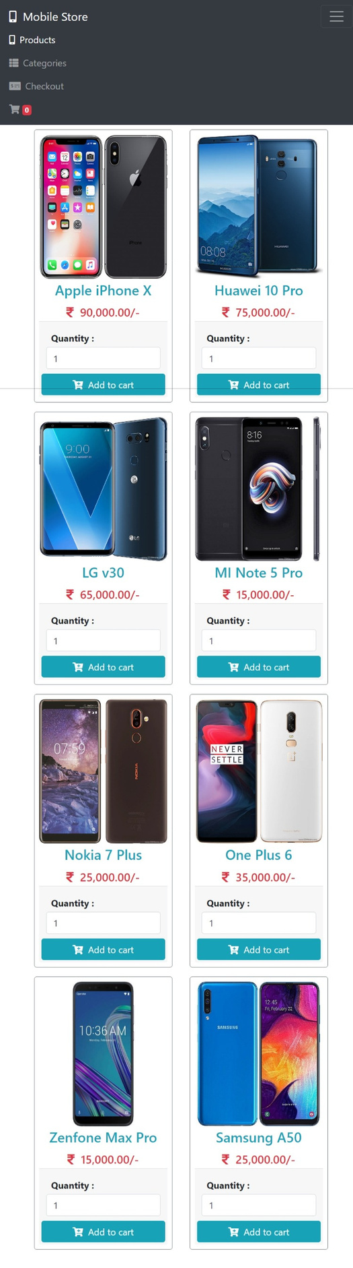
RESPONSIVE DESIGN

Slide 15
SUMMARY
In this project, we have successfully implemented a online shopping cart website as a full-stack developer
click here to visite the project on GitHub

Slide 16
THANK YOU

