Slide 1
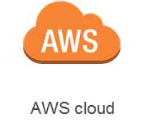


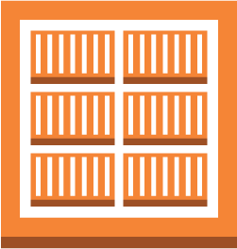










Amazon S3
Provisioning
Bucket
CloudWatch
Logs
ECR
Registry
VPC
Docker
root
volume
Docker
root
volume
Docker
root
volume
Jenkins
serer
root
volume
Docker
dev-helloworld
test-helloworld
prod-helloworld
jenkins-helloworld
dev-helloworld
Security Group
test-helloworld
Security Group
prod-helloworld
Security Group
shared-Jenkins
Security Group
Dev subnet
Test subnet
Prod subnet
Jenkins subnet
Privileged Access
Security Group
Availability Zone #1
Internet gateway

