Slide 1


SSO – Oauth – OpenID
A comparison of the three technologies
Jason Luttrell
CSD 370-T301 Secure Software Development
Module 1.2

Slide 2
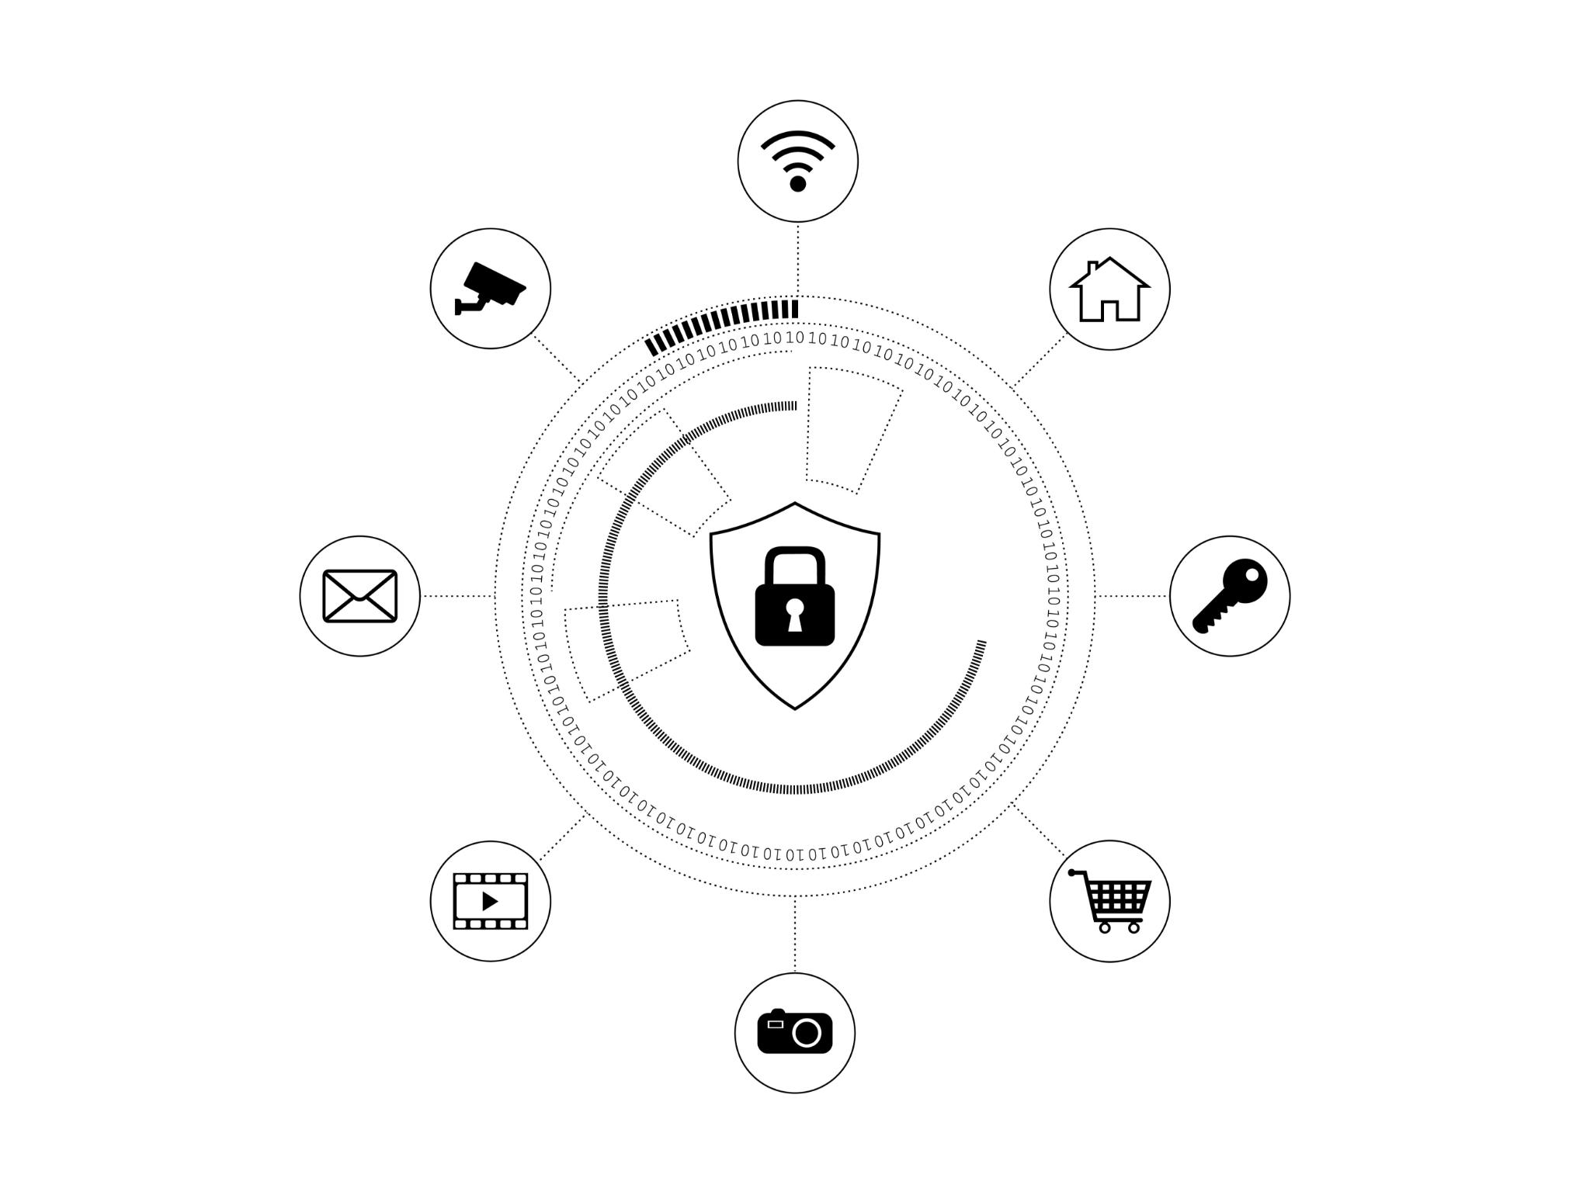
Understanding SSO, OAuth, OpenID
Single Sign-On (SSO)
SSO allows users to log in to multiple applications with a single set of credentials. This simplifies user experience.
OAuth
OAuth is a protocol that allows secure authorization of resources without sharing credentials. It is widely used for web applications.
OpenID
OpenID is an authentication protocol that allows users to be verified by third-party services. It enhances security and convenience.
Notes:
Definitions and workings of Single Sign-On (SSO), OAuth, and OpenID.

Slide 3

Key Definitions
SSO
Single Sign-On (SSO) is a session and user authentication service that permits a user to use one set of login credentials to access multiple applications.
OAuth
OAuth is an open standard for access delegation, commonly used as a way to grant websites or applications limited access to a user's information without exposing passwords.
OpenID
OpenID is an authentication protocol that allows users to verify their identity on different websites without having to create multiple accounts.
Notes:
This slide explains what SSO, OAuth, and OpenID are and covers how they work.

Slide 4

Single Sign-On (SSO)
Simplifies User Experience
SSO simplifies the user experience by allowing users to access multiple applications with one login, reducing password fatigue.
Improves Security
SSO improves security by decreasing the number of passwords users need to manage, reducing the number of attack vectors.
The more passwords a user has to manage the more likely poor password practices will creep in to the security culture
Notes:
Single Sign-On (SSO) is a user authentication process that permits a user to access multiple applications with one set of login credentials. It simplifies the user experience by reducing password fatigue and improves security by decreasing the number of attack vectors.

Slide 5

OAuth Explained
Access Delegation Standard
OAuth is a standard for delegating access, granting limited access to user information without exposing passwords.
Token Issuance
OAuth works by issuing tokens to third-party applications with user consent via an authorization server.
User Consent
The authorization server issues tokens to third-party applications only with the user's consent, ensuring secure access.
Examples Include
Giving Spotify permission to access your Alexa account
Using Facebook or Google to log into a webpage
Notes:
OAuth (Open Authorization) is a standard for access delegation commonly used as a way to grant websites or applications limited access to a user's information without exposing passwords. OAuth works by allowing tokens to be issued to third-party applications by an authorization server with the user's consent.

Slide 6

Oauth is Authorization
OAuth is not an API authentication service. Rather it more about authorization or checking to see what permissions or privileges a user has for accessing resources.
For a simple simile, consider the following: authentication is showing your ID to get into an airport while authorization is what allows you to access some areas and not others.
The process of authentication is handled by the application or site serving as the identity provider (like OpenID).
As an authorization standard, OAuth doesn't manage authentication directly. But it can give already-authenticated users access to appropriate resources.
Notes:
OAuth (Open Authorization) is a standard for access delegation commonly used as a way to grant websites or applications limited access to a user's information without exposing passwords. OAuth works by allowing tokens to be issued to third-party applications by an authorization server with the user's consent.

Slide 7

What is OpenID?
Single Login Credentials
OpenID allows users to log in to multiple websites using a single set of login credentials.
OpenID Provider
Users authenticate to an OpenID provider, which then allows access to OpenID-enabled websites.
Seamless Login Experience
OpenID provides a seamless login experience across multiple websites by using a single authentication process.
Notes:
OpenID is an authentication protocol that allows users to log in to multiple websites using a single set of credentials. It works by allowing users to authenticate to an OpenID provider and then use this authentication at OpenID-enabled websites, providing a seamless login experience.

Slide 8

Implementing SSO, OAuth, and OpenID
Begin with a clear understanding of user requirements.
Select a reliable SSO provider that fits organizational needs.
Integrate OAuth by implementing an authorization server.
Choose an OpenID provider that aligns with security standards.
Thoroughly test the integrations to ensure seamless user experience.
Notes:
In this slide, we will discuss the practical steps for implementing SSO, OAuth, and OpenID. Start by understanding the specific needs of your users to choose the right solutions. Ensure that you select a reputable SSO provider and implement OAuth with a robust authorization server. Additionally, select an OpenID provider that meets security standards, and don't forget to conduct comprehensive testing to provide a seamless experience.

Slide 9

Summary
The combination of OpenID and OAuth to enable your Enterprise SSO is a robust solution that can enhance user efficiency and satisfaction while providing the security needs that Mesusa Corp. requires.
Notes:
Single Sign-On (SSO), OAuth, and OpenID each play crucial roles in modern authentication and authorization processes. SSO enhances user experience, OAuth secures delegated access, and OpenID simplifies authentication across services.

Slide 10

References
Conklin, W. A., & Shoemaker, D. P. (n.d.). CSSLP secure software lifecycle professional all-in-one exam guide (3rd ed.). Retrieved from https://platform.virdocs.com/read/2096595/2/#/4/4
Frontegg. (n.d.). OIDC authentication guide. Retrieved June 2, 2025, from https://frontegg.com/guides/oidc-authentication
Kong. (n.d.). What is OAuth? Kong. Retrieved June 2, 2025, from https://konghq.com/blog/learning-center/what-is-oauth
Notes:
Single Sign-On (SSO), OAuth, and OpenID each play crucial roles in modern authentication and authorization processes. SSO enhances user experience, OAuth secures delegated access, and OpenID simplifies authentication across services.

