Slide 1

Convolution and Correlation Visualizer
EEE 4602 Project Presentation
Presented by:
Adhnan Kalim, Ar-Rafi Ishraq, Ashfiq Ul Rahman, Tanjim Mahbub

Slide 2

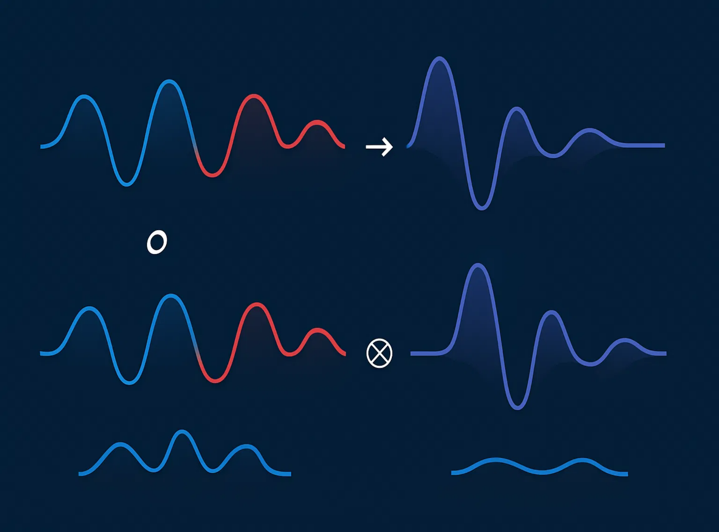
Project Overview
Problem Statement
Key Features
Design and implement a GUI application that allows users to visualize the convolution operation between two signals, supporting both discrete-time and continuous-time signal modes.
Signal type selection (discrete/continuous)
Custom signal input options
Real-time animation of convolution process
Correlation visualization capability
Objectives
Adjustable animation speed and reset controls
Reinforce understanding of convolution in both discrete and continuous domains
Provide hands-on experience with computational tools
Create an interactive visualization tool for educational purposes

Slide 3
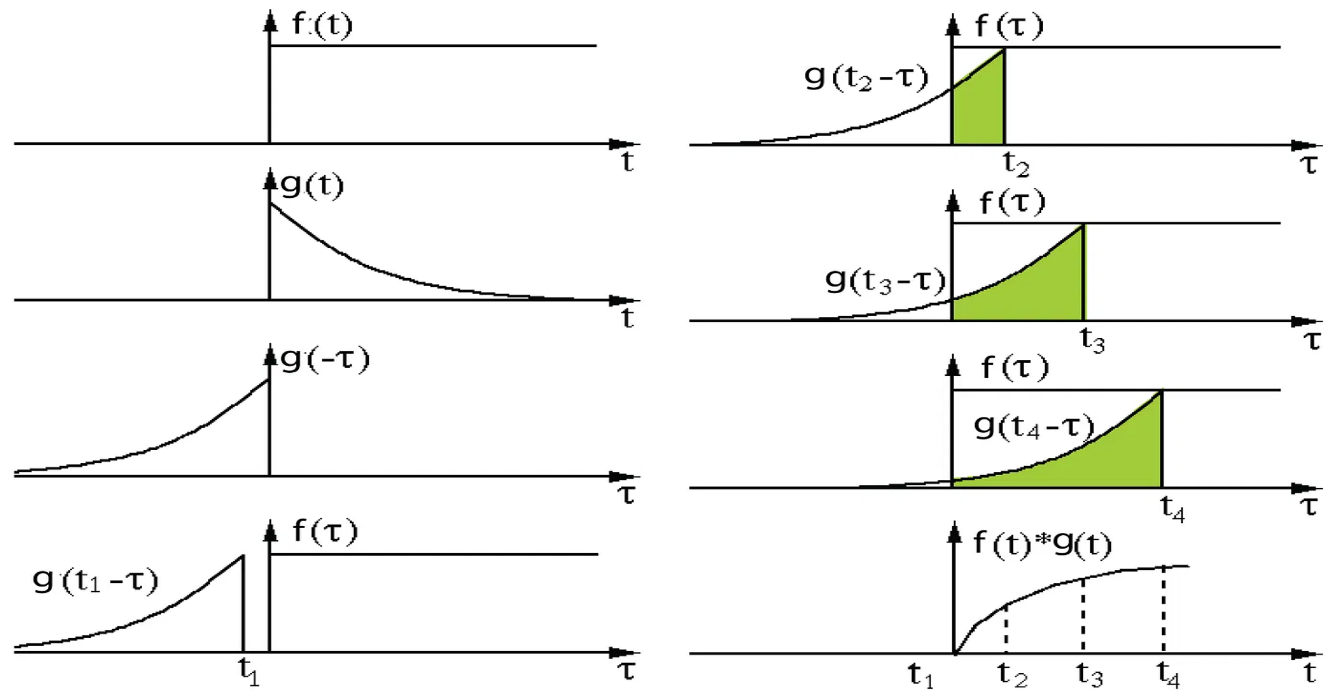
Introduction to Convolution
What is Convolution?
A mathematical operation that expresses the relationship between an input signal, the impulse response of a system, and the output.
For continuous time:
(f * g)(t) = ∫ f(τ) g(t - τ) dτ
For discrete time:
(f * g)[n] = Σ f[k] g[n - k]
Applications:
Signal processing: filtering signals, removing noise
Image analysis: feature extraction, edge detection
Machine learning: convolutional neural networks (CNNs)

Slide 4

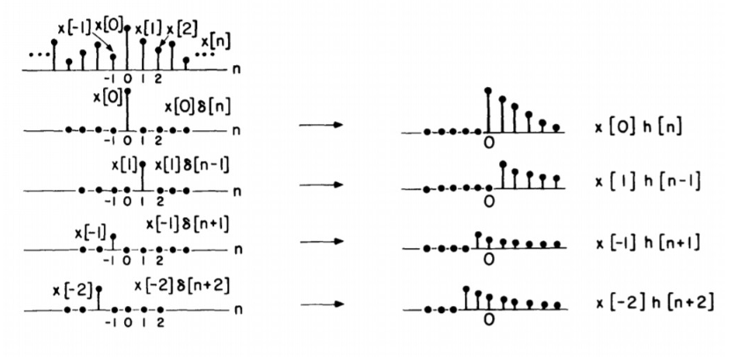
Discrete-Time Convolution
Mathematical Definition
(x * h)[n] = Σ x[k] · h[n-k]
where k ranges over all integers
Process Steps
1
Flip the impulse response h[n] to get h[-n]
2
Shift h[-n] by n to get h[n-k]
3
Multiply x[k] and h[n-k] at each point
4
Sum all products to get output y[n]
GUI Implementation
User inputs signal vectors and starting indices
Animation shows shifting impulse response
Real-time calculation of convolution sum
Three plots: input signal, shifting impulse response, and output

Slide 5







Continuous-Time Convolution
Mathematical Definition
(f * g)(t) = ∫ f(τ) g(t - τ) dτ
Process Steps
Flip one signal: g(τ) → g(-τ)
Shift the flipped signal: g(-τ) → g(t-τ)
Multiply the signals: f(τ) × g(t-τ)
Integrate the product over all τ & repeat for all t
GUI Implementation
Signal selection from standard types (rectangular, triangular, step, sawtooth)
Parameter specification (amplitude, start/end time)
Real-time animation of the shifting and multiplication process

Slide 6

Theoretical Overview
1. GUI Setup
Core Functions (Continued)
Modern UI window with organized panels and input controls
C. runContinuousConvolution
Signal domain selection: Discrete-Time (DT) or Continuous-Time (CT)
Approximates convolution integral: y(t) = ∫ x(τ) * h(t-τ) dτ
Uses numerical integration for computation
DT mode: Numerical vectors and starting indices for x[n] and h[n]
Plots x(τ), h(t-τ), and buildup of y(t) frame-by-frame
CT mode: Signal shapes (Rectangular, Triangular, etc.) with parameters
D. runContinuousCorrelation
Buttons for Convolution, Correlation, and Reset operations
Computes R(t) = ∫ x(τ) * h(τ-t) dτ
Speed slider to control animation timing
Similar to convolution but without signal flipping
Three visualization axes: input, shifted signal, and result
Animates each step visually
2. Mode Switching
4. Reset and Plot Management
Switches between DT and CT input panels based on user selection
Clears plots and resets inputs to default values
Uses radio button group to determine the active domain
Adjusts x/y-axis limits dynamically
Ensures clean visualization for each new operation
3. Core Functions
5. Utility Functions
A. runDiscreteConvolution
generateSignal:
Creates different shaped signals
Flips h[n], shifts across x[n], multiplies and sums overlapping values
pauseForSlider:
Controls animation timing
Animates the convolution process step-by-step
updateYLim:
Dynamically adjusts y-axis range
B. runDiscreteCorrelation
Shifts h[n-k] over x[n] without flipping
Point-wise multiplication and summing for correlation
Conceptual Takeaway
This GUI provides an interactive, visual, and educational way to explore signal operations step-by-step, helping users understand convolution and correlation in both discrete and continuous domains.

Slide 7
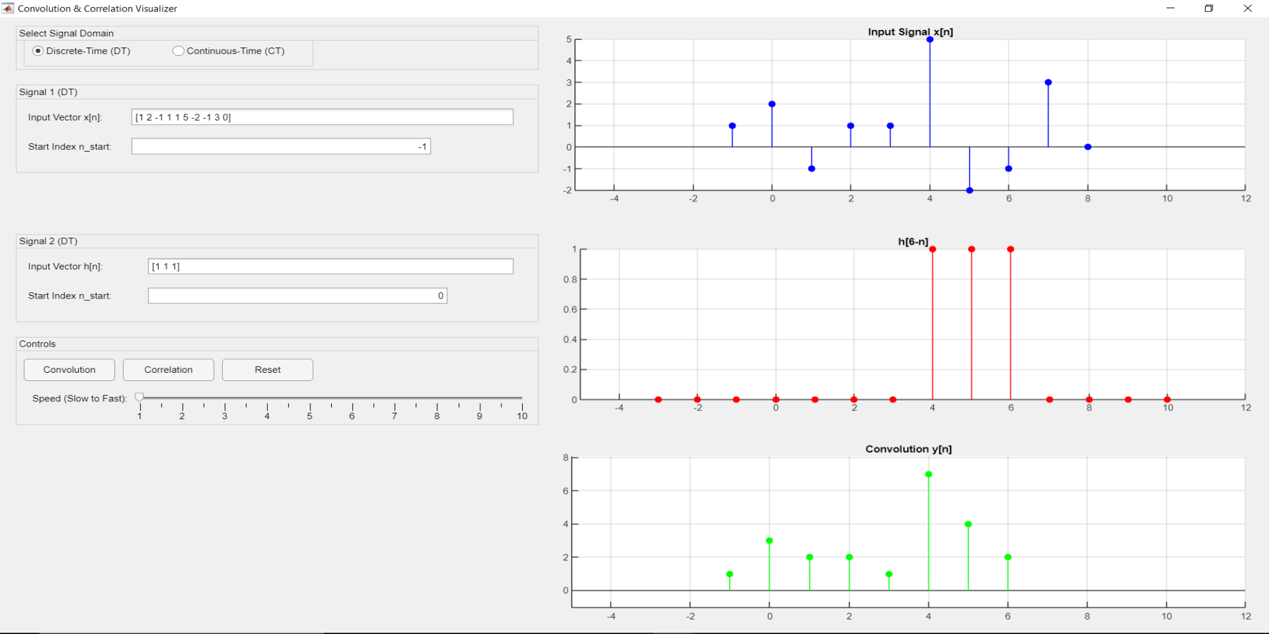





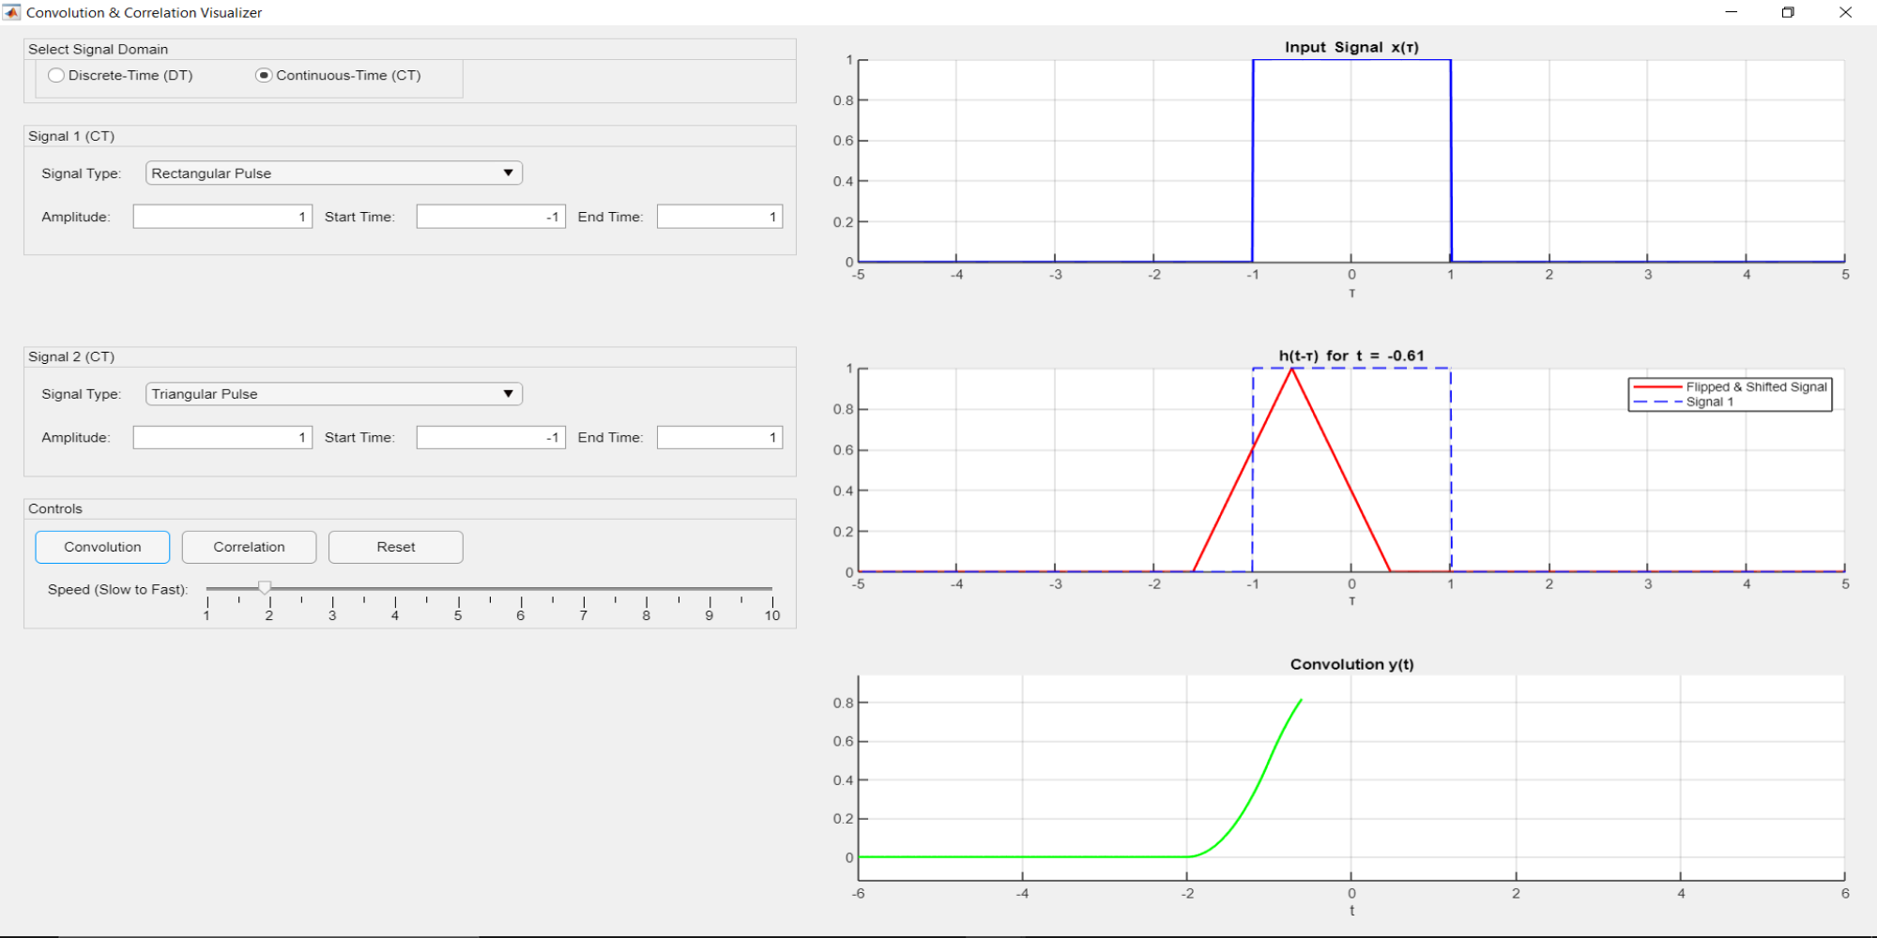
GUI Features and Usability
Key Features
Domain selection (Discrete/Continuous)
Signal input with customization options
Toggle between convolution and correlation
Real-time animation with adjustable speed
Reset functionality for new operations
Usability Highlights
Intuitive interface with clearly labeled sections
Synchronized plots for better understanding
Visual feedback during operation
Educational tool for signal processing concepts

Slide 8
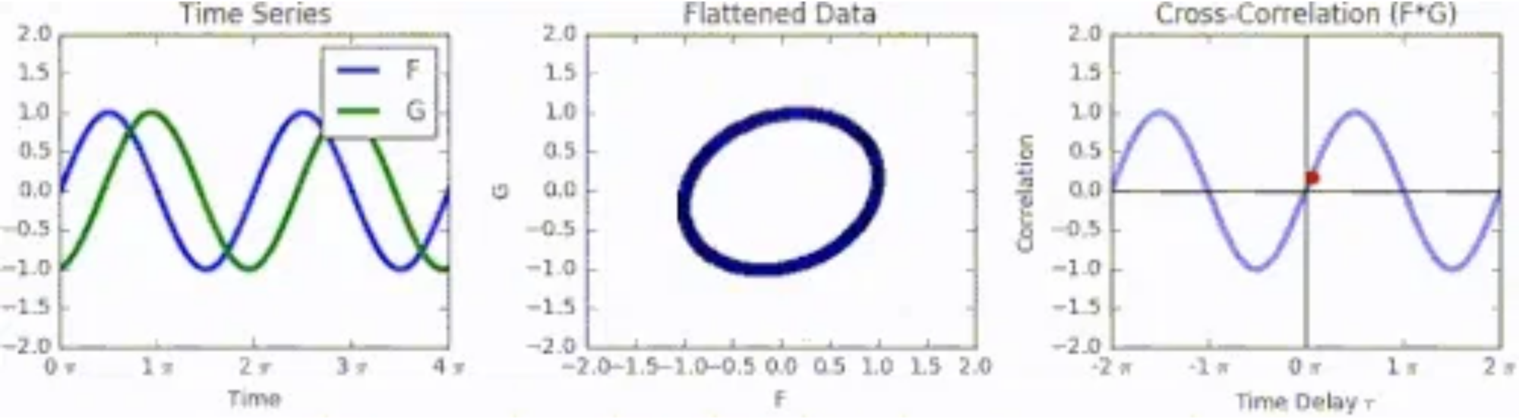
Introduction to Correlation
What is Correlation?
A measure of similarity between two signals as a function of the displacement of one relative to the other.
For continuous time:
(f ⋆ g)(t) = ∫ f(τ) g(t + τ) dτ
For discrete time:
(f ⋆ g)[n] = Σ f[k] g[n + k]
Applications:
Pattern recognition and feature detection
Signal alignment and time delay estimation
Noise reduction and signal recovery
Image registration and template matching

Slide 9

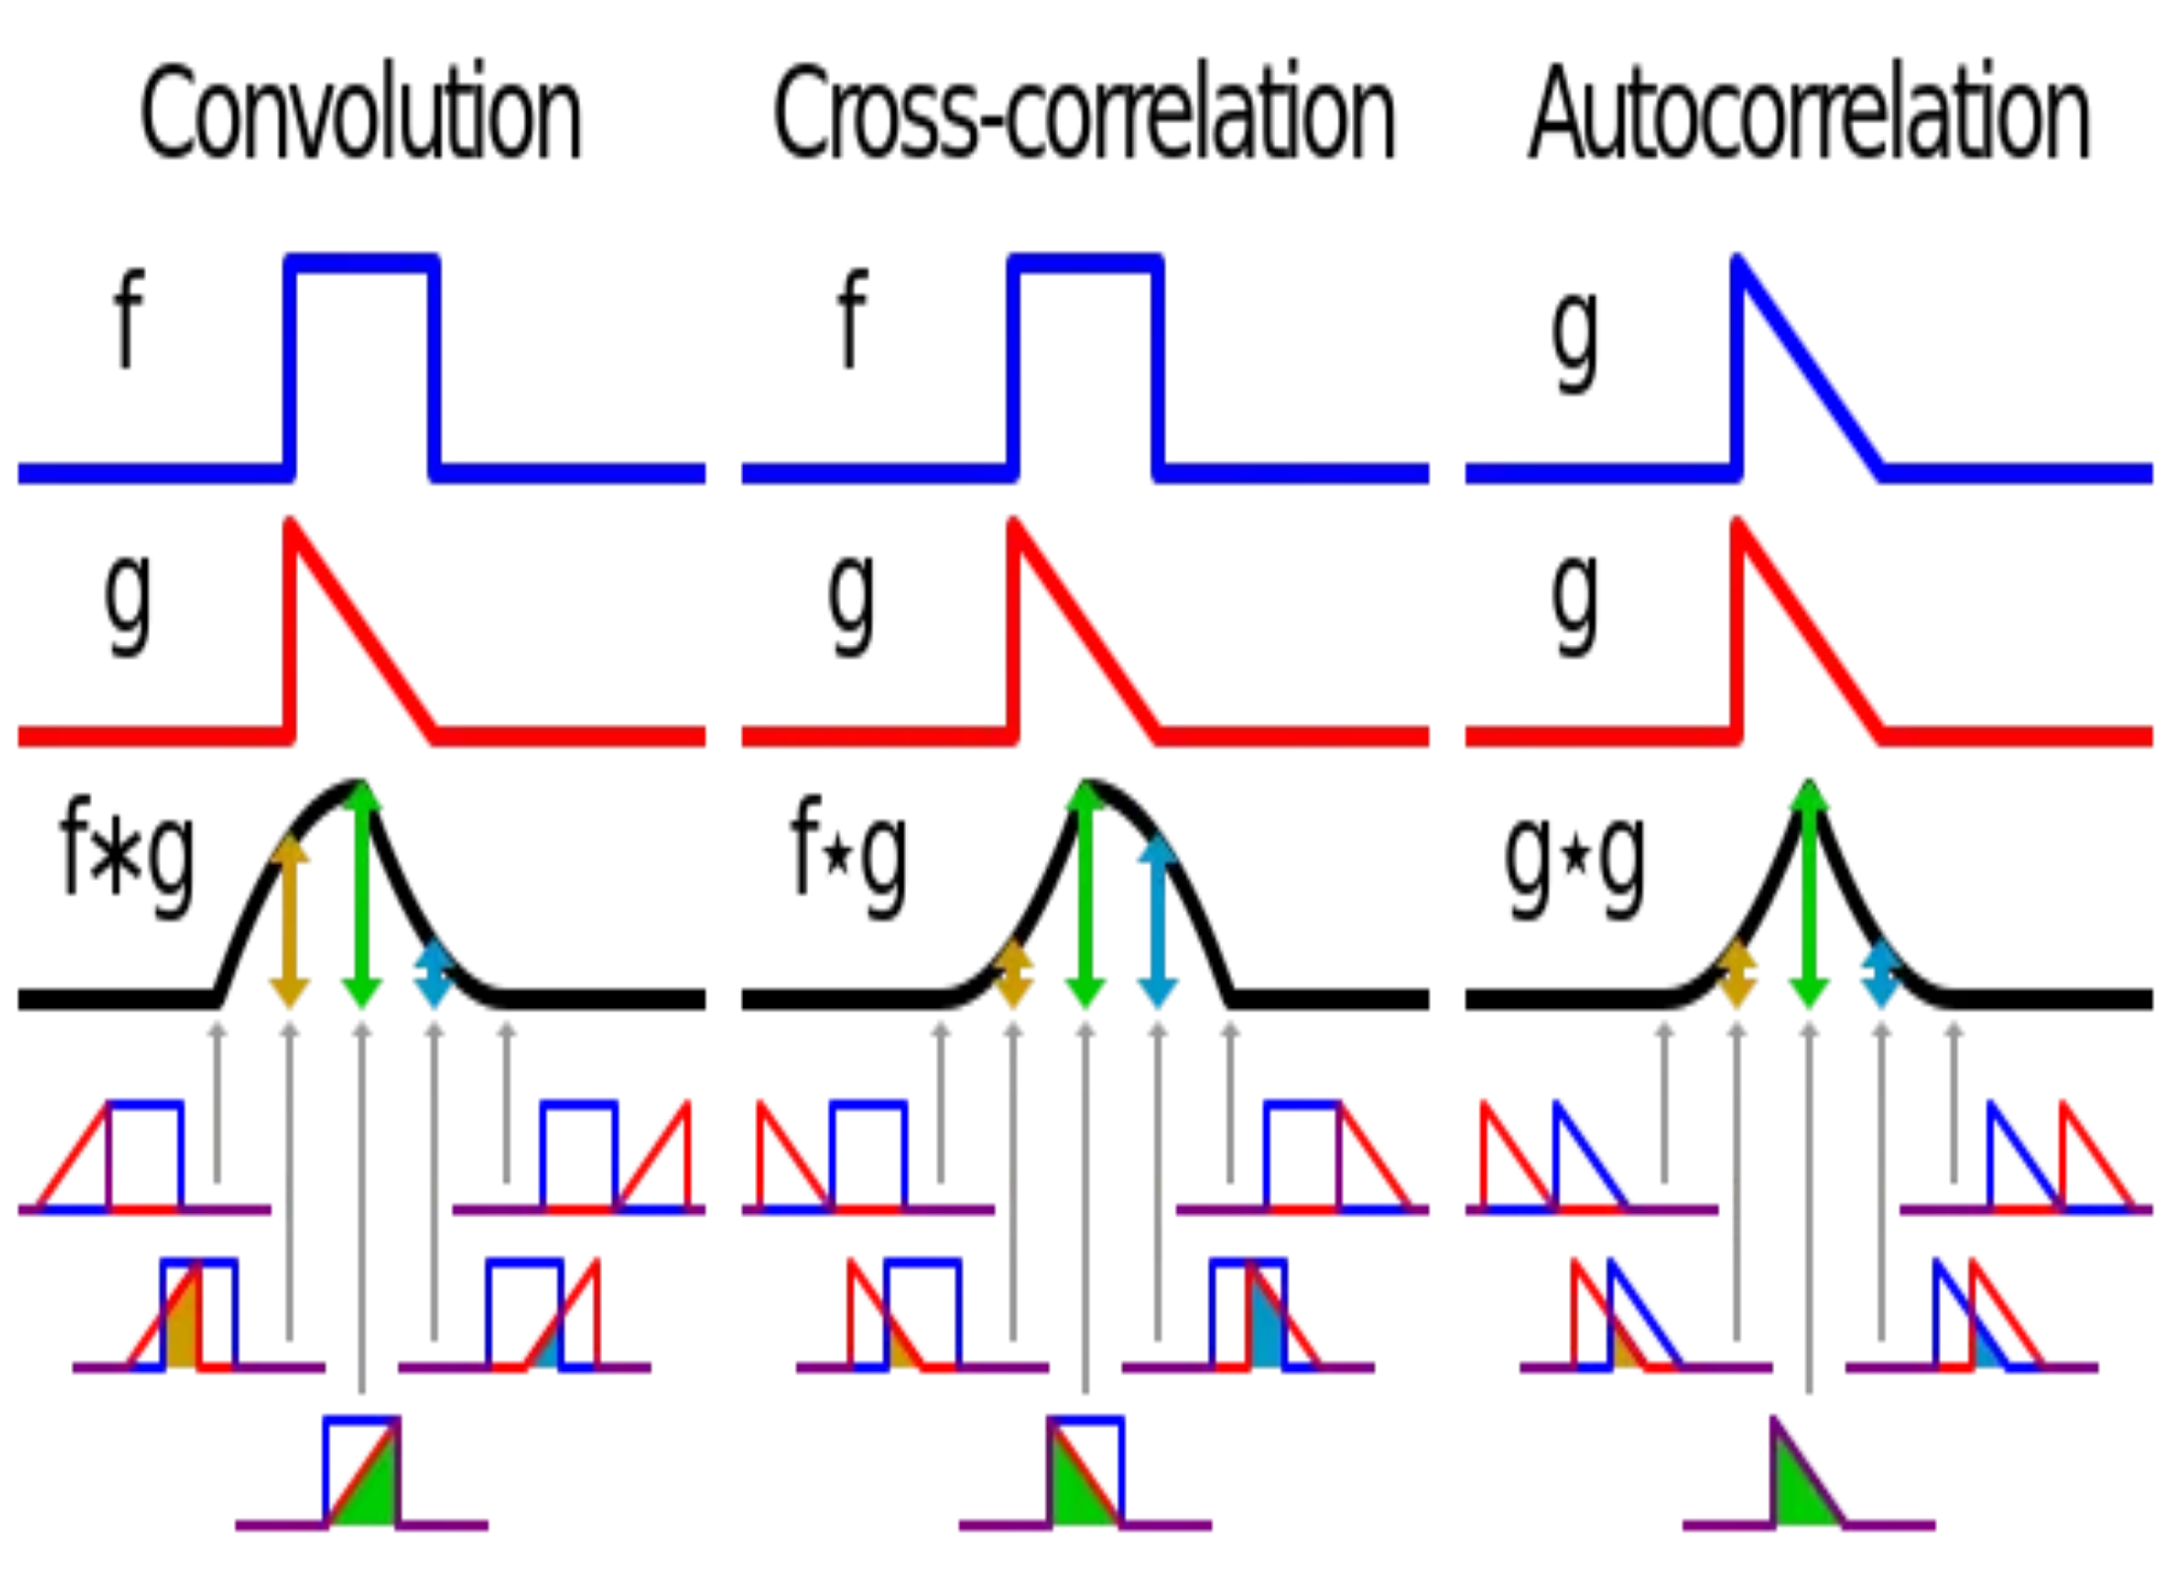
Convolution vs. Correlation
Feature
Convolution
Correlation
Signal Flipping
Time-reversal of h(t)
No time-reversal
Mathematical Form
(f * g)(t) = ∫ f(τ) g(t - τ) dτ
(f ⋆ g)(t) = ∫ f(τ) g(t + τ) dτ
Primary Use
System response
Pattern matching
Commutative
Yes (f * g = g * f)
No (f ⋆ g ≠ g ⋆ f)
Key Difference
The fundamental difference is in the direction of shifting: convolution involves time-reversal followed by shifting, while correlation involves only shifting without time-reversal.

Slide 10


Project Timeline
Achievements
Successfully implemented an interactive GUI for visualizing convolution and correlation
Supported both discrete and continuous time domains
Created real-time animation of the convolution process
Implemented adjustable animation speed control
Added correlation functionality as a special feature
Skills and knowledge development through the project
Project Timeline
Week 1:
Week 2:
Week 3:
Week 4:
Week 5:
Week 6:
Project Announcement
Implement Discrete-Time Signal Handling
Implement Continuous-Time Signal Handling
GUI Development
Add Animation
Debugging
Interaction Design
Implement Speed Control
Documentation
Project Planning & Research
Finalization

Slide 11



Thank You!
Questions & Answers
Questions?
Discussion
Feedback

