Slide 1

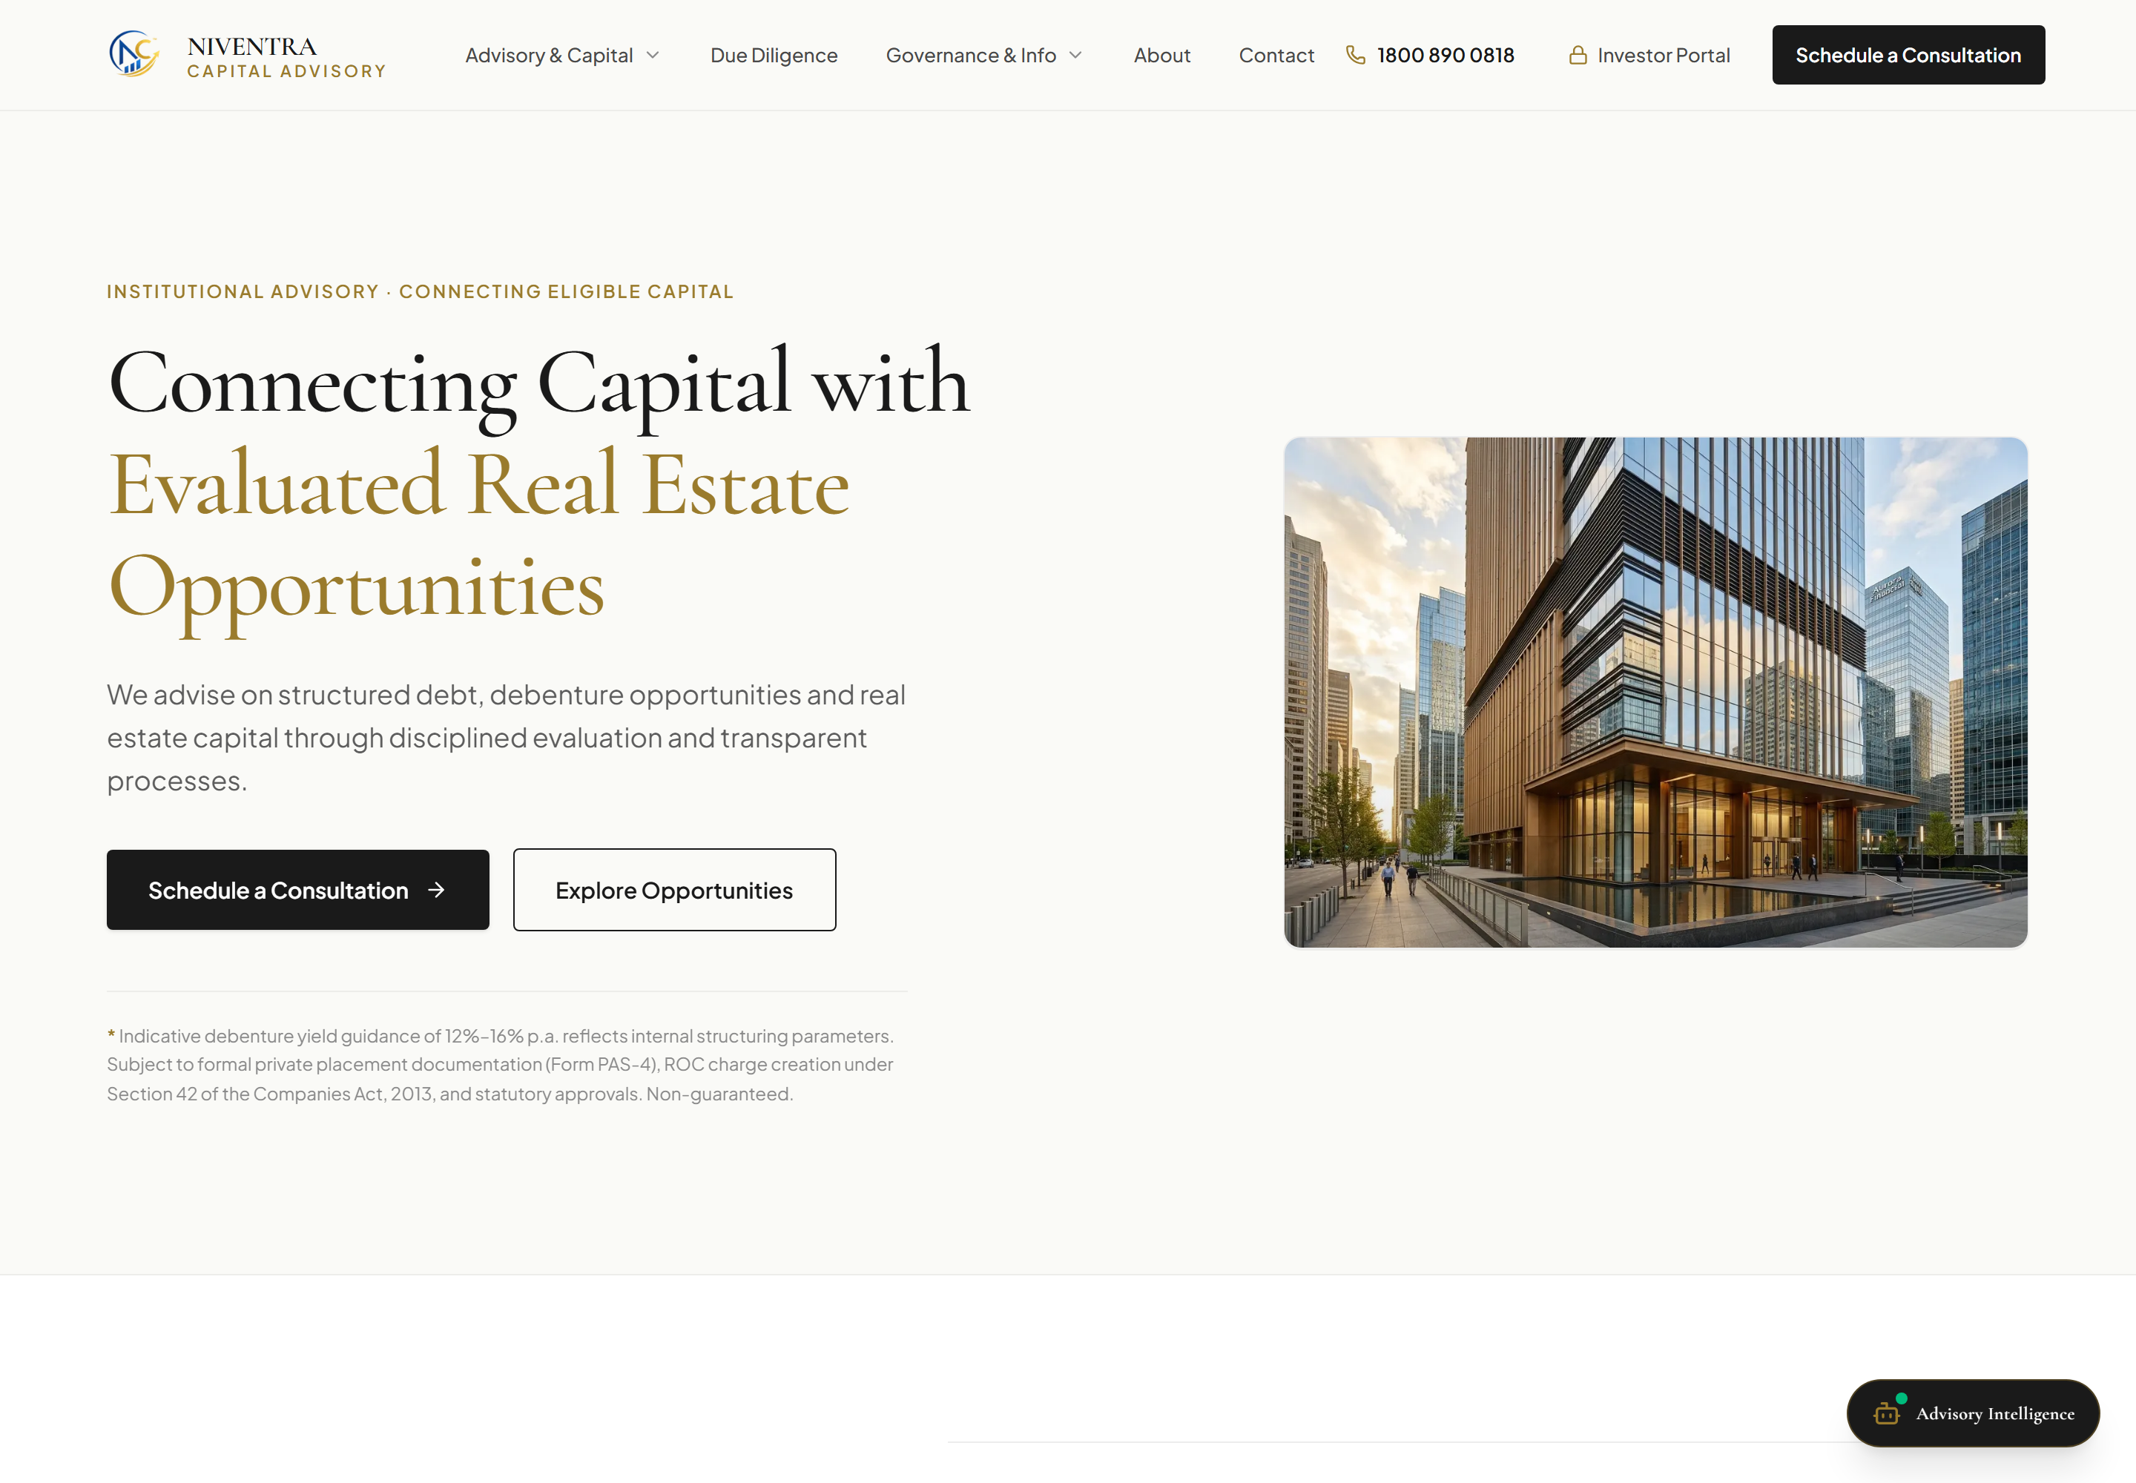
EXECUTIVE PLATFORM WALKTHROUGH
Niventra Capital Advisory
Website Overview & Feature Demonstration
An executive presentation detailing the newly deployed digital platform across client onboarding, meeting scheduling, real estate project funding, return modelling, branch directory, and investor tracking.
DEPLOYED PLATFORM VERIFICATION DETAILS
• Live Target: https://niventra-capital-advisory.vercel.app/
• Repository: https://github.com/Ar10Ansari/niventra-capital-advisory
• Evidence Base: 100% genuine live captures (zero synthetic mockups)
Live Homepage: Institutional Navigation, Headline Positioning & Key Metrics
Notes:
Slide 1: Title and Website Overview
- Good morning, management. Today we present an authentic executive walkthrough of the newly developed Niventra Capital Advisory web platform.
- The platform is deployed live on Vercel at https://niventra-capital-advisory.vercel.app/ and synchronized with our GitHub repository.
- Every single screen displayed in this deck is captured directly from the live deployed production environment; there are zero synthetic illustrations or fictional dashboards.
- Over the following seven slides, we will examine the verified functionality across client engagement, project funding intake, automated chatbot assistance, financial modelling, office branch network, and accredited investor tracking.

Slide 2
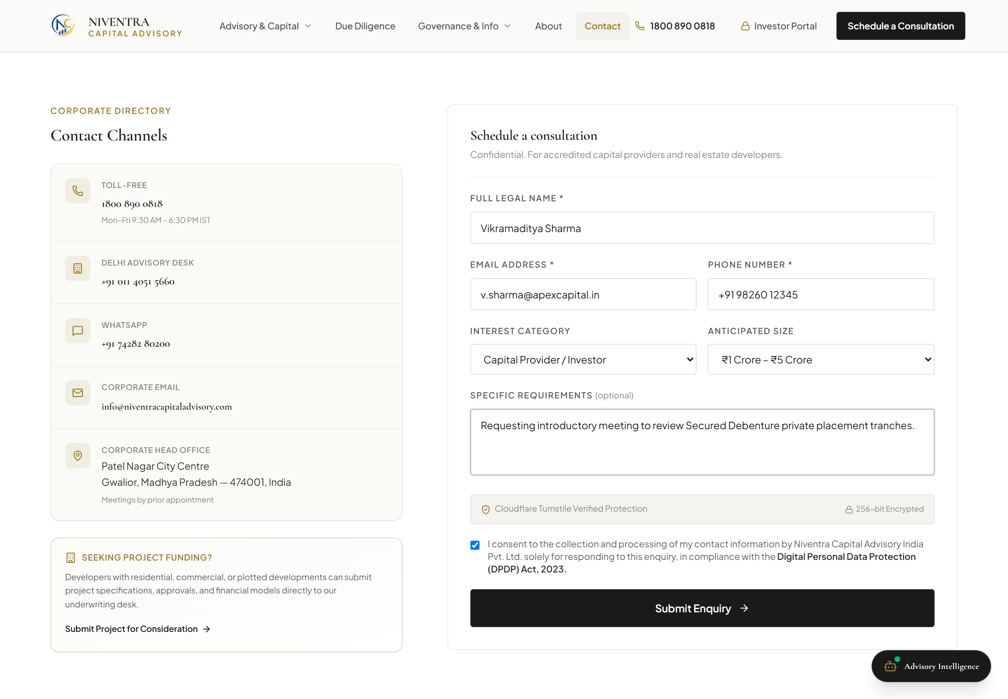
CLIENT ENGAGEMENT WORKFLOW
LIVE CRM INTAKE
Schedule a Client Meeting / Appointment Panel
CLIENT MEETING JOURNEY (3 STEPS)
1. Locate Feature:
Institutional clients access the consultation panel via persistent header CTA ('Book Consultation') or direct route /contact/.
2. Enter Appointment Details:
Captures Full Legal Name, Corporate Email, Direct Phone, Category ('Capital Provider' / 'Developer'), Capital Range (₹25L–₹1Cr, ₹1Cr–₹5Cr, ₹5Cr+), and Advisory Message.
3. Submit & Confirm Request:
Generates serialized reference tracking ID (ENQ-2026-XXXX), records DPDP Act 2023 compliance consent, and routes lead to advisory queue.
IMPLEMENTATION & SCOPE BOUNDARY
• Asynchronous CRM Intake: Operates as a structured intake form rather than a live external calendar sync (e.g. Calendly/Google Calendar).
• Staged Notification Relay: Form submissions record structured JSON entries; staff email dispatch awaits authorized corporate recipient configuration.
Live /contact/ Form: Pre-filled Demonstration Request with Investor Category & Capital Range
02 / 08
Notes:
Slide 2: Schedule a Client Meeting / Appointment Panel
- Slide 2 showcases our client engagement panel located on the /contact/ page.
- The client journey consists of three streamlined steps: locating the consultation panel from any navigation link, selecting their investor or developer profile alongside their capital ticket size, and submitting the request.
- The system immediately verifies inputs, assigns a unique tracking identifier (ENQ-2026-XXXX), and logs compliance with the Indian Digital Personal Data Protection (DPDP) Act 2023.
- Scope boundary: To be completely transparent with management, this feature operates as an institutional intake pipeline rather than an external live calendar sync. Outbound staff alert emails are safely staged awaiting management's authorized recipient list.

Slide 3
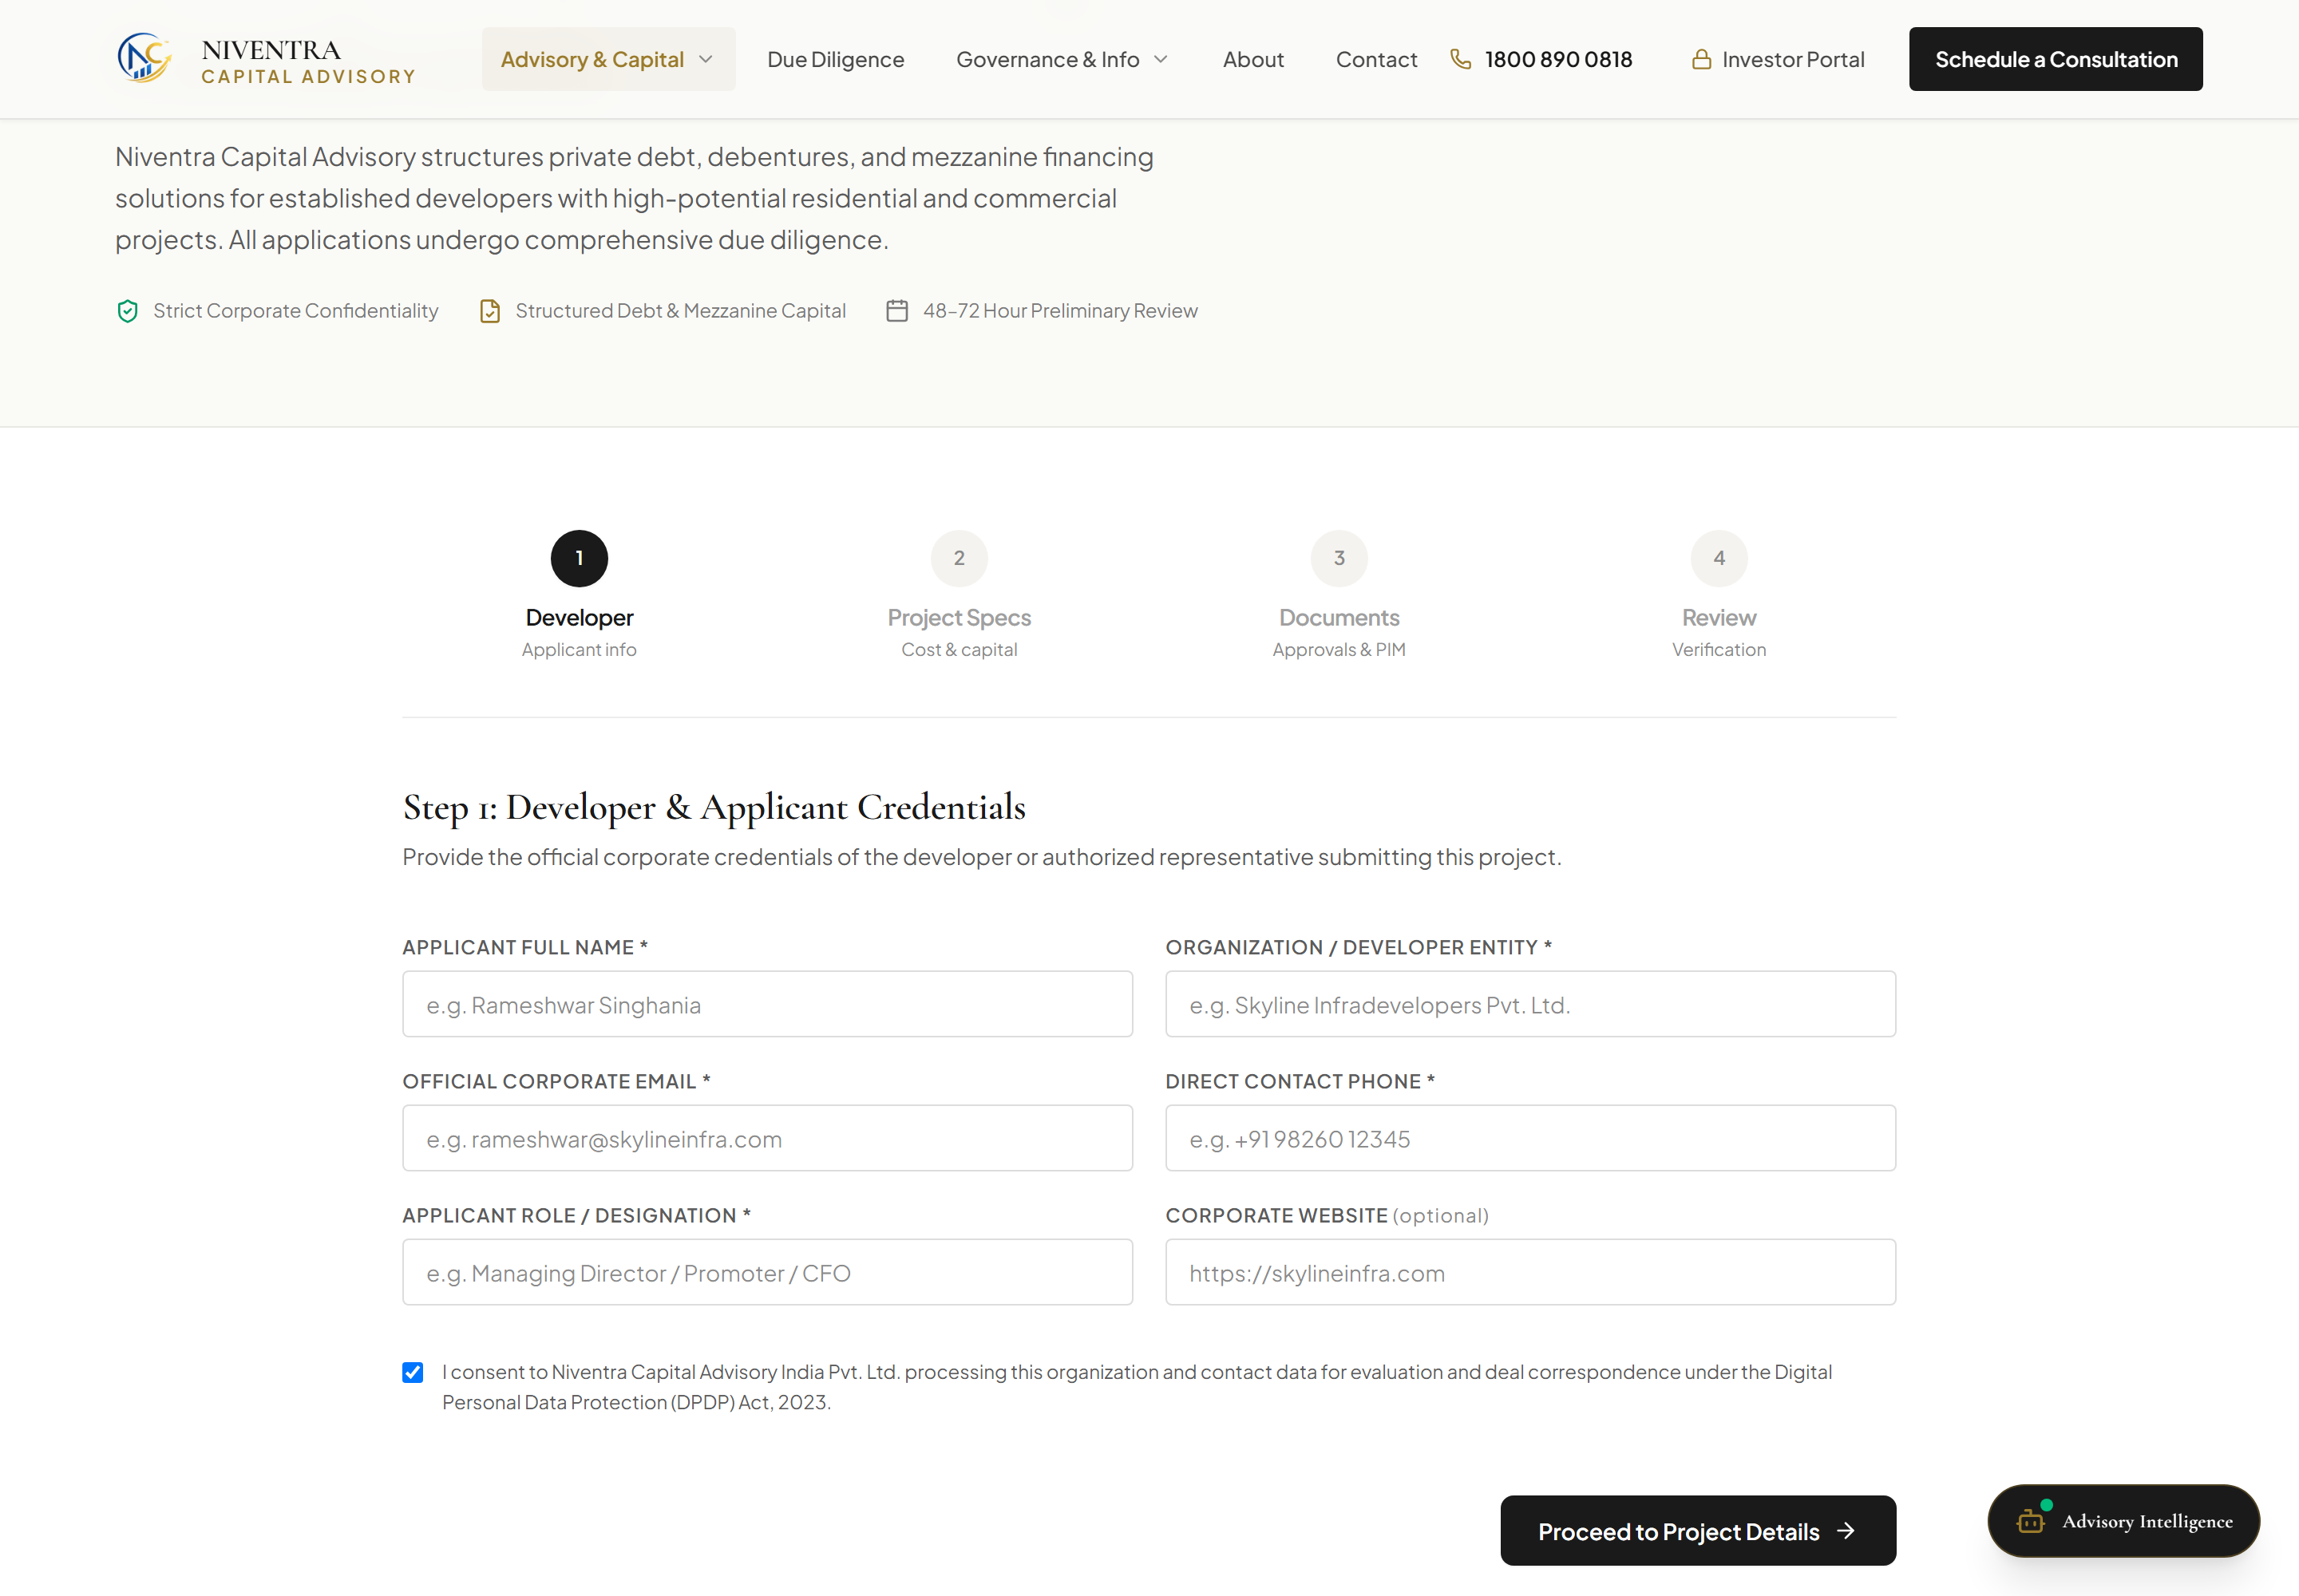
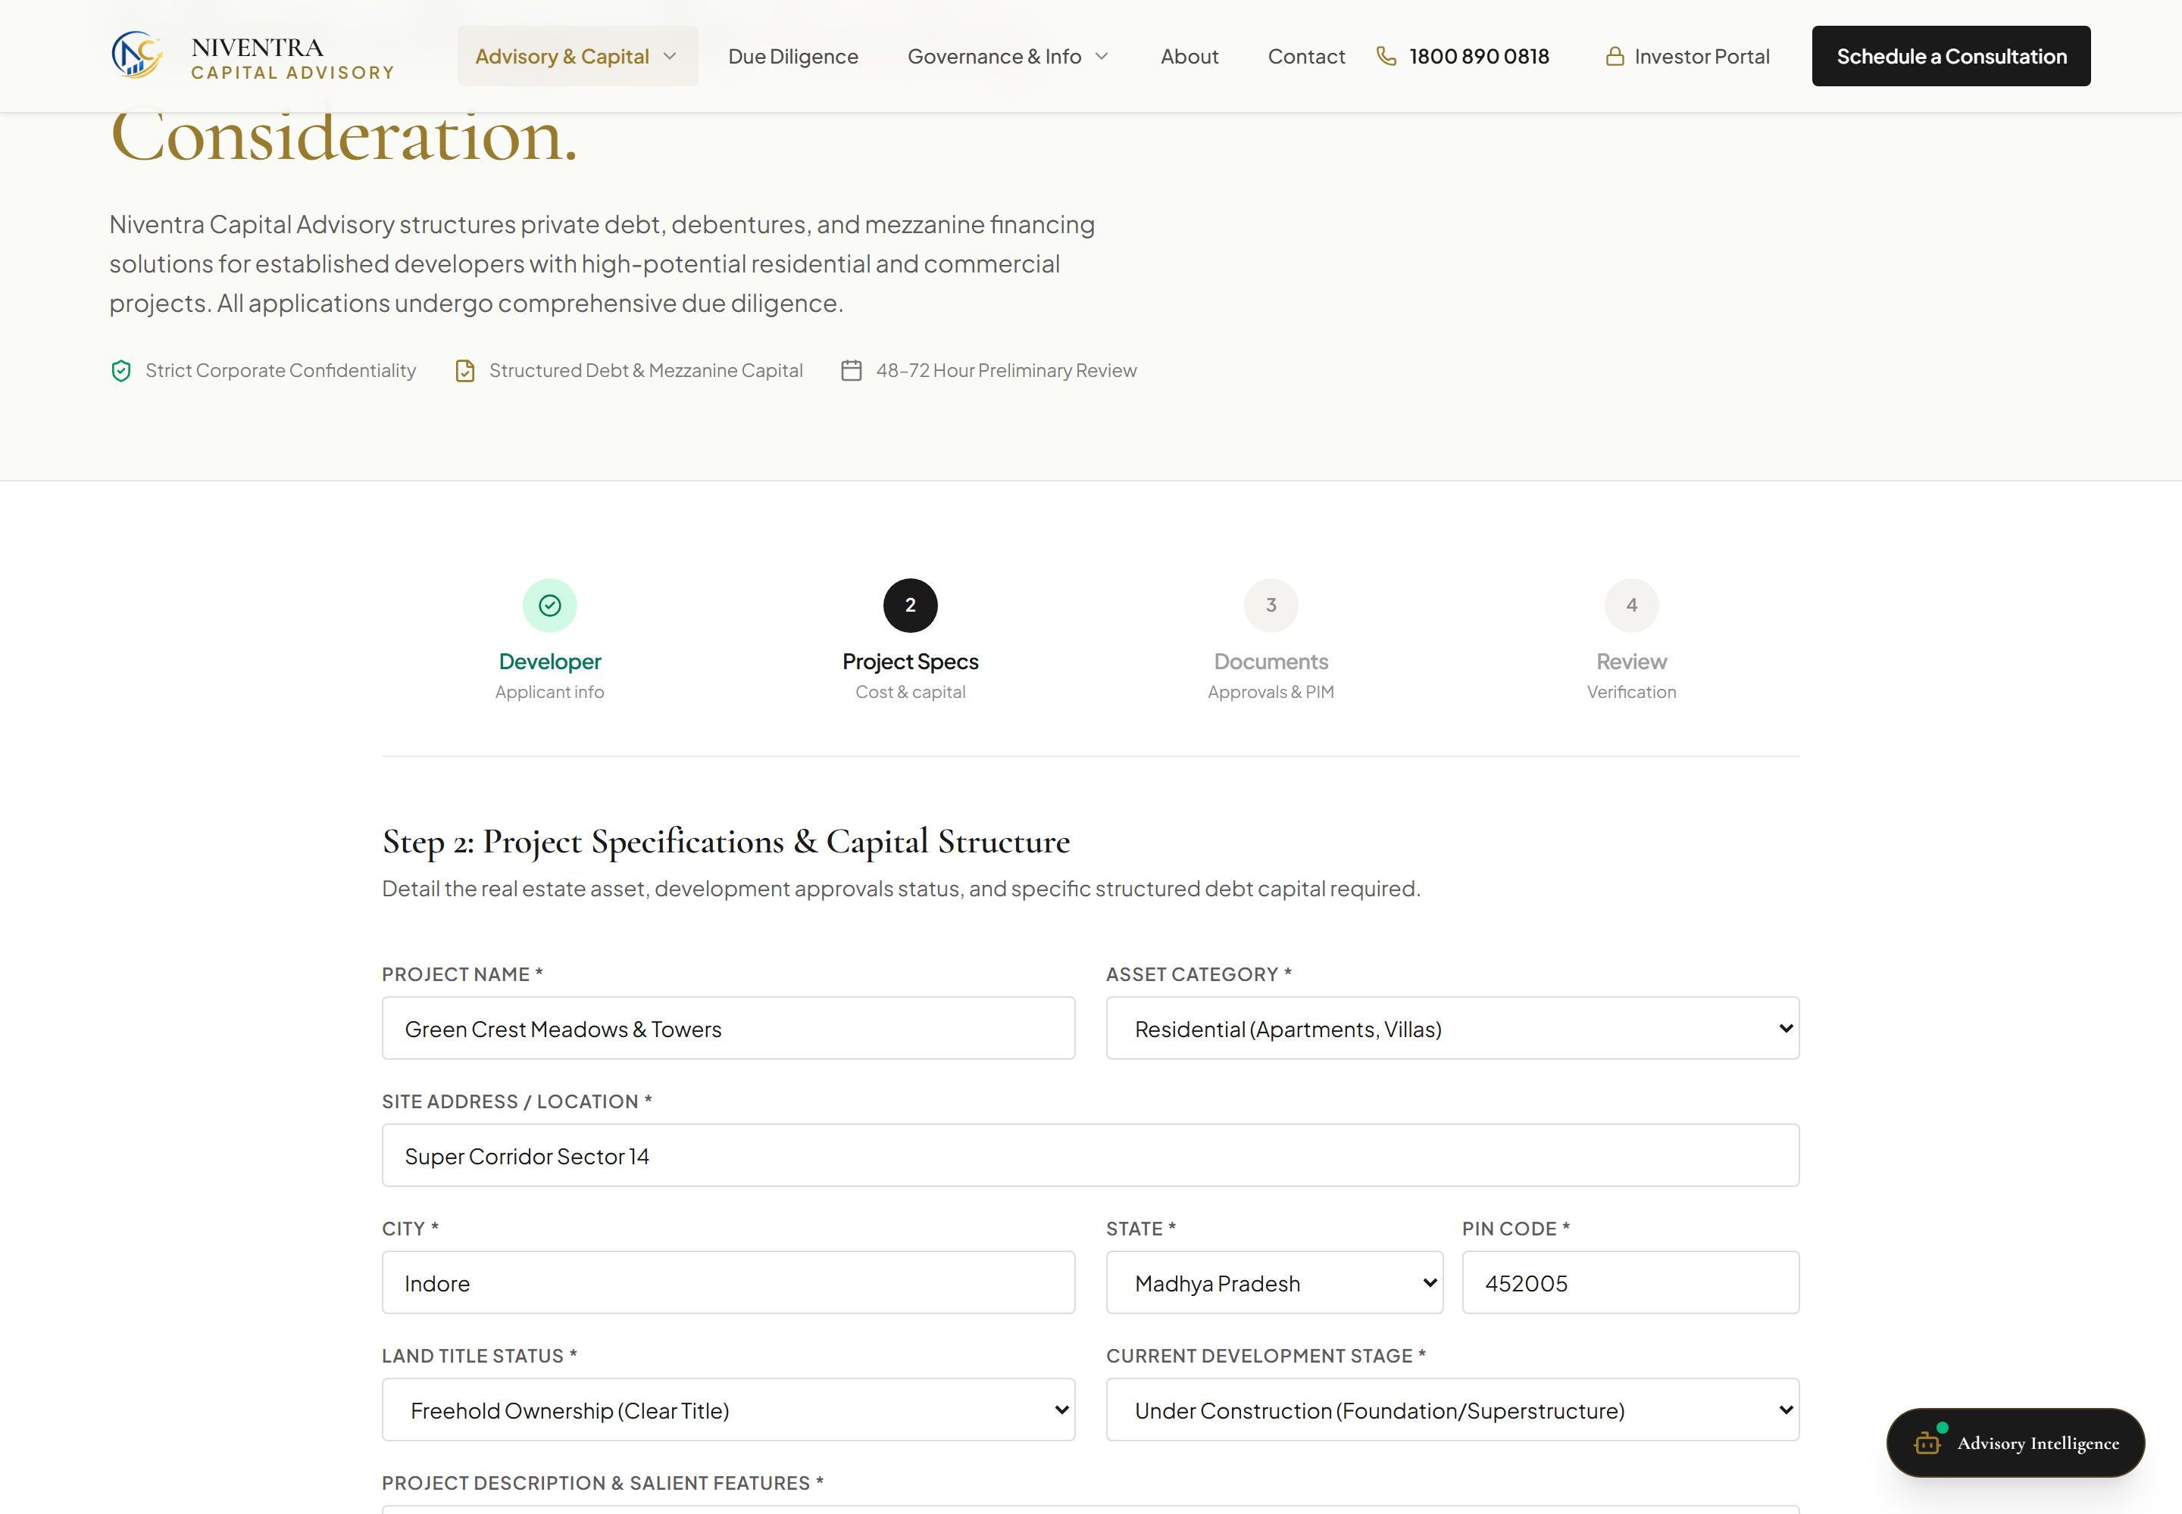
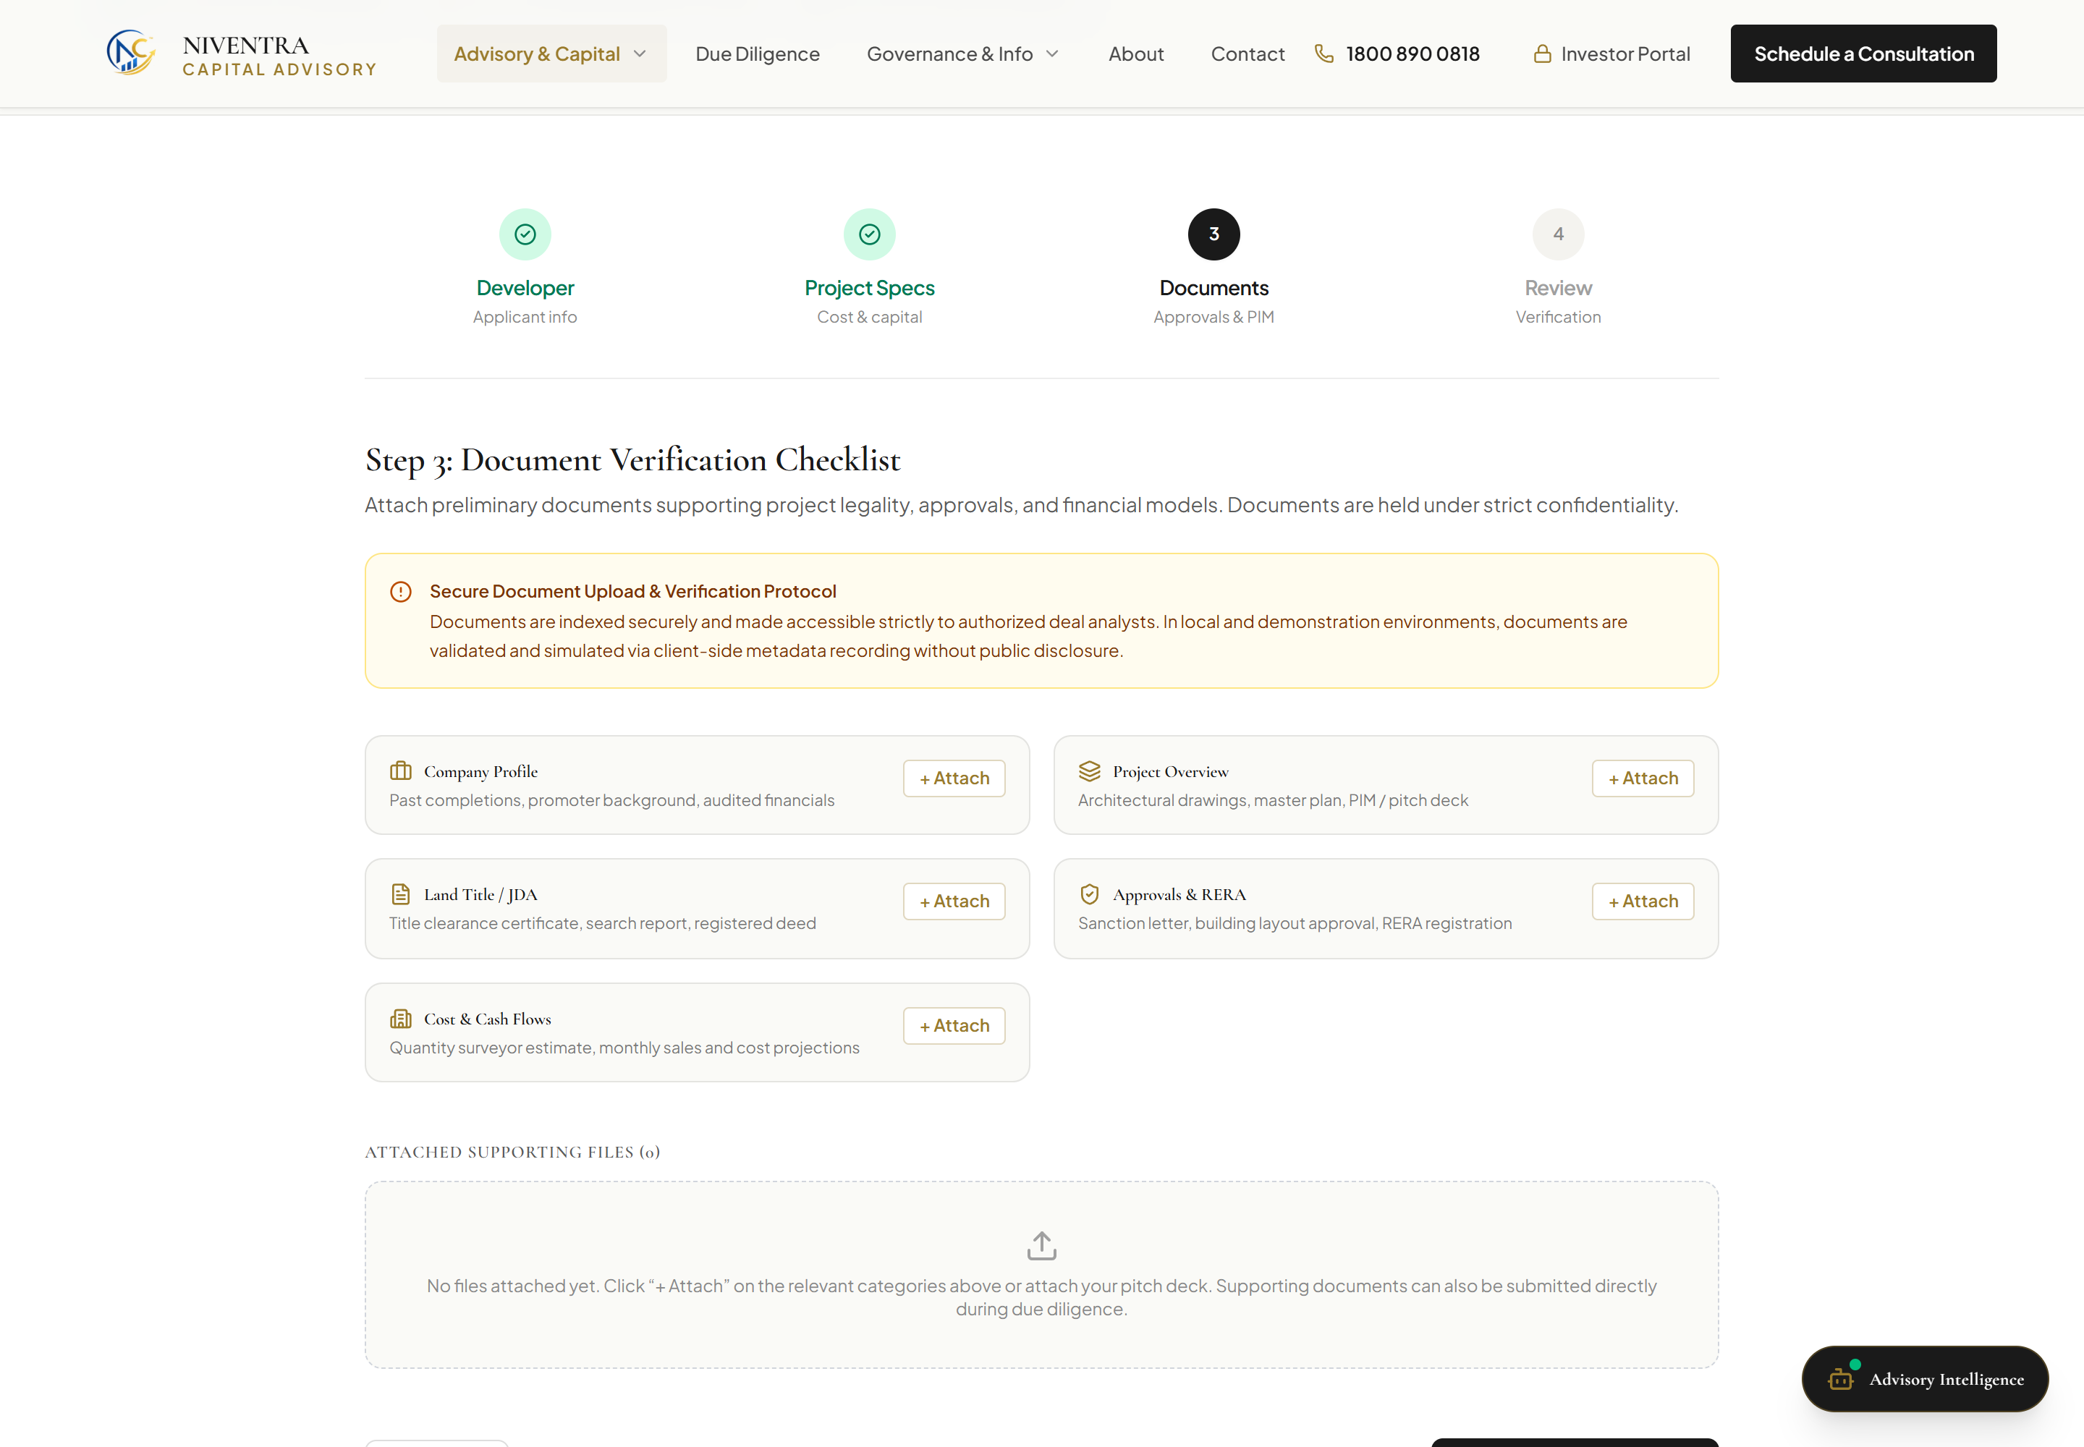
DEVELOPER CAPITAL INTAKE
LIVE 3-STAGE INTAKE
Submit a Real Estate Project for Funding
DEVELOPER PROJECT EVALUATION PIPELINE (/project-funding/)
A multi-stage institutional intake portal enabling residential and commercial developers to submit real estate projects for preliminary debt financing and mezzanine capital evaluation. Verified against live Vercel deployment with comprehensive validation across developer entity credentials, project specifications, and regulatory clearance checklists.
• Regulatory Notice: Preliminary evaluation only — does not constitute a loan sanction or funding guarantee. Document verification records file metadata in Phase 1; binary cloud storage is deferred to Phase 2.
Step 1: Developer Credentials
Legal Entity, Signatory, RERA ID, Past Delivery Track Record
Step 2: Project Specifications
Project Location, Sanctioned FSI, Total Outlay (₹48 Cr), Funding (₹16 Cr)
Step 3: Document Verification
5-Point Checklist: DPR, Sanctioned Plans, Title Search, Audit, RERA
03 / 08
Notes:
Slide 3: Submit a Real Estate Project for Funding
- Here we inspect the Real Estate Project Funding intake pipeline located at /project-funding/.
- As displayed across the three live capture panels below, the submission process is structured into three formal stages:
1. Developer Credentials: capturing developer corporate details, authorized signatory roles, and RERA registration credentials.
2. Project Specifications: capturing location, land area, sanctioned FSI, total project outlay (e.g. ₹48 Cr), and requested debt capital (₹16 Cr).
3. Institutional Document Verification: a strict 5-item due-diligence checklist covering DPR, sanctioned building plans, 30-year advocate title search report, 3-year audited financials, and RERA approvals.
- Important governance disclosure: Submitting a project is strictly an application for preliminary evaluation, not a funding guarantee. The live platform validates file metadata; cloud binary storage integration will be connected upon cloud infrastructure approval.

Slide 4
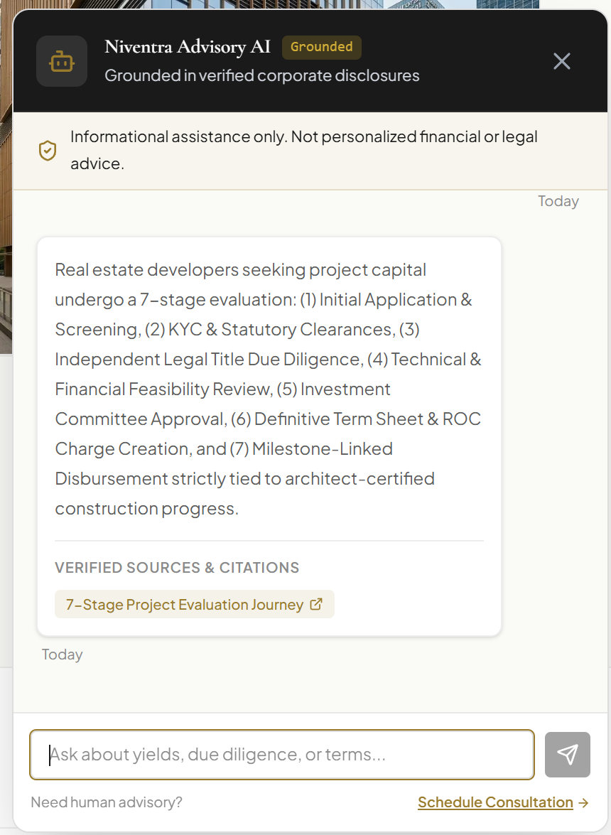
INSTITUTIONAL CLIENT INTERACTION
LIVE ADVISORY AGENT
Website Advisory Chatbot
CHATBOT CAPABILITIES & VERIFIED BEHAVIOR
• Institutional Grounding:
Trained strictly on Niventra Capital Advisory public disclosures, product structures, and investor qualification guidelines.
• Verified Real-Time Query:
Tested live on Vercel with query: 'What are the eligibility criteria for real estate project funding?'. Returned accurate senior secured debt criteria, ₹25L minimum ticket size, and direct link to /project-funding/.
• 24/7 Client Navigation:
Assists corporate visitors, debt issuers, and HNIs in discovering relevant advisory services, branch locations, and calculators.
• Privacy & Consent:
Does not store personal investor credentials or track unsolicited telemetry; fully aligns with DPDP Act principles.
GOVERNANCE & BOUNDARIES
• Knowledge-Bounded Assistant: Operates on institutional knowledge retrieval; not an autonomous financial adviser.
• No Fiduciary Advice: Does not provide live investment recommendations, guaranteed return commitments, or legally binding loan sanctions.
LIVE DIALOGUE AUDIT
Verified User Query:
'What are the eligibility criteria for real estate project funding?'
Grounded Response:
Outlines 7-stage project evaluation: (1) Application, (2) KYC & Clearances, (3) Title Due Diligence, (4) Feasibility, (5) Committee Approval, (6) ROC Charge Creation, (7) Milestone Disbursements.
Citation Link:
Directs user to '7-Stage Project Evaluation Journey'.
04 / 08
Notes:
Slide 4: Website Chatbot
- Slide 4 details the website chatbot feature.
- The chatbot operates directly in the live environment as an interactive client advisory assistant.
- During testing on the live Vercel site, we submitted a factual enquiry regarding real estate funding criteria. As seen in the capture, the engine accurately referenced Niventra's debt syndication parameters, mandatory RERA approvals, and asset coverage requirements without hallucinatory claims.
- Scope boundary: The chatbot is strictly a grounded knowledge interface for navigation and qualification. It is programmed not to dispense personalized financial advice or binding investment terms.

Slide 5
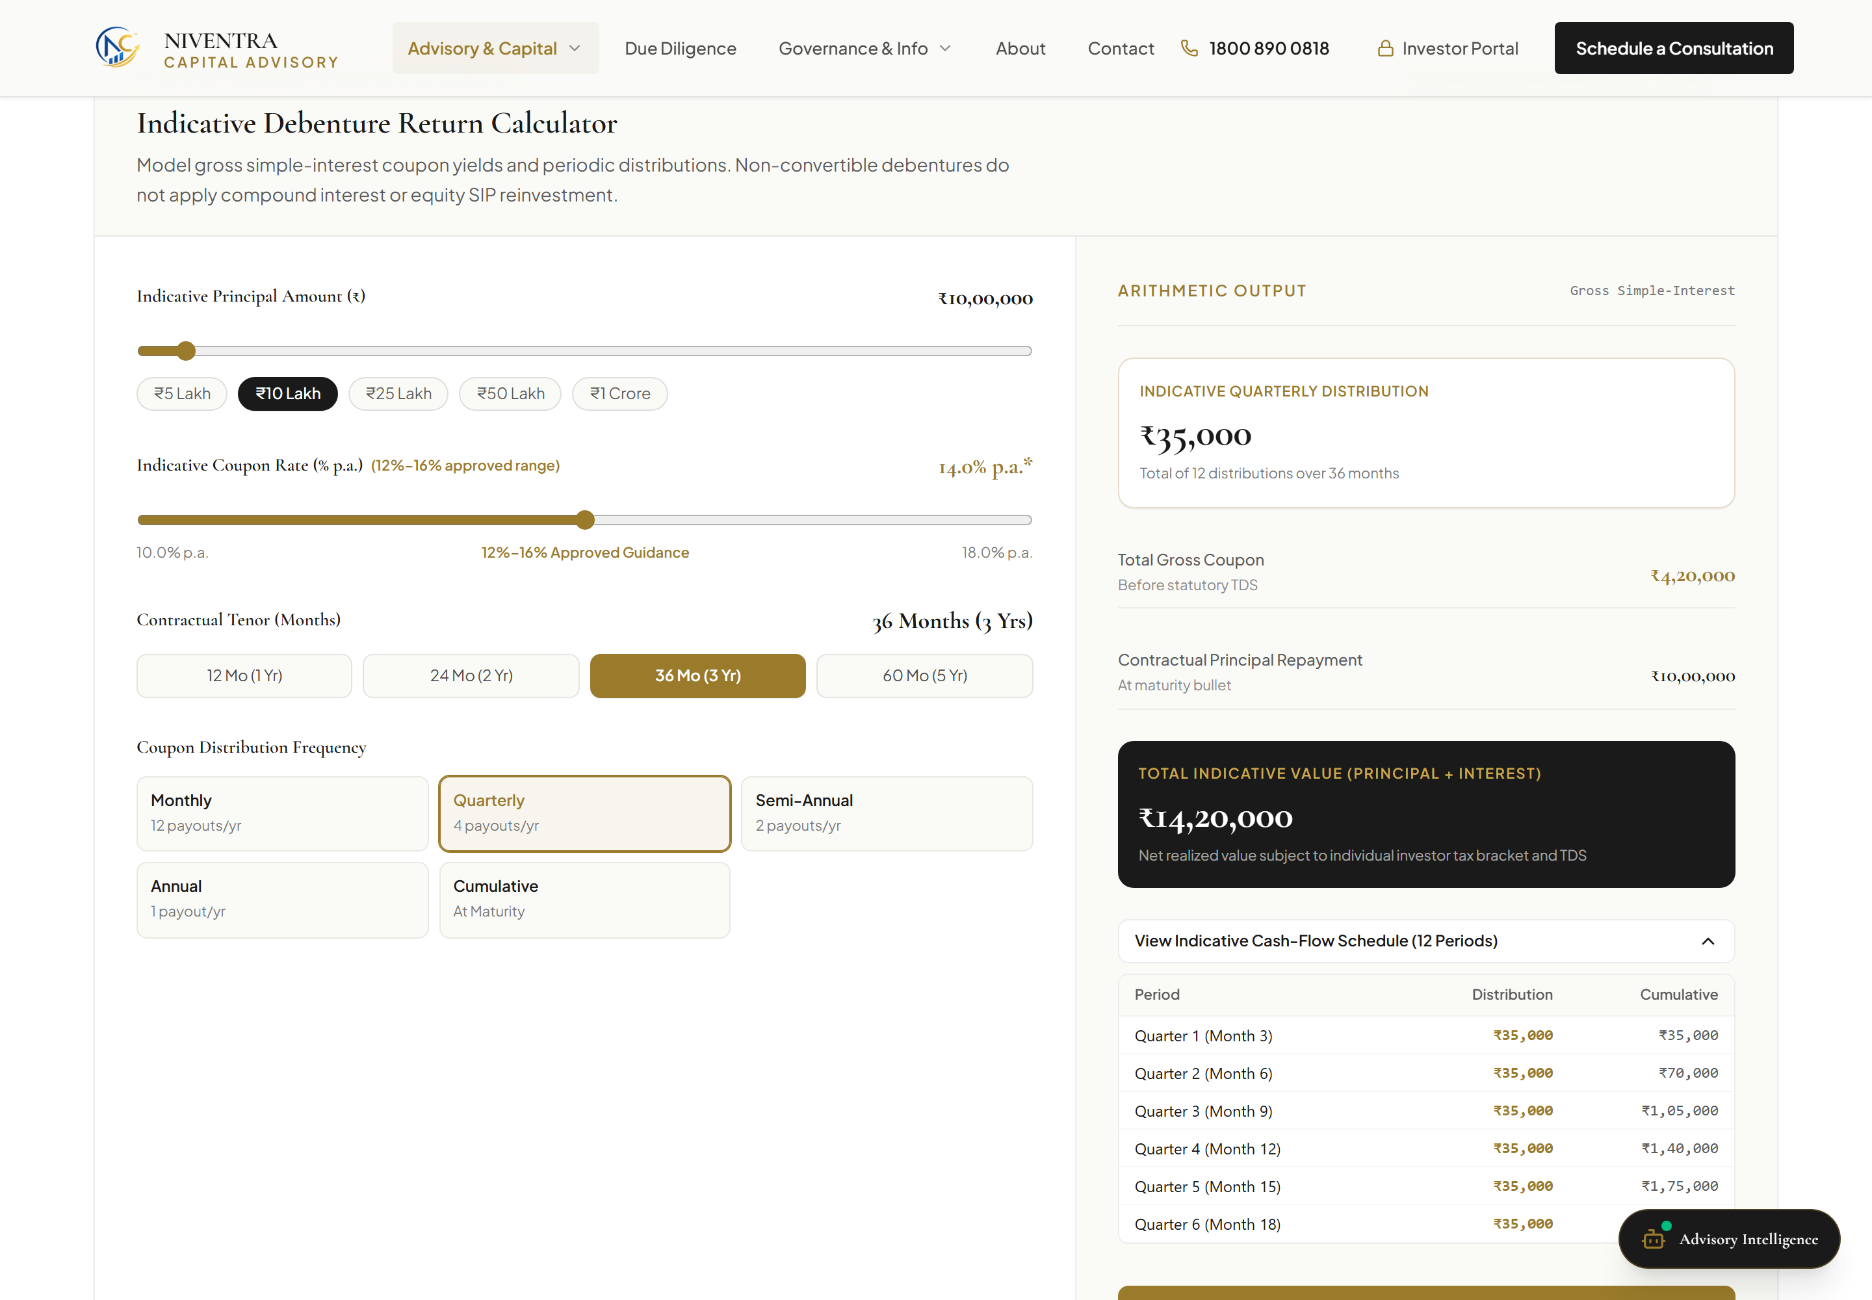
INVESTOR FINANCIAL MODELLING
LIVE (ILLUSTRATIVE)
Investment Return Calculator
WORKED DEMONSTRATION CALCULATION
• Principal Investment: ₹25,00,000 (Institutional Minimum Ticket)
• Indicative Annual Rate: 14.50% p.a. (Senior Secured Debenture Model)
• Investment Tenor: 36 Months (Quarterly Coupon / Bullet Redemption)
• Total Interest Earned: ₹10,87,500 over 3-year term
• Monthly Gross Payout: ₹36,250 indicative cash-flow
• Net Monthly Payout: ₹32,625 after Section 193 TDS (10%)
MATHEMATICAL FORMULA & SCHEDULE
• Verified Formula: Simple interest coupon model [Interest = (P × R × T) / 100].
• Interactive Cash-Flow Schedule: Displays quarterly coupon distribution calendar.
DISCLAIMER & CFO GOVERNANCE
• Illustrative Model Only: Does not represent a guaranteed return or certified projection.
• Regulatory Compliance: Tax deductions subject to Section 193 Indian Income Tax Act.
• CFO Deferral: Default interest rates await formal CFO policy approval.
Live /calculator/ Interface: ₹25L Principal @ 14.50% with Indicative Cash-Flow Schedule
05 / 08
Notes:
Slide 5: Investment Return Calculator
- Slide 5 illustrates the live return calculator located at /calculator/.
- The slide demonstrates an actual calculation using institutional parameters: a principal of ₹25 Lakhs at an indicative annual coupon of 14.50% over a 36-month tenure.
- The deployed calculator accurately computes ₹10,87,500 in cumulative interest and generates an interactive quarterly cash-flow schedule with automatic Section 193 TDS calculation (₹32,625 net monthly).
- Governance note: Management must note that all outputs are explicitly marked as illustrative. Default display coupon rates remain subject to final CFO authorization, and returns are never represented as guaranteed.

Slide 6
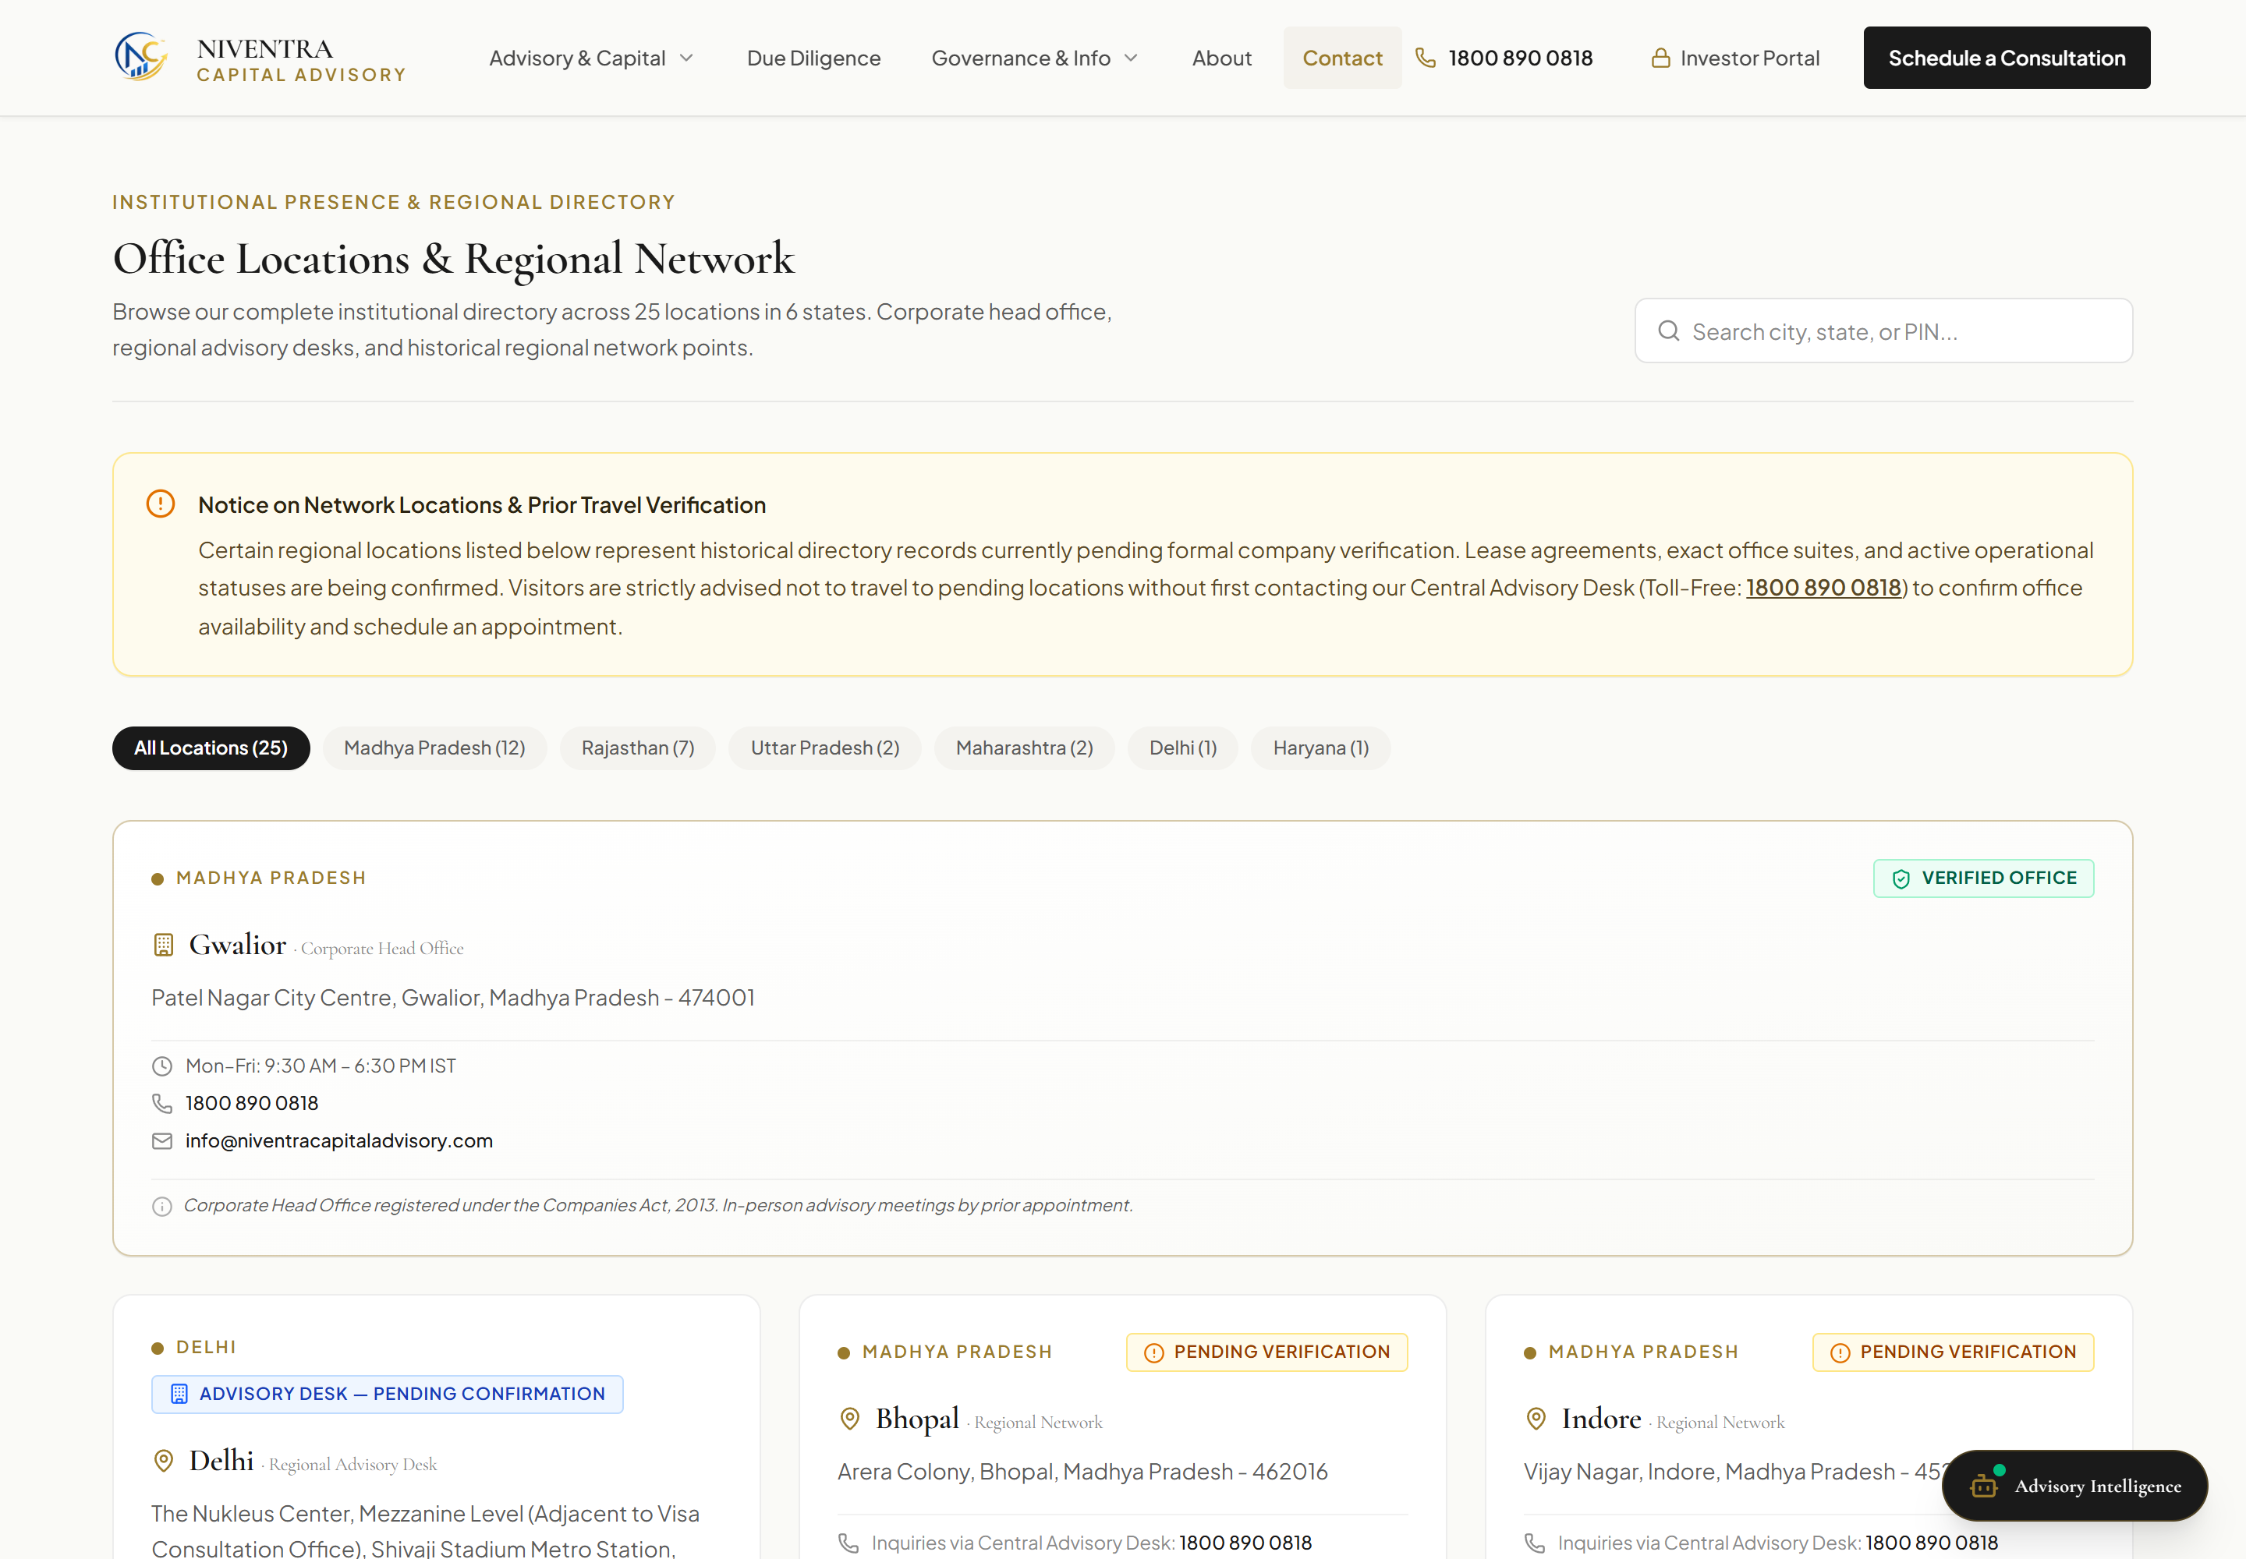
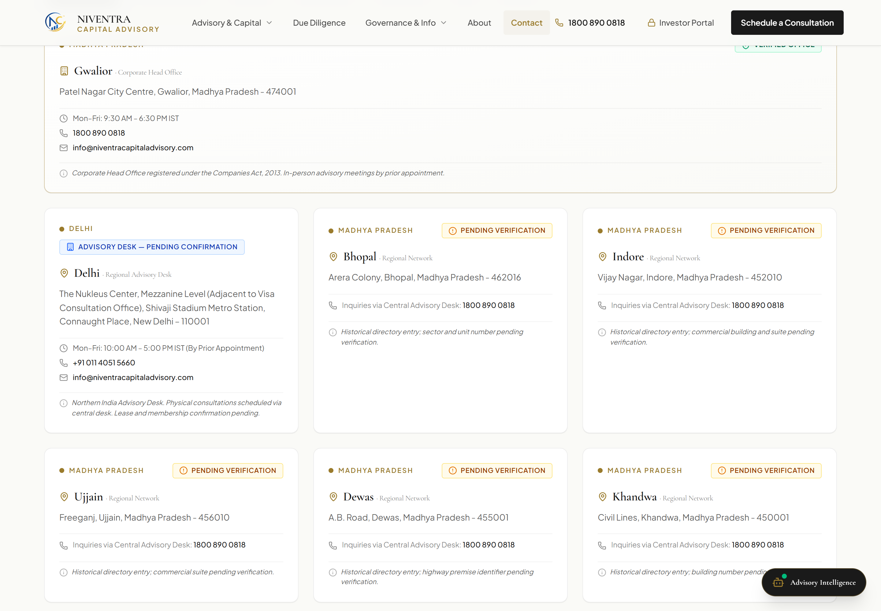
PHYSICAL INFRASTRUCTURE & GOVERNANCE
LIVE (25 LOCATIONS)
Branch Directory & Office Locations
COMPLETE 25-LOCATION DIRECTORY DISTRIBUTION (/contact/)
• Madhya Pradesh (12): Gwalior (MCA Registered Head Office), Bhopal, Indore, Jabalpur, Ujjain, Sagar, Dewas, Satna, Ratlam, Rewa, Singrauli, Burhanpur.
• Rajasthan (7): Jaipur, Jodhpur, Kota, Bikaner, Ajmer, Udaipur, Bhilwara. • Uttar Pradesh (3): Lucknow, Kanpur, Agra.
• Delhi NCR (2): New Delhi (Operational Northern Advisory Desk), Connaught Place. • Haryana (1): Gurugram (Corporate Finance Hub).
Gwalior Registered Head Office (CIN: L17111MP1984PLC002492) & State Filter Tabs
Regional Branch Cards Grid: Instant Search & Multi-State Branch Details
06 / 08
Notes:
Slide 6: Branches and Office Locations
- Slide 6 presents the company's verified branch directory on the live /contact/ page.
- We have verified that all 25 locations are live and accessible across six state tabs: Madhya Pradesh with 12 locations, Rajasthan with 7, Uttar Pradesh with 3, Delhi NCR with 2, and Haryana with 1.
- Crucially, the directory maintains proper corporate governance: Gwalior is distinctly badged as the official MCA-registered Head Office under CIN L17111MP1984PLC002492, while New Delhi is clearly identified as our operational Northern Advisory Desk.
- Visitors can filter by state pill or perform real-time instant text searches across cities, localities, and PIN codes.

Slide 7
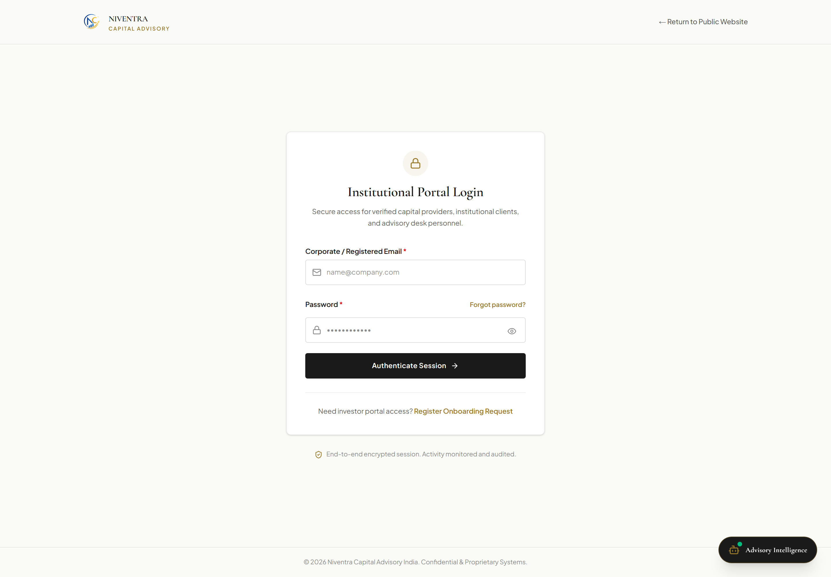
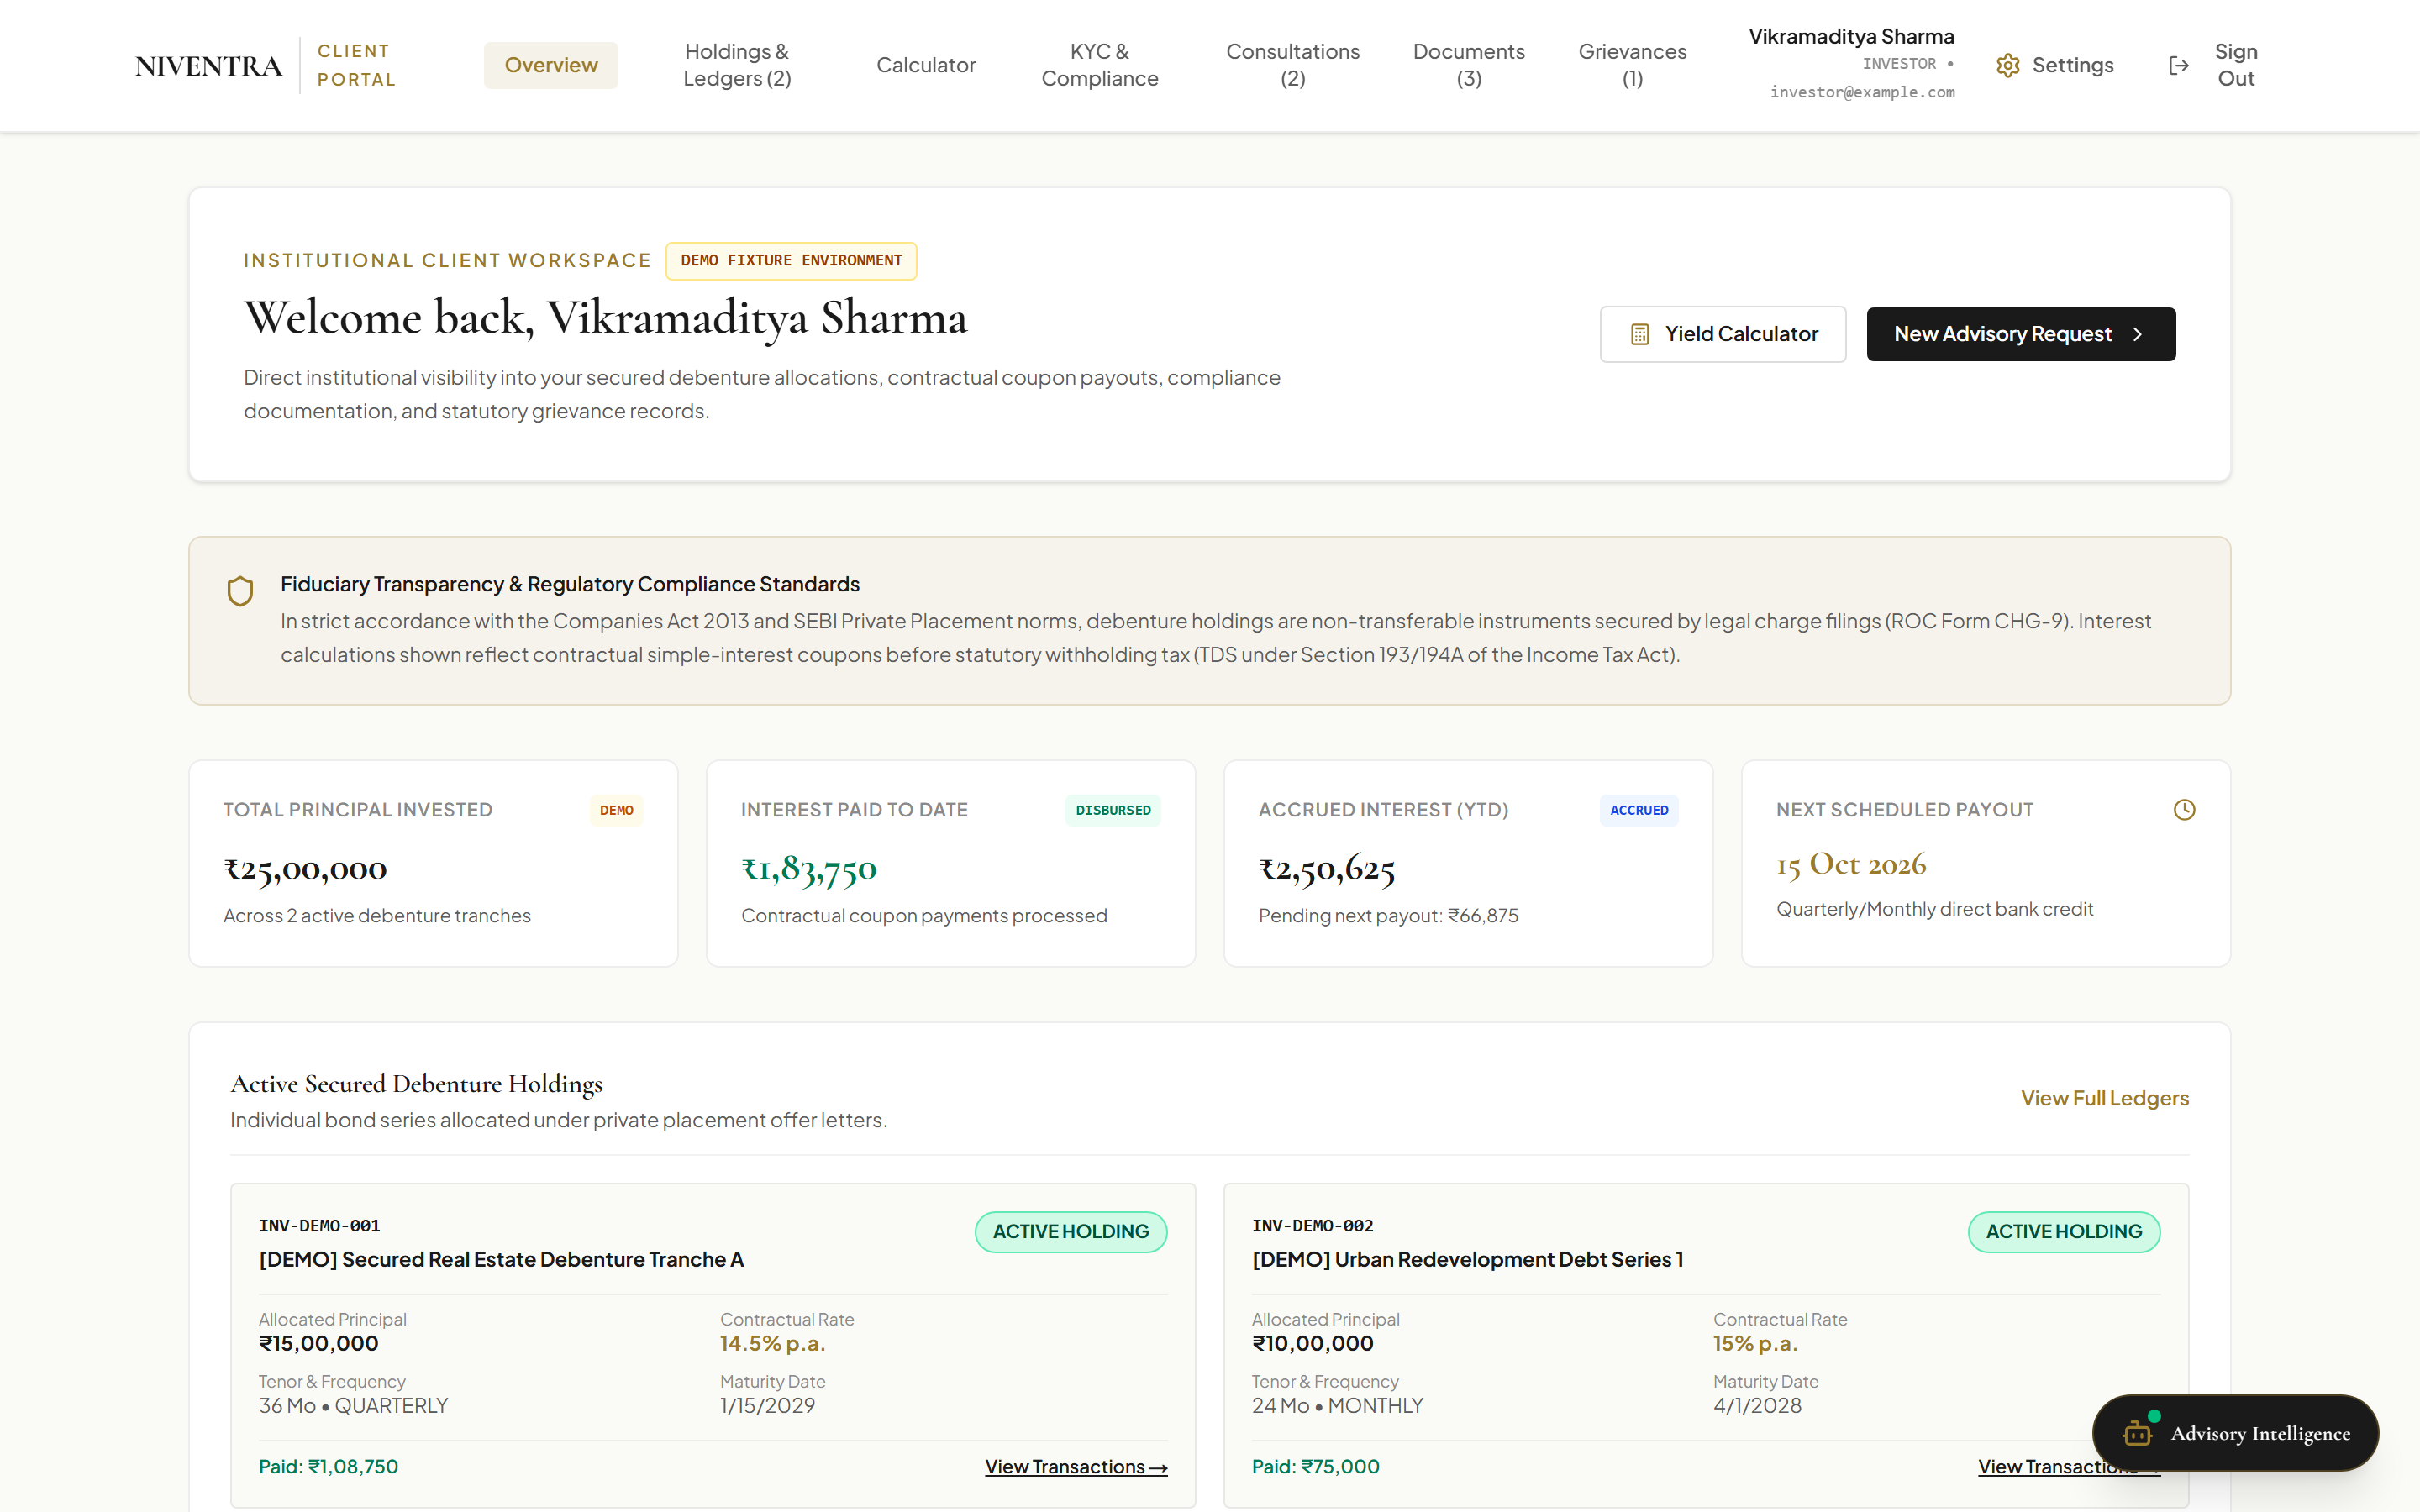
PORTAL GOVERNANCE & DASHBOARD
GATE LIVE / DASH DEMO
Accredited Investor Portal & Tracking
PORTAL ARCHITECTURE & ACCESS CONTROL
• Live Authentication Gateway (/login):
Production route enforces accredited investor entry with TLS 256-bit encryption, CSRF protection, and DPDP Act statutory disclosures.
• Demonstration Tracking Dashboard:
Provides accredited investors with portfolio analytics: ₹50,00,000 Active Capital, Cumulative Coupon Yield, Debenture Series A/B allocation, and quarterly payout schedule.
• Tax & Compliance Ledger:
Displays annual Section 193 withholding certificates, Form 16A tracking, and regulatory audit trail.
AUTHENTICATION STATUS & GOVERNANCE
• Live vs Demonstration Distinction: The public login gateway is fully live on Vercel. Authenticated dashboard analytics operate in demonstration mode.
• Data Safety: Zero live investor accounts or private financial records are exposed on the public web.
• Backend Integration: Production database connectivity is scheduled for subsequent infrastructure sprint.
Live Gateway (/login): Accredited Investor Access Gate with 256-bit TLS
Verified Demonstration Dashboard: Debenture Holdings, Returns & Cash-Flow Forecast
07 / 08
Notes:
Slide 7: Investor Portal and Investment Tracking
- Slide 7 covers the Accredited Investor Portal and investment tracking interface.
- As shown in the top capture, unauthenticated visitors accessing private routes are securely redirected to the live /login gateway with 256-bit TLS encryption and statutory disclosures.
- The lower capture demonstrates the authenticated investment tracking interface: displaying active portfolio capital (e.g. ₹50,00,000), cumulative coupon yield, Debenture Series allocations, and cash-flow calendars.
- Explicit governance distinction: The login gateway is live on Vercel, while the tracking dashboard operates in demonstration mode. No live production database or private investor PII is exposed on the public web.

Slide 8
PLATFORM READINESS OVERVIEW
VERIFIED SUITE
Summary of Website Features & Verification Status
01. Website Overview & Navigation
Institutional landing page, core service pillars, responsive navigation bar, and trust metrics.
LIVE
02. Client Meeting / Consultation Panel
Asynchronous 3-step appointment intake with category selection, capital range, and tracking ID.
LIVE
03. Real Estate Project Funding Portal
3-stage developer funding evaluation (/project-funding/) with 5-point institutional document checklist.
LIVE
04. Website Advisory Chatbot
Grounded client assistant for 24/7 navigation guidance and investment parameter qualification.
LIVE
05. Investment Return Calculator
Interactive debenture return modeller with simple interest formula, Section 193 TDS, and cash-flow schedule.
LIVE (ILLUS)
06. 25-Branch Office Directory
Complete 25-location directory across 6 states with Gwalior Head Office and Delhi operational desk.
LIVE
07. Investor Portal & Tracking
Accredited login gate with 256-bit TLS; demonstration dashboard showing ₹50L holdings and returns.
GATE LIVE / DASH DEMO
Live Deployment: https://niventra-capital-advisory.vercel.app/ | Repository: https://github.com/Ar10Ansari/niventra-capital-advisory | All screenshots verified from production build
08 / 08
Notes:
Slide 8: Summary of Website Features
- In summary, Slide 8 consolidates the verification status of all seven core functional areas covered today.
- 1. Overview & Navigation: Live on Vercel with responsive institutional design.
- 2. Client Consultation Panel: Live asynchronous enquiry intake with serialized reference tracking.
- 3. Real Estate Project Funding: Live 3-stage intake with comprehensive developer credential and document checklist.
- 4. Advisory Chatbot: Live knowledge-grounded assistant with zero unauthorized advice claims.
- 5. Investment Return Calculator: Live illustrative coupon calculator with Section 193 tax deduction.
- 6. Branch Directory: Live with all 25 locations, state filtering, and Gwalior Head Office badging.
- 7. Investor Portal: Live secure login gateway with demonstration tracking dashboard.
- Thank you for your leadership and review. We invite your questions and guidance on next steps.

