Slide 1
A prediction and recommendation ENGINE
cse 499 : FLASHRIDE

Slide 2

WHAT IS FLASHRIDE?
Multi-purpose application which analyses user preferences using various regression and prediction algorithm.
It is an all in one user friendly application since the user can interact in a way like never before.
Main focus is on the following categories :
Travel
Bookings
Food

Slide 3
features
One tap digital solution to simplify living.
Price comparison tool which helps in recommendation of fares and booking prices.
Based on the user preferences, it recommends the best solution available in a particular domain.
Choice feed which predicts information from previous transactions.
User issues can be addressed by a chatbot.
Sentiment analysis to check for positive and negative reviews.

Slide 4
Technology used
Open source platforms like Node JS and Python
Available on both web and mobile platforms
Node Server and PostgreSQL for backend
Sentiment Analysis and Google maps API for location and distance calculation using Node JS
Data Analysis and Chatbot using Python libraries

Slide 5
application entities
Users - The end users who use the application.
Intermediary - The people who provide/ perform the service. e.g. drivers
Services - The different things that a user can avail. e.g. cabs

Slide 6
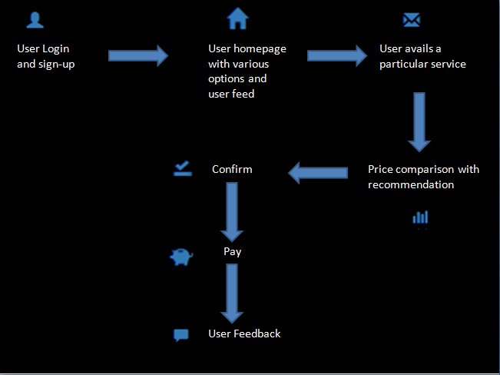
workflow

Slide 7
What we have done so far?
Front End Designing of web application
Database in PostgreSQL
Server in Node JS
Google Maps API integration
Prediction of fares of cab services and recommendation as per given rates
Chatbot to answer user queries

Slide 8
What we plan to do?
Add the different user modules like the various login and register screens with sessions
Complete the travel module with complete front end and back end functionalities
Connect travel module to users for recommendations and predictions
Extend to other domains like food and bookings

Slide 9

THANK YOU!!

