Slide 1

Guru Nanak Dev Engineering College Ludhiana
Department Of Civil Engineering
Topic – Design philosophies
Submitted To – Dr H.S Rai Sir
Submitted By – Aryan Gupta
C.R.N - 2214006

Slide 2
DESIGN PHILOSOPHIES
Objectives of RCC Design
To achieve a structure that will result in a Safe and Economical solution. It consists of the following steps:
1 Idealization of Structure for Analysis [The process of replacing an actual structure with a simple system conducive to analysis is called structural idealization].
2 Estimation of Loads
Analysis of Idealized Structure to determine
(a) Axial Thrust
(b) Shear
(c) Bending Moments
(d) Deflections
Design of Structural Elements
Material Specifications and Detailing of Reinforcement
Detailed Structural Drawing
Design Philosophies
1 Working Stress Method
2 Ultimate Load method
3 Limit State Design
D
B
BEAM
Idealized Beam

Slide 3
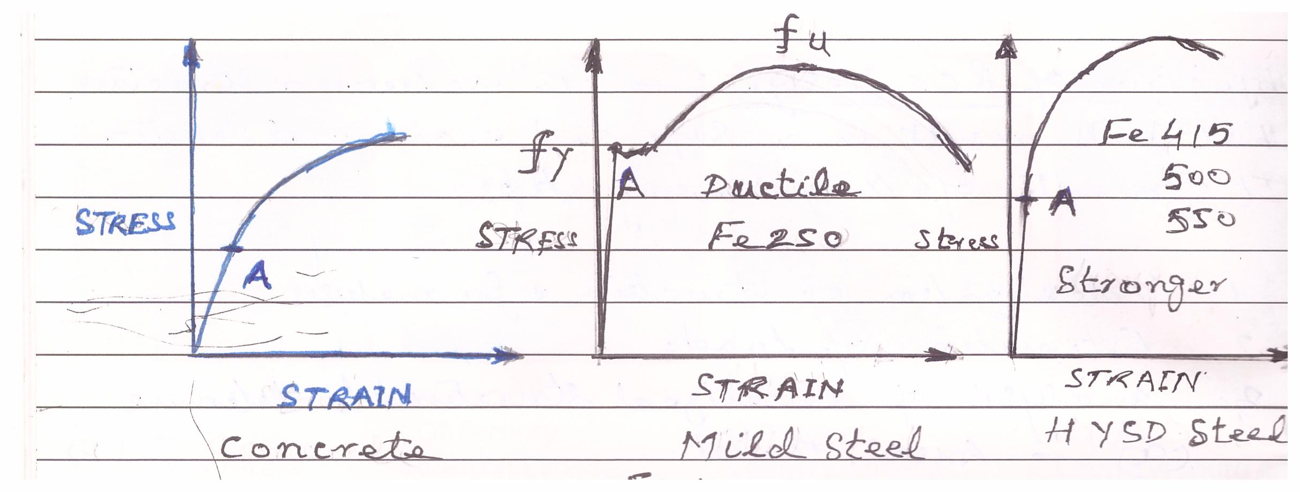
WORKING STRESS METHOD
Fig 1: Stress Strain Curves for Concrete and Steel
Working Stress Method is an Elastic Method i.e. the material behaves Elastically and Hook's Law is valid i.e. Stress is Proportional to Strain.
This means Strength of only that part of the material is considered which is under
Elastic Limit i.e. up to point 'A'.
The remaining Strength Beyond point A is not taken into consideration for a
particular Load.
This can be summarized as

Slide 4
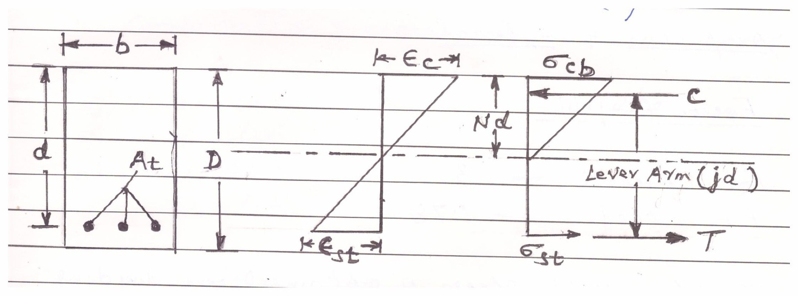
Stress Variation
Strain Variation
1 Concrete is Elastic
2 Steel and Concrete act together Elastically
3 The relationship between Stress and Strain is Linear right upto failure/collapse of the structure.
4 The Permissible Stresses for Concrete and Steel are not exceeded anywhere in the Structure when subjected to the worst combinations of Working Loads.
5 The Sections are Designed as per the Elastic Theory of Bending assuming that both materials i.e. concrete and steel obey the Hook's law.
6 The Elastic Theory assumes a Linear Variation of Strain and Stress i.e. Zero at the Neutral Axis and Maximum at the extreme fibre.
Beam Section
Beam Section
Strain Variation
Stress Variation
Fig 2 Stress & Strain Variation Along the Depth of Beam

Slide 5

ASSUMPTIONS
1 A Section which is Plane before Bending remains Plain after Bending
2 Bond between Steel and Concrete is perfect within the Elastic Limit of Steel
3 The Stress Strain Relationship of Steel and Concrete under Working Loads is a Straight Line
4 Concrete is Elastic i.e. Stress varies Linearly from Zero at the Neutral Axis to a maximum at the extreme fibre.
5 The Modular Ratio 'm' has the value
Where:-
σ_{cbc} :-Permissible Compressive Strength due to Bending in MPa
Permissible Stresses
Although the Stresses are kept within the Elastic Limits and most of the Strength is not taken into account, the Stresses in Concrete and Steel are further reduced by a Factor of Safety to account for uncertainties in the Estimation of the Working Loads and variations in the Properties of Materials
Factor of Safety
For Concrete 3
Steel 1.78

Slide 6


The Permissible Stress is obtained by dividing Grade of concrete by 3 and Yield Strength of Steel be 1.78.
Different values of Permissible Stresses for Concrete and Steel are given in Tables 21 and 22 IS 456 - 2000 and for Shear Stresses in Table 23 of IS 456 - 2000.
Hence for properly designed Structural Elements the Stresses computed under the action of working loads will be well within the Elastic Range. e.g.
For M20 Concrete :
Permissible Compressive Stress Permissible Stress in Concrete
in Bending Compression
For Fe250 Steel :
Permissible Tensile Stress Permissible Stress in Concrete
in Bending Tension

Slide 7
Structural Element is Designed for :
(1) Strength and (2) Stiffness under working loads
Strength Consists of:
(a) Compression Bending
(b) Shear
(c) Torsion
(d) Combination of above factors
Stiffness Consists of:
(a) Deflections
(b) Cracking
(d) Vibrations
Types of Loads
(a) Dead Loads
(b) Live Loads or Imposed Loads
(c) Wind Load
Earthquake Load
Static Loads
Dynamic Loads

Slide 8
DRAWBACKS
1 Concrete is not an Elastic Material. The inelastic material behaviour of concrete actually starts from very low stresses. The Actual stress distribution in concrete section is in fact Non Linear and cannot be described by a Triangular Stress Diagram.
2 The Section Designed is Uneconomical as the Strength of the material beyond the Elastic Zone is not taken into consideration.
3 Since Factor of Safety is on the Stresses under Working Loads; its not possible to account for uncertainties associated with different types of loads

Slide 9
LIMIT STATE DESIGN METHOD
The object of Design based on Limit State Concept is to:
“Achieve an acceptable Probability that a Structure will not become Unserviceable in its Life Time for the use for which it is intended, i.e. it will not Reach to a Limit State”.
A Structure with appropriate degrees of Reliability should be able to withstand safely all the loads that are liable to act on it throughout its life and it should also satisfy the Serviceability Requirements, such as,
Deflections and
Cracking
It should also be able to maintain the required Structural Integrity during and after accidents, such as:
Fires
Explosions
Local Failures
In other words, all relevant Limit States must be considered in the Design to ensure an adequate degree of “Safety and Serviceability”
Various Limit States, which needs to be examined are:

Slide 10
1 Limit State of Collapse
The Limit State that concerns with the safety of people and/or safety of structure are classified as “Limit State of Collapse” or Ultimate Limit State.
Following Limit States shall be verified where they are relevant
Loss of Equilibrium of the Structure or any part of it considered as a Rigid Body
Failure due to Excessive Deformations, Rupture and Loss of Stability of Structure.
Failure caused by Fatigue or other Time Dependent effects.
These above Limit States Corresponds to Maximum Load carrying capacity
Violation of Collapse Limit State implies Failure in the sense that a clearly defined Limit State of Structural Usefulness has been exceeded.
However it does not mean a complete collapse
The Collapse Limit State may correspond to
Flexure
Compression
Shear
Torsion

Slide 11
Limit State of Serviceability
The Limit State that Concerns with the :
Functioning of the Structure or Structural Members under Normal use
Comfort of People or Appearance of the Construction work
Shall be Classified as Serviceability Limit State
The verification of Serviceability Limit State is based on the following aspects
(a) Deformations that affects
Appearance
Comfort of Users
The Function of the Users
(b) Vibrations
That Causes Discomfort
That Limits the Functional Effectiveness of Structure
(c) Damage/Cracking That is likely to affect
Appearance
Durability
Functioning

Slide 12
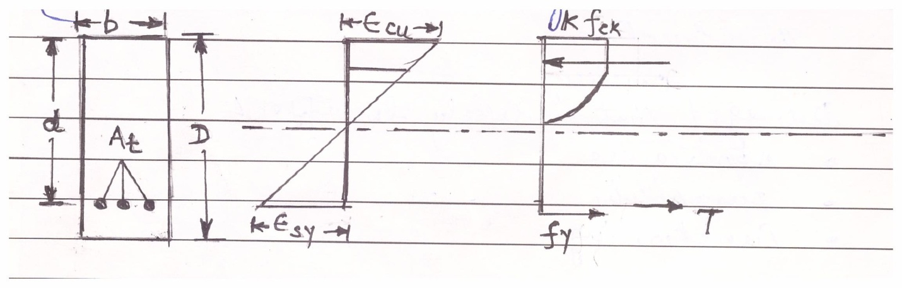
Hence effectively it is a S₃ problem i.e. for structure to be safe, it should have
Strength
Stiffness/Serviceability
Stability against
Overturning
Sliding
Shrinkage
And off course
Economy
The Limit State approach of Design basically considers the strength of material beyond Elastic Limit where the Stress is no longer Proportional to Stress.
It follows a Parabolic variation.
This is due to the Non-Linear behaviour of concrete as it is a Heterogeneous Material.
Figure 3 Stress Strain Curve in Limit State Design

Slide 13

The Limit State of Design of RCC Structures takes into account the probabilistic and Structural Variations in the
Material properties,
Loads and
Safety Factors.
Hence the Resistance to Bending , Shear, Torsion and Axial Loads at every section shall not be less than the Appropriate value at that section produced by the probable most unfavourable combination of Loads on the Structure using the appropriate Partial Safety Factors.
The Limit State of Collapse can be expressed by the following expression:
Where
R:- Resistance or capacity of structure
L:- Loads acting on the Structure
λ:- Load Factor >1
μ: Safety Factor associated with the uncertainties in the material properties
The Factors μ and λ are called partial safety factors.

Slide 14

Characteristic & Design Values and Partial Safety Factors
In order to keep the Structure Safe, Partial Safety Factors are applied to the calculations of Loads and Material Strength.
Characteristic Strength of Material
It means that value of Strength of Material below which not more than 5% of test results are expected to fall.
The Characteristic Strength should be in accordance with Table 2 of IS 456 – 2000
Design Value
The Characteristic Strength is determined in a laboratory by testing 15 cm cubes in compression under controlled conditions.
But at site the conditions are not controlled.
The strength is a non-quantified quantity and due to the Errors, Mistakes and Ignorance of workers at site, it is possible that the required strength may not be achieved.
Hence, in order that the structure does not fail due to lack of strength of material the Design Strength is taken into consideration.
Design Strength =

Slide 15

Design Strength =
Where,
f_{ck} :- Characteristic Strength of Material
γ_{m} :- Partial Safety Factor appropriate to Material
The Partial Safety Factor for Material Strength is a DIVIDING Factor i.e. the Material Strength is reduced and only corresponding loads are allowed on the structure.
Partial Safety Factor γ_{m} [as per IS 456 2000 clause 36.4.2.1] for
Concrete = 1.5
Steel = 1. 15
Characteristic Loads [Clause 36.2 of IS 456 – 2000]
The term Characteristic Load means that value of Load which has a 95% Probability of not being exceeded during the life of the structure.

Slide 16
For the purpose, of determining the loads the loads are taken as per ::
Dead Loads as given in IS 875 [Part 1]
Imposed Loads as given in IS 875 [Part 2]
Wind Loads as given in IS 875 [Part 3]
Snow Loads as given in IS 875 [Part 4]
Seismic Loads as given in IS 1893
Shall be assumed as Characteristic Loads
Design Values
In order that the Loads coming on the Structure never surpasses or are more than the Characteristic Loads, the value of the load given in the code is increased by multiplying it by a factor known as Partial Safety Factor and is termed as “Designed Load”
Design Load F_{d} is given by:
Where
F:- Characteristic Load
γ_{f}:- Partial Safety Factor appropriate to nature of loading
The Values of Partial Safety Factor for Load shall be taken as given in Table 18 of IS 456 – 2000 i.e.

Slide 17
Load Combination | Dead Load (DL) | Imposed Load (IL) | Wind Load (WL)
DL + IL | 1.5 | 1.5 | -
DL + WL | 1.5 | - | 1.5
*DL + WL | 0.9 | - | 1.5
DL +IL + WL | 1.2 | 1.2 | 1.2
* When Stability against overturning is critical or Stress Reversal is Critical

Slide 18
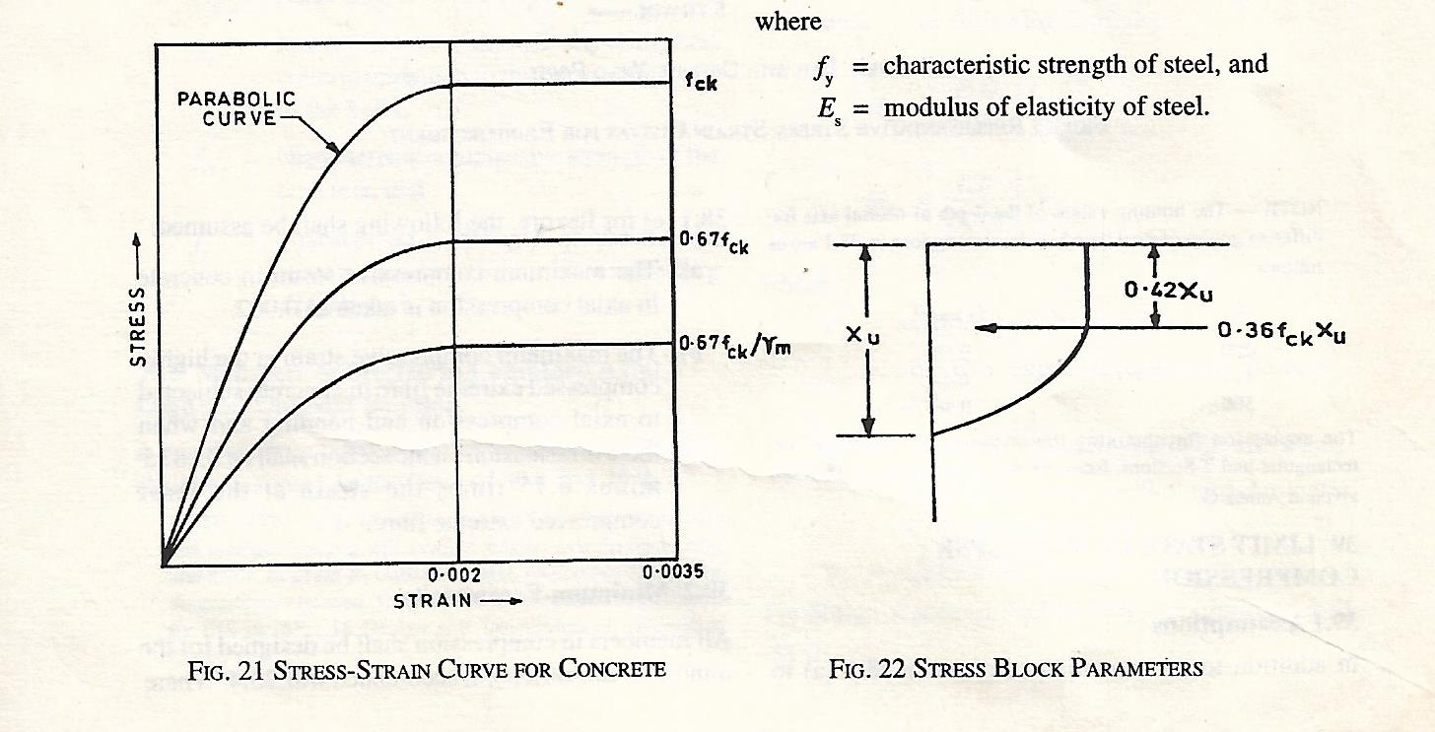
Stress – Strain Relationship for Concrete
Fig 4 Idealized Stress Strain Curve and Stress Block Parameters for Concrete
The Mechanical Properties of Concrete and therefore, the Stress Strain
Relationship is influenced by a number of factors such as:
Type of Aggregate and Concrete Mix
Strength of Concrete
Age of Concrete
Shape and Size of Concrete Specimen
Creep

Slide 19
The experimental Stress-Strain curve for concrete is too complicated to be used in design.
The Code IS 456 – 2000 has idealized it as shown in Fig 4 [Given at page 69, Clause 38, Fig 21].
Since the concrete is heterogeneous, the curve is a Parabola i.e. Stress is not Proportional to Strain.
As per the Code the Curve remain parabolic upto a strain of 0.002, beyond which the strain remains constant with increasing load until a strain of 0.0035 (0.35%) has reached when the concrete is said to have failed.

Slide 20
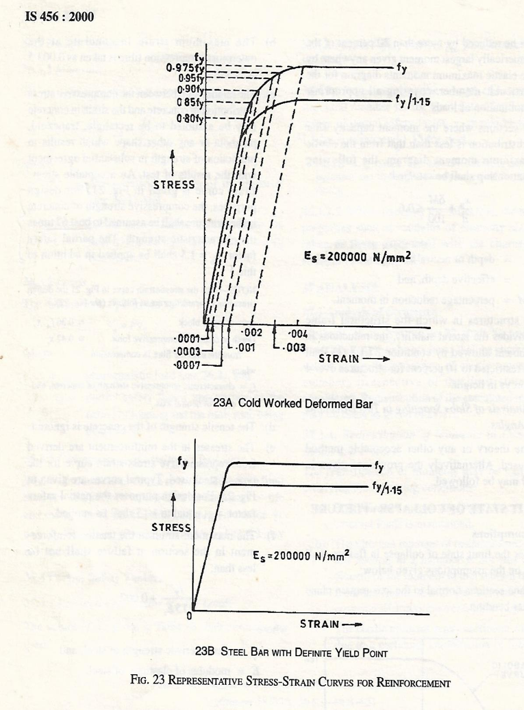
Stress – Strain Relationship for Steel
Fig 5 Idealized Stress Strain Curves for Steel

Slide 21
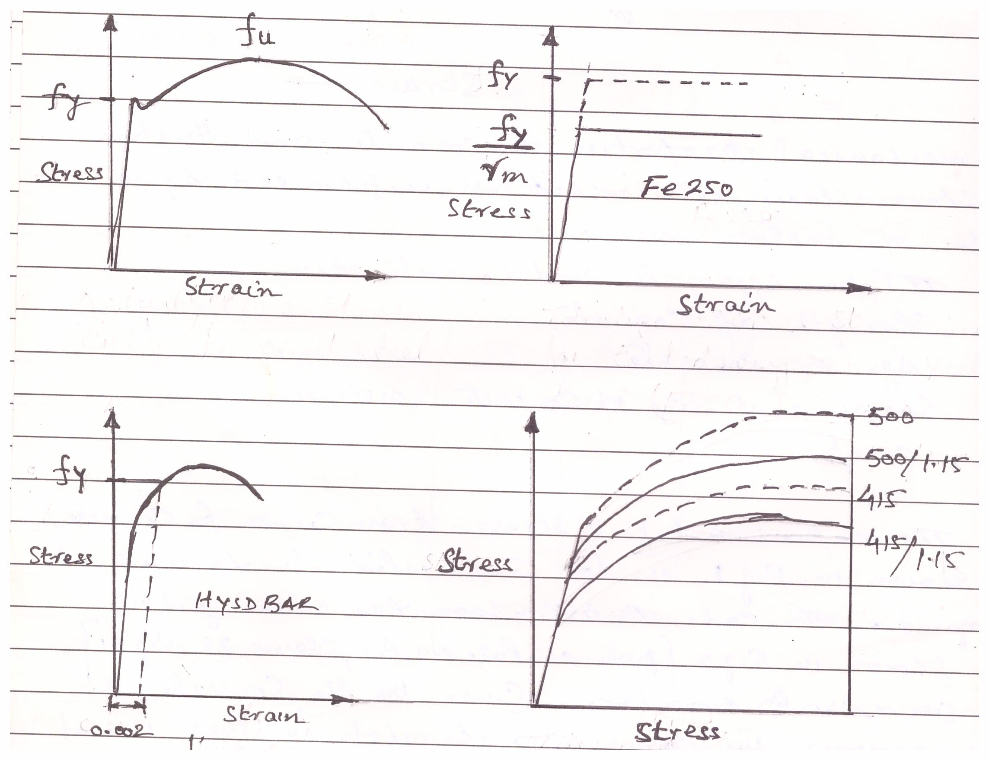
Actual Stress Strain
curve for Mild Steel
Idealized Stress Strain curve for
Steel having definite Yield Point
Actual Stress Strain
curve for HYSD Bars
Idealized Stress Strain curve for
HYSD Bars
Fig 6 Typical Stress Strain Curves for Mild Steel and HYSD Bars

Slide 22
SINGLY REINFORCED SECTIONS
A
Compression
b
D
d
A
Tension
Clear Span
A Reinforced Concrete Flexure Member should be able to resist to the following stresses induced due to Imposed Loads :
Tensile Stress
Compressive Stress
Shear Stress
Concrete :-
Fairly Strong in Compression
Weak in Tension
Tensile Strength taken as Zero
Steel:-
Very Strong in Tension
Steel takes up Tension in the Tensile Zone of the Flexural Member.

Slide 23
While Designing a Reinforced Concrete Section, the Loading, Span, Grade of Concrete, Grade of Steel and Width of Section are usually known in advance.
The Section Dimensions and Area of Steel Bars [Reinforcing Steel] are to be determined.
There can be no unique section for a given set of forces. There are many possible combinations.
Thus the cost will decide the final design

Slide 24
ASSUMPTIONS
Design for the Limit State of Collapse in Flexure shall be based on the assumptions as per IS 456 – 2000; Clause 38.1, p 69
Plane Sections Normal to the Axis remain Plane after Bending
The Maximum Strain in Concrete at the outermost Compression Fibre is taken as 0.0035 in Bending
The Relationship between Stress-Strain distribution in Concrete is Parabolic upto a Strain of 0.002 and then constant upto a Strain of 0.0035 at which the concrete is said to have failed [IS 456 – 2000, Fig 21, pp. 69]
For Design purpose the Compressive Strength of Concrete is taken as 0.67 times the Characteristic Strength of Concrete. A Partial Safety Factor γ_{m} = 1.5 shall be applied in addition to this.
The Tensile Strength of Concrete is ignored
The Stress in the Reinforcement is derived from the representative Stress-Strain Curve for the type of Steel used. The typical Curves are given in Fig 23 of IS 456 – 2000; pp. 70
For Design Purposes the Partial Safety Factor of γ_{m} = 1.15 shall be applied to the Characteristic Strength of Steel

Slide 25



The Maximum Strain in Tension Reinforcement in the Section at Failure should not be less than the following i.e.
Bending of Beams
We know that
OR
f_{cr} = 0.7 √f_{CK}

Slide 26
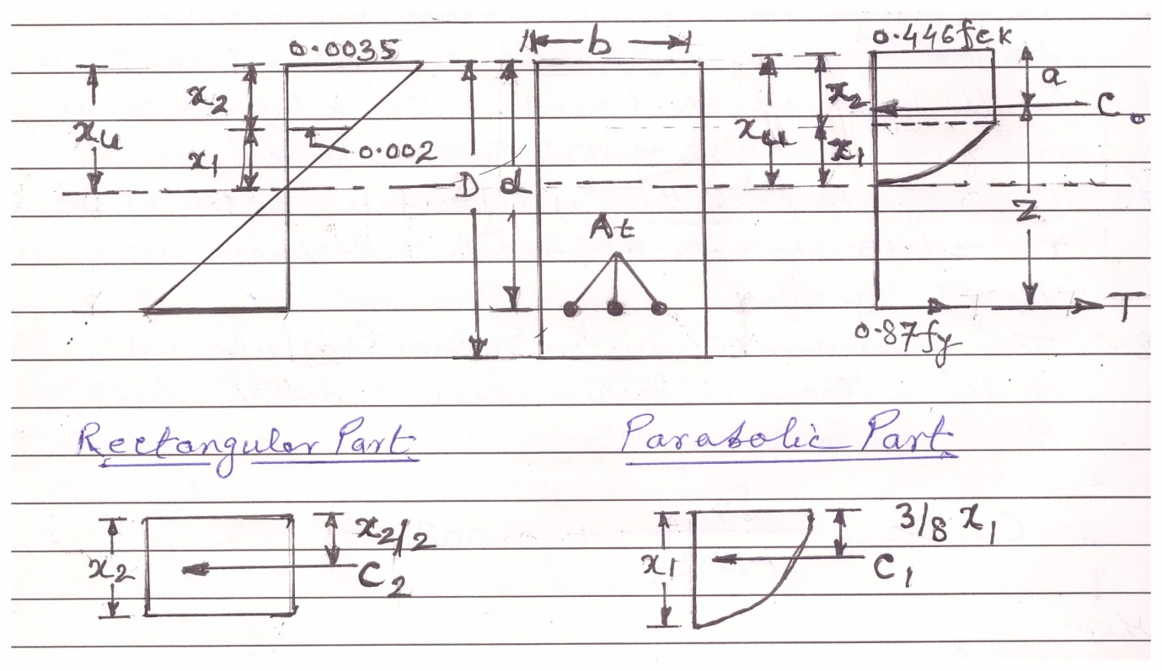

MOMENT OF RESISTANCE
Neutral Axis
Fig 8: Stress Block Parameters
Consider a Simply Supported Beam subjected to Bending under factored loads.
For Equilibrium total force of Compression must be equal to the total force of Tension i.e.
C = T
The applied Bending Moment at Collapse i.e. Factored Bending Moment is equal to the Resisting Moment of the Section provided by the Internal Stresses.
This called the Ultimate Moment of Resistance.

Slide 27
Now
Force = C = C₁ + C₂
C = Force x Area
And
M_{R} = Force x Lever Arm
The portion above the Neutral Axis is in Compression and the Strain is proportional to distance from Neutral Axis (NA) to the Extreme Compression Fibre i.e. Zero at the NA to a Maximum at the Extreme fibre.
The cross section below the NA is in Tension and hence the Concrete is assumed to have Cracked.
All the Tensile Stresses are supposed to be borne by steel bars and stresses in all the steel bars are equal.
The resultant Tensile Force thus acts at the Centroid of the Reinforcing Bars.
The distance from the Extreme Compression Fibre to the centroid of the Reinforcing Bars i.e. line of action of Tensile Force is called the Effective Depth 'd'.
Now,
Maximum Compressive Stress in Concrete without Safety Factor
= 0.67 f_{CK} [Assumption 4]

Slide 28




Let,
X₁ : Depth of Parabolic Portion
X₂ : Depth of Rectangular Portion
From,
Similar Triangles of Strain Diagram,
Depth of Parabolic Portion is
Or,
Depth of Rectangular Portion
X₂ = X_{U} - X₁
=
OR

Slide 29
Force of Compression
Parabolic Block :-
C₁ = Stress x Area
= (0.67 f_{CK} ) × (2/3 X₁ . b)
= (0.67 f_{CK} ) × (2/3 . X_{U} . b)
C₁ = 0.255 f_{CK} .b . X_{U}
Rectangular Block:-
C₂ = Stress x Area
= (0.67 f_{CK} ) × ( X₂ . b)
= (0.67 f_{CK} ) ×( X_{U} . b)
C₂ = 0.287 f_{CK} .b . X_{U}
Hence Total Force of Compression without Partial Safety Factor
C_{O} = C₁ + C₂
= 0.255 f_{CK} .b . X_{U} + 0.287 f_{CK} .b . X_{U}
C_{O} = 0.542 f_{CK} b X_{U} {Without Partial Safety Factor}

Slide 30


Now Applying Partial Safety Factor of 1.5 the Design Force of Compression is:-
C = 0.36 f_{CK} b X_{U}
Now,
Moment of Resistance = Force × Lever Arm
Lever Arm = Z = d ˗ a
Where,
'a' is the distance of line of action of force of compression from the extreme top fibre.
To determine 'a' take moment of all the forces about top extreme fibre. i.e.

Slide 31

C_{O} × a = 0.225 f_{CK} .b . X_{U} ²
a = 0.42 X_{U}
Where,
X_{U} : Depth of Neutral Axis from Top Fibre
B : Width of the Section
DEPTH OF NEUTRAL AXIS
Depth of NA can be obtained by considering the equilibrium of normal force i.e.
Force of Compression = Force of Tension
Resultant Force of Compression
C = Average Stress × Area

Slide 32

C = 0.36 f_{CK} b X_{U}
Resultant Force of Tension
T = 0.87 f_{Y} A_{t}
Now
C = T
0.36 f_{CK} b X_{U} = 0.87 f_{Y} A_{t}
OR,
Where,
A_{t} = Area of Tension Steel

Slide 33


LEVER ARM
The forces of Compression and Tension forms a Couple.
The distance between the lines of action of these two forces is called the Lever Arm and is denoted by 'Z'.
The equation of equilibrium Σ M = 0 is satisfied by equating the factored Bending Moment to the Moment of Resistance offered by either Force of Compression or Force of Tension.
Lever Arm Z = d ˗ a
OR
Z = d ˗ 0.42 X_{U}
Now,
Moment of Resistance

Slide 34
Now,
Moment of Resistance w. r. t. Concrete
M_{RC} = Compressive Force × Lever Arm
M_{RC} = 0.36 f_{CK} b X_{U} . Z
Moment of Resistance w. r. t. Steel
M_{Rt} = Compressive Force × Lever Arm
M_{Rt} = 0.87 f_{Y} A_{t} . Z

Slide 35
MODES OF FAILURE
Balanced Section :-
If the ratio of Steel to Concrete in a beam is such that the maximum strain in concrete and steel reach simultaneously, a sudden failure would occur with less alarming deflections.
Such a beam is referred to as a Balanced Reinforced Beam.
Under Reinforced Beam :-
When the amount of steel is kept less than that in the Balanced Section, the NA moves upwards so as to reduce the area under compression to maintain the Equilibrium Condition i.e.
Force of Compression is equal to the Force of Tension. [This is because the Force of tension becomes less than the Force of Compression and hence the Force of Compression has to be reduced]
In this process the Centre of Gravity of compressive forces also shifts upwards.
Under increasing Bending Moments Steel is strained beyond Yield Point and the Maximum Strain in concrete remains less than 0.35% i.e. 0.0035.
If the beam is further loaded, the strain the section increases. Once the steel has yielded it does not take any additional stresses for the additional strain and the total force of tension remains constant.
However compressive stresses in concrete increases with the additional strain.

Slide 36
Thus the NA and Centre of Gravity of Compressive Forces further shifts upwards to maintain Equilibrium.
This results in an increase in the Moment of Resistance of the Beam. This process of shift in the NA continues until maximum strain reaches its Ultimate Value i.e. 0.35% and the Concrete Crushes.
Such a beam is referred to as "Under Reinforced Beam".
The Failure is called Tension Failure because Yielding of Steel was responsible for higher strains in concrete resulting in its failure.
Over Reinforced Beam :-
When the amount of steel is kept more than that in the Balanced, the NA tends to move downwards and the Strain in Steel remains in Elastic Region.
If the beam is further loaded the stresses in steel keeps on increasing and so the force of tension.
Here the force of tension is more than that of compression, and hence to maintain the equilibrium of tensile and compressive forces the area of concrete resisting compression has to increase so as to increase the force of compression.
In this process the NA furher shifts downwards until maximum strain in concrete reaches its ultimate value of 0.35% and concrete crushes. The Steel is well within Elastic Limits.
Such a beam is referred to as an "Over Reinforced Beam" and the failure as Compression Failure

Slide 37
MAXIMUM DEPTH OF NEUTRAL AXIS
A compression failure in a Over Reinforced Beam is a Brittle Failure.
The Maximum Depth of NA is therefore limited to ensure that the Steel will reach its Yield Point before Concrete fails in Compression, so that a brittle Failure is avoided.
Let the Limiting Value of the depth of NA be X_{U Lim}.
When,
X_{U} = X_{U Lim} [ Balanced Section ]
X_{U} < X_{U Lim} [ Under Reinforced Section ]
X_{U} > X_{U Lim} [ Over Reinforced Section ]

Slide 38



The Limiting Value of Depth of NA X_{U Lim}. for different grades of steel can be obtained from Strain Diagram as shown in Fig 8.
From Similar Triangles
or
or
Where
E = 2 × 10⁵ N/mm²
The Limiting values of Depth of NA for different grades of steel are given in Table 1
0.0035
X₂
0.002
X_{U Lim}
X₁
d
From Fig 8

Slide 39
Table 1 Maximum Depth of Neutral Axis
Grade of Steel f_{Y} (N/mm²) | X_{U Lim}
250 | 0.53 d
415 | 0.48 d
500 | 0.46 d
550 | 0.44 d
LIMITING VALUES OF TENSION STEEL AND MOMENT OF RESISTANCE
Since the maximum depth of NA is limited the maximum value of moment of resistance
is also limited i.e.
M_{U Lim} w. r. t Concrete = 0.36 f_{CK} b X_{U} . Z
M_{U Lim} = 0.36 f_{CK} b X_{U Lim} (d ˗ 0.42 X_{U Lim} ) {Balanced Section}
M_{U Lim} w. r. t Steel = 0.87 f_{Y} A_{t} . Z
M_{U Lim} = 0.87 f_{Y} A_{t} (d ˗ 0.42 X_{U Lim} ) { Balanced Section}

Slide 40

For a given Rectangular Beam Section, the Limiting Values of M_{U Lim} depends on the Grade of Concrete and the Grade of Steel.
The Values of Limiting Moment of Resistance with respect to different Grades of Concrete and Steel are given in Table 2.
Table 2: Limiting Moment of Resistance (N-mm)
Grade of Concrete | Fe 250 | Fe 415 | Fe 500 | Fe 550
General | 0.148f_{CK} b d² | 0.138f_{CK} b d² | 0.133f_{CK} b d² | 0.130f_{CK} b d²
M 20 | 2.96 b d² | 2.76 b d² | 2.66 b d² | 2.60 b d²
M 25 | 3.70 b d² | 3.45 b d² | 3.33 b d² | 3.25 b d²
M 30 | 4.4 b d² | 4.14 b d² | 3.99 b d² | 3.90 b d²
The percentage of Tensile Reinforcement Corresponding to Limiting Moment of Resistance is obtained by equating the forces of tension and compression
0.87 f_{Y} A_{t} = 0.36 f_{CK} b X_{U Lim}

Slide 41


Let,
The limiting values of tensile reinforcement percentage corresponding to different grades of steel and concrete in a Singly Reinforced Beam are given in Table 3.
Table 3: Limiting Tensile Steel in Rectangular Section (%)
Grade of Concrete | Percentage of Tensile Steel
f_{CK} (N/mm²) | Fe 250 N/mm² | Fe 415 N/mm² | Fe 500 N/mm² | Fe 550 N/mm²
M 20 | 1.76 | 0.96 | 0.76 | 0.66
M 25 | 2.20 | 1.19 | 0.94 | 0.83
M 30 | 2.64 | 1.43 | 1.13 | 1.00

Slide 42

Minimum and Maximum Tension Reinforcement
Minimum Reinforcement : [ As per Clause 26.5.1.1; pp. 46; of IS 456 - 2000 ]
The minimum area of tension reinforcement should not be less than that given by the following :
Where,
A_{S} = Minimum Area of Tension Reinforcement
b = Breadth of Beam or breadth of Web of T-Beam
d = Effective depth of Beam
f_{Y} = Characteristic Strength of Steel Reinforcement in N/mm₂
Maximum Reinforcement :
The maximum area of tension reinforcement should not exceed 4% of the Gross Cross-Sectional area of beam to avoid difficulty in placing and compacting concrete properly in the formwork i.e.
A_{SM} > 0.04 b D

Slide 43
THANK YOU
For given your Time

