Slide 1

Smart Traffic Lights
Traffic for a better world!
Team:
Francesca Fanelli – s313432
Aaron Segers – s306765
Cristiano Vittori – s316801
Maureen Zwart – s307021
Course:
01QWRBH: Programming for IoT Applications
Prof. Edoardo Patti
Prof. Matteo Orlando

Slide 2
Agenda
Problem Statement and Objectives
Use Case Diagram
Communication Protocols
Service catalog and resource catalog
Sensors
Traffic Lights protocols and LEDs management
User Awareness

Slide 3


Problem Statement
Energy Abuse due to Traffic Lights Always Switched ON
Insufficiently Planned working days for Traffic Light Manufacturers

Slide 4


Objectives
Decrease Energy Abuse for a More Sustainable Future
Improve Efficiency of Traffic Light Manufacturers

Slide 5
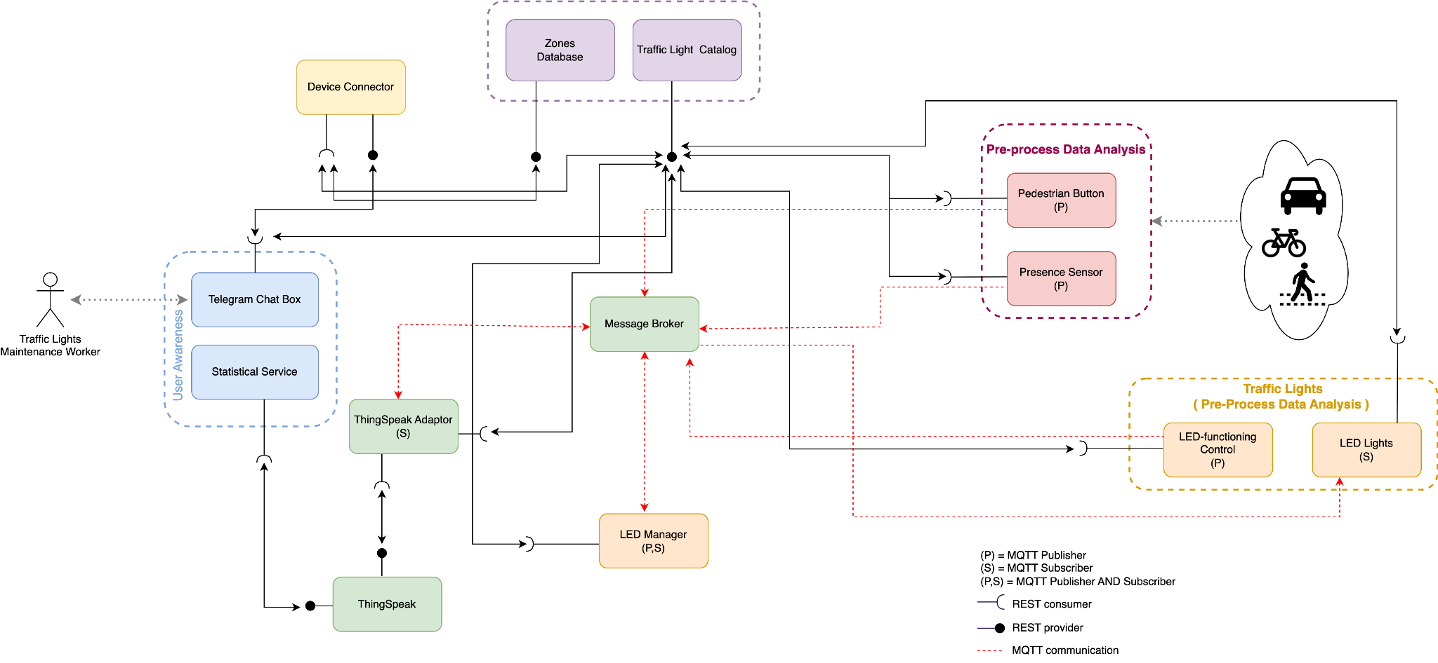
Use Case Diagram

Slide 6
Communication Protocols

Slide 7
MQTT
REST
Asynchronous communication
Lightweight/Flexible
Publish/subscribe paradigm
Hierarchical message topics
Synchronous Communication
Request/Response paradigm
On demand access to the system information via Catalogs

Slide 8
MQTT Topics
<base topic>/<...>/<zone>/<crossroad>
Led Sensor
SmartTrafficLight
example:
Sensor
Led
Subscribe
Led Manager
Publish
A
Publish
A
Subscribe
1
TrafficLights 1
Subscribe
1

Slide 9
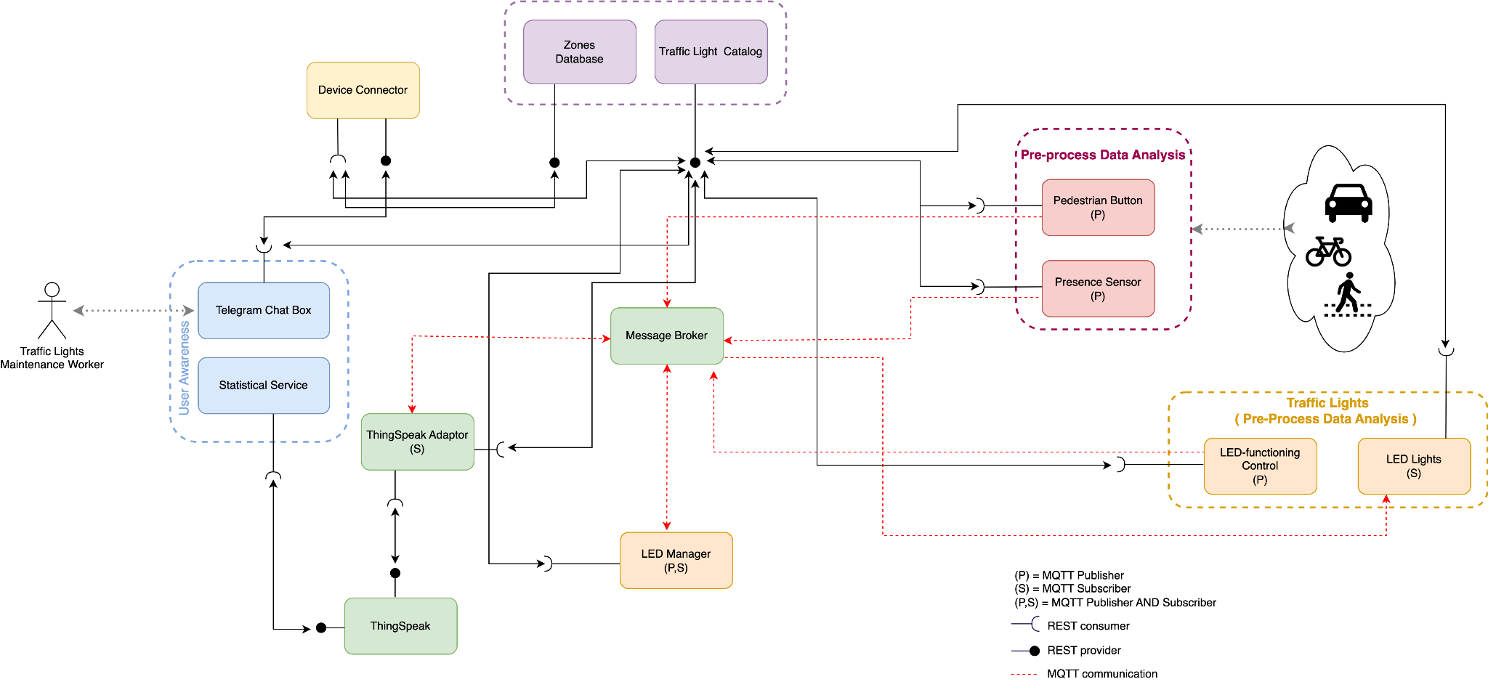
Service and resource catalogs

Slide 10
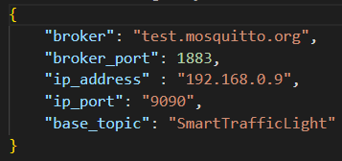
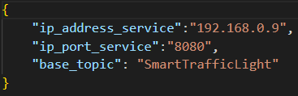
Service and Resource Catalogs
Service and Resource catalogs are implemented.
Communication with all other devices/resources via REST.
Periodical registration of actors on Resource catalog.
Periodical registration of Resource catalog on Service catalog
Resource catalog info provided by service catalog to all actors.
Server catalog info available to all actors.

Slide 11
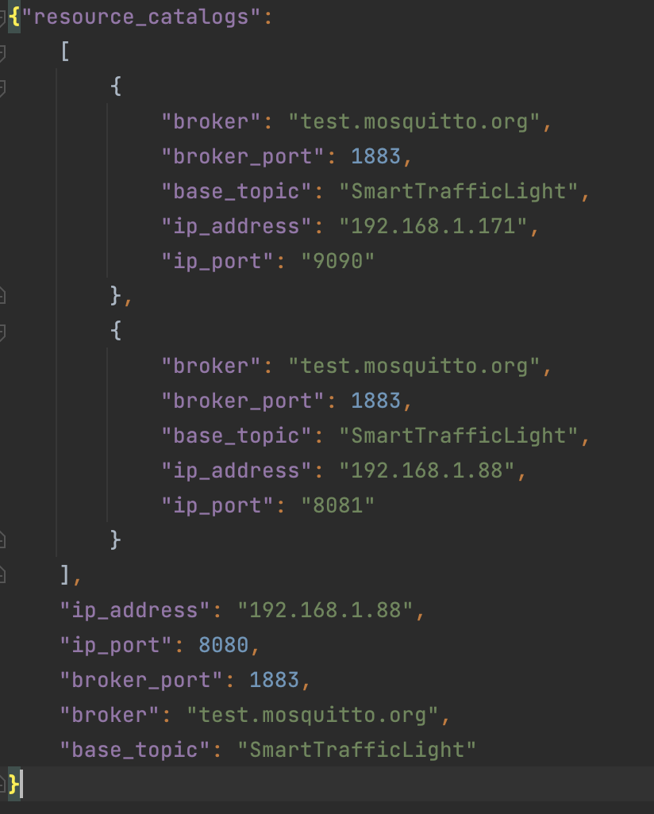
Service Catalog
GET: provides information about resource catalog (latest registered, full list) or broker
PUT: register updated version of resource catalog

Slide 12
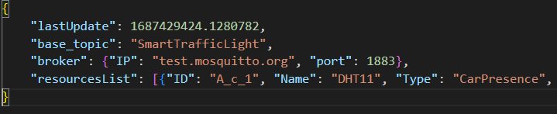
Resource Catalog
Periodical registration to Service catalog (PUT requests)
PUT: register resources to catalog
GET: provides information about broker, full resources list, Zone Database
Resource Catalog

Slide 13
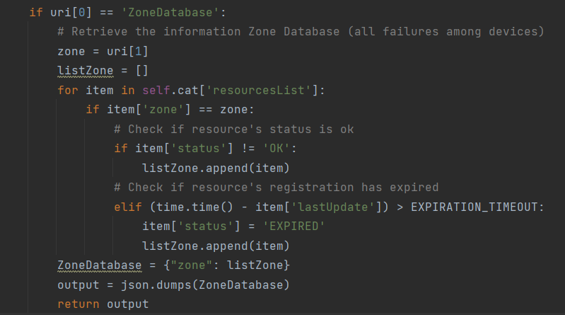
Zones Database
Zone Database includes all resources which are malfunctioning or whose registration has expired
Zone Database is forwarded to manufacturers via Telegram Bot (REST)
GET
Telegram Bot

Slide 14
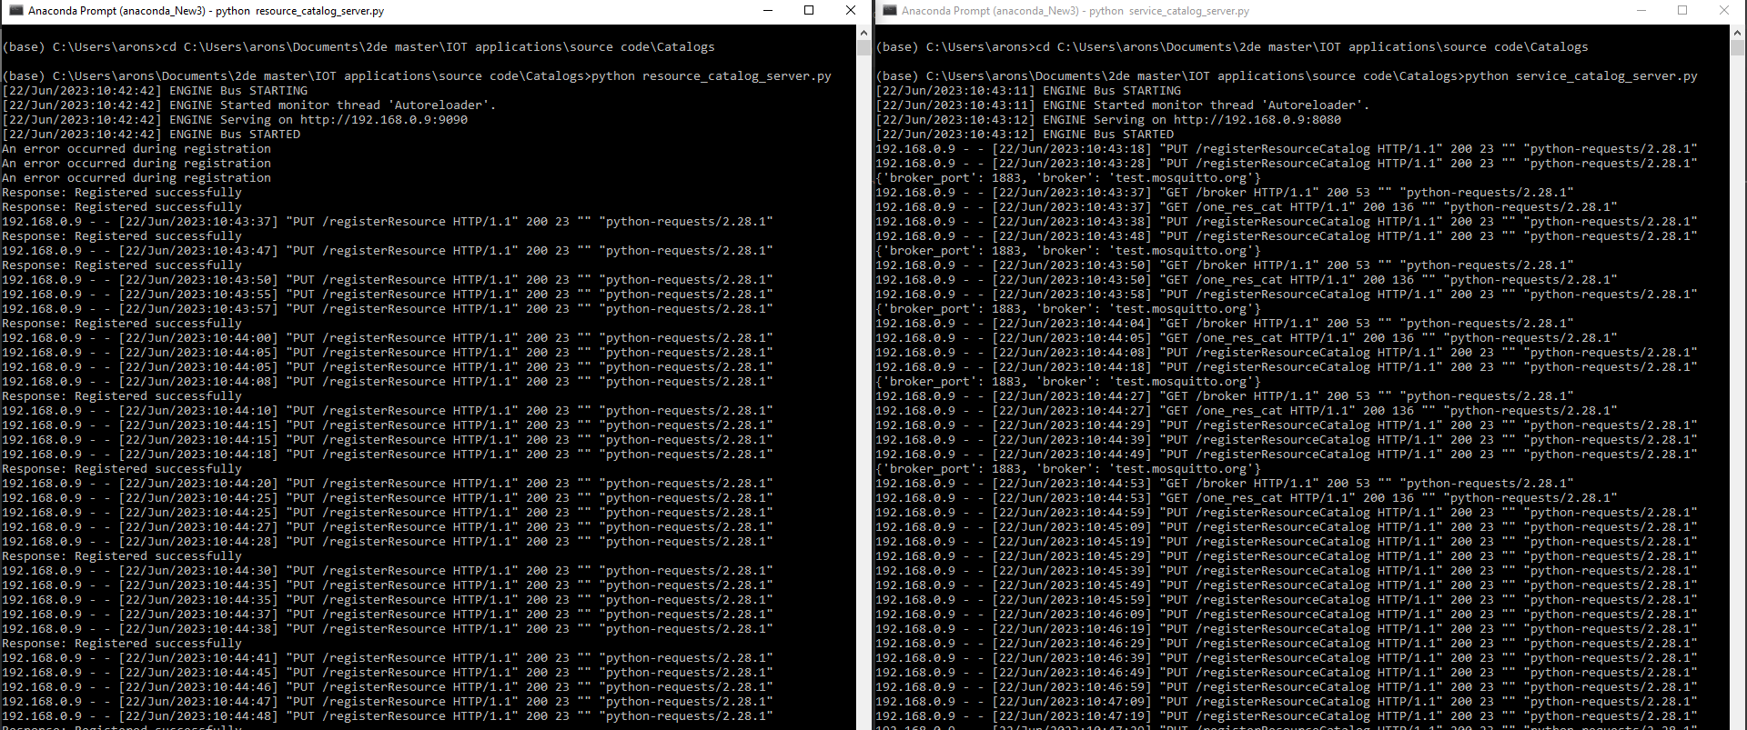

Slide 15
Sensors

Slide 16
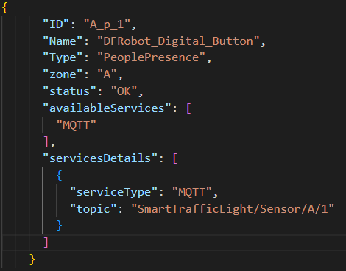
Pedestrian Button
Push the button
Triggers the traffic light cycle (if turned off)
→ Pedestrian protocol
Publish (MQTT) on topic SmartTrafficLight/Sensor/A/1
REST connection to Traffic light catalog
Scalability ensured through JSON settings files: same code for more than one sensor

Slide 17
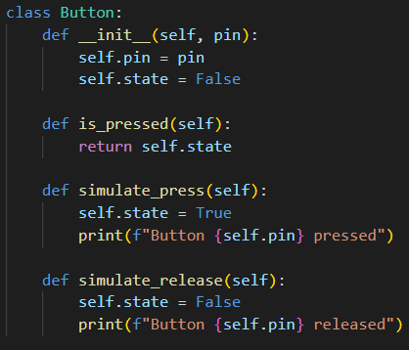
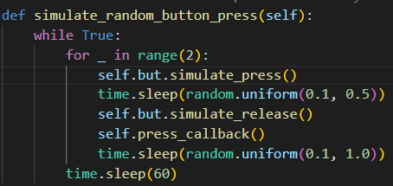
Pedestrian Button Simulation
Push the button
Triggers the traffic light cycle (if turned off)
→ Pedestrian protocol
2 random presses each minute

Slide 18
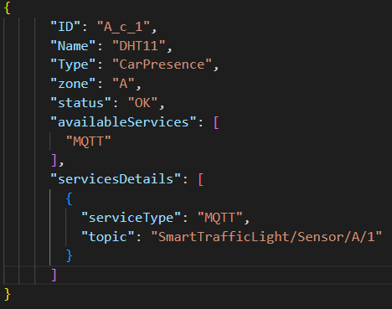
Presence Sensor
Detection of cars approaching crossroad
Triggers the traffic light cycle (if turned off)
→ Cars protocol
Publish (MQTT) on topic SmartTrafficLight/Sensor/A/1
REST connection to Traffic Light Catalog
Scalability ensured through JSON settings files: same code for more than one sensor

Slide 19
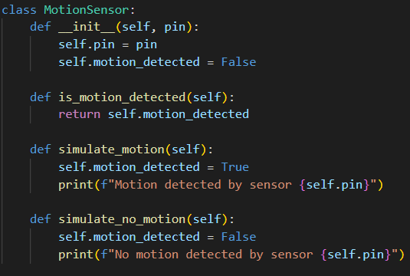
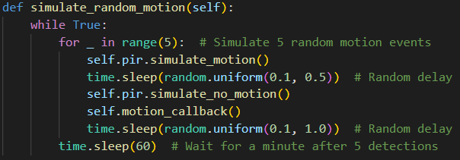
Presence Sensor Simulation
MotionSensor:
detectmotion
simulate_motion
no_motion
Random motion:
5 random detections
Restart after 1 minute

Slide 20
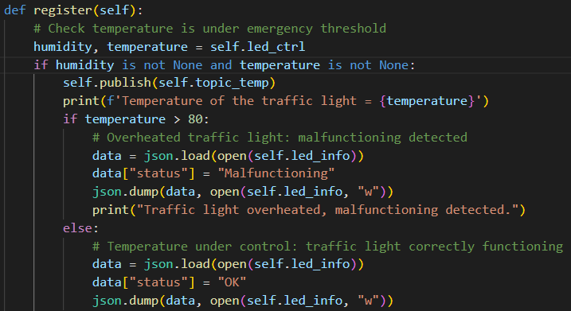
TrafficLight Temperature Sensor
It controls functioning of Traffic Lights
Implemented in LED actuator code
If it detects too high temperatures
→ change “status” of Traffic Light
Publishes temperature:
SmartTrafficLight/Led/A/temp

Slide 21
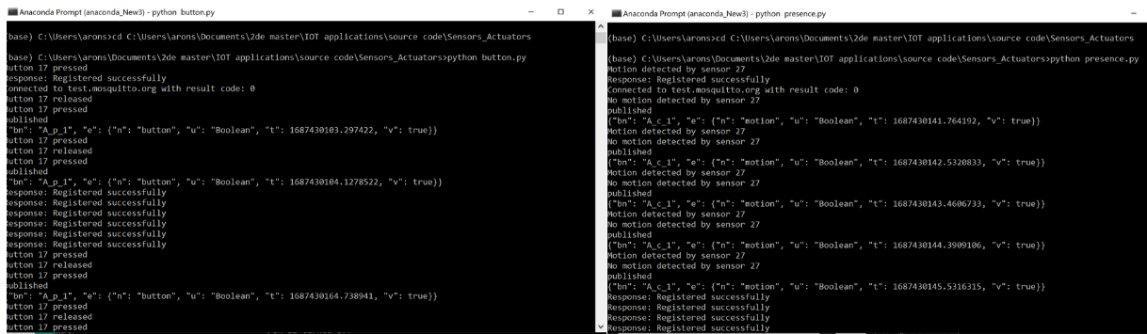
Sensor Terminals

Slide 22

Traffic light protocols
STOP!!!
WAIT!!!
GO!!

Slide 23
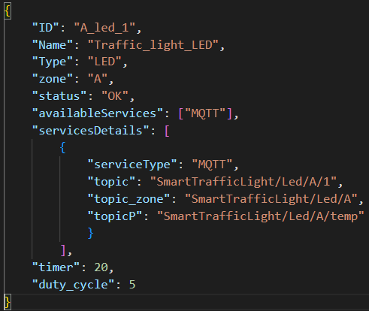
Car Protocol
Presence sensor positioned 100m before the traffic light
On car detection:
Turn on Traffic Lights of the whole zone
Start: green for cars
Traffic cycle: 20s before turning off
5s Green -> 5s Red
Timer and duty cycle can be modified through a practical JSON configuration file

Slide 24

Pedestrian protocol
On pedestrian request (button push)
Turn on only Traffic Lights of that crossroad
Start: green for pedestrians
Traffic cycle: 20s before turning off
5s Green -> 5s Red
Timer and duty cycle can be anyway modified through a practical JSON configuration file

Slide 25
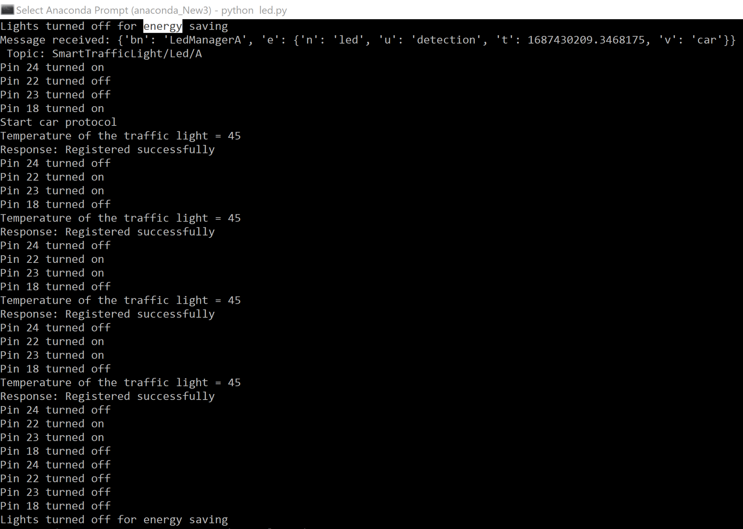
Energy saving protocol
After timer expiration:
Turn off traffic light for energy saving
New detection → Start correct protocol

Slide 26
LED Manager and Traffic Lights

Slide 27
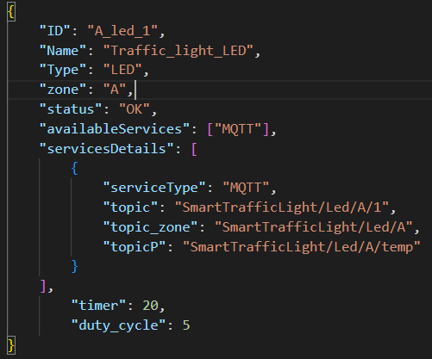
Traffic Lights
The led actuator → Turns on/off the led of crossroad
Subscribes to topics:
SmartTrafficLight/Led/A (common to all zone A)
SmartTrafficLight/Led/A/1
Publishes to topic:
SmartTrafficLight/Led/A/temp

Slide 28
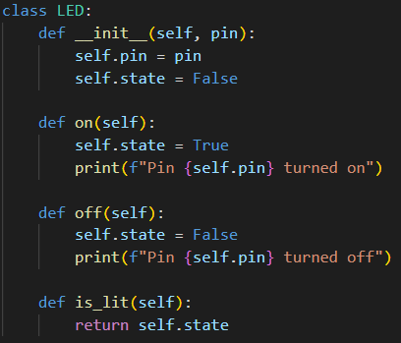
Traffic Lights Simulation
Recreate Led:
pin: represents led location
3 different states:
on
off
is_lit

Slide 29
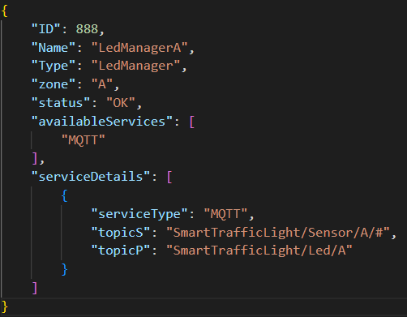
LED Manager
Zone-specific
Communicates to all LED actuators
Subscribes to topic SmartTrafficLight/Sensor/A/#
Publishes to topic (if car detection):
SmartTrafficLight/Led/A (common to all zone A)
Publishes to topic (if pedestrian on crossroad c):
SmartTrafficLight/Led/A/c

Slide 30
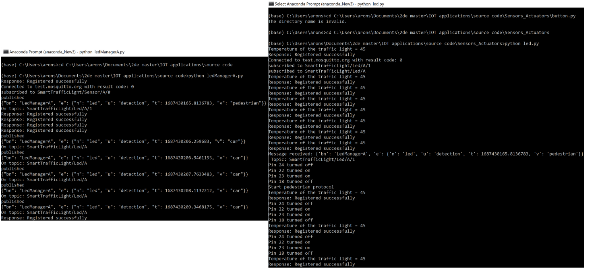

Slide 31
User
Awareness

Slide 32
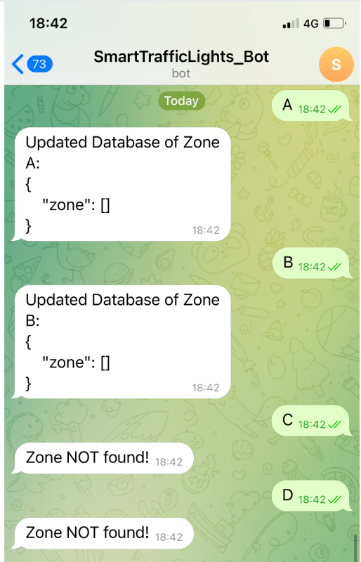
Telegram Bot
Allows fast and efficient maintenance
On demand it provides Zone Database containing a list of all the malfunctioning traffic lights of a specific zone
Manufacturer
Telegram Chat Box
GET
Zone Database

Slide 33
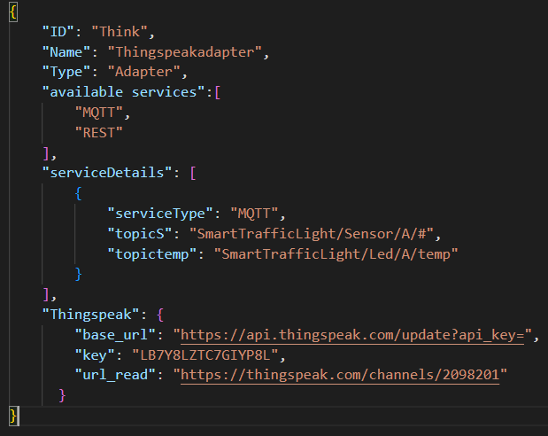
Thingspeak
Distributed Thingspeak Adaptor:
Subs: SmartTrafficLight/Sensor/A/#
Pedestrian detection
Car detection
Temperature
ThingSpeak provides:
Data analysis over time
Pedestrians and cars detection rate
Traffic peaks analysis
Temperature over time

Slide 34
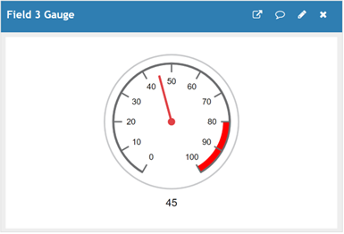
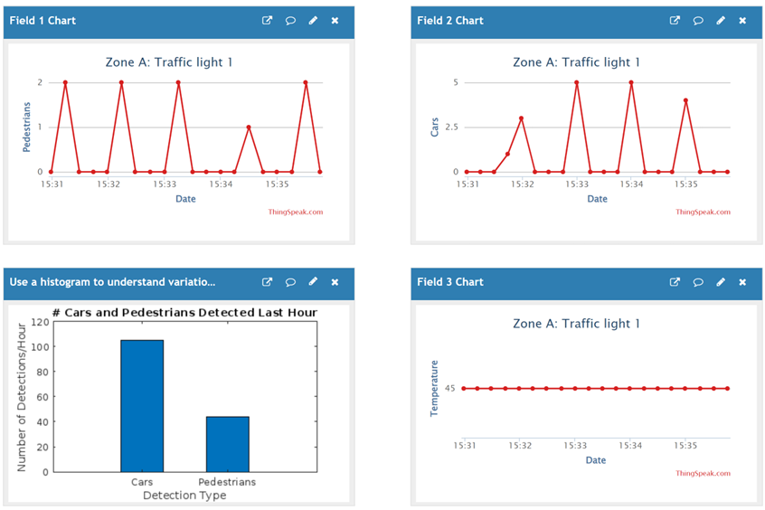
ThingSpeak Output
Thingspeak analysis:
amount cars / pedestrians
Total/ hour
Temperature of the led
Temperature indication

Slide 35
Smart Traffic Lights
Traffic for a better world!
Energy Saving
Traffic statistics
Traffic control
Clear interface

Slide 36
Thank You!
Francesca Fanelli – s313432
Aron Segers – s306765
Cristiano Vittori – s316801
Maureen Zwart – s307021

