Slide 1



CHAPTER 01
Tour the App
What if you could move from first prompt to pull request without piecing together context across tools?
github.com/github/copilot-app-for-beginners
Notes:
Chapter 01 starts with a practical question: why use a desktop app if you already use Copilot in an editor or terminal? Then it tours the main navigation, compares chats with project sessions, and covers modes, models, and settings.

Slide 2

CHAPTER 01
CHAPTER 01
In this chapter
Why use the app
01
Copilot already works next to your code. The app solves a different problem: supervising agent work end to end.
Tour the app
02
Learn where you start work, find GitHub items, save repeat tasks, and extend the app.
03
Sessions, modes, and models
Pick the session type, mode, and model that fit the task in front of you.
Notes:
This chapter has 3 parts: Why use the app, Tour the app, Sessions, modes, and models.

Slide 3
CHAPTER 01
SECTION 1 OF 3
Why use the app
01
Copilot already works next to your code. The app solves a different problem: supervising agent work end to end.
Notes:
Section 1: the why. The editor and terminal are great for work next to the code you already have open. The app focuses on the supervision loop around agent work.

Slide 4
CHAPTER 01
THE CHALLENGE
Supervising agent work is the hard part
When work is spread across tools, you ask "where was I?"
CHALLENGE
WHAT THE APP ADDS
Shared working copy
Project sessions that keep focused work separate
Scattered evidence
Sessions, diffs, terminal, previews, and GitHub in one app
Explore vs. change
Chats for questions, project sessions for code
Progress buried in chat
Canvases: a shared board you and the agent update
Repeat work
Automations that run on demand, on a schedule, or from events
Notes:
Five problems show up when you supervise agent work from an editor or terminal alone. Two agent tasks can blur together in one folder and branch. The plan, diff, tests, and PR live in different tools. A quick question and a real change feel the same until files start changing. Plan steps and checks scroll away in a long chat. And you retype the same prompts every week. The app answers each one. It does not replace your editor.

Slide 5
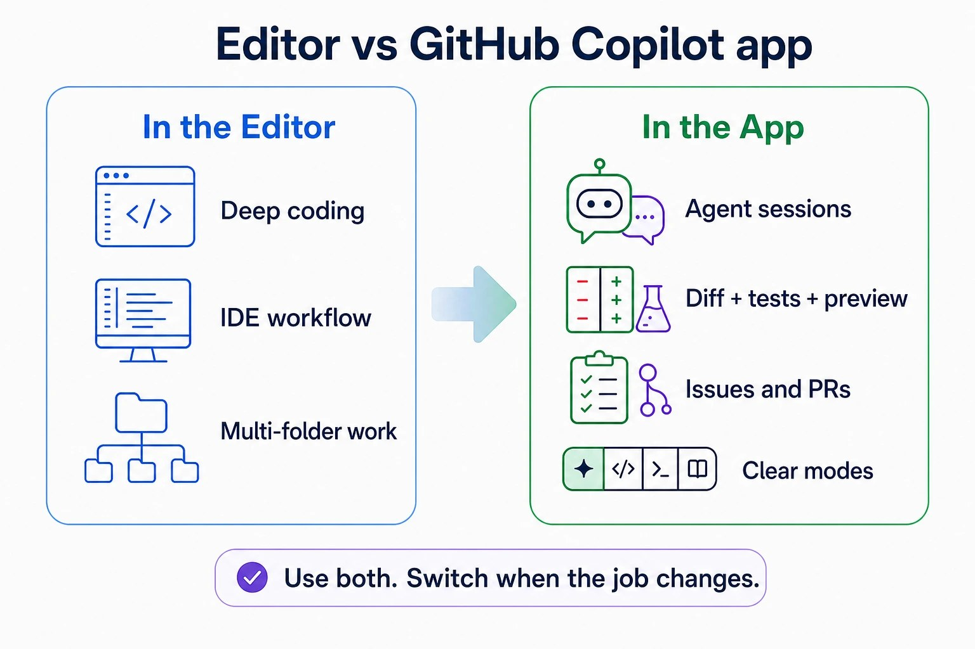



CHAPTER 01
WHERE THE APP FITS
Keep your editor. Switch when the job changes.
Stay in your editor
For deep editing and debugging.
Open the app to supervise
Run sessions, review changes, ship PRs.
Jump back any time
Open the project in VS Code from the app.
Notes:
You do not have to choose one tool. Keep VS Code, Visual Studio, JetBrains, or your usual editor for deep editing. Use the app as a single desktop control center to run and review agent work. From the app, you can open the same project in VS Code any time.

Slide 6
CHAPTER 01
SECTION 2 OF 3
Tour the app
02
Learn where you start work, find GitHub items, save repeat tasks, and extend the app.
Notes:
Section 2: a quick tour of the interface.

Slide 7
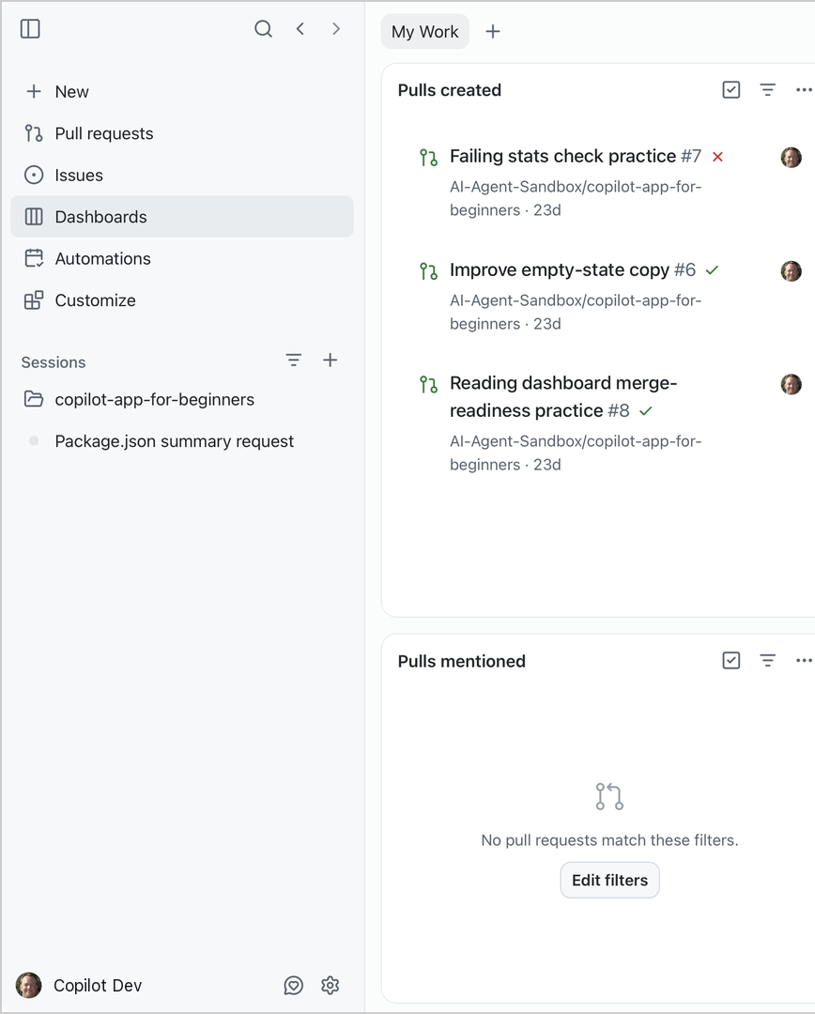





CHAPTER 01
TOUR THE APP
The sidebar views
New
Start a chat or project session.
Pull requests and Issues
GitHub work that involves you.
Dashboards
My Work widgets for GitHub work.
Automations
Tasks can run on a schedule or event.
Customize
Skills, MCP, plugins, and canvases.
Notes:
New is the landing view, where you start a chat or project session and choose a mode and model. Pull requests and Issues list GitHub work that involves you. Dashboards shows My Work widgets for pull requests and issues. Automations holds recurring agent tasks. Customize is where you manage skills, MCP servers, plugins, extensions, and canvases, which Chapters 04 to 06 cover. The Sessions area lists connected repositories and their project sessions. A Chats row appears after your first chat.

Slide 8
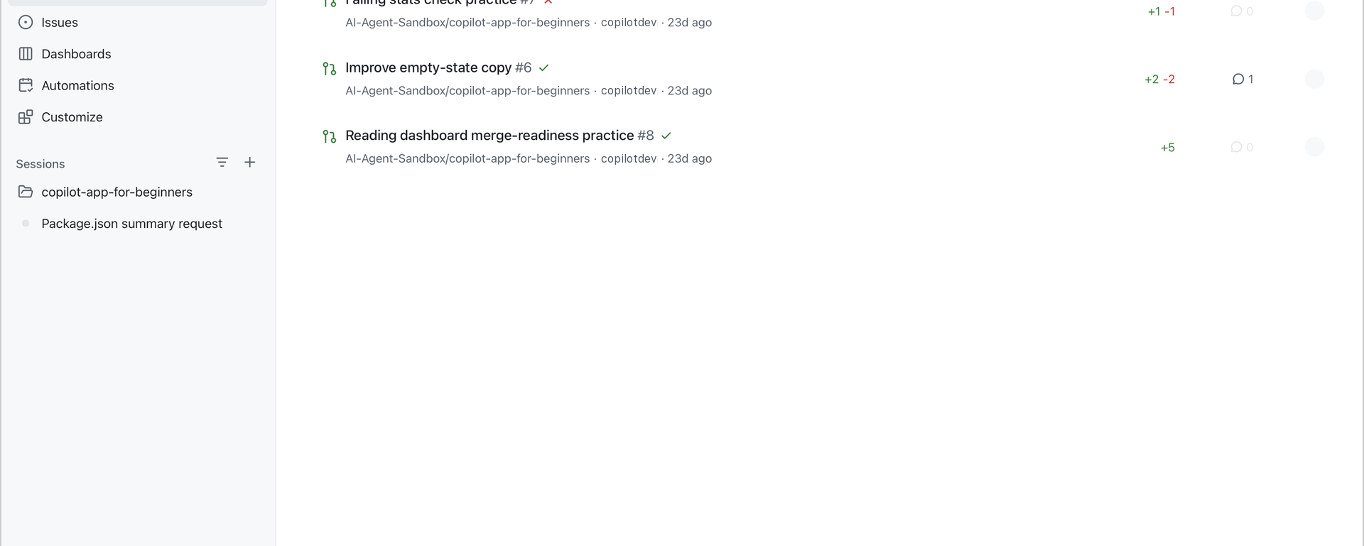
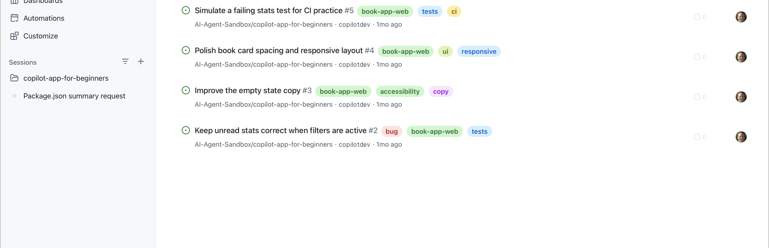


CHAPTER 01
TOUR THE APP
Your GitHub work, in two views
The practice items from setup already appear here.
Pull requests
Issues
Practice PRs: Authored by me.
Practice issues: Assigned to me.
Notes:
The Pull requests view lists GitHub pull requests that involve you. Tabs such as Authored by me and Review requests filter the list. Use the filter icon, select query mode, and enter repo:OWNER/REPOSITORY to limit results to one repository. Open a pull request to read its checks and comments, or start a session to work on it. The Issues view works the same way, with tabs such as Assigned to me and Created by me. You can start a session from an issue or create a new one.

Slide 9
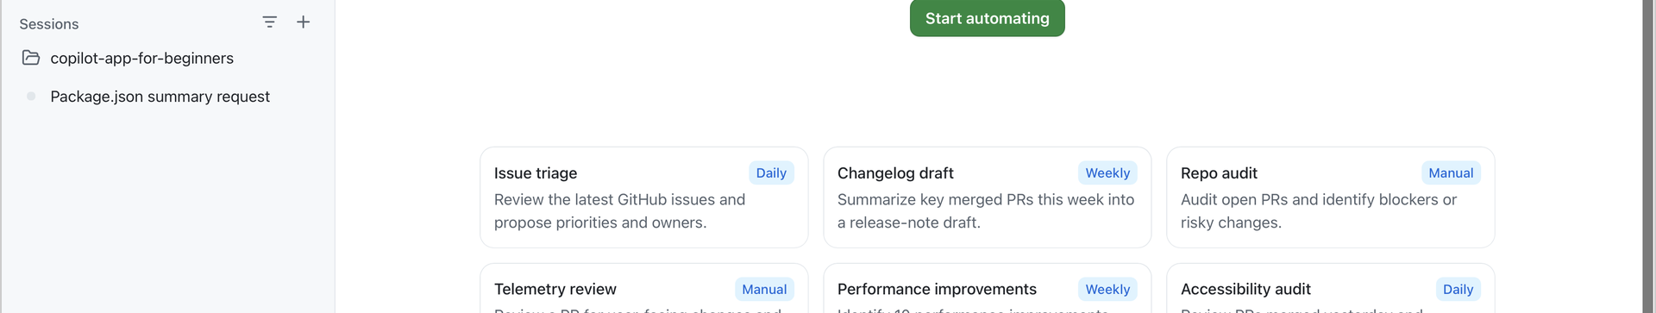


CHAPTER 01
TOUR THE APP
Automations and settings
Automations
Settings
Templates you run manually, on a schedule, or from events.
The gear icon at the bottom of the sidebar.
Notes:
The Automations view shows tasks that run manually, on a schedule, or from events, locally or in the cloud. Chapter 07 covers automations. Settings opens from the gear icon at the bottom of the sidebar. Sessions holds app-wide instructions and branch naming. Model providers add your own models and keys; they do not replace the model picker. Voice dictation is optional and turns speech into editable prompt text. Repository settings are available from the repository menu. You do not need to change anything now.

Slide 10
CHAPTER 01
SECTION 3 OF 3
Sessions, modes, and models
03
Pick the session type, mode, and model that fit the task in front of you.
Notes:
Section 3: sessions, modes, and models.

Slide 11
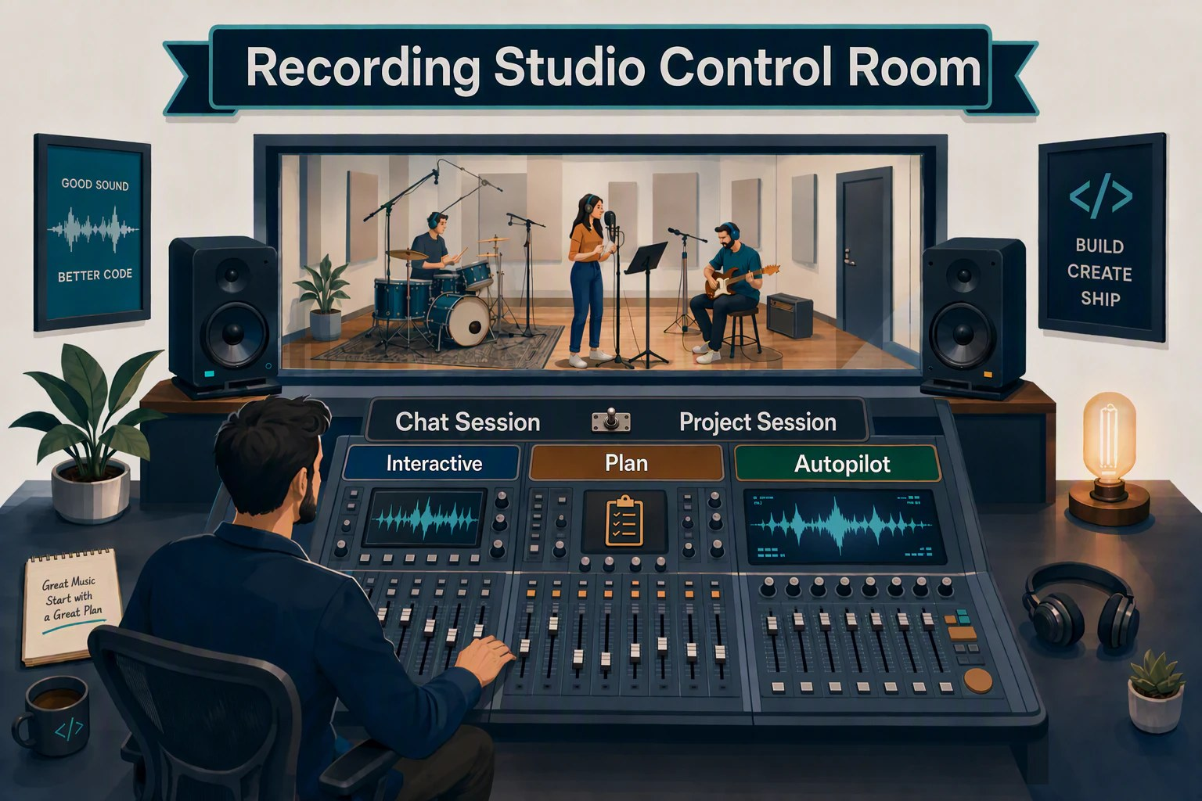




CHAPTER 01
FROM THE STUDIO
In the control room
A producer does not direct every song the same way.
Chat
A quick question.
Interactive
Direct each take.
Plan
Chart it first.
Autopilot
Hand off a clear task.
Notes:
Some quick questions just need a fast answer. Some takes need close direction. Some need the arrangement charted out first. The app works the same way: first you choose the kind of session, then a mode for how closely you direct the work.

Slide 12


CHAPTER 01
SESSIONS
Chat or project session?
Chat session
Project session
Ask, brainstorm, summarize
Plan, edit, test, and open PRs
No branch or worktree
Usually a New worktree
Start with + > Chat
Start with + on a project
PROMPT
PROMPT
Give me a beginner-friendly tour of samples/book-app-web. Do not change files.
When should I use a chat vs. a project session? Do not change files.
Notes:
Try both session types. Select the plus next to Sessions, then Chat, and confirm the project picker shows Chat. Ask when to use each session type. No branch or worktree is created. Then return to the project session from Chapter 00 and ask for a tour of the Book App. The full prompt in the chapter also asks for technologies, data flow, tests, and a reading order. The Chapter 00 session used Current checkout on purpose. The app remembers that choice, so you will switch back to New worktree in Chapter 02.

Slide 13

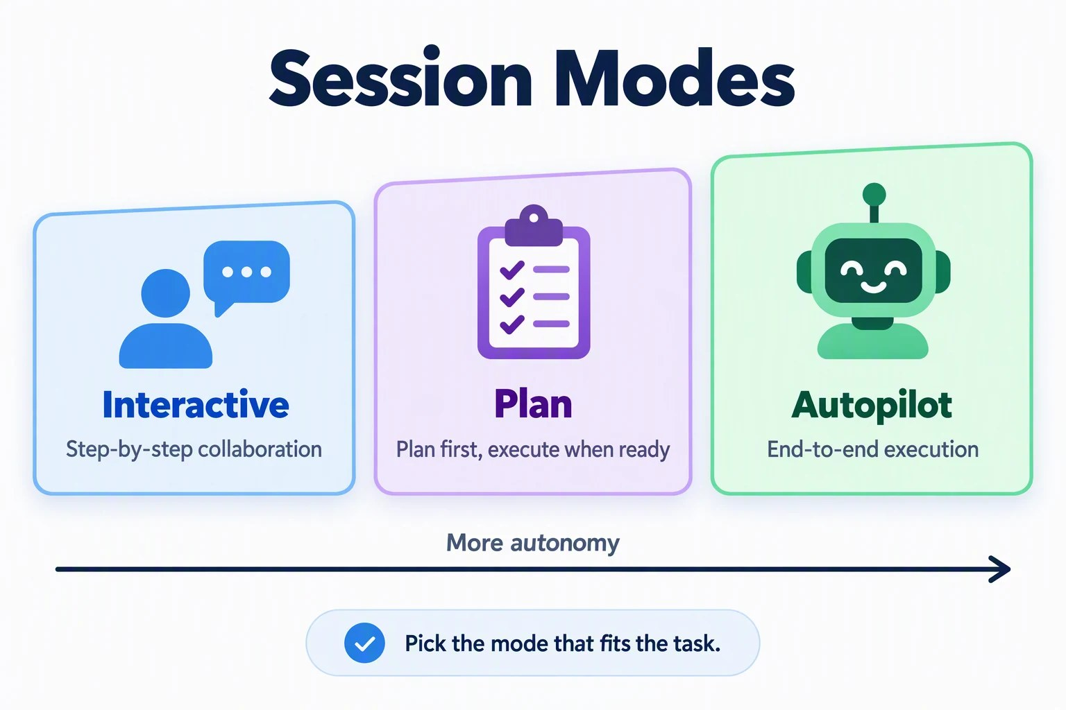



CHAPTER 01
MODES
Pick a mode for the task
Interactive
Stay involved at every step.
Plan
Approve a plan before any change.
Autopilot
Well-defined tasks, clear outcomes.
Tool permissions: when to ask first.
Notes:
Interactive is step-by-step collaboration. Plan creates a plan before executing. Autopilot is end-to-end execution without interruption. The mode menu also has Tool permissions: Always ask asks before each tool, Approve all runs tools without asking, and Assisted asks only when a tool request fails an AI safety check. Check this setting so you know when to expect approval requests.

Slide 14


CHAPTER 01
MODELS AND REASONING EFFORT
Choose how the agent thinks
Model
Speed, skill, cost
PROMPT
In samples/book-app-web, explain how filterBooks searches book titles and authors. Does letter case affect the results? Refer to the relevant file. Do not change any files.
Effort
Reasoning depth
Context window
Text it can hold
Fusion: Standard, High, Max. Autopilot is a mode.
Expected: Search ignores letter case. The answer points to src/App.tsx.
Notes:
The model control is below the prompt box, next to the mode selector. Copilot Fusion offers Standard, High, and Max effort levels. Fusion selects models for the request; it is not a single model. This differs from Autopilot, which controls how independently the agent works. Individual model choices can show Model, Effort, and Context window controls. A larger context window helps long sessions but uses more AI credits. For a tour or short explanation, keep Standard or the model default. For a hard bug or multi-file change, consider a higher effort or a stronger model; neither guarantees a correct answer.

Slide 15



CHAPTER 01
PROMPT BOX SHORTCUTS
Work faster in the prompt box
Reuse what worked, and try again without retyping.
Retry a response
Prompt history
Voice dictation
Use Retry below a response to rerun it with a different model, effort, or context window.
Press Ctrl+R (Cmd+R on macOS) to search recent prompts from all sessions and reuse one.
Speak a prompt, then edit the text before you send it. Optional.
Notes:
Three features save time in the prompt box. If a response does not work for you, select Retry below it and pick a different model, reasoning effort, or context window. You do not retype the prompt. Press Ctrl+R, or Cmd+R on macOS, to open your prompt history across all sessions. Search it and select a prompt to reuse it. Voice dictation is on by default. It turns speech into prompt text that you can edit before you send it. You can change the microphone and transcription model in Settings, Voice dictation, and the operating system must allow microphone access.

Slide 16
CHAPTER 01
KEY TAKEAWAYS
What to remember
Views: New, Pull requests, Issues, Dashboards, Automations, Customize, and Sessions.
Keep your editor for deep coding. Use the app to run and review agent work.
1
2
Chats are for exploration. Project sessions are for repository work.
Interactive, Plan, and Autopilot set how much autonomy the agent has.
3
4
REVISIT THIS CHAPTER
NEXT · CHAPTER 02
Open Chapter 01 on GitHub
Sessions, Worktrees, and Context →
Notes:
Recap the chapter. Keep the model and effort defaults for simple tasks. Next, Chapter 02 solves the shared working copy problem with isolated worktree sessions and focused context with @, #, and /.

