Slide 1



CHAPTER 02
Sessions, Worktrees, and Context
What if every task had its own workspace, branch, context, and history?
github.com/github/copilot-app-for-beginners
Notes:
Chapter 01 named the shared working copy problem. This chapter solves it. Sessions get their own branch and folder through worktrees, and you learn to give the agent focused context with @, #, and slash commands. Then you run a full session from a GitHub issue.

Slide 2

CHAPTER 02
CHAPTER 02
In this chapter
01
Worktrees keep work apart
Give every task its own folder and branch, so parallel work never collides.
02
Give Copilot focused context
Attach exactly what the task needs. Less is often more.
03
From issue to verified fix
Start from a practice branch, attach the issue, plan, then verify the fix.
Notes:
This chapter has 3 parts: Worktrees keep work apart, Give Copilot focused context, From issue to verified fix.

Slide 3
CHAPTER 02
SECTION 1 OF 3
Worktrees keep work apart
01
Give every task its own folder and branch, so parallel work never collides.
Notes:
Section 1: worktrees.

Slide 4
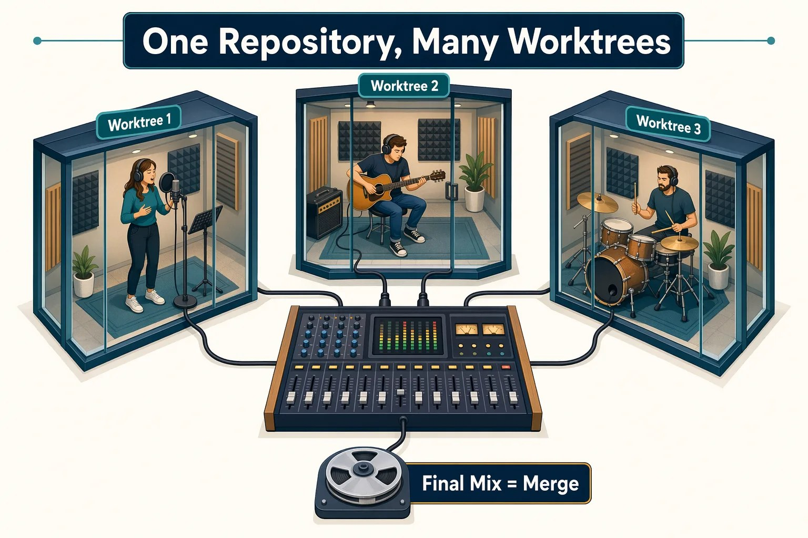



CHAPTER 02
FROM THE STUDIO
One studio, many recording booths
You would not crowd three musicians around one microphone.
Same song
Every booth records for one repository.
Own booth
Each worktree has its own folder and branch.
Mix later
Combine the takes through a merge.
Notes:
Picture one song that three musicians record at the same time. Each gets a soundproof booth, and you mix the takes later. Each track can be edited separately. A worktree is that booth: same repository, its own folder and branch, so parallel work does not collide.

Slide 5
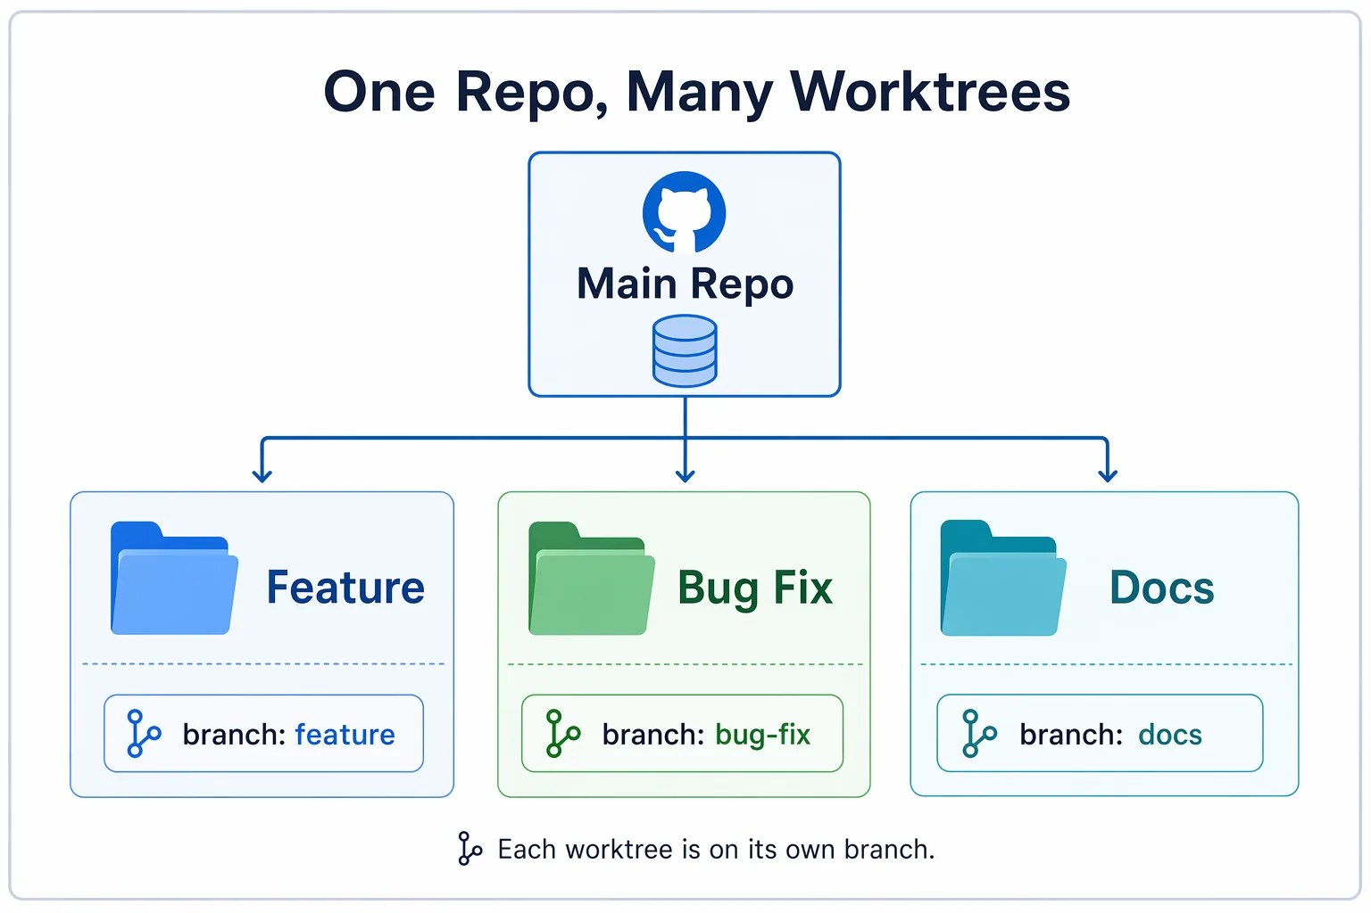
CHAPTER 02
CORE CONCEPT
What is a Git worktree?
An extra working folder for the same repository, on its own branch.
WITHOUT ISOLATION
WITH A WORKTREE
Each task has its own folder
Tasks share one folder
Branch state is easy to lose
The branch shows in the app
Diffs stay with the session
Diffs mix together
Notes:
A Git worktree is an additional working directory for the same repository, usually checked out to a different branch. You can work on several tasks without stashing changes or switching branches in one folder. The app uses worktrees so each session has its own folder, its branch is visible, and its diff stays tied to that session. That is what lets several sessions run in parallel. In this chapter, work through one session at a time.

Slide 6
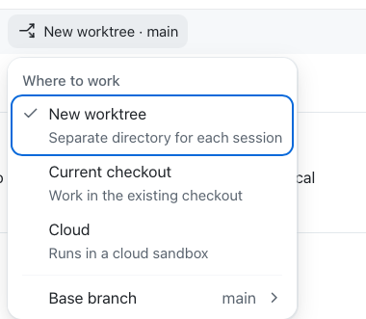




CHAPTER 02
WHERE A SESSION RUNS
Choose speed or isolation
The workspace selector below the prompt box decides.
New worktree
Own folder and branch. Course default.
Current checkout
Your clone. Fast, not isolated.
Cloud
A GitHub-hosted sandbox.
Switch back to New worktree now.
Notes:
Three choices. New worktree gives the session its own folder and branch beside your clone; it is the safe default this course uses. Current checkout works directly in your clone. Cloud runs in a GitHub-hosted sandbox and is in public preview. The menu also has Base branch, the branch a new worktree starts from. The app remembers your last choice, and you chose Current checkout in Chapter 00, so point to the project, select plus, and choose New worktree now. Sessions started with Create from always get a new worktree. Worktrees only separate files and branches, not ports, databases, or background processes. Two dev servers on the same port still collide, so use 5174 for a second preview.

Slide 7
CHAPTER 02
SECTION 2 OF 3
Give Copilot focused context
02
Attach exactly what the task needs. Less is often more.
Notes:
Section 2: context. Isolation is half of a good session. The other half is giving the agent the right files, issues, and commands.

Slide 8

CHAPTER 02
CONTEXT SYNTAX
Four keys attach context
Type one in the prompt box, then pick from the list.
@
#
/
&
Slash commands
Files or folders
Issues or PRs
Other sessions
@samples/book-app-web/src
/chronicle standup
& then pick one
#3
You can also drag files from your computer onto a session in the sidebar to attach them.
Notes:
The at sign attaches files or folders. The hash attaches issues or pull requests. The slash runs commands and skills. The ampersand references another session when the prompt box offers it. You can also drag files from your computer and drop them onto a session or agent in the sidebar; this is useful for files that are not in the repository. Give the smallest amount of useful context. Type slash to see what your app supports; commands vary by version, plugins, skills, and policy. You will use rubber-duck in Chapter 03, agent and skills in Chapter 04, and create-canvas in Chapter 06.

Slide 9
CHAPTER 02
SLASH COMMANDS
Type / to discover more
Commands vary by app version, plugins, skills, and policy.
/chronicle
Recap your recent work
/rubber-duck
Critique a plan or diff
/orchestrate
Delegate to child sessions
/context
Tokens, context, spend
/agent
Switch custom agents
/review
Review this session
/research
Write a cited report
/create-canvas
Build a shared board
Notes:
Slash commands are shortcuts in the prompt box. This chapter uses chronicle and context. Others appear later in the course: rubber-duck in Chapter 03, agent and skills in Chapter 04, and create-canvas in Chapter 06. Review reviews the changes in the current session. Research produces a cited report. Orchestrate coordinates work across several sessions or repositories by delegating to child sessions. Usage shows usage and rate limits. An installed skill can also run as its own command, such as book-app-reviewer. Type a slash to see what your app supports.

Slide 10
CHAPTER 02
SECTION 3 OF 3
From issue to verified fix
03
Start from a practice branch, attach the issue, plan, then verify the fix.
Notes:
Section 3: put isolation and context together. The practice branch has a less helpful empty-state message on purpose.

Slide 11
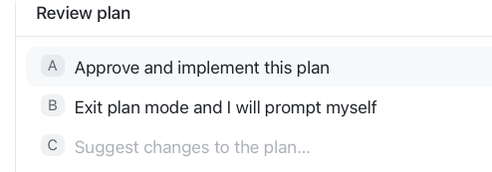
CHAPTER 02
EXERCISE
Plan a fix from issue #3
Start from the practice-empty-state-copy branch.
1
Create from the branch
Create from > Branches.
2
Attach it in Plan mode
Type #3, then ask for a plan.
3
Review the plan
Choose Exit plan mode.
Notes:
Point to the project in the sidebar and select the Create from icon that appears. On the Branches tab, pick practice-empty-state-copy; the app starts a new worktree session. Set Plan mode, type hash 3 and pick Improve the empty state copy, then add: Investigate the issue and create a plan to address it. Copilot may ask a short scope question first; pick the recommended answer. The plan opens in the Plan tab, and a Review plan box replaces the prompt box. Choose Exit plan mode and I will prompt myself. The session returns to Interactive so you can capture a baseline before any change.

Slide 12
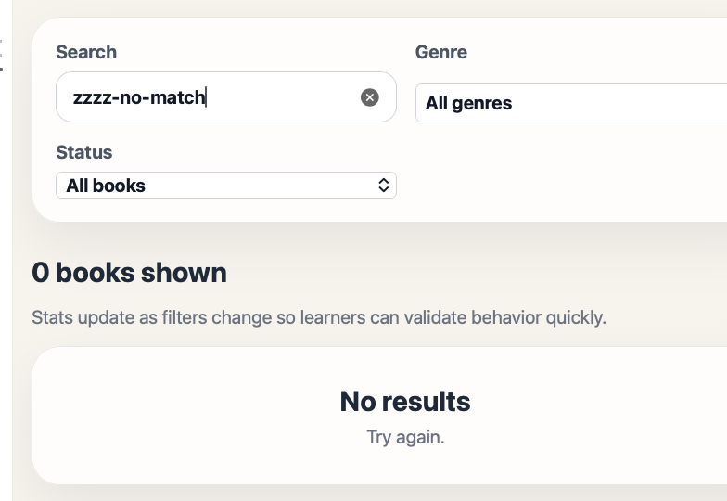
CHAPTER 02
EXERCISE
Capture a baseline, then compare
Know the current behavior before you change it.
BEFORE: ZZZZ-NO-MATCH
1
Run the app and search
Only No results. Try again.
2
Send Implement the plan
Inspect the Changes tab.
3
Reload and search again
Now it suggests a new search, genre, or status.
Notes:
Ask Copilot to run the Book App and open the preview. Search for hobbit and confirm The Hobbit appears. Then search for zzzz-no-match. The baseline says No results and Try again, which does not tell anyone what to do. Send Implement the plan; the plan checklist updates as Copilot works. Inspect the diff in the Changes tab. Reload and search again: the message should suggest changing the search term, genre, or reading status.

Slide 13
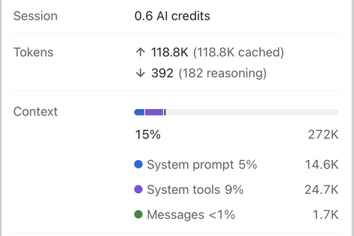
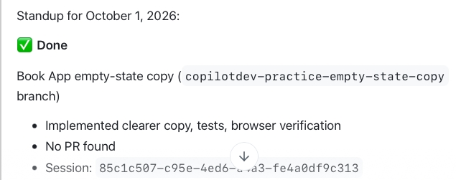
CHAPTER 02
INSPECT THE SESSION
Ask the session what it did
/chronicle standup recaps your last day.
/context opens usage details.
Notes:
Run chronicle standup to review your recent work. Then run /context. It opens the usage popup below the prompt box. Expand Context to see how the current context window is used. The popup also shows plan usage, session AI credits, and token totals. The session's working branch, base branch, Remote control, path, project, name, and ID are available by selecting the session name at the top of the app. /context does not show those session details. Use it after at least one prompt, and check it before adding more context to a busy session. This practice branch has an intentional regression and main is already correct, so there is no pull request. Ask Copilot to stop the dev server.

Slide 14

CHAPTER 02
YOUR TURN
Add a light and dark theme
Use @ to attach the code this time. Keep the work in its worktree.
Create from main. Check usage with /context.
1
Start from main
Success
You can name the branch, the context you attached, and your evidence. main does not change.
Plan with @src
Accessible toggle, readable in both themes.
2
Implement and inspect
Check the diff and both themes.
3
Tests, build, then /chronicle standup.
4
Validate and recap
Notes:
The assignment repeats the workflow with a new feature: a light and dark theme toggle. Start a new worktree session from main and inspect the session name and /context usage popup. Preview the app and confirm it only has a light theme. In Plan mode, attach samples/book-app-web/src with the at sign and ask for a small plan. Implement, inspect the diff, and try hobbit and zzzz-no-match in both themes. Run the tests and build, compare the chronicle standup with what you saw, and stop the dev server.

Slide 15
CHAPTER 02
KEY TAKEAWAYS
What to remember
Worktrees keep each session's changes away from your main checkout.
They isolate files and branches, not ports or databases.
1
2
Use @, #, and / to attach only the context that helps.
Capture a baseline before a change, then compare against it.
3
4
REVISIT THIS CHAPTER
NEXT · CHAPTER 03
Open Chapter 02 on GitHub
Development and GitHub Workflows →
Notes:
Recap. Sessions are focused agent workspaces, and chronicle and context show what a session did and what it holds. Next, Chapter 03 uses isolated sessions for real development: the inner loop of review, test, and preview, and the outer loop of issues, pull requests, review comments, and checks.

