Slide 1



CHAPTER 04
Skills and Custom Agents
What if you could reuse your review checklist instead of typing the same reminders for each task?
github.com/github/copilot-app-for-beginners
Notes:
Chapter 03 connected a change to its diff, tests, preview, and pull request. This chapter makes that workflow reusable. A skill stores review guidance. A custom agent defines a role and the tools it may use.

Slide 2

CHAPTER 04
CHAPTER 04
In this chapter
01
Skills save your checklist
Store a review checklist once, then apply it every time the task comes up.
02
Custom agents define a role
Give a specialist a clear role and only the tools that role needs.
Notes:
This chapter has 2 parts: Skills save your checklist, Custom agents define a role.

Slide 3
CHAPTER 04
CHOOSE THE RIGHT FEATURE
Prompt, rules, workflow, or role?
You do not need an agent for every skill, or a skill for every prompt.
FEATURE
LIVES IN
APPLIES
One-off prompt
The current conversation
When you send it
Instructions
copilot-instructions.md
Every task in the project
skills/<name>/SKILL.md
When the task matches, or you invoke it
Skill
Custom agent
agents/<name>.agent.md
When you select it with /agent
Notes:
Four options. A one-off prompt applies once. Repository instructions in .github/copilot-instructions.md are house rules for every task in the project. A skill in .github/skills is guidance for one repeated task, such as a review checklist. A custom agent in .github/agents is a named role with instructions and a limited set of tools, such as a read-only explainer. Find skills in the Customize view. Select custom agents with slash agent or the agent picker.

Slide 4
CHAPTER 04
SECTION 1 OF 2
Skills save your checklist
01
Store a review checklist once, then apply it every time the task comes up.
Notes:
Section 1: skills.

Slide 5
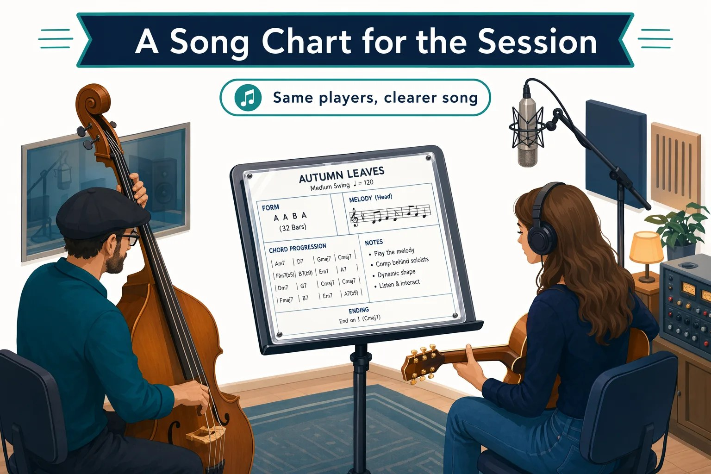



CHAPTER 04
FROM THE STUDIO
A song chart for the session
The players know their instruments. The chart keeps this song consistent.
A skill is the chart
Instructions for a repeated task.
An agent is the specialist
A role with the right tools.
You still listen back
A chart does not guarantee a good take.
Notes:
The players already know their instruments. The bandleader still hands out a chart so everyone plays this song the same way. A skill is that chart. A custom agent is the specialist who follows it. You still check the result.

Slide 6
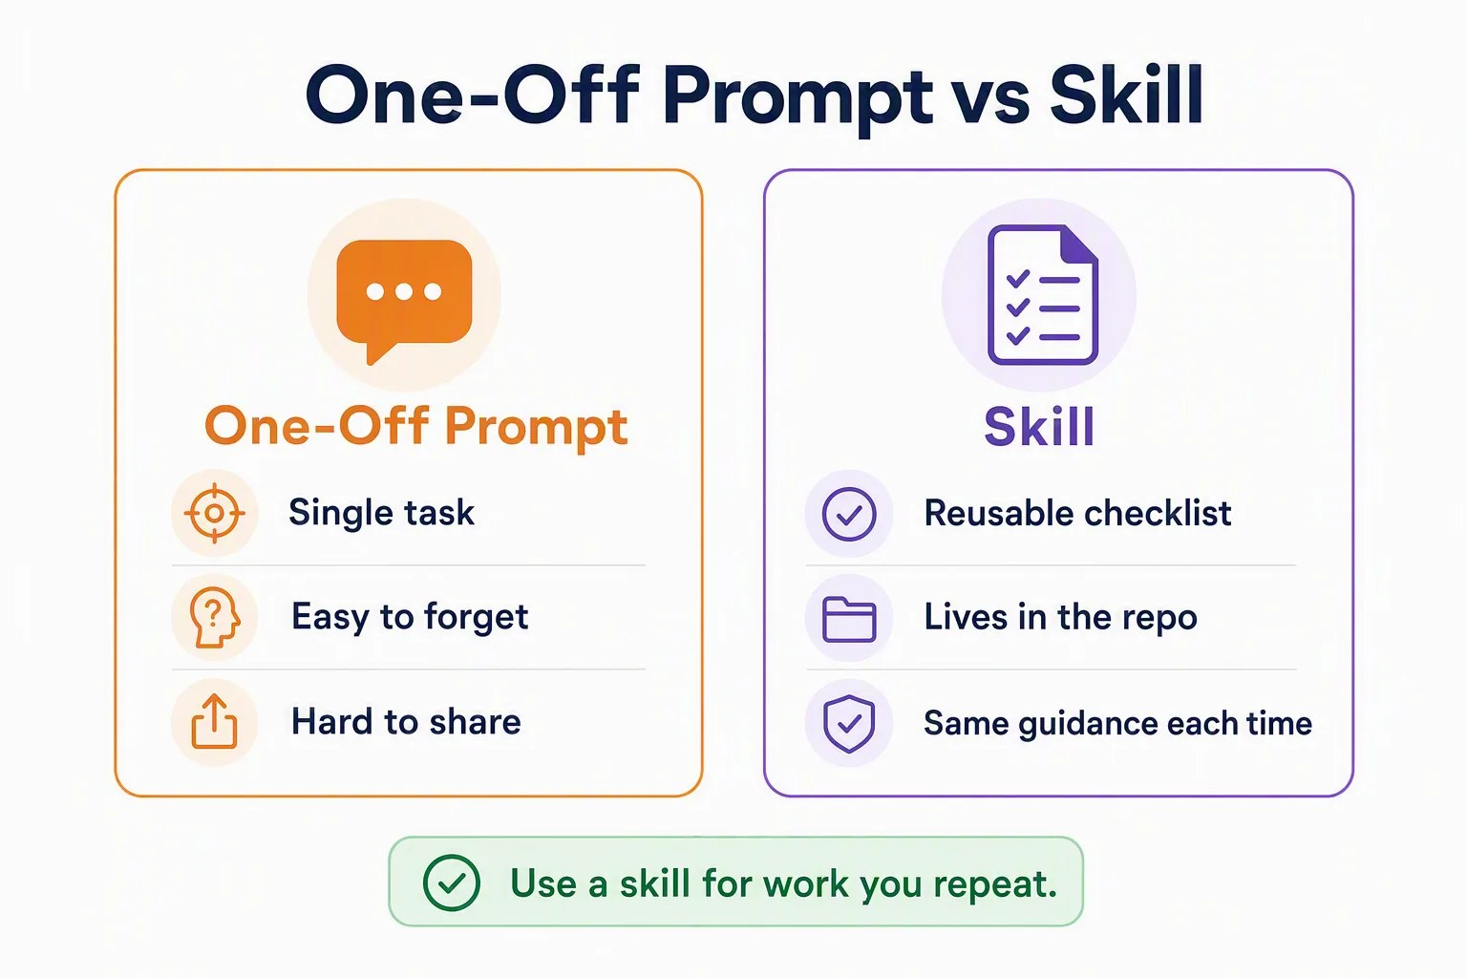


CHAPTER 04
WHY A SKILL
Use a skill for work you repeat
A one-off prompt
Helps once, then you retype it.
A skill
Lives in the repo. Same guidance every time.
Shared through Git
Your whole team gets the checklist.
Notes:
Instructions are the house rules. A skill is the chart for one kind of song. Use a skill when you repeat the same kind of work. A one-off prompt is easy to forget and hard to share. A skill is a reusable checklist that lives in the repository and gives the same guidance each time. Repository skills are shared through Git; personal skills apply across projects on your machine.

Slide 7



CHAPTER 04
ANATOMY OF A SKILL
A folder with a SKILL.md file
The course includes .github/skills/book-app-reviewer/.
SKILL.md
---
Frontmatter
name: book-app-reviewer
The description tells the app when to load it.
description: Review changes in
samples/book-app-web for
accessibility, layout, tests,
Instructions
and small changes.
The checklist the agent follows.
---
# Review focus
A skill guides. It does not stop editing. Read unfamiliar skills first.
​- Stack, tests, and build
​- Accessibility
​- Responsive layout
Notes:
A skill is a folder with a SKILL.md file. The block between the dashes is YAML frontmatter. Keep each description line indented under its key so the YAML remains valid. The description matters: it tells the app when to load the skill. Below it is the Markdown checklist. Repository skills are shared through Git; personal skills apply across your projects. A skill is guidance, not a permission boundary. Review without editing does not disable editing tools. Skills can also include scripts or tell Copilot to use tools, so read unfamiliar skills before you enable them.

Slide 8
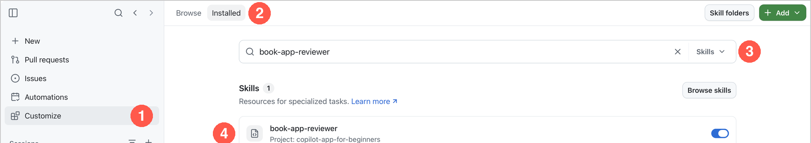
CHAPTER 04
EXERCISE
Update the skill, then use it
1
Find and check it
Customize > Installed > Skills.
2
Append two rules
Heading structure and text alternatives.
3
Reload
Check Changes, then /skills reload.
4
Review in Plan mode
Confirm the skill loaded in the activity.
Notes:
Work in a new worktree session from main in Interactive mode. In Customize, open Installed, select the Skills type filter, and search for book-app-reviewer; confirm it is enabled. Use the type and scope filters to find repository skills. Ask Copilot to explain the frontmatter, then append two rules: headings describe page structure, and informative images and icons have text alternatives. Edit only SKILL.md. Reload skills, switch to Plan mode, and ask for a review of samples/book-app-web/src that applies the new rules and proposes at most one improvement. Expand the activity to confirm the skill loaded.

Slide 9




CHAPTER 04
CHECK THE RESULT
What a good review points to
Your new heading rule should find a real issue in the code.
Heading levels today
A move to h3 must also update the .book-card h2 CSS.
h1
Page title
h2
Results heading
The plan must not claim tests passed. It only read code.
h2
Book titles (same level)
h3
Book titles (likely fix)
Check the activity, not only the answer.
Notes:
In the original sample, the book titles and the results heading both use h2. A good review applies the heading rule and may propose h3 for book titles. If so, it must account for the book-card h2 CSS selector. It must not claim that any tests ran. The skill should appear in the slash menu as book-app-reviewer. A general prompt can also load a matching skill, so check the activity rather than the wording.

Slide 10
CHAPTER 04
SECTION 2 OF 2
Custom agents define a role
02
Give a specialist a clear role and only the tools that role needs.
Notes:
Section 2: custom agents.

Slide 11
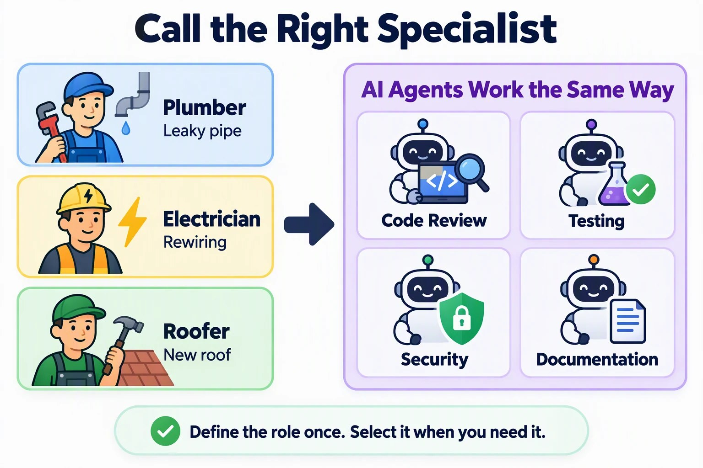


CHAPTER 04
FROM THE STUDIO
Hire the right specialist
You call a plumber for a leak, not an electrician.
A defined role
Review, testing, security, or docs.
The right tools
Only what that job requires.
Clear instructions
Defined once, used every time.
Notes:
For house repairs you choose a specialist based on the job: a plumber, an electrician, or a roofer. Each knows the requirements and brings the right tools. Custom agents apply the same idea to code review, testing, security, and documentation. A custom agent is not a different mode or necessarily a different model.

Slide 12



CHAPTER 04
ANATOMY OF A CUSTOM AGENT
A read-only Book App explainer
Like a skill, plus a tools list.
book-app-explainer.agent.md
---
name and description
name: book-app-explainer
Shown in the agent picker.
description: Explain the Book App
to a beginner without changing
tools
files.
tools: ["read", "search"]
read and search only. No edits.
---
Read the code before answering.
Body
Do not edit files or run commands.
Behavior and answer format.
Answer in four parts.
Notes:
Ask Copilot to create .github/agents/book-app-explainer.agent.md with the exact Markdown from the chapter, and to stop if the file already exists. Inspect it in Changes and confirm tools contains only read and search. Keep the description as a valid, indented YAML value if it wraps across lines. The name identifies it in the agent picker. The description states its purpose. The body defines behavior and a four-part answer format: what it does, how the data moves, one small example, and what the tests cover plus one manual check.

Slide 13
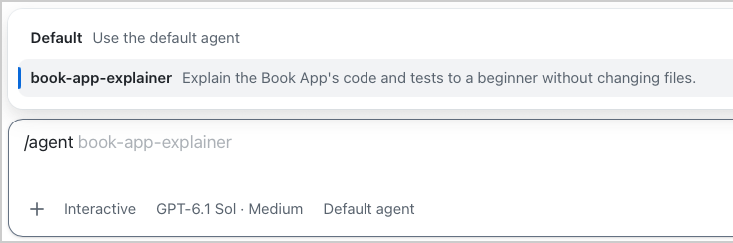
CHAPTER 04
EXERCISE
Load the agent, then ask it to explain
The app loads custom agents when it starts.
1
Quit and reopen
2
Select the agent
3
Ask it to explain
Closing the window is not enough.
Send /agent book-app-explainer.
How stats follow the Unread filter.
Notes:
The app loads custom agents when it starts. Wait for active work in all sessions to finish, quit the GitHub Copilot app, open it again, and select this chapter's session. Closing the window is not the same as quitting. Then type slash agent and select book-app-explainer, and send the command. The screenshot shows the list before sending, so it still says Default agent; after sending, the live picker should show book-app-explainer. Ask it to explain how App.tsx keeps statistics aligned with filtered books, following its four-part format. A good answer traces filters through filterBooks to filteredBooks, and shows how that list reaches ReadingStats and the book cards. It separates test coverage from a manual check. No files change. Return to the default agent before the assignment.

Slide 14


CHAPTER 04
LEAST PRIVILEGE
Give the agent only what it needs
tools is the real limit
No list means all tools
Switch agents
read and search cannot edit files or run tests.
Always name the tools a role needs.
Use the default agent to run tests.
Notes:
The tools list is the real limit. The skill said review without editing, but only the agent tool list actually removes editing. Omitting the list allows all available tools. Instructions like only work in this folder guide the agent but are not a file-system sandbox. When you need to run tests, switch back to the default agent rather than widening the explainer.

Slide 15

CHAPTER 04
YOUR TURN
One skill-guided change, fully validated
Same worktree, default agent.
Use /book-app-reviewer.
1
Plan with the skill
Success
One focused change, passing checks, and you can explain instructions vs. skill vs. agent.
2
Record a baseline
Tests and build pass first.
Implement and validate
Exit plan mode. Diff, tests, build, browser.
3
4
Save a record
Only the checks you ran.
Notes:
Use the skill heading recommendation, or a focused test for the heading structure if no change was needed. Plan with the skill, record a baseline, implement only that change, and validate it with tests, build, and the browser at desktop and narrow widths. Ask Copilot to inspect the rendered heading levels, because appearance alone does not show structure. Finally, ask the default agent to write samples/book-app-web/docs/chapter-04-review.md, marking any check you did not run.

Slide 16
CHAPTER 04
KEY TAKEAWAYS
What to remember
Instructions are shared rules. Skills are reusable guidance for one task.
A custom agent is a specialist role with its own tools.
1
2
Skills guide. The agent tools list is what limits actions.
Check the activity and the files, not only the agent's claims.
3
4
REVISIT THIS CHAPTER
NEXT · CHAPTER 05
Open Chapter 04 on GitHub
MCP Servers and Plugins →
Notes:
Skills and custom agents customize how the app works with your project. Match an agent's tools to its task. Next, Chapter 05 extends what the app can access: an MCP server for documentation and a plugin that supplies a skill.

