Slide 1



CHAPTER 07
Automations
What if a prompt you run every morning could run itself?
github.com/github/copilot-app-for-beginners
Notes:
Chapter 06 made session work visible. This chapter makes repeatable work reusable. You start with a manual review readiness report, schedule it for every morning, and then look at event triggers and cloud automations.

Slide 2

CHAPTER 07
CHAPTER 07
In this chapter
01
Anatomy of an automation
Every automation is a saved prompt with a trigger, tools, and a place to review it.
02
Build a review readiness report
Which PRs are ready to merge, and what is blocking the rest?
03
Events and cloud
Optional. React to repository events, or run while your laptop is closed.
Notes:
This chapter has 3 parts: Anatomy of an automation, Build a review readiness report, Events and cloud.

Slide 3
CHAPTER 07
SECTION 1 OF 3
Anatomy of an automation
01
Every automation is a saved prompt with a trigger, tools, and a place to review it.
Notes:
Section 1: what an automation is made of.

Slide 4
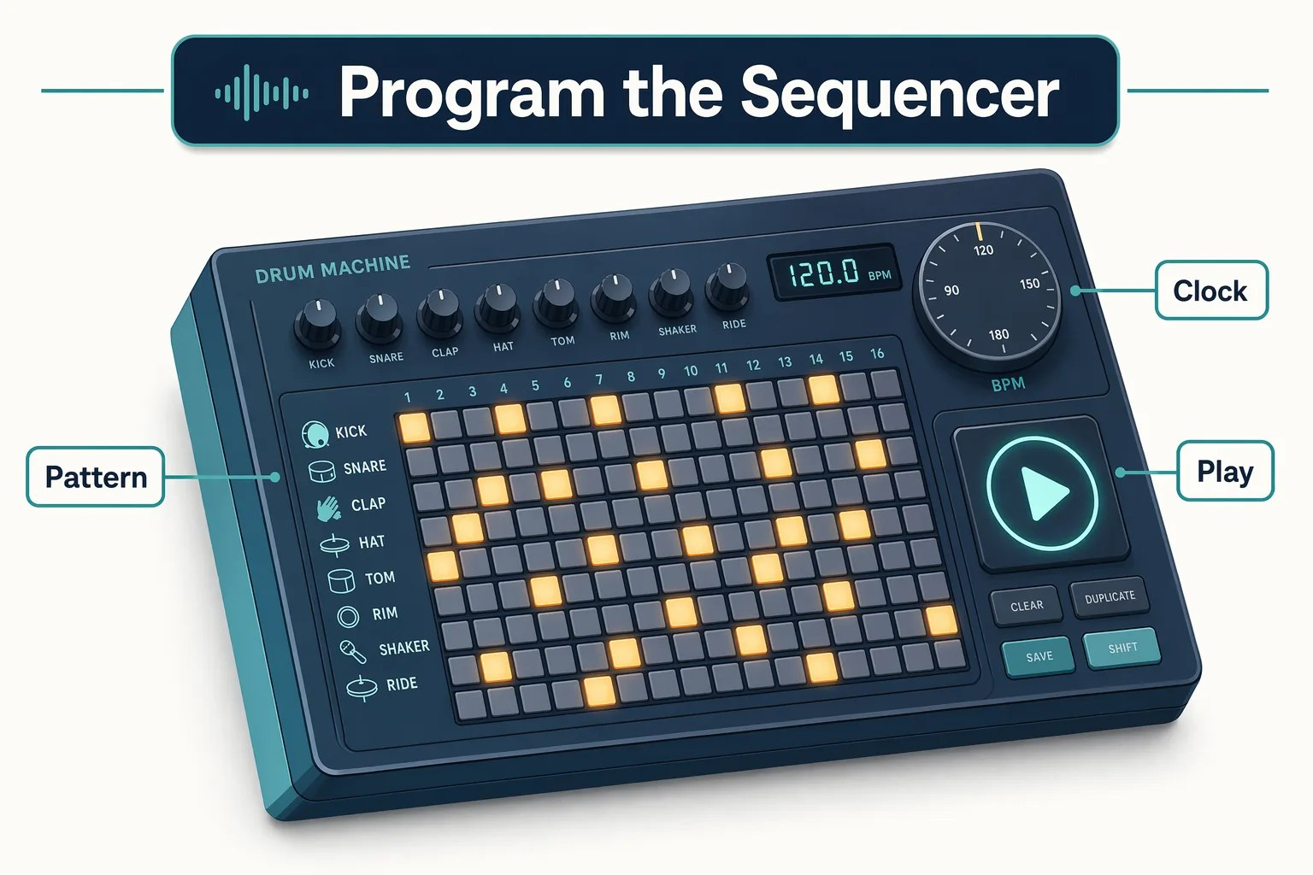
CHAPTER 07
FROM THE STUDIO
Programming the sequencer
Program the pattern once. Press play when you need it.
SEQUENCER
AUTOMATION
Programmed pattern
Saved prompt
Hit play
Manual trigger
Run on the clock
Schedule
Check the mix
Review the result
Notes:
A producer does not replay the same drum pattern by hand every night. They program it into a sequencer once and let it run. Chosen instruments map to selected tools. And the producer still checks the mix: a human reviews the result.

Slide 5
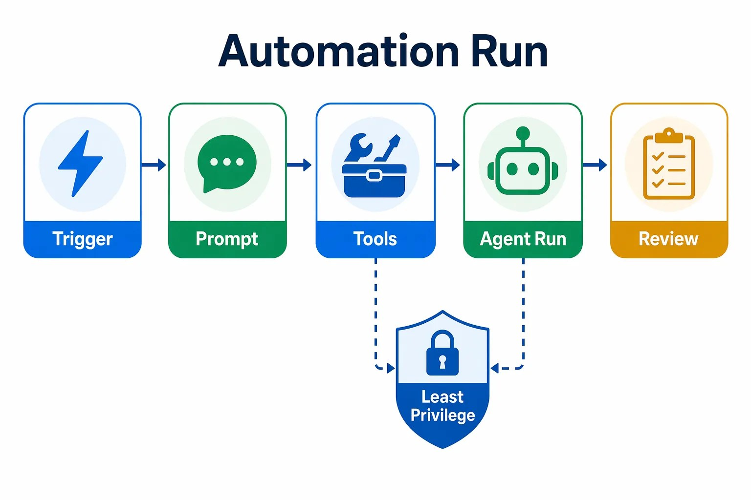




CHAPTER 07
CORE CONCEPT
Four parts of an automation
Trigger
What starts it?
Prompt
What should the agent do?
Tools
What is the least access needed?
Review path
Where do I check the result?
Notes:
Every automation has four parts: a trigger that starts it, a prompt that says what to do, tools that grant the least access needed, and a review path where you inspect the result. Automations are saved in the app, not committed to the repository. Treat the prompt like production instructions: keep secrets out and give it only the tools it needs.

Slide 6
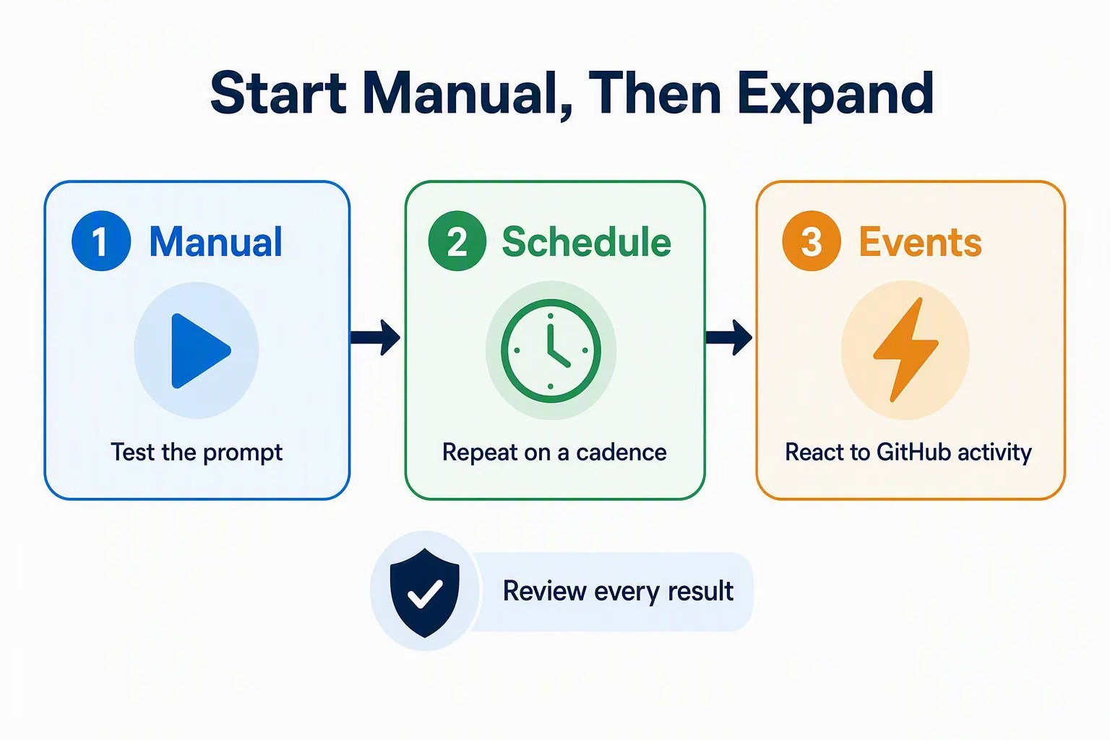


CHAPTER 07
START SAFE
Start manual, then expand
Test the prompt before you add a schedule or trigger.
Good first automation
A read-only report you already run by hand.
Avoid at first
Writing code, commenting, labeling, or merging.
Notes:
Manual automations run only when you choose. That lets you test the prompt, inspect output, adjust scope, avoid surprise runs, and confirm tools are minimal. Good starters: which pull requests are blocked and what do they need next, or what should I validate before opening a PR. Avoid first automations that write code, post comments, change labels, approve reviews, or merge. Issue text is untrusted input, and a read-only summary reduces prompt-injection risk, where hostile text tries to steer the agent.

Slide 7
CHAPTER 07
SECTION 2 OF 3
Build a review readiness report
02
Which PRs are ready to merge, and what is blocking the rest?
Notes:
Section 2: The Pull requests view lists open pull requests. It does not explain merge readiness across them. This automation adds that analysis.

Slide 8
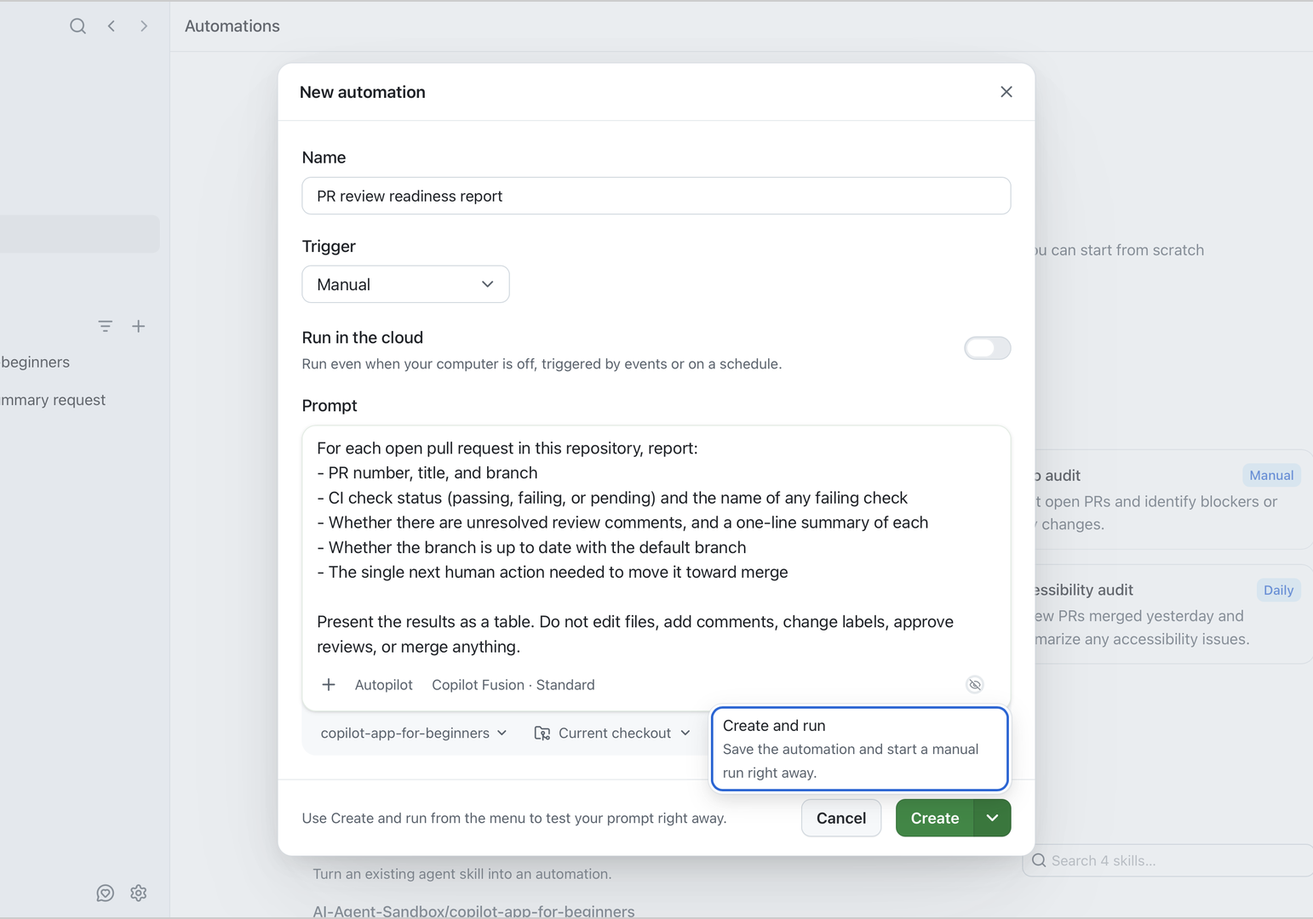
CHAPTER 07
EXERCISE
Create a manual readiness report
Automations > New automation. Set Trigger to Manual.
1
Name it
PR review readiness report
2
Paste the read-only prompt
CI, comments, and the next action per PR.
3
Cloud off, Current checkout
Runs locally. It only reads data.
4
Create and run
From the arrow next to Create.
Notes:
Before you start, select Pull requests and your fork. On Authored by me, you should see practice PRs. Open Automations, select New automation, name it PR review readiness report, change Trigger from Daily to Manual, make sure Run in the cloud is off so it runs locally, and paste the full prompt from the chapter. Use Select repository to pick your copilot-app-for-beginners fork, then set Workspace to Current checkout because the report only reads data. Use the arrow next to Create and choose Create and run. It appears under Your automations with a Manual label, and the run appears under Recent runs.

Slide 9
CHAPTER 07
INSPECT THE RUN
Why each PR is blocked
Your PR numbers, titles, and statuses may differ.
PULL REQUEST
CI
NEXT HUMAN ACTION
#6 Improve empty-state copy
Pass
Address the review comment
#7 Failing stats check practice
Fail
Fix the favorite count
#8 Reading dashboard
Pass
Ready to merge
Notes:
Wait for the run to succeed, then open the run detail. Confirm the prompt matches what you pasted, there is no error text, and the result is a table of open pull requests. This is a representative result from the seeded PRs. The value is the analysis: unlike the Pull requests view, which lists open items, this report explains why each PR is blocked and the single next human action. Because the prompt is read-only, the risk stays low.

Slide 10
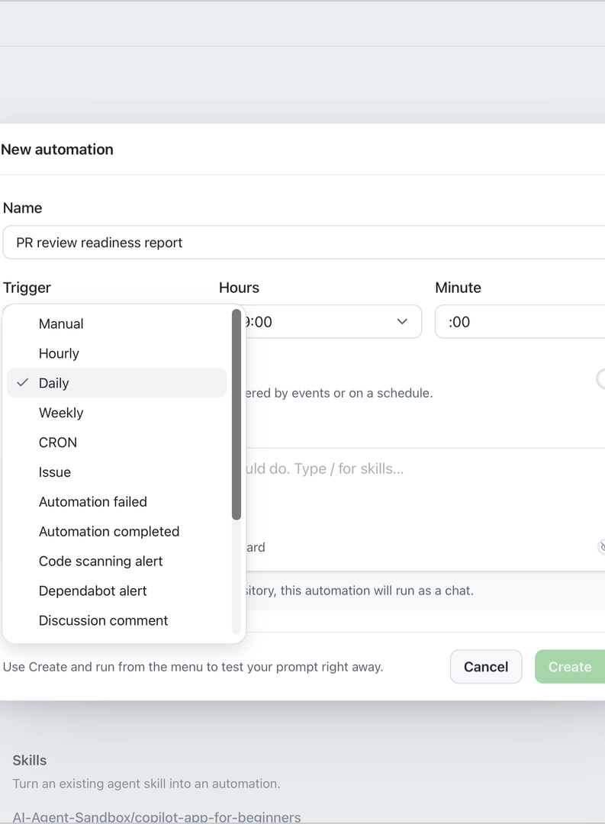
CHAPTER 07
EXERCISE
Schedule it for every morning
Manual: "What is the status now?"
Daily: "What changed since yesterday?"
1
Edit the trigger
Manual to Daily, at 08:00.
2
Keep the app running
Local runs need the app open and awake.
3
Check Recent runs
A new run appears without pressing Run.
Notes:
A manual automation answers what is the status right now. A scheduled one answers what changed since yesterday. This automation is local, so it runs only when your computer is awake and the app is running. Open it, select Edit, change the trigger to Daily, and choose 08:00 in Hours. Hours can have more than one time selected. Clear any other selected hours, including the default 09:00, so only 08:00 remains. Keep Minute at 00, confirm the repository, and save. Check the Daily label, schedule, and Next run time. The app also supports Hourly, Weekly, and CRON.

Slide 11
CHAPTER 07
SECTION 3 OF 3
Events and cloud
03
Optional. React to repository events, or run while your laptop is closed.
Notes:
Section 3 is optional and covers more advanced options. Both need extra care.

Slide 12

CHAPTER 07
EVENT TRIGGERS
React to repository activity, safely
Issue, PR, discussion, alert, workflow, or automation events can start a run.
1
Start read-only
Summaries, not edits.
One repository
Never every repo you can access.
2
Hostile issue text plus write tools raises prompt-injection risk.
3
Filter narrowly
By label or search query.
4
Hold write tools
Until several runs look right.
Notes:
The current Trigger menu includes Issue, Automation failed, Automation completed, Code scanning alert, Dependabot alert, Discussion comment, Discussion opened, Discussion updated, Pull request, Secret scanning alert, Sub issue added, and Workflow. Schedule choices include Hourly, Daily, Weekly, and CRON. The menu is longer than its window, so scroll to see every choice. Event triggers react to external input. Keep them read-only, scope them to one repository, and filter by label or query. Avoid write tools until the summary is reliable, and review the run history regularly.

Slide 13

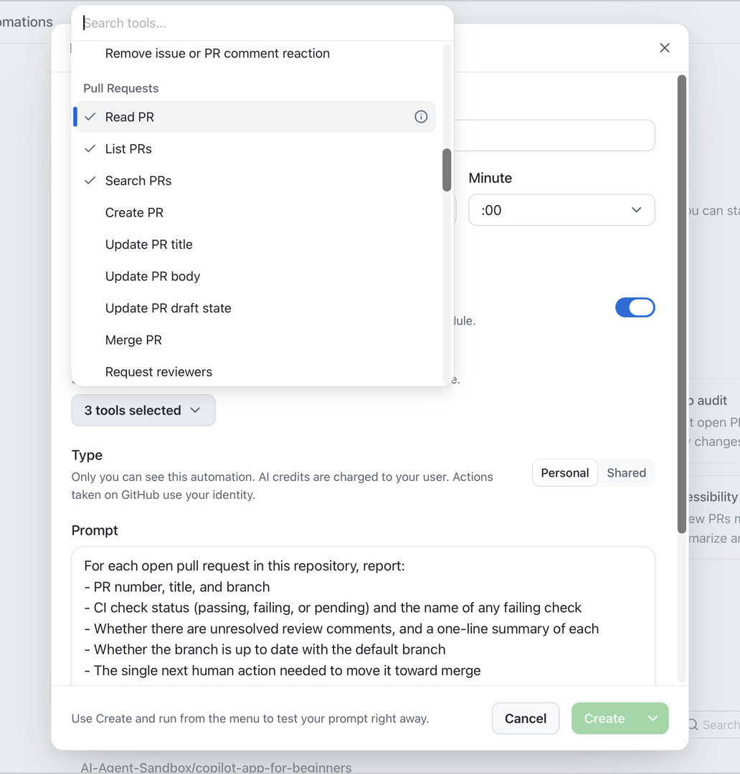
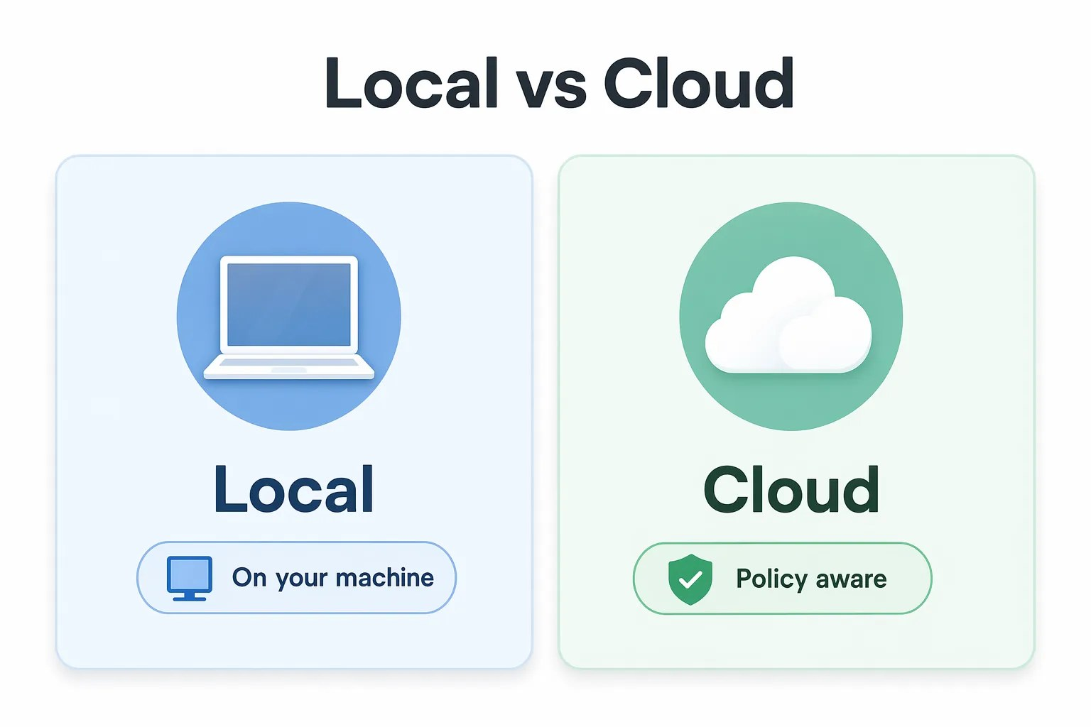

CHAPTER 07
LOCAL OR CLOUD
Move to the cloud only when it is proven
Cloud runs on GitHub even when your laptop is closed.
Cloud needs
Cloud agent enabled
A private or internal repo
Actions minutes and AI credits
Select only the tools the task needs.
Notes:
Every automation so far is local: it runs from your machine while the app is open. A cloud automation runs on GitHub-hosted infrastructure. It needs Copilot cloud agent enabled and an organization that allows automations. The repository must be private or internal; this public course fork cannot use cloud automations. Each cloud run uses Actions minutes and AI credits. Personal charges AI credits to you and uses your GitHub identity for actions. Shared is visible to people with repository access, charges credits to the repository owner, and uses Copilot's identity for actions. Personal does not make cloud sessions or logs private; people with repository access can see them. The current Tools picker shows Select tools before you choose. Select only what the task needs.

Slide 14

CHAPTER 07
YOUR TURN
Automate one task from your own work
1
Name it clearly
Anyone knows what it does.
Success
Keep it manual
One bounded task. Say what not to do.
You can explain why it is safe to run again.
2
3
Run it once
Then open the run history.
4
Revise the prompt
Tighten scope and noise.
Notes:
Create one manual automation for your own work. Name it clearly, use a manual trigger, and write one bounded task. Keep it read-only: local automations have no tool list, so the prompt must say not to edit files, post comments, or change GitHub items. Run it once and revise the prompt from the history. If you can explain why it is safe to run again, you are done.

Slide 15



CHAPTER 07
COURSE COMPLETE
Human judgment stays in the loop
You decide at every control point.
Before implementation starts
Before a pull request opens
Before any merge automation
Practice on small, real issues first. Add advanced workflows as the work stays validated and reviewable.
Keep learning: github.com/github/copilot-app-for-beginners
Notes:
You went from setup through sessions and worktrees, context, the development and GitHub loops, skills and custom agents, MCP servers and plugins, canvases, and automations. The constant was keeping a human in control: before implementation starts, before a pull request opens, and before any merge automation is enabled. The link returns to the course home.

Slide 16
CHAPTER 07
KEY TAKEAWAYS
What to remember
An automation is a saved prompt, trigger, tool set, and review path.
Start manual. Test the prompt before you add a schedule.
1
2
Event triggers and cloud come later. Keep them read-only and narrow.
A read-only report adds analysis the Pull requests view does not.
3
4
REVISIT THIS CHAPTER
COURSE HOME
Open Chapter 07 on GitHub
GitHub Copilot app for Beginners →
Notes:
Recap the automation principles, especially least privilege: keep write actions out of early automations that read issue content. The links go back to this chapter and to the course home.

