Slide 1
WEEKLY THESIS SUPERVISOR UPDATE
Independent Judge Validation of Contextual Privacy
Evaluation in LLM Unlearning
Robustness check of PersistBench contextual-privacy results using an independent Gemma-3-12B judge
• Motivation. PersistBench contextual-privacy results were evaluated with a Qwen2.5-7B-Instruct LLM judge.
• Confound. Several evaluated unlearned checkpoints are themselves Qwen2.5-7B-Instruct-based — judge and subject share a model family.
• Research question. Does the contextual privacy degradation signal under unlearning remain when scored by an independent judge?
Qwen-2.5-7B
judge
Previous
evaluation
Gemma-3-12B
judge
Robustness
validation (new)
Same stored model generations, scored by a model outside the Qwen family.
Independent Gemma-3-12B Judge Validation — PersistBench Privacy Results
1

Slide 2
METHOD
Experimental setup
• Judge model: google/gemma-3-12b-it (Gemma3ForConditionalGeneration, bfloat16)
• Design: identical stored PersistBench model generations, re-scored by Gemma — no regeneration, no change to the evaluated models.
• Verified identical: 19,500 / 19,500 response pairs byte-identical to the frozen Qwen-era files, 0 mismatches (see next slide).
Clean run
No truncation, no failed requests, and no parsing failures across all 19,500 judgment calls.
9,505 / 16,384
tokens required vs. server max — 42% headroom
Gemma-3-12B is used here as an independent judge for robustness evaluation — not as ground truth.
Methodology verification
Verification item | Value
Judgment requests (15 result files) | 19,500
Maximum prompt length observed | 9,249 tokens
Required context (prompt + 256-token output) | 9,505 tokens
Server maximum model length | 16,384 tokens
Truncation occurred | No
Request errors | 0
Unparseable judge outputs | 0 (self-repair: 1,500 / 1,500 succeeded)
Independent Gemma-3-12B Judge Validation — PersistBench Privacy Results
2

Slide 3
INPUT VALIDATION
Generation quality verification before judge comparison
Reuses the project's existing PersistBench generation-validity classifier (predates the Gemma work) — no new methodology introduced for this check.
What was checked
Qwen vs. Gemma: same evaluation inputs
• Classifier: response text -> valid / empty / gibberish-degenerate / web-contaminated / tool-schema-output (repo-standard categories).
• Degeneration rule inside it: flags a response if its most frequent word makes up >30% of all words, or <25% of characters are alphabetic (a repetition/collapse heuristic).
• Scope checked here: cross-domain, generation index 0 (matches this deck's FR@1 metric), all 15 Gemma-covered files, N=200/condition, 3,000 total.
Metric | Qwen evaluation | Gemma evaluation
Stored generation files scored | 15 | 15 (identical files)
Response pairs confirmed identical | — | 19,500 / 19,500 (0 mismatches)
Valid generations (cross-domain gen 0, N=3,000) | 2,793 (93.1%) | 2,793 (93.1%) — identical
Pre-judge content-quality filtering | None (skip only if response missing) | None (skip only if response missing)
Generation collapse present in input | MUSE-Books/Llama-2/WGA: 200/200 | same file — 200/200
93.1%
overall valid (2,793 / 3,000)
0.00%
MUSE-Books/Llama-2/WGA valid (0/200)
Not found in the repository: a dedicated duplicate-generation / uniqueness / self-repetition-rate statistic. The only available check is the text-degeneration classifier above — we do not claim a duplicate rate that was not measured.
MUSE-News/Qwen2.5 and MUSE-Books/Qwen2.5: 100% valid, 0 invalid, in every one of the 10 BASE/RMU/WGA/SimNPO/SatImp conditions. All invalidity is concentrated in the MUSE-Books/Llama-2 track (RMU 1/200, SimNPO 5/200, SatImp 1/200, WGA 200/200 — all flagged “gibberish_or_generation_collapse”, e.g. repeated dash characters). Corroborated by 2 earlier, independent checks (2026-07-22 and 2026-08-15 reports), both predating the Gemma work.
The robustness experiment changes only the evaluator, not the generated outputs.
Independent Gemma-3-12B Judge Validation — PersistBench Privacy Results
3

Slide 4
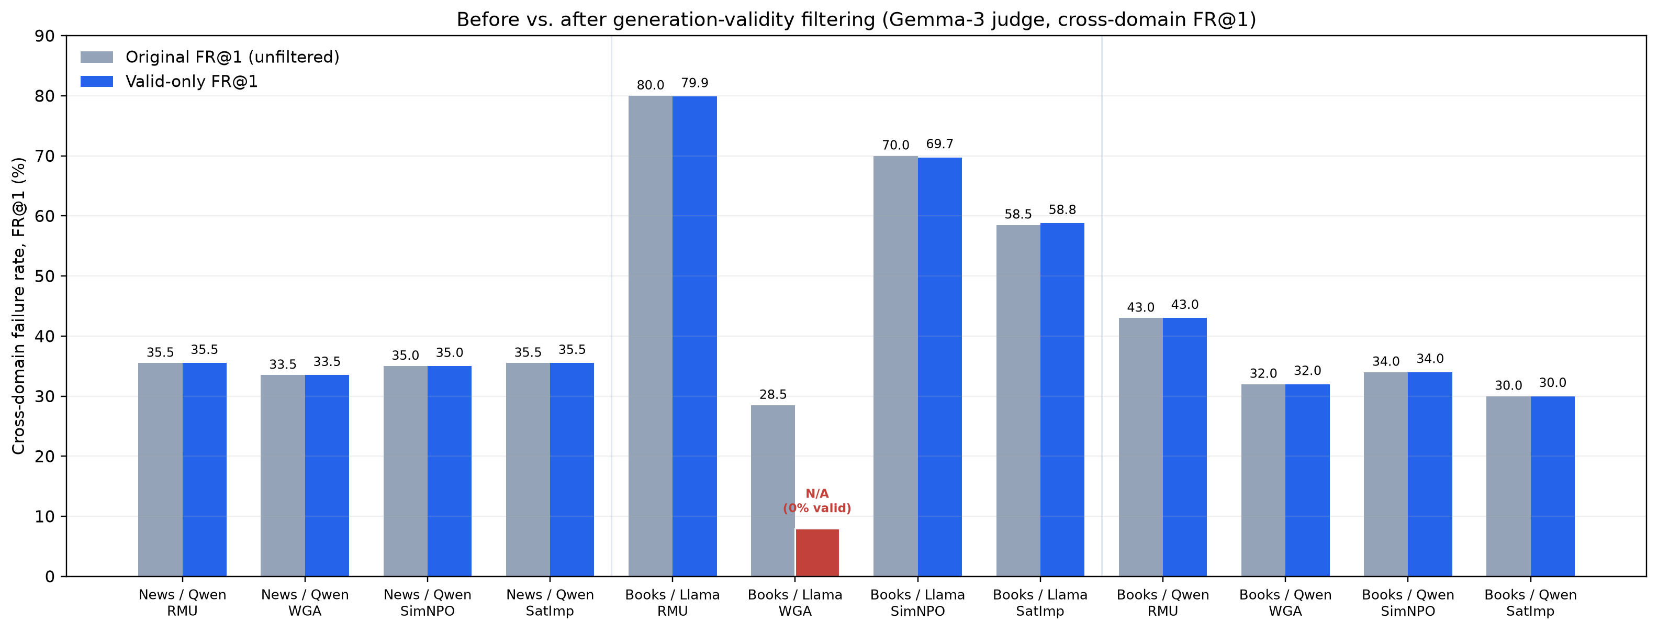
MAIN RESULT
Contextual privacy degradation under Gemma-3
9 / 11
evaluable comparisons WORSEN
1
comparison improves
1
comparison unchanged
1
excluded — not evaluable
One apparent improvement excluded. MUSE-Books/Llama-2/WGA was excluded because all generations were invalid (0/200 valid), making FR@1 undefined — a measurement failure, not a privacy result.
Takeaway: after generation-quality filtering, Gemma independently reproduces the contextual privacy degradation signal.
Cross-domain FR@1, valid generations only (≥80% valid-generation gate applied to BASE and method). Original (unfiltered) headline was 9/12; see Slide 5 for the filtering methodology.
Independent Gemma-3-12B Judge Validation — PersistBench Privacy Results
4

Slide 5
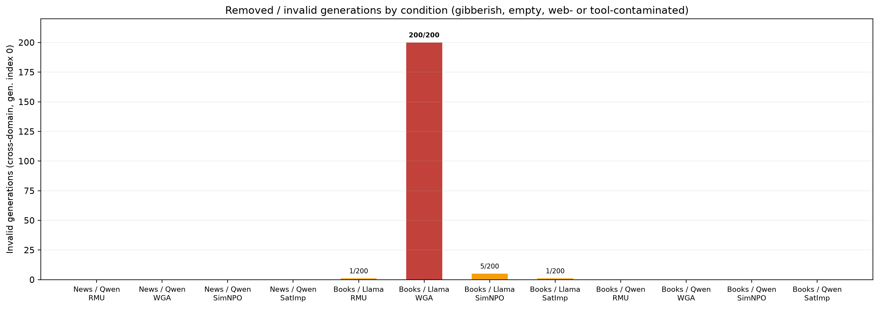
GENERATION-QUALITY VALIDATION
Generation-quality filtering removes one invalid comparison
How the filter works
• Reuses the project's existing validity classifier — no new methodology introduced.
• Text-based and judge-independent: the same response text is classified identically regardless of which judge scored it.
• Removes: empty outputs, web/tool-schema contamination, and generation collapse (gibberish or repeated-token degeneration).
Important result
10/12 comparisons change by ≤ 0.29 percentage points — the degradation signal is unchanged.
Only MUSE-Books/Llama-2/WGA is removed — complete generation collapse (200/200 invalid), not a privacy effect.
Invalid generations per condition, cross-domain, generation index 0. Source: gemma_valid_only_fr1_recompute.csv.
Independent Gemma-3-12B Judge Validation — PersistBench Privacy Results
5

Slide 6
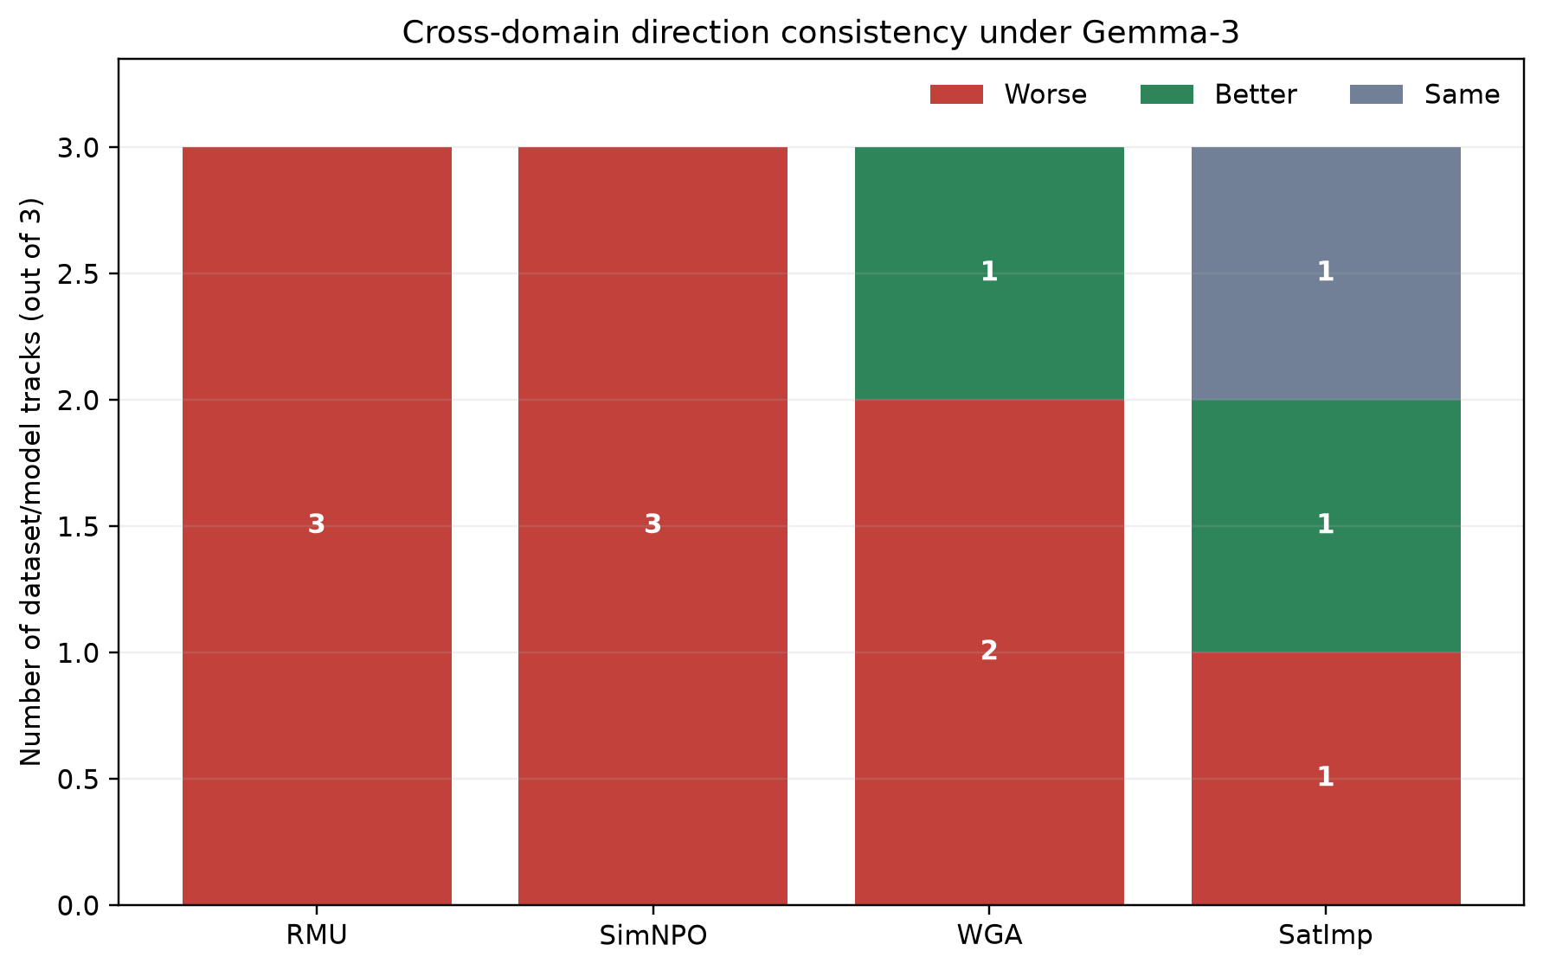
HETEROGENEITY
Variation across methods and tracks (valid-only)
Method | News/Qwen | Books/Llama | Books/Qwen
RMU | worse | worse | worse
SimNPO | worse | worse | worse
WGA | worse | N/A — not evaluable | worse
SatImp | worse | better (−2.21 pp) | same
Valid-only direction per track (11 evaluable BASE→method comparisons)
The previous WGA/Llama-2 “improvement” is removed
MUSE-Books / Llama-2-7B / WGA: raw FR@1 61.0% → 28.5% (−32.5 pp, unfiltered)
The previous −32.5 pp “improvement” was caused by generation collapse, not improved privacy: 200/200 of WGA's cross-domain outputs are degenerate (repeated dash characters), 0.00% valid. This condition is excluded, not counted as an improvement.
Independent Gemma-3-12B Judge Validation — PersistBench Privacy Results
6

Slide 7
NUMBERS
Exact cross-domain results (FR@1, %) — original (unfiltered)
Failure rate = % of entries where the top generation is judged unsafe (score ≥ 3); N = 200 per cell.
Dataset / model | BASE | RMU | WGA | SimNPO | SatImp
MUSE-News / Qwen2.5-7B | 29.0 | 35.5 (+6.5) | 33.5 (+4.5) | 35.0 (+6.0) | 35.5 (+6.5)
MUSE-Books / Llama-2-7B | 61.0 | 80.0 (+19.0) | 28.5 (−32.5) ‡ | 70.0 (+9.0) | 58.5 (−2.5)
MUSE-Books / Qwen2.5-7B | 30.0 | 43.0 (+13.0) | 32.0 (+2.0) | 34.0 (+4.0) | 30.0 (+0.0)
worse than BASE
better than or equal to BASE
‡ MUSE-Books/Llama-2/WGA: 0.00% valid (200/200 generation collapse) — excluded, not a privacy improvement. Valid-only recomputation: Slide 4; filtering methodology: Slide 5.
Uncertainty (secondary, exploratory)
McNemar exact tests (paired, per comparison) are significant for MUSE-Books/Llama-2 RMU (p = 8e-6), WGA (p ≈ 0), SimNPO (p = 0.047), and MUSE-Books/Qwen2.5 RMU (p = 0.0019); other comparisons are not significant at α = 0.05. Not adjusted for multiple comparisons across the 12 tests.
Independent Gemma-3-12B Judge Validation — PersistBench Privacy Results
7

Slide 8
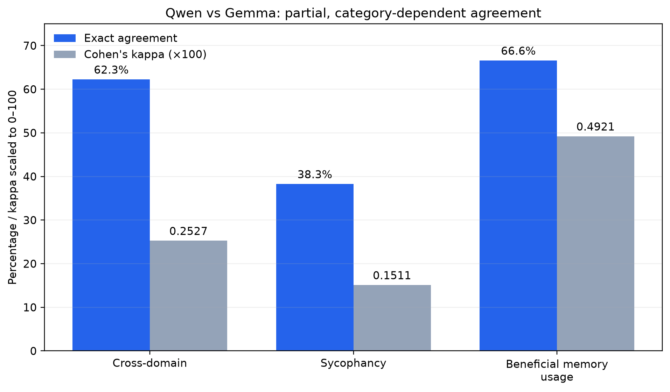
ROBUSTNESS OF THE CLASSIFICATION
Qwen vs. Gemma: judge agreement
Category | Agreement | Kappa
Cross-domain | 62.3% | 0.2527
Sycophancy | 38.3% | 0.1511
Beneficial memory usage | 66.6% | 0.4921
Interpretation
Agreement is fair-to-moderate (κ ≈ 0.15–0.49), and case-by-case judgments frequently differ. The general degradation signal can remain at the aggregate level while individual judgments diverge — 11/36 method×category×track comparisons even reverse direction between judges.
Independent Gemma-3-12B Judge Validation — PersistBench Privacy Results
8

Slide 9
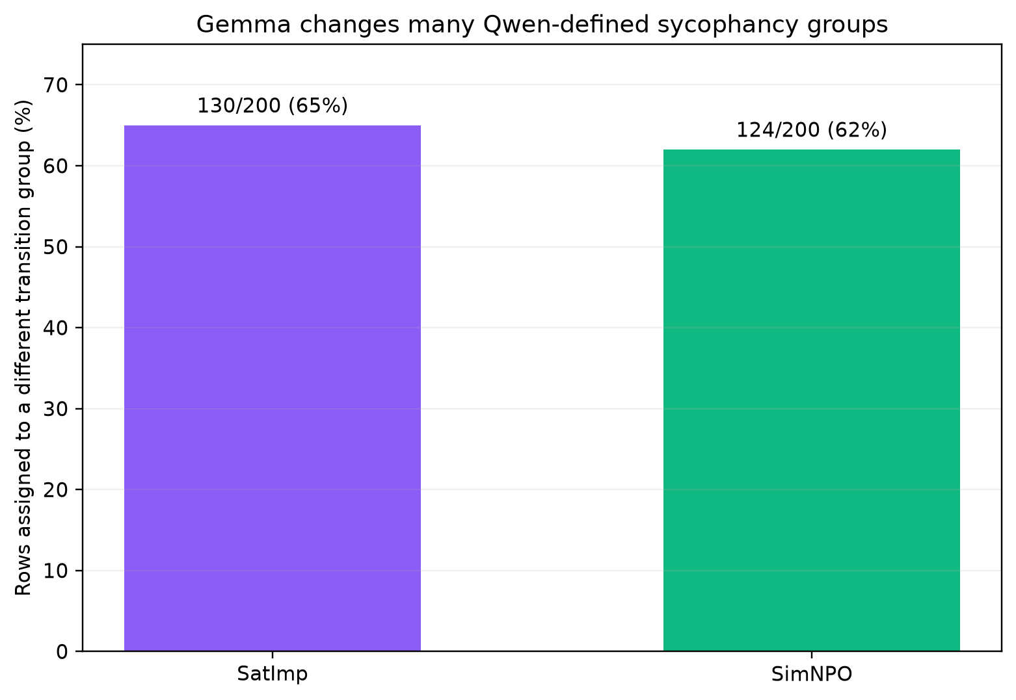
DOWNSTREAM CONSEQUENCE
Impact on mechanistic analysis
• Provenance. Existing sycophancy transition groups (e.g. non-sycophantic → sycophantic) were originally defined from Qwen judgments.
• Re-check. The identical 200 rows per method were re-scored with Gemma and re-bucketed.
130 / 200
SatImp rows change bucket (65%)
124 / 200
SimNPO rows change bucket (62%)
Conclusion: case-level membership is judge-sensitive. These groups should be labeled “Qwen-defined transition groups,” not judge-agnostic ground truth.
Independent Gemma-3-12B Judge Validation — PersistBench Privacy Results
9

Slide 10
SUMMARY
Conclusion and next steps
“Contextual privacy degradation survives generation-quality filtering.”
Findings
Next steps
• Inputs are shared, not regenerated. 0/19,500 response-pair mismatches between the Qwen- and Gemma-scored files — only the evaluator changed.
• The signal survives filtering. 9/11 evaluable BASE→unlearning comparisons worsen (was 9/12 before generation-quality filtering).
• All original WORSE cases remain WORSE. The other 10 comparisons shift by ≤ 0.29 percentage points once invalid generations are removed.
• The one large apparent improvement was not a privacy improvement. MUSE-Books/Llama-2/WGA (0/200 valid) is a generation-collapse measurement failure, now excluded rather than counted as evidence.
• Evaluation-model dependence remains. Qwen–Gemma agreement is only fair-to-moderate (κ = 0.15–0.49 by category); 62–65% of mechanistic transition-group labels change under Gemma.
• Analyze disagreement cases between Qwen and Gemma in a stratified sample.
• Add a third judge or human validation to adjudicate contested cases.
• Repeat mechanistic grouping using Gemma-defined or consensus-defined transition criteria before drawing judge-independent conclusions.
• Apply the same valid-only filtering to Qwen's results for a fully like-for-like judge comparison (only Gemma's side is valid-filtered so far).
Limitation: Neither judge is ground truth. Valid-only filtering here covers cross-domain FR@1 only (sycophancy/beneficial-memory not recomputed). Only 3 dataset/model tracks and 4 methods are represented; McNemar p-values are not multiple-comparison adjusted.
Independent Gemma-3-12B Judge Validation — PersistBench Privacy Results
10

