Slide 1
第三篇PO文素材 先下載大檔for提案專用，確認會用到的圖之後可再列舉付費

Slide 2

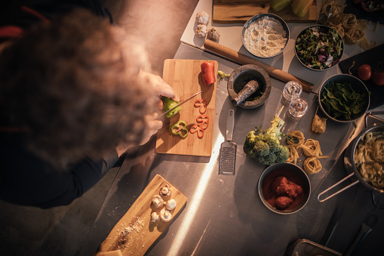
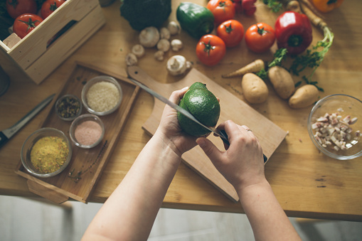
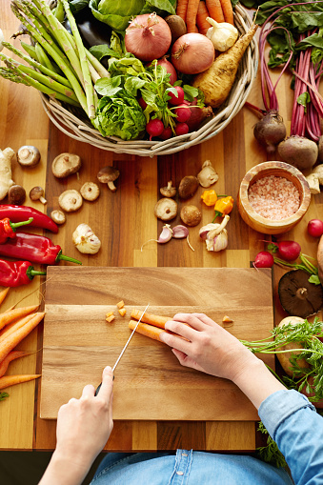
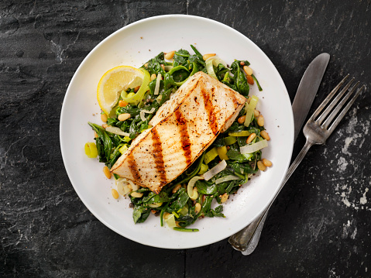
https://www.gettyimages.com/photos/922401584?excludenudity=true&family=creative&phrase=922401584&sort=best#license
https://www.gettyimages.com/photos/665779498?excludenudity=true&family=creative&phrase=665779498&sort=best#license
https://www.gettyimages.com/photos/944261368?excludenudity=true&family=creative&phrase=944261368&sort=best#license
https://www.gettyimages.com/photos/480132486?excludenudity=true&family=creative&phrase=480132486&sort=best#license
https://www.gettyimages.com/photos/503337620?excludenudity=true&family=creative&phrase=503337620&sort=best#license
(第一波已下載)
https://www.gettyimages.com/license/168613586

