Slide 1


LiSSA: Toward Generic Traceability Link Recovery through Retrieval-Augmented Generation
Dominik Fuchß, Tobias Hey, Jan Keim, Haoyu Liu, Niklas Ewald, Tobias Thirolf, Anne Koziolek, KASTEL – Institute of Information Security and Dependability

Slide 2
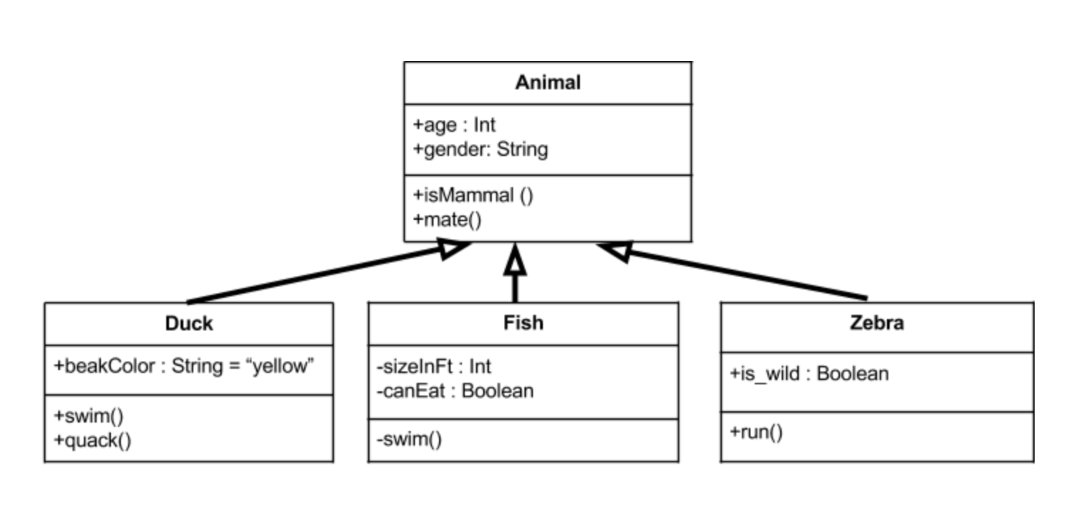

What makes Trace Links important?
Requirements
Design
Issues
Trace links are evidently
useful for
Software Maintenance
Bug Localization
Software Architecture Documentation
Software Architecture Models
Code
Change Impact An.
package network
class Consensus {
…
}
package security
class Encryption {
…
}
System Security
package service
class Controller {
…
}
package dataaccess
class Products {
…
}
class Users {
…
}
…
Artifact
Relation
Notes:
If we look into development process of software …
Typical artifacts that we produce are requirements, sa docs, sa models like UML component diagrams, and of course code.
Between different kinds of artifacts, there can be shared information like the existence of certain elements but also some explicit information that is special to a specific kind of artifact.
* For example, code can contain elements like classes, packages, … while requirements express the desired needs for a system.
(*click*) Trace links make explicit, which elements in the different artifacts are related and where the artifacts contain shared information about a certain entity.
(*click*) This way, trace links can improve efficiency for software maintenance, bug localization, change impact analysis, and system security, among others.
(*switch*)

Slide 3
What makes Trace Links important?
Multitude of different artifacts
Typical TLR tasks:
Requirements to Code
Documentation to Code
…
Many specialized approaches
Requirements to Requirements
Documentation to Model
Documentation to Code
Requirements to Code
Model to Code
…
Notes:
We have seen that we have a multitude of different artifacts ...
(*click*) thus, there are also typical TLR tasks that have been researched like requirements to code or documentation to code
(*click*) However, this also means that we have many specialized approaches.
(*switch*)

Slide 4
What makes Trace Links important?
Multitude of different artifacts
Typical TLR tasks:
Requirements to Code
Documentation to Code
…
Many specialized approaches
Requirements to Requirements
Documentation to Model
Documentation to Code
How does Retrieval-Augmented Generation perform for different TLR tasks?
Requirements to Code
Model to Code
…
Notes:
The motivation for our research was now that many of the TLR tasks involve the handling of natural language artifacts; and with the rise of LMs (or LLMs) we saw the opportunity to take a closer look into whether they can be used with retrieval augmented generation to solve multiple TLR tasks.
(*switch*)

Slide 5
LiSSA: Process
Dataflow
Data
Process
Retrieval
Target Artifact
Target Preprocessing
Target Elements
Embedding
Vector Store
(Target Elements)
Source Artifact
Source
Preprocessing
Source Elements
Retrieve top-k elements
Target Element Candidates
Mapping
Trace Links
Aggregation
Prompting
Notes:
The general idea is now that we treat similar artifacts (e.g., artifacts that contain natural language like requirements or documentation similar)
Thus, we created a RAG-Pipeline.
As overview, we take two artifacts Source-to-Target TLR use IR methods to find candates, use LLMs to classify whether a TL should be done or not. And in the end, we have TLs.
(*click*) lets take a look into the retrieval part.
First we deal with the target artifacts; e.g., the code for Req-2-Code TLR.
Preprocessing splits the files of the code e.g., into methods that we can later map to methods
Then we embed the elements meaning that we use an embedding model to generate a vector representation of the element content. We then store this in a vector store, that we can easily retrieve similar elements.
(*click*) for the source artifact we do nearly the same, we split and embed; but then we use the embedded elements to retrieve candidates from the target elements that are smiliar to the source elements; thats the retrieval part.
(*click*) Then we use the candidates per source element and promt a LM to classify whether there should be a trace link
(*click*) finally to get the TLs, we might need to fix granularities by aggregation

Slide 6
Evaluation
Preprocessing: Extract elements from artifacts
No preprocessing
Code chunking (fixed size)
Code method splitting
Model element extraction
Sentence splitting
Prompting: Classify whether elements belong to each other
No prompt: Always classify as ”trace link” → IR baseline
KISS: Simple Yes/No-classification task (zero shot)
Chain-of-thought: Zero shot prompt + request for reasoning
Notes:
So what have we analyzed now ...
Preprocessings ...
Prompting ...

Slide 7
Evaluation
Requirements to Code TLR
Documentation to Code TLR
Documentation to Model TLR
Notes:
And we evaluated that on three TLR tasks

Slide 8
Evaluation: Requirements to Code
Requirements to Code TLR
Documentation to Code TLR
Documentation to Model TLR
Notes:
Let’s take a look at the results. The baselines are always in green; and our approach configurations in blue
And we have seen that our approach configurations that uses no preprocessing and Chain-of-thought prompting performs (sign) better than SotA

Slide 9
Evaluation: Documentation to Code
Requirements to Code TLR
Documentation to Code TLR
Documentation to Model TLR
Notes:
For Doc. To Code, it depends a bit; for smaller projects of a benchmark, we perfom better than SotA; if we include projects that contain trace links from single sentences to thousands of code files, we perform worse; especially because of the retrieval part of our approach

Slide 10
Evaluation: Documentation to Model
Requirements to Code TLR
Documentation to Code TLR
Documentation to Model TLR
Notes:
Regarding the documentation to architecture model, we do not outperform state of the art; but we also see differeces in the performance depending on what we define as source and what as target artifact; i.e., Model2Documentation works better than Documentation to Model

Slide 11


Conclusion
We presented LiSSA, a generic TLR framework that uses RAG
In the evaluation,
Our approach can significantly outperform state-of-the-art for requirement to code TLR – avg. F1: 0.278 (FTLR) vs. 0.322 (GPT-4o + CoT)
Chain-of-thought (CoT) prompting was on average more effective than simple classification prompting
Artifact-to-artifact TLR was (on average) better than fine-grained mappings
Outlook:
Inter-requirements TLR with LiSSA (see https://ardoco.de/c/refsq25)
Documentation to code TLR (see https://ardoco.de/c/icsa25)
Definition of different kinds of “Trace Links”
Revisit fine-grained mappings + advanced aggregation strategies
Automatic prompt engineering
ardoco.de/c/icse25
Notes:
In summary, …

Slide 12
Backup

Slide 13
LiSSA: Concepts
Similar treatment of similar artifacts
Code-like artifacts (e.g., source code, test code)
Natural language artifacts (e.g., requirements, documentation, issues)
Structural model artifacts (e.g., UML component models)
Knowledge
- identifier
- type
- content
Element
- granularity
parent
Artifact
0..1
Notes:
Therefore, we created LiSSA, a framework that shall enable generic TLR by treating similar artifacts similar.
Meaning ...
(*click*) One essential aspect of the framework is the concept of elements and artifacts

Slide 14
Research Questions
RQ1: Performance of RAG-based TLR compared to SotA
Significantly outperforming for requirements to code TLR
Documentation to Code: Better performance on smaller projects (less TLs)
Documentation to Architecture: No outperformance
RQ2: Effectiveness of CoT prompting
CoT performs better than simple classification prompts
RQ3: Preprocessing Techniques
On average, not benefitial to split artifacts
However, on some projects this helps a lot
RQ4: Effects of classification step compared to IR-only
Classification improves TLR

Slide 15
What makes Trace Links important?
Multitude of different artifacts
Typical TLR tasks:
Requirements to Code
Documentation to Code
Requirements to Requirements
…
Many specialized approaches
How does Retrieval-Augmented Generation perform for different TLR tasks?

Slide 16
Evaluation: Requirements to Code (Datasets)
Dataset | Domain | NL | Programming | Requirements | Code | TLs
SMOS | Education | IT | Java | 67 | 100 | 1044
eTour | Tourism | EN | Java | 58 | 116 | 308
iTrust | Healthcare | EN | Java | 131 | 226 | 286
Dronology (RE) | Aerospace | EN | Java, Python | 99 | 423 | 602
Dronology (DD) | Aerospace | EN | Java, Python | 211 | 423 | 740

Slide 17
Evaluation: Requirements to Code (GPT-4o, F₁-score)
Approach | SMOS | eTour | iTrust | Dronology (RE) | Dronology (DD) | Average | Weighted Average
VSM_{OPT} | 0.422 | 0.483 | 0.217 | 0.158 | 0.131 | 0.282 | 0.283
LSI_{OPT} | 0.422 | 0.453 | 0.253 | 0.162 | 0.135 | 0.285 | 0.285
FTLR | 0.389 | 0.474 | 0.222 | 0.172 | 0.140 | 0.278 | 0.273
None/None/IR | 0.366 | 0.342 | 0.105 | 0.196 | 0.144 | 0.230 | 0.249
None/None/KISS | 0.285 | 0.493 | 0.290 | 0.260 | 0.229 | 0.312 | 0.288
None/None/CoT | 0.294 | 0.526 | 0.276 | 0.273 | 0.241 | 0.322 | 0.299

Slide 18
Prompts
Prompt: KISS
Question: Here are two parts of software development artifacts. {source_type}: '''{source_content}''' {target_type}: '''{target_content}''' Are they related? Answer with 'yes' or 'no'.
Prompt: CoT
Below are two artifacts from the same software system. Is there a traceability link between (1) and (2)? Give your reasoning and then answer with 'yes' or 'no' enclosed in <trace></trace>. (1) {source_type}: '''{source_content}''' (2) {target_type}: '''{target_content}'''

Slide 19
Evaluation: Requirements to Code

